Slide 1
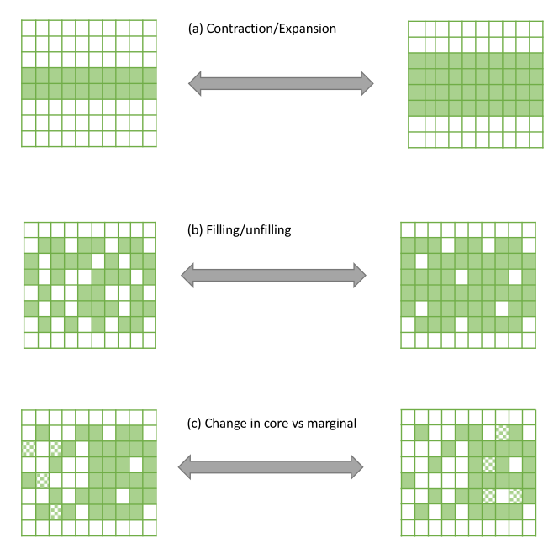

Slide 2

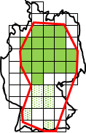
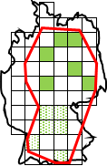
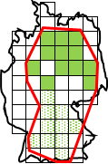
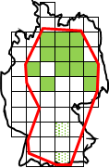
A) Change at range edges (EOO & AOO change)
Extent of Occurrence
Absent cell
Expansion
Occupied cell (within core range)
Occupied cell (within marginal range)
Contraction
B) Changes within range (AOO change only)
Filling
Unfilling
C) Spatial variability in change
Gain in core range
Loss in core range
Gain in marginal range
Loss in marginal range

Slide 3
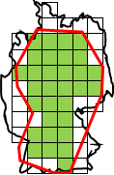
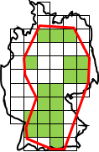
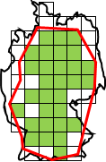
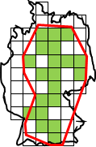
A) Change at range edges (EOO & AOO change)
Extent of Occurrence
Absent cell
Expansion
Occupied cell (within core range)
Occupied cell (within marginal range)
Contraction
B) Changes within range (AOO change only)
Filling
Unfilling
C) Spatial variability in change
Gain in core range
Loss in core range
Gain in marginal range
Loss in marginal range
D) Spatial variability in change
Clumpiness gain
Clumpiness loss
Non-clumpiness gain
Non-clumpiness loss

Slide 4
Clumpiness loss
Clumpiness gains
Delta
Losses
Time point B
Time point A
Gains
Delta
Non clumpiness loss
Non clumpiness gains
Delta
Losses
Time point B
Time point A
Gains
Delta

Slide 6
A) Non clumpiness changes
Starting
Ending
Gains
Delta

Slide 7
A) Clumpiness changes
Starting
Ending
Non clumpiness loss
Non clumpiness gains
Delta
Losses
Time point B
Time point A
Gains
Delta

