Slide 1

Team Software Process
By: Bryan Peterson

Slide 2

Presentation Topics
History
Brief overview of the Team Software Process (TSP)
TSP Team Launch
Team-working
Conclusion

Slide 3
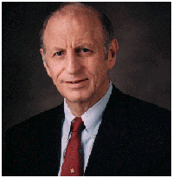
History
Watts S. Humphrey Introduced the Capability Maturity Model (CMM) in the 1980’s
Personal Software Process
  individual level
Team Software Process

Slide 4
TSP Overview
The Team Software Process (TSP) is a defined process for a group of students or software professionals to develop quality software on time and within budget
It is based on a sequential incremental model that divides development effort into a set of development cycles where each cycle involves producing software that satisfies some subset of the software requirements
TSP builds upon the Personal Software Process (PSP)

Slide 5
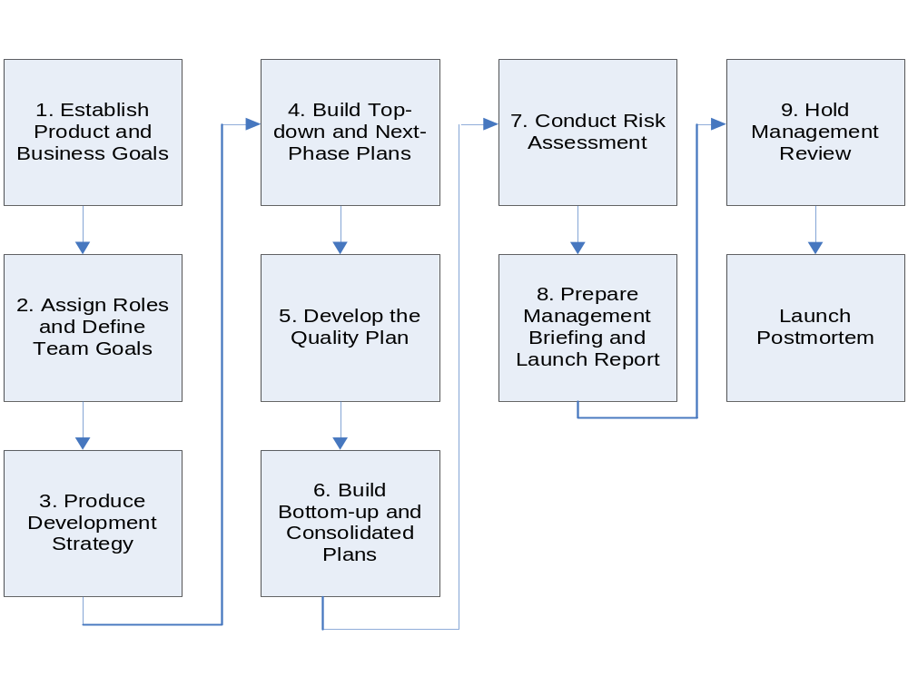
The Launch

Slide 6

Day 1
Meeting 1
  Marketing and management meet with the team to discuss the group’s objective
Meeting 2
  Team defines its goals and each member’s individual roles are identified and recorded
Meeting 3
  Conceptual design
  Development strategy
    Multiple-build strategy
  Define development process to be used
  Support tools
  Define products to be produced

Slide 7

Day 2
Meeting 4
  Develop team plan
    Estimate product sizes
    Identify project tasks
    Estimate effort
    Produce schedule of team’s availability
  Alternative plans
Meeting 5
  Quality plan
    can be used in parallel with the project development stages to assess the quality of the work as progress is being made
  Peer reviews
Meeting 6
  Balance team plan
  Track progress against plan

Slide 8

Day 3
Meeting 7
  Risk assessment
Meeting 8
  Prepare launch report for management

Slide 9

Day 4
Meeting 9
  Hold management review
Launch Postmortem
  Review team’s work
  Provides a structured way to learn and improve
    Look at what you did compared to what you planned to do
    Look for improvement opportunities and decide how to change your practices for the next cycle or the next project

Slide 10
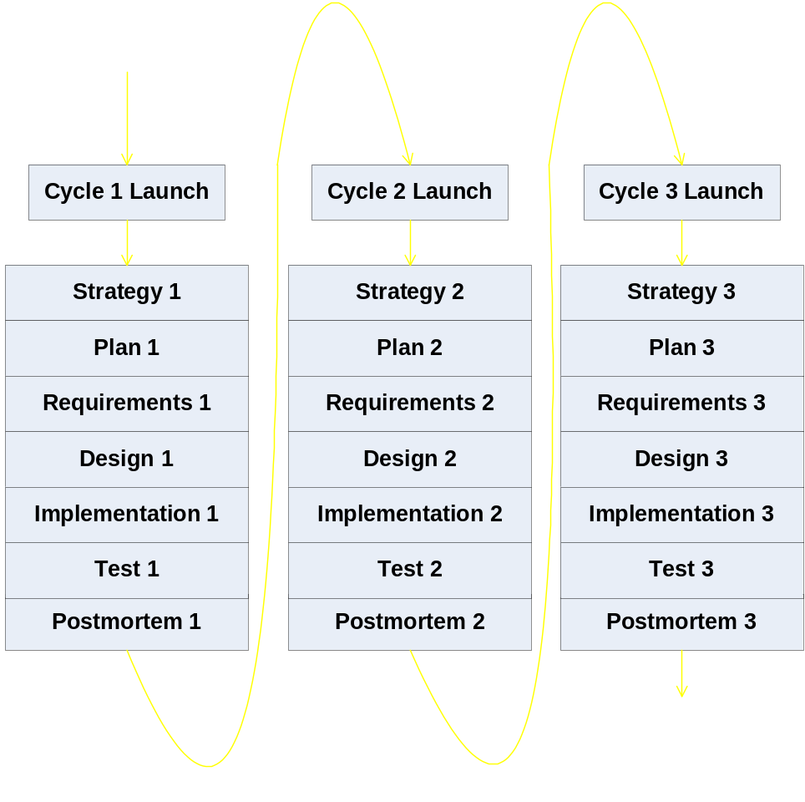
TSP Structure and Flow

Slide 11

Team Working
Consists of following and maintaining the plan
Tracking progress

Slide 12

Conclusion
TSP provides a development framework to produce quality software on time and within budget
TSP launch process helps to build a cohesive team dedicated to the plan they helped develop
Data acquired from launch processes becomes an early indicator if anything in the schedule slips
Teams take ownership of the project

Slide 13
References
Hilburn, Thomas B. Teams need a process! Annual Joint Conference Integrating Technology into Computer Science Education.
Humphrey, Watts, S. Introduction to the Team Software Process. Addison-Wesley Publishing Co., Inc., Reading, MA, 2000.
Humphrey, Watts S. Pathways to Process Maturity: The Personal Software Process and Team Software Process. <http://interactive.sei.cmu.edu/Features/1999/June/Background/Background.jun99.htm>. 29 November 2007.
Humphrey, Watts S. TSP: Leading a Development Team. Addison-Wesley Publishing Co., Inc, Boston, MA, 2006.
Noopur Davis and Julia Mullaney. “The Team Software Process (TSP) in Practice: A Summary of Recent Results.” Software Engineering Institute. 2005. Carnegie Mellon University. 10 Sept. 2006. <http://www.sei.cmu.edu/publications/documents/03.reports/03tr014.html>
Tadayan, Nasser. Software engineering based on the team software process with a real world project. Journal of Computing Sciences in Colleges. 19, 4 (April 2004).

