Slide 1

Dave Parnas and Software Engineering
Trey Voit

Slide 2

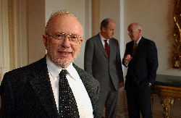
Introduction
The “Grandmaster” of Software Engineering
Influence on Software Engineering since its beginnings

Slide 3
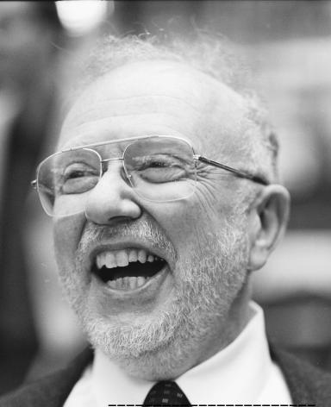
Brief Biography
Born February 10th 1941
Science or Engineering?
  In his youth, Parnas was always teetering on which way he wanted the focus of his education to lean, either science or engineering

Slide 4
Brief Biography (cont.)
Bronx High School of Science
  Studied Engineering
Carnegie Institute of Technology (Carnegie Mellon University)
  Studied Science
    Physics for Two Years
  Switched Back to Engineering
    Graduated in 1961 with a degree in Electrical Engineering

Slide 5
Brief Biography (cont.)
Began teaching at Carnegie Mellon
  Began teaching as well as continuing study at the University
Earned Ph. D. in Engineering

Slide 6
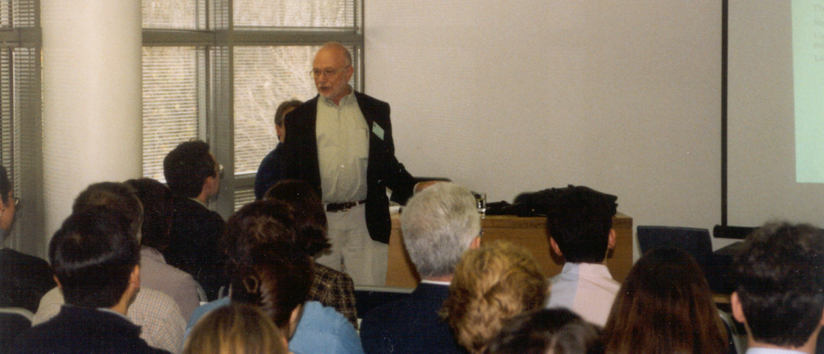
Teachings
Information Hiding
  Research in modularization
  Lines of code that work together should be recognized as an object, not just a subroutine
  Basis of modern Object Oriented Programming

Slide 7
Teachings (cont.)
Abstract Interfaces
  Design interfaces that provide services without revealing their implementations
Program Hierarchy
  Use common hierarchical structures to fit your needs

Slide 8
Software Engineering
While Teaching at Carnegie
  Distinction between Computer Science and Engineering
  Engineering
    Sound, proven practices and methods for reaching a product
  Computer Science
    Ideas, Concepts, and Exhibition of Programming Languages
    No method to the madness

Slide 9
Software Engineering
Computer Science and Engineering must be bridged
  Much need for research on how to design software
Software Engineering is born

Slide 10
Parnas and Ethics
Influential and Respected Voice in Software Community
  Has written many papers on the subject
  Involved in real-world ethical issues
Huge emphasis on ethical awareness in Software Engineering

Slide 11
Parnas and Ethics
Licensing of Software Engineers
  Public Interest
    hopes that the licensing of software engineers will produce better, safer, easy-to-use software
  “A meaningless title is a worthless title.”
    Incompetent Programmers
      Big risk to SE
    One bad programmer can easily create two new jobs (fixing their mistakes)

Slide 12
Parnas and Ethics
Strategic Defense Initiative
  Missile defense system proposed by Reagan in 1983
  Ethically unsound, because it was not testable!
  Parnas was on the advising committee for the project, and brought attention to this issue
  System was never fully developed or deployed

Slide 13
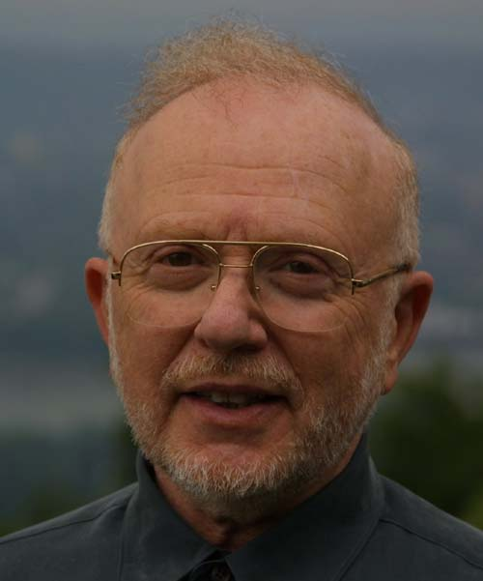
Conclusion
Parnas has influenced software engineering as it is recognized today
His teachings and research will continue to improve Software Engineering, and eventually bring it to a thriving and ethically sound industry

Slide 14
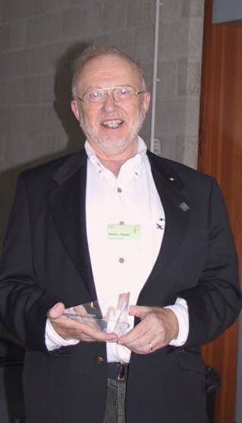
Awards and Honors
ACM “Best Paper” Award 1979
Two “Most Influential Paper” Awards 1991, 1995
  International Conference on Software Engineering
“Doctor honoris causa”
  Catholic University of Leuven
ACM SIGSOFT's “Outstanding Research” Award 1998

