Slide 1
Indian E-Commerce
Customer Behavior & Sales Analytics
DATA
ANALYTICS
PROJECT
Data cleaning • Exploratory analysis • Visualization • Power BI
Presented by: Bowthya Sree
Python | Pandas | NumPy | Matplotlib | Seaborn | Power BI | GitHub

Slide 2
Problem Statement & Dataset
Understanding customer behavior and sales performance in e-commerce
PROBLEM
DATASET
E-commerce businesses generate large amounts of customer
and transaction data. The challenge is to identify high-performing
categories, effective marketing channels, purchasing behavior and
opportunities to improve conversion.
25,000 customer visit records covering customer, session, product,
pricing, marketing, cart, purchase, rating, payment, season and
location information.
RECORDS
TOTAL REVENUE
CONVERSION RATE
25,000
₹10.12M
22.46%
Objective: Analyze sales and customer behavior patterns and provide data-driven business recommendations.
2

Slide 3
Data Preparation & Exploratory Data Analysis
Python-based cleaning, analysis and validation
DATA PREPARATION
EDA AREAS
KEY METRICS
• Inspected rows, columns and data types
• Checked missing values
• Checked duplicate records
• Converted visit dates to proper date format
• Validated numerical and purchase-related
fields
• Prepared cleaned data for Power BI
• Revenue and purchase performance
• Product categories
• Marketing channels
• User types and payment methods
• Seasons, locations and devices
• Correlation and outlier analysis
Total Revenue
₹10.12M
Average Revenue
₹404.65
Total Customers
≈8K
Total Purchases
≈6K
Conversion Rate
22.46%
3

Slide 4
Data Visualizations
Charts used to communicate trends, comparisons and relationships
Revenue by Product Category
Monthly Revenue Trend
Revenue by Marketing Channel
Identifies high-revenue product categories
Shows revenue movement across
12 months
Compares channel-level performance
Revenue by Device Type
Purchase vs Non-Purchase
Discount vs Revenue
Compares revenue contribution by device
Shows conversion versus non-conversion
Examines the relationship between
discount and revenue
Rating Distribution
Customer rating patterns
4

Slide 5
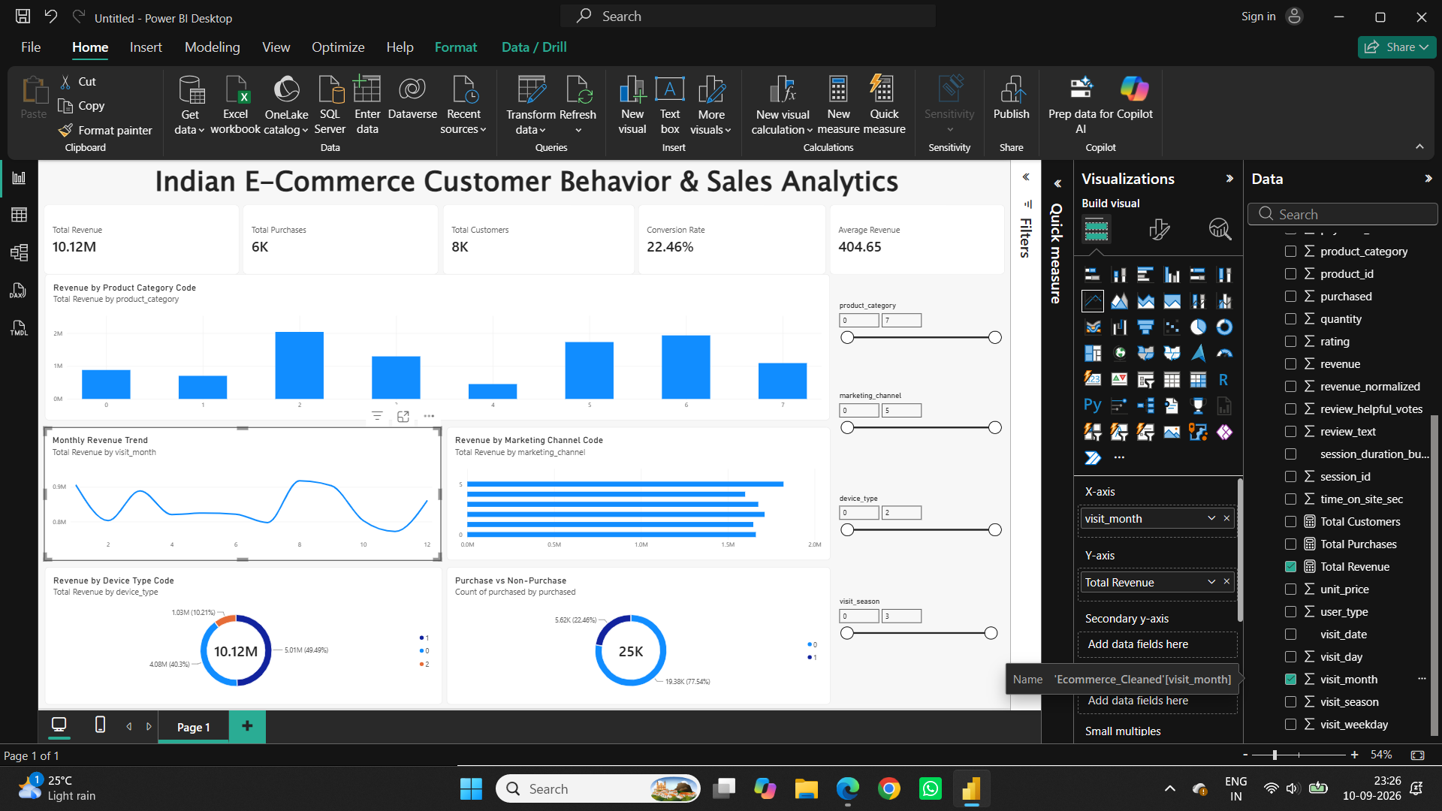
Power BI Dashboard & Key Insights
Interactive dashboard for business performance analysis
HIGHEST CATEGORY
Code 2 — ≈₹2.04M
TOP MARKETING CHANNEL
Code 5 — ≈₹1.82M
TOP DEVICE
Code 1 — ≈₹5.01M
PURCHASE CONVERSION
22.46% of visits
5

Slide 6
Business Recommendations & Conclusion
Turning analysis into actionable decisions
RECOMMENDATIONS
CONCLUSION
1. Improve the checkout process to increase conversion.
2. Reduce cart abandonment with a simpler purchase flow and
reminders.
3. Strengthen marketing efforts on high-performing channels.
4. Promote high-revenue product categories.
5. Optimize the shopping experience across device types.
Python and Power BI helped transform raw e-commerce data into
meaningful business insights about revenue, customers,
purchases, categories, channels and devices.
FINAL TAKEAWAY
The analysis highlights clear opportunities to improve conversion,
reduce cart abandonment and focus business resources on
high-performing areas.
6

Slide 7
Thank You

