Slide 1


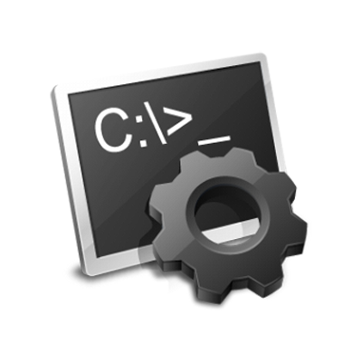

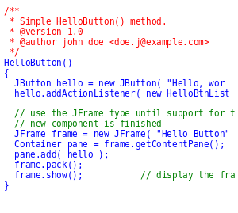

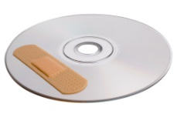
Patchr
How do we validate repair specifications?
We synthesize appropriate patches [Patchr] for many examples
…. and validate the patches using human input (mturk, pull requests) [part of Harvestr]
Motivation for developers to provide feedback:
Patches easier to understand than repair specs
Patches, if correct, immediately useful to developers
Repair Spec
Query Buggy Apps
Buggy Code
Fixr DB
Patchr
Patches
Fixed Android Code
Notes:
Slide –
Block diagram

Slide 2






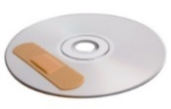
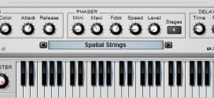
Patchr - Overview
Fixr DB
Deltar
Harvestr
Input
Query for Apps with similar bug
Output
Repair Spec
Patches
Patchr

Slide 3
Synthesizing patches from repair specs Example - View.setTag()
Bug
Fix
Incorrect Code
viewObj.setTag(R.id.view, argObj)
Bug due to WeakHashMap sTag
and
argObj (“reaches”) viewObj
Fix for the bug
ArrayList viewList = new ArrayList()
viewList.add(argObj)
viewObj.setTag(viewList)
This removes the reachability relation
argObj (“does not reach”) viewObj
Notes:
View has a static field sTag which is a weak hash map from View to SparseArray. (For those unfamiliar with java a static field means there is one instance for all objects) code: private static WeakHashMap<View, SparseArray<Object>> sTags; WeakHashMap is designed to remove entries that are no longer reachable. It does this by iterating through its entries and removing the ones that have been garbage collected. However it holds onto strong references to the values in the key value map. For this reason anything strongly referenced from a value in a WeakHashMap will not be collected. From the documentation:
"Implementation note: The value objects in a WeakHashMap are held by ordinary strong references. Thus care should be taken to ensure that value objects do not strongly refer to their own keys, either directly or indirectly, since that will prevent the keys from being discarded."
When setTag is called it will, through a series of calls to internal functions, first check if sTags is null, if so it will create a new WeakHashMap, then it will check if there is a SparseArray entry for the view it was called on, if not it will create it. Finally the tag object will be inserted into the sparse array. If this tag contains a reference to the view then it has violated the framework invariant specified in the documentation for SparseArray. This defect does not exist in later versions of the Android framework since the tags are now stored in a local (non static) field of type SparseArray. The edge we are using as an indicator still exists though despite the framework version.
Code:
View (with the setTag method, note android version 2.3 revision 1) http://grepcode.com/file/repository.grepcode.com/java/ext/com.google.android/android/2.3_r1/android/view/View.java#View.setTagInternal%28android.view.View%2Cint%2Cjava.lang.Object%29
Sparse Array (specifically look at the javadoc and the method 'expungeStaleEntries') http://grepcode.com/file/repository.grepcode.com/java/root/jdk/openjdk/6-b27/java/util/WeakHashMap.java#WeakHashMap.expungeStaleEntries%28%29
1 class View {
2 static WeakRef<View> sKey = null;
3 static Obj | v 67→∗ sKey sTag = null;
4 void setSTag(Obj tag) {
5 sKey = new WeakRef(this); sTag = tag; }
6 Obj mTag;
7 void setMTag(Obj tag) { mTag = tag; }
8 }

Slide 4
Synthesizing patches from repair specs Example - View.setTag()
Error Invariant I (bug pre-condition)
arg (“reaches”) caller
Repair Spec R
Talks of both buggy and fixed program
“syntactic”- at these lines
(-) caller.setTag(R.id.view, arg)
(+) ArrayList A = new ArrayList()
(+) A.add(arg)
(+) caller.setTag(A)
“semantic” –
(-) arg (“reaches”) caller
Or
(-) View.sTag != null
(+) View.sTag == null
Patch P
Location of Bug
Old code to be replaced
New code to be added
Notes:
Patch to another slide
Slide to explain the patches from repair spec

Slide 5
Synthesizing patches from repair specs Syntactic Repair Spec
Prototypes what happens to certain lines of old code and what new line(s) of code to be added
Challenge:
Figure out actual variable names from spec for the patch
If the buggy code contains partial code of the fix then synthesizer must take it into account while creating the patch
Spec
(-) caller.setTag(R.id.view, arg)
(+) ArrayList A = new ArrayList()
(+) A.add(arg)
(+) caller.setTag(A)
Patch
Replace
tv.setTag(R.id.view, vw)
with
ArrayList x = new ArrayList();
x.add(vw);
tv.setTag(x);

Slide 6
Synthesizing patches from repair specs Semantic Repair Spec
Explains the root cause that must be fixed and will be used to generate syntactic spec
Challenge:
Figure out old lines of code that cause the bug and must be removed/modified.
Using the above info generate a syntactic repair spec
Patchr has domain knowledge of Android framework
Inherits the challenges of syntactic spec while adding a whole new layer complexity of converting semantics to syntax
Spec
(-) arg (“reaches”) caller
or
(-) View.sTag != null
(+) View.sTag == null
Synthesized to syntactic spec as below
(-) caller.setTag(R.id.view, arg)
(+) ArrayList A = new ArrayList()
(+) A.add(arg)
(+) caller.setTag(A)
Patch
Replace tv.setTag(R.id.view, vw) with
ArrayList x = new ArrayList();
x.add(vw);
tv.setTag(x);

Slide 7
Synthesizing patches from repair specs Example - Signature
Example Code
class VerSig {
public static void main(String[] args) {
Signature sig = Signature.get(...)
sigToVerify = inputSignature();
PublicKey pubKey1 = ...
// sig.initVerify missing here
sig.update(buffer1, 0, len1);
bool verif = sig.verify(sigToVerify); }}
get
I
initVerify
inputSignature
V
update
Rest of state Diagram
verify
U1

Slide 8
Synthesizing patches from repair specs Example - Signature
Error Invariant I (Bug Pre-condition)
verify() called at state I
Repair Spec R
“syntactic”-
(+)sig.initVerify
sig.update(…)
sig.verify(…)
“semantic” –
call verify() at state U1
Patch P
Add sig.initVerify() before sig.update()
get
I
initVerify
inputSignature
V
update
Rest of state Diagram
verify
U1

Slide 9
Technical Issue: Source Transformation
Recoder reads and transforms Source files
JAVA Source
WALA uses IR for all the transformation
We use Recoder for Java source code transformation
Challenge: mapping Analysis Results to Source Code
WALA IR to Bytecode for source information
WALA IR
WALA Reads byte code and generates IR from it
Bytecode to Source for source Information
Bytecode

Slide 10


Demo of applying a Patch
Fixr DB
Buggy Code
Repair Spec
Patch
Fixed Code
Synthesizer
Patchr.scala

