Slide 1

App

Slide 2
App
App Server
Runtime
Libraries
OS Kernel

Slide 3
App
App
App
App Server
App Server
App Server
Runtime
Runtime
Runtime
Libraries
Libraries
Libraries
OS Kernel
OS Kernel
OS Kernel
DEV
TEST
PROD

Slide 4
App
App Server
Machine Image
Runtime
Libraries
OS Kernel

Slide 5
Machine Image
Machine Image
Machine Image
DEV
TEST
PROD

Slide 6
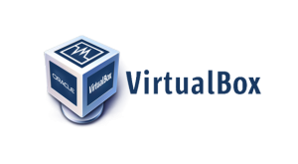


Boxfuse Component Inventory
Bootable App
App

Slide 7
Machine Image
Bootable App
Legacy OS
Multiple GBs
Boxfuse Micro OS
Few MBs

Slide 8
Bootable App

Slide 9
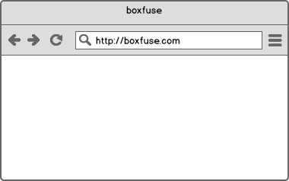
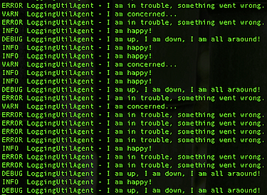

ps

versions
4.3.5
4.4
5.0
5.0.1
...
Instance
Boxfuse Inventory
open
run
ls
kill
Instance
logs
Image
fuse
Payload
push
rm
Image

pull

deploy
Boxfuse Vault

Slide 10

ls
Boxfuse Inventory
Image
Image
Image
fuse
Payload
rm
Image

Slide 11
Image
Instance
run
kill
Instance
ps
Instance
Instance

Slide 12
Instance
Instance
logs
open

Slide 13

Image


push
Image

Boxfuse Vault
pull
Boxfuse Vault


deploy
Boxfuse Vault

