Slide 1

App

Slide 2
App
App Server
Runtime
Libraries
OS Kernel

Slide 3
App
App
App
App Server
App Server
App Server
Runtime
Runtime
Runtime
Libraries
Libraries
Libraries
OS Kernel
OS Kernel
OS Kernel
DEV
TEST
PROD

Slide 4
App
App Server
Machine Image
Runtime
Libraries
OS Kernel

Slide 5
Machine Image
Machine Image
Machine Image
DEV
TEST
PROD

Slide 6
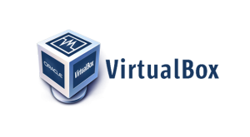



Boxfuse Component Inventory
Bootable App
App

Slide 7


Boxfuse Component Inventory
Bootable App
App
Boxfuse Image Generation
5 Seconds

Slide 8
Machine Image
Bootable App
Legacy OS
Multiple GBs
Boxfuse Secure Micro OS
Few MBs

Slide 9
Bootable App

Slide 10
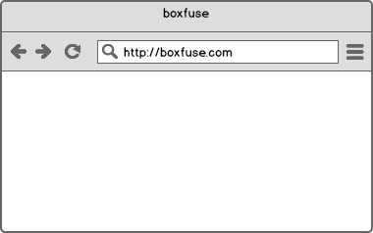
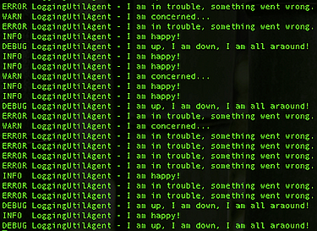

inventory


Component
Boxfuse Vault
push
Component

ls
ps

pull
Boxfuse
Inventory
Image
Instance
open
run
fuse
logs
rm
Payload
Image
kill
Instance

Slide 11
ls
Component
Image
Image
Component


Boxfuse
Inventory
Image
fuse
Payload
rm
Image

Slide 12
Image
Instance
run
kill
Instance
ps
Instance
Instance

Slide 13
Instance
open
Instance
logs

Slide 14

Image


push
Image

Boxfuse Vault
pull
Boxfuse Vault


deploy
Boxfuse Vault

Slide 15




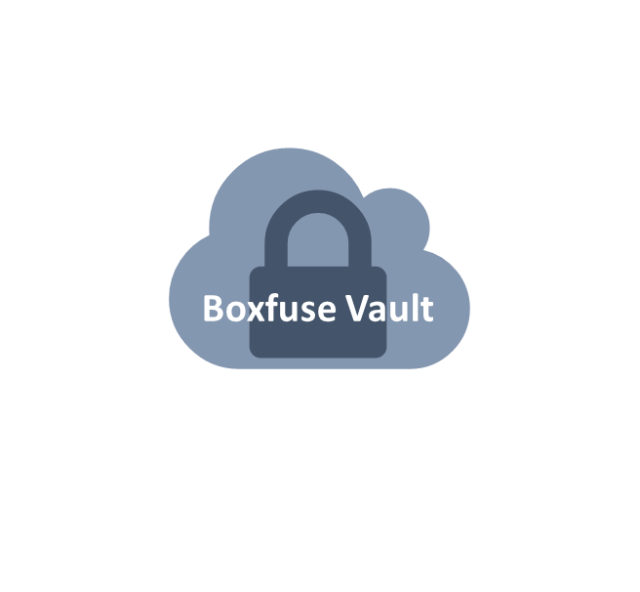


Image
Minimal
Secure
Portable

Slide 16


Image
package
pre-integration-test
integration-test
post-integration-test
deploy

