Slide 1
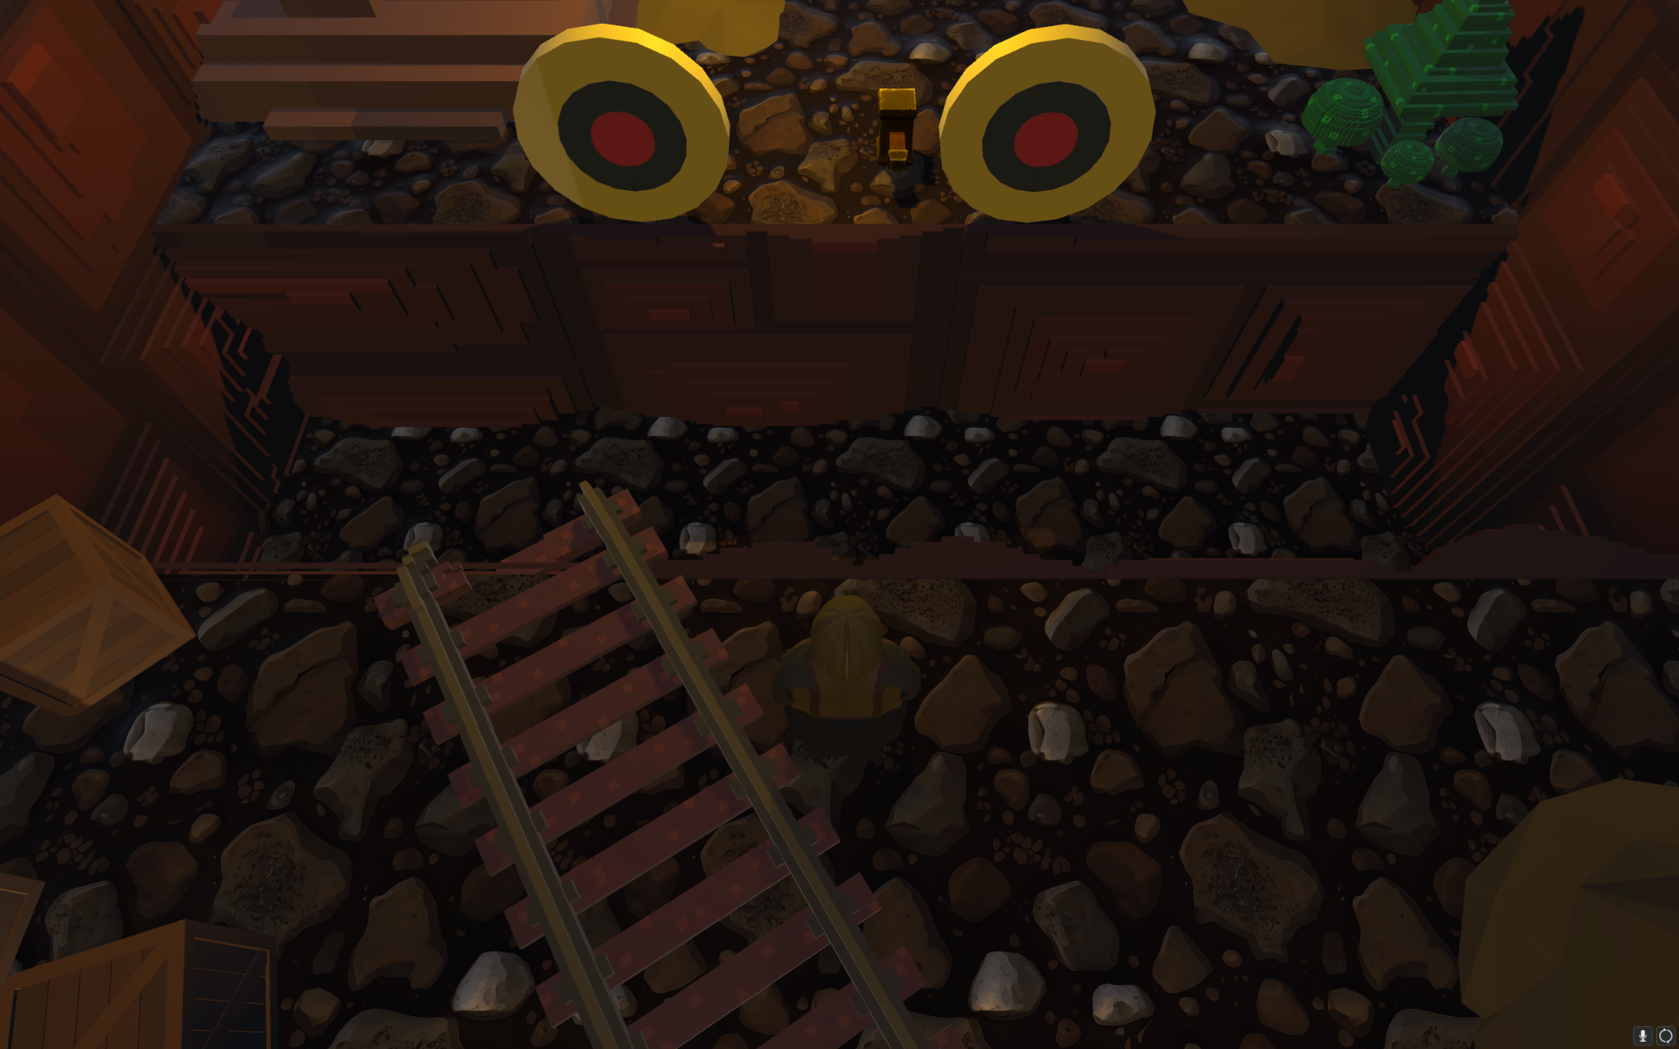

Final Presentation
Boxi Fu & Mingfu Li
Diji Diallo, Franco Grimoldi Calo, Jose Pescador & Mallow Chu

Slide 2
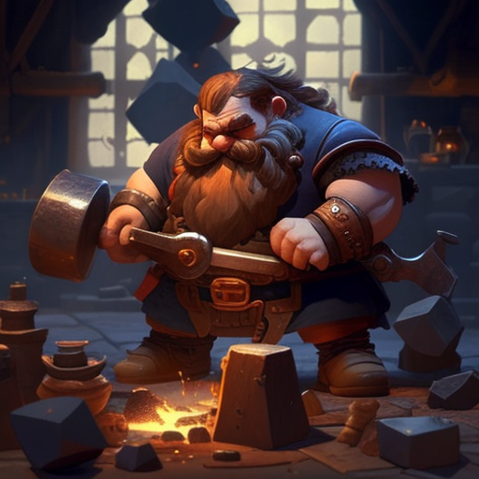

Precious Stones
A Character action-adventure game
Play as a dwarf who starts an adventure following his father’s wishes
Use his beloved hammer to defeat monsters and solve puzzles
Boxi & Mingfu
Notes:
3-5 Boxi
2, 6-8

Slide 3
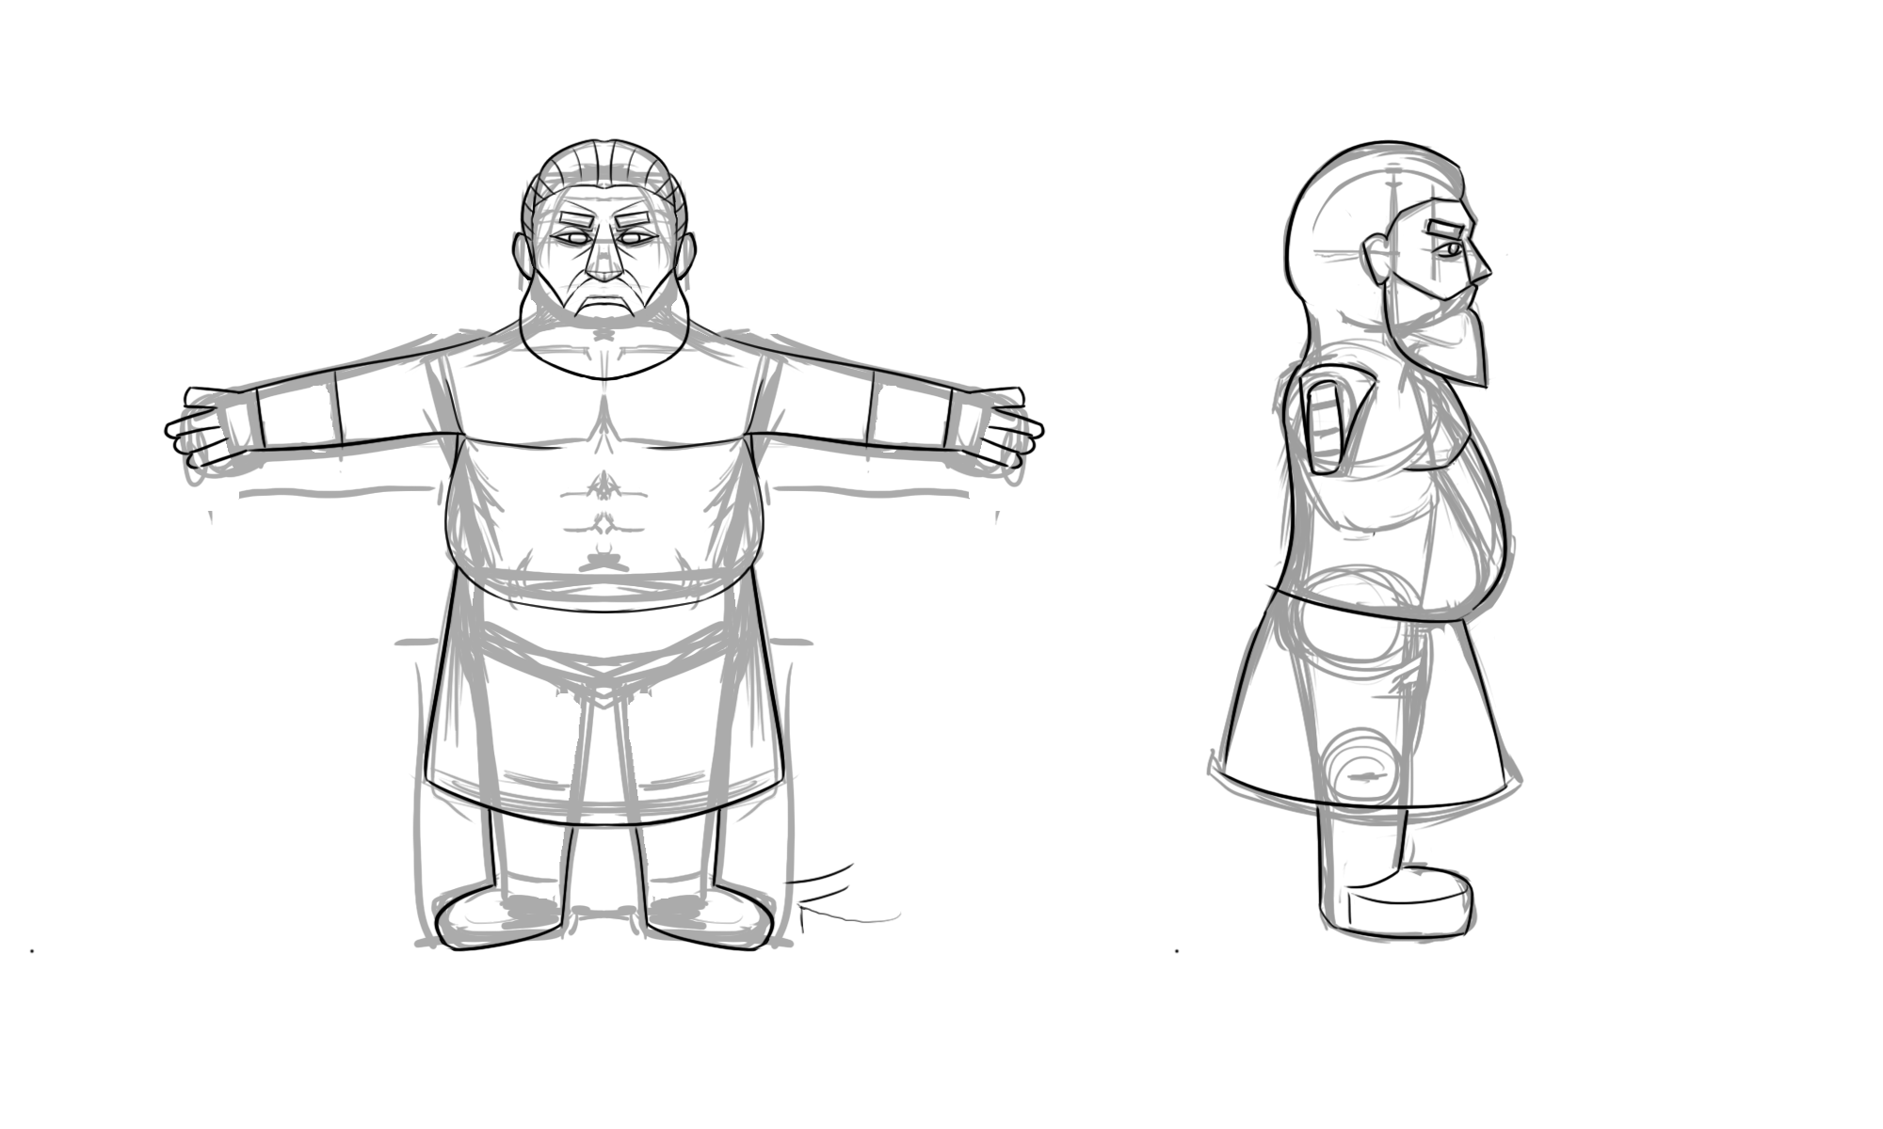
More on Precious Stones
Release on PC (Mouse and Keyboard control)
People who are new to action-adventure genre
Combat, Puzzles & Interconnected levels
Beautiful background musics and juicy sound effects
Boxi & Mingfu

Slide 4
Gameplay Demo!
Boxi & Mingfu

Slide 5
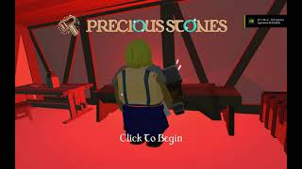
Boxi & Mingfu

Slide 6
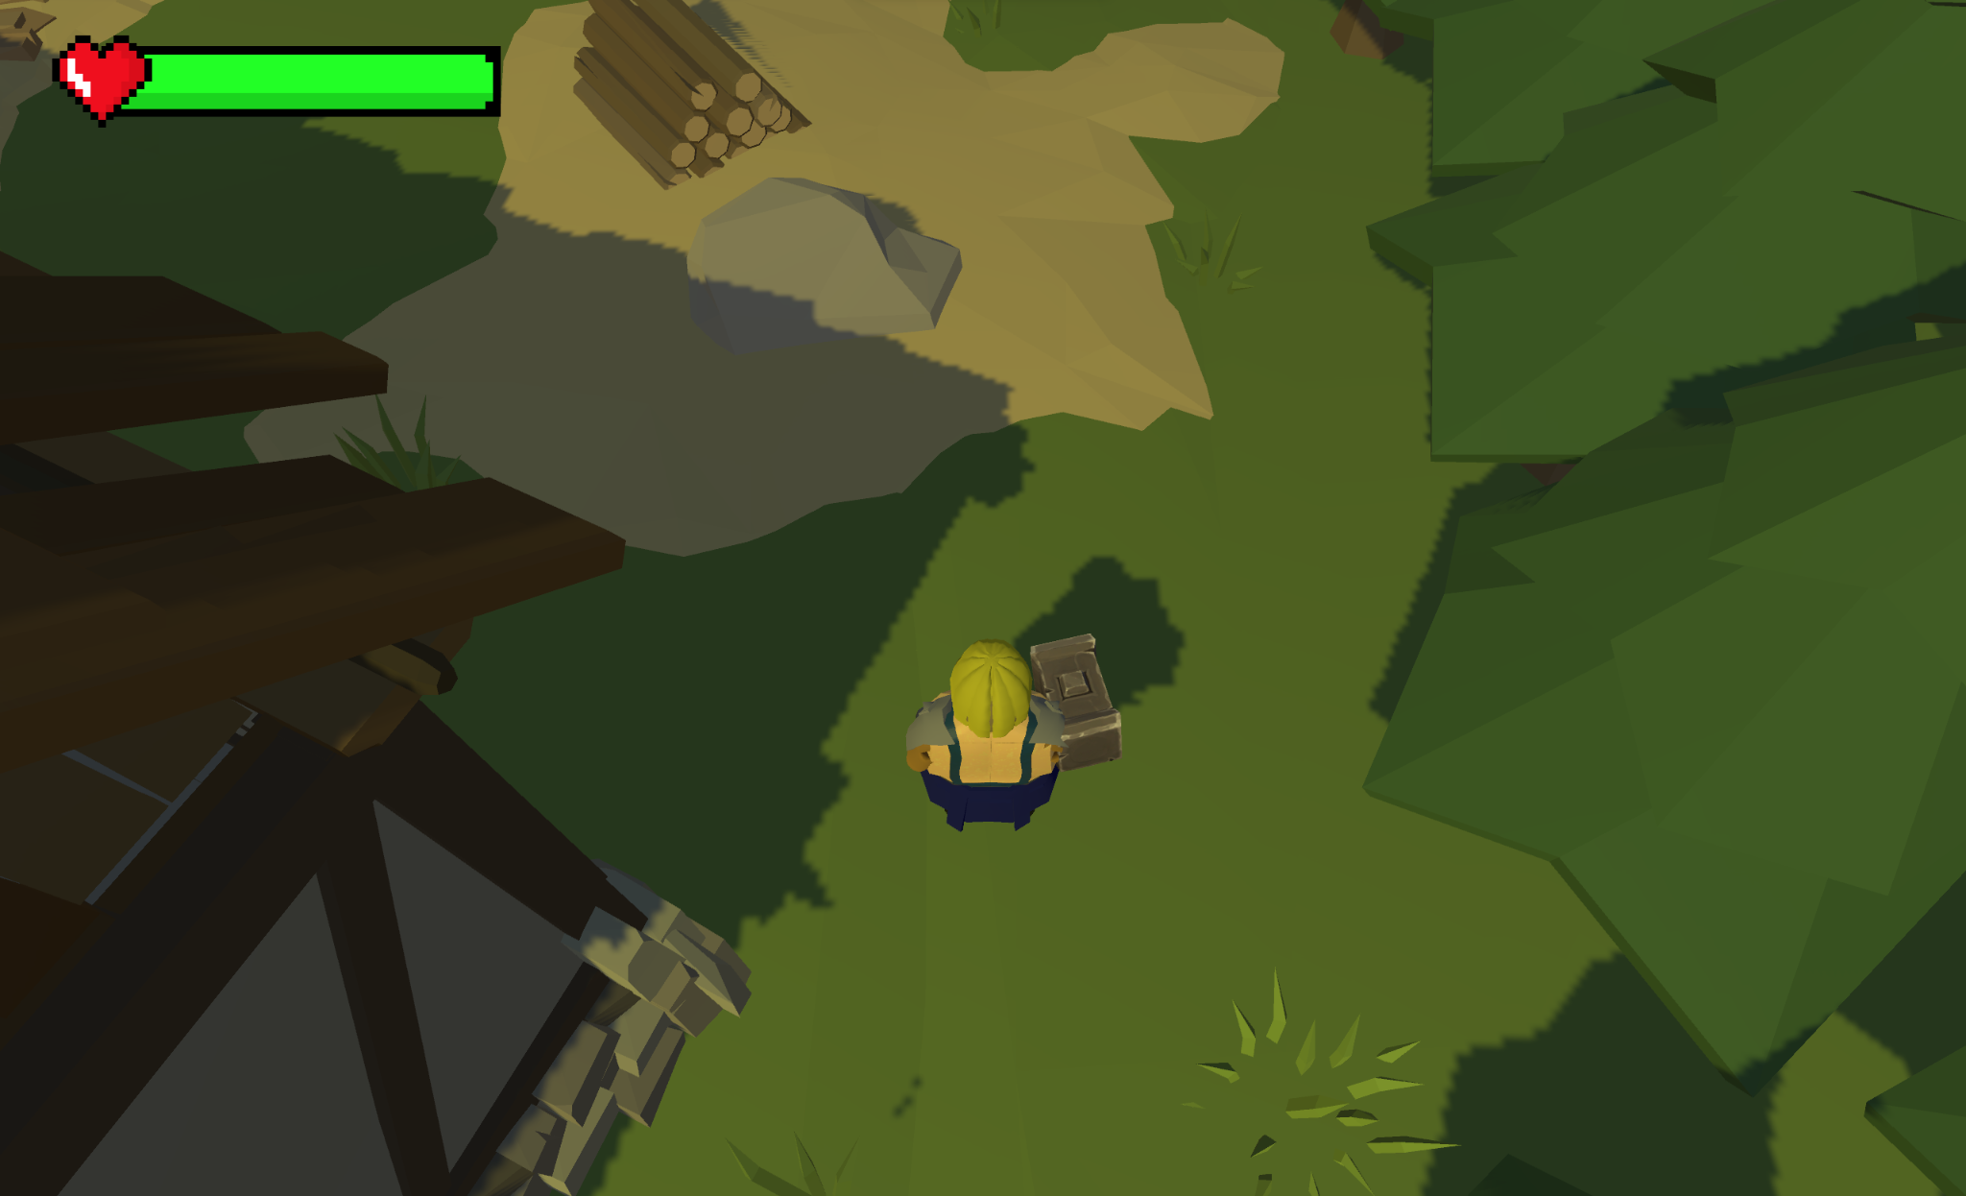
Production Values
We chose the simplistic and stylistic low-polygon art for most of our 3D assets.
Many cute and little sequences of character and UI animations
We used techniques like camera shake, frame freezing, and particles for game feel
Boxi & Mingfu

Slide 7
Behind the scenes
First hammer throwing & recalling prototype
Critics on “juiciness”
Boxi & Mingfu

Slide 8
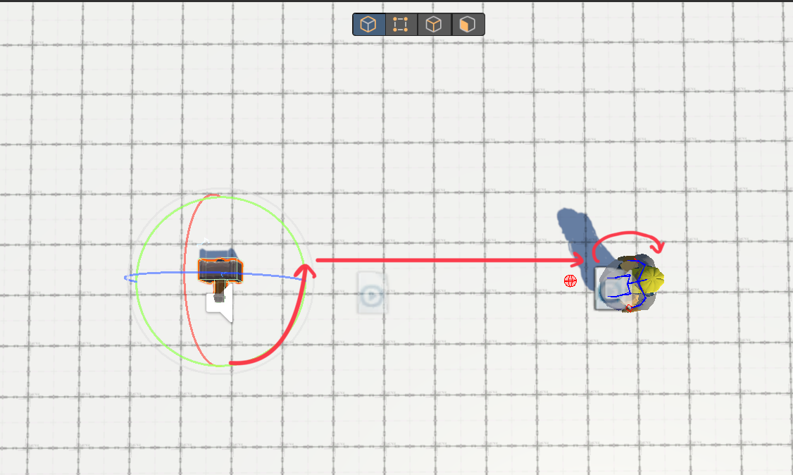
Behind the scenes
Hammer throwing/recalling iteration
Aiming Correction
Input Changes
Boxi & Mingfu

Slide 9



Future of our game
Release on Itch.io
Controller support
Localization

Slide 10
Thank you!
Boxi & Mingfu

Slide 11
Credit
USC Games
Berklee College of Music

