Slide 1
Advertisement – CS3233

Slide 2
Shameless Advice

Slide 3
Learn a Version Control Tool

Slide 4






But which?

Slide 5

There is only one true way

Slide 6
Watch this to convince yourself
http://www.youtube.com/watch?v=4XpnKHJAok8

Slide 7
Fundamentals
Remote
Tracking files (git add)
Commit (git commit)
Branch (git branch)
Merging (git merge)
Diff (git diff)
History (git log)
Cloning (git clone)
Fetch changes (git fetch)
Push changes (git push)
Pull changes (git pull)

Slide 8
Helpful stuff
Contributing?
Need to store temporary changes? (git stash)
Find string (git grep)
Blame (git blame)
Pickaxe (git log –S)
Show file from known revision (git show)
Finding bug (git bisect)
Generate patches
(git format-patch)
Apply git generated patches (git am)
Apply non git patches (git apply)

Slide 9
Screwed up?
More helpful stuff
Show branch “history” (git reflog)
“Undo” changes (git reset)
Reset changes (git reset) – NOTE: One of the most dangerous commands in git
Checkout known revision (git checkout)
Rebase branch (git rebase)
Reorder commits (git rebase –i)
Get a commit from branch (git cherry-pick)
Bundles (git bundle)
Show graph (git log –pretty –-oneline)

Slide 10
Advanced
Hooks (pre-receive, post-receive, post-update)
Submodules
Git replace
Subtree merge
Sparse checkout
Alternates
Shallow clone
Per-hunk commiting (git add –i, git add –p)
Filter branch

Slide 11


Learn a Programmer’s Text Editor

Slide 12











Learn UNIX

Slide 13
Learn how to test code

Slide 14
If there’s one slide I am selfish enough not to show you it’s the next

Slide 15


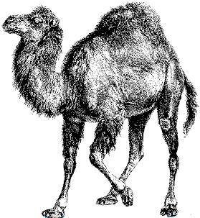


Python, Java, C, Perl, Lisp http://catb.org/~esr/faqs/hacker-howto.html

Slide 16
Learn How to Speak Well

Slide 17
Learn How to Write Well

Slide 18
Give back - Become a TA

Slide 19
Don’t try to learn too much too quickly – The brain needs time

Slide 20
Your CAP is not that important – unless you wish to go to grad school like Shubham

Slide 21
Know which profs to listen to and which not to =P

Slide 22
Share. The pie grows bigger, not smaller, as you share it

Slide 23
Know who are your true friends – and treasure them

Slide 24
The world is as big as your heart.

Slide 25


Slide 26
Stay healthy

Slide 27
Exercise. A strong body = A strong mind

Slide 28
Follow your heart

Slide 29
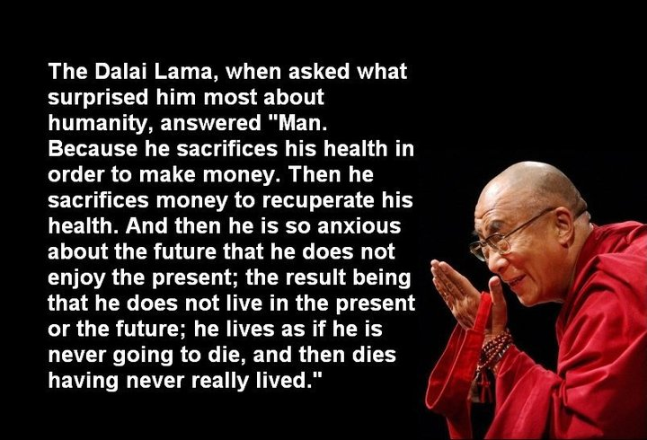
Don’t delay what you can do today to tomorrow

Slide 30
And if you think that was the most important message of the day… you’re wrong.

Slide 31
Because the next one is.

Slide 32
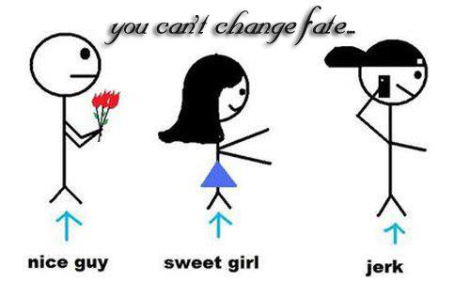

Don’t waste your time chasing after girls

