Slide 1
PS1 Comments

Slide 2


Slide 3


Slide 4
Don’t take the CS2101 + CS2103T combo when you’re a TA
Moral of the story

Slide 5
PS1 - Correctness
O(n) query (AVL Tree as glorified sort)
O(n) for first, O(log n) for subsequent queries

Slide 6
PS1 – Major issues
Put your stuff in a _folder_ before compressing. It should be psX (where X is problem set number and “ps” are lowercase)
Stale code / Commented out code – Please remove
Indentation: Tabs = 4 spaces wide!!!

Slide 7
PS1 – Major issues
Follow style guide (as much as possible)
“Extra” output (like printing time elapsed) – minus 10 marks from now on

Slide 8
PS1 - Changes
RAR files are accepted
Don’t need empty README file if it’s really self explanatory

Slide 9
PS1 - Collaborators
Don’t need to state IVLE forum stuff
You are highly encouraged to share output with others!

Slide 10

PS1 – Staff oopses
People who did AVL Tree but O(n) query can only get max 99/100
Those who used TreeSet / TreeMap can get 100 with ease
Will be resolved next semester

Slide 11
Java Priority Queue
< 5 min

Slide 12

Google is your best friend =)

Slide 13
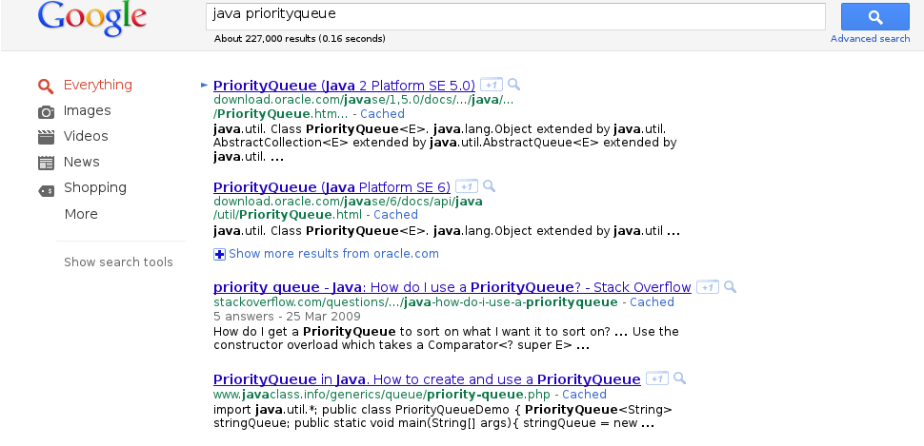
Google is your best friend =)

Slide 14
Data, data, data

Slide 15
Computer Science, like Physics, is about time and space

Slide 16
What it takes to represent data
Character | ASCII | Hex | Binary
( | 40 | 28 | 00101000
1 | 49 | 31 | 00110001
D | 68 | 44 | 01000100
m | 109 | 6D | 01101101
Some bits are actually not needed

Slide 17
Here’s a simple method to cut the space required

Slide 18
Huffman Coding

Slide 19
Given this text
“aaaaaaaaaaaaaaaaaaaabbbbbbbbbbcccccdd”
Length: 38 (including newline at the end)
You need 38 bytes to encode this

Slide 20
Idea: Build a frequency table

Slide 21
An imaginary text file
Character | Frequency
newline | 1
a | 20
b | 10
c | 5
d | 2
aaaaaaaaaaaaaaaaaaaaa
bbbbbbbbbbcccccdd

Slide 22
Idea: Build a tree of prefixes

Slide 23
High occurring characters encoded using small no. of bits

Slide 24
This is where the priority queue comes in

Slide 25
An imaginary text file
Character | Frequency
newline | 1
a | 20
b | 10
c | 5
d | 2
aaaaaaaaaaaaaaaaaaaaa
bbbbbbbbbbcccccdd

Slide 26
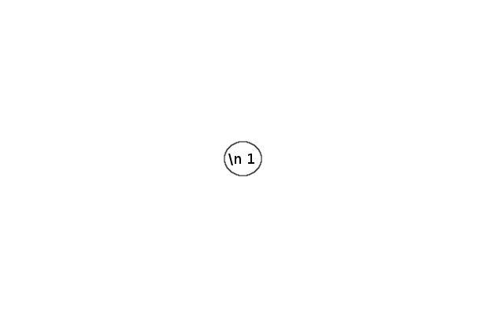
Character | Frequency
newline | 1
a | 20
b | 10
c | 5
d | 2

Slide 27
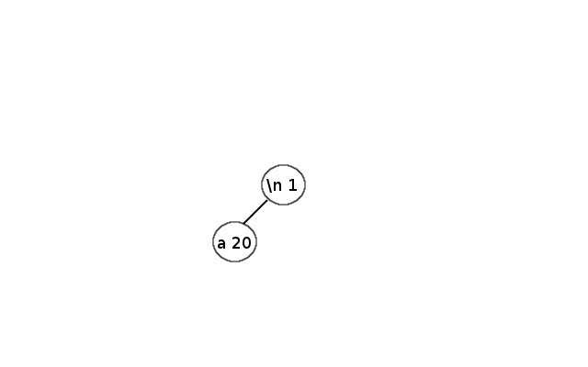
Character | Frequency
newline | 1
a | 20
b | 10
c | 5
d | 2

Slide 28
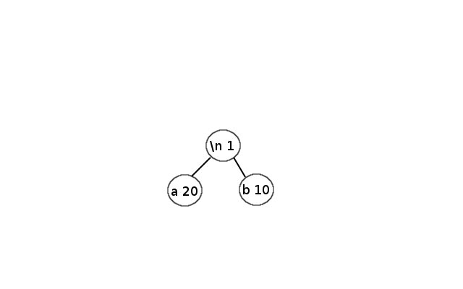
Character | Frequency
newline | 1
a | 20
b | 10
c | 5
d | 2

Slide 29
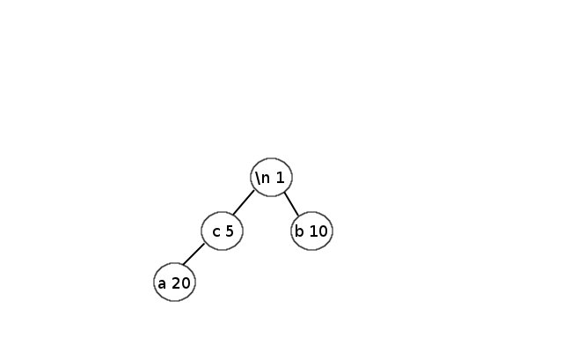
Character | Frequency
newline | 1
a | 20
b | 10
c | 5
d | 2

Slide 30
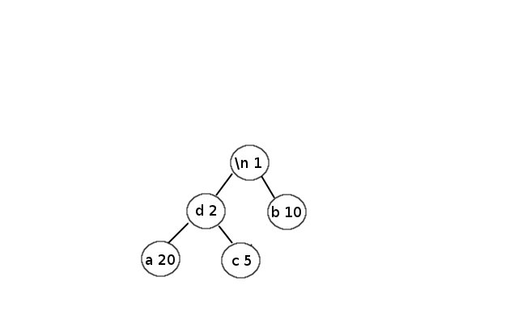
Character | Frequency
newline | 1
a | 20
b | 10
c | 5
d | 2

Slide 31
Build prefix tree

Slide 32
Prefix Tree algorithm
Unless heap has only 1 element left:
Remove the 2 smallest elements from heap
Combine them to form a “bigger” node
Insert the node into the PQ
Goto line 1

Slide 33
Initial state of heap

Slide 34
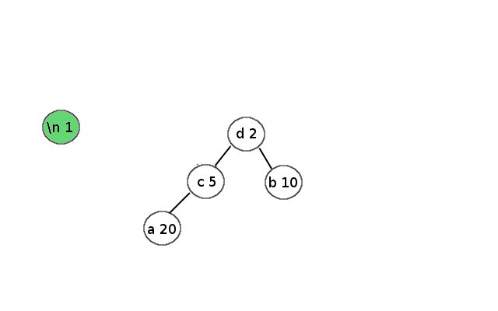
Remove 1st elem

Slide 35
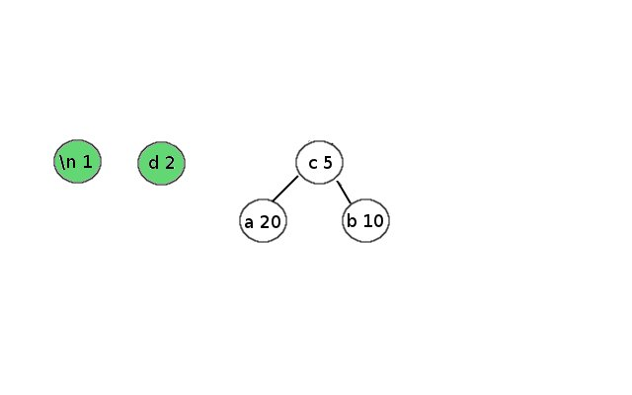
Remove 2nd elem

Slide 36
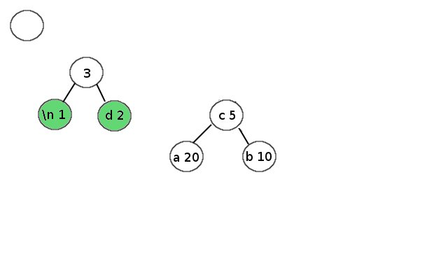
Merge the 2 elems

Slide 37
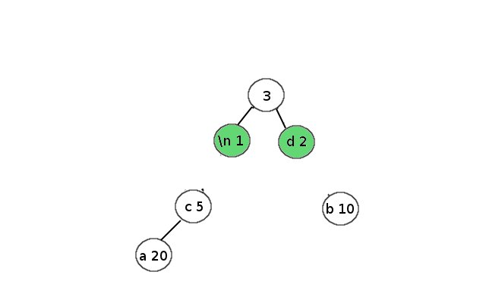
Put new node back into PQ

Slide 38
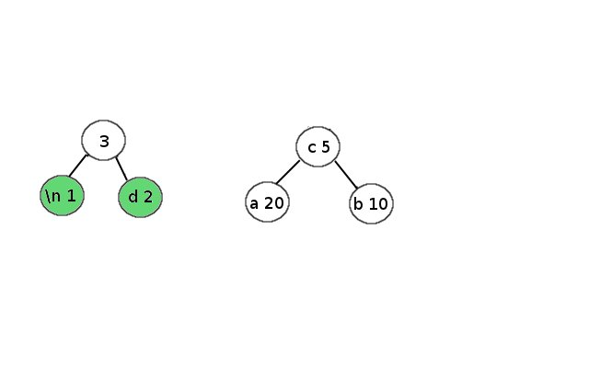
Get top elem from heap

Slide 39
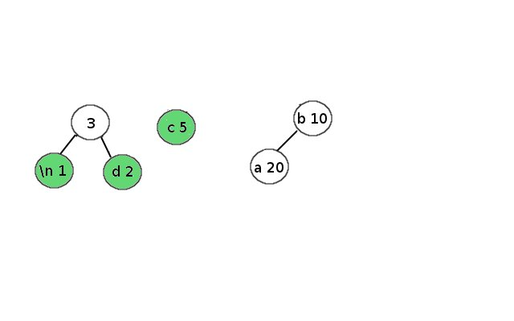
Get 2nd elem from heap

Slide 40
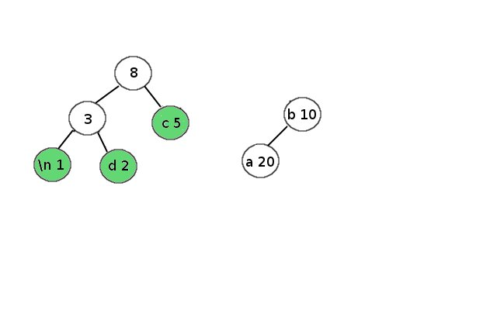
Merge

Slide 41
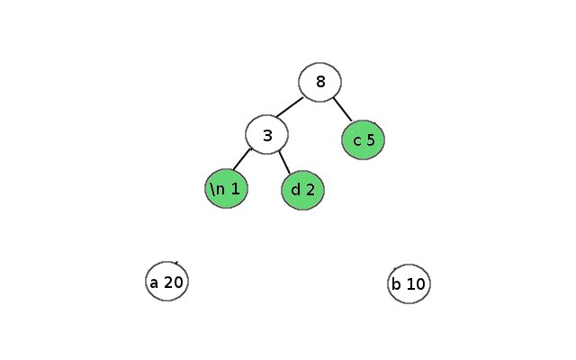
Put back into heap

Slide 42
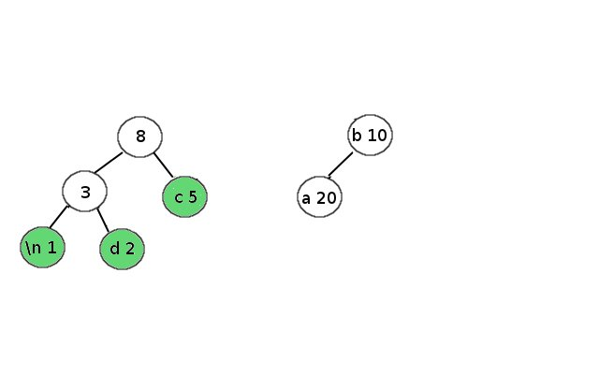
Take top elem from heap

Slide 43
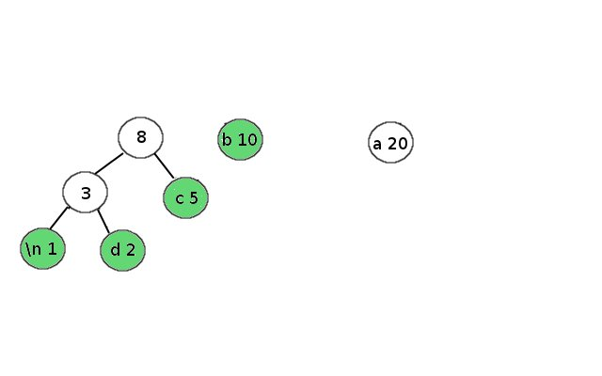
Take 2nd elem from heap

Slide 44
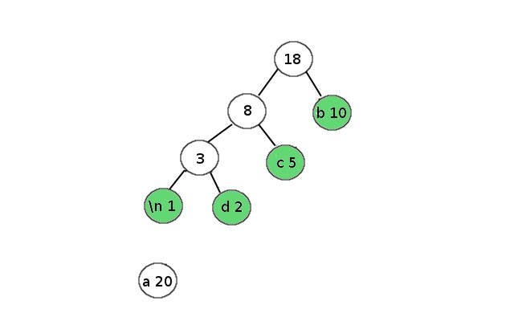
Merge + put back to heap

Slide 45
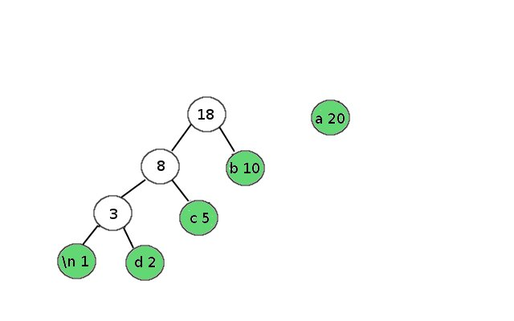
Take top 2 elems from heap

Slide 46

Merge and put back into heap

Slide 47
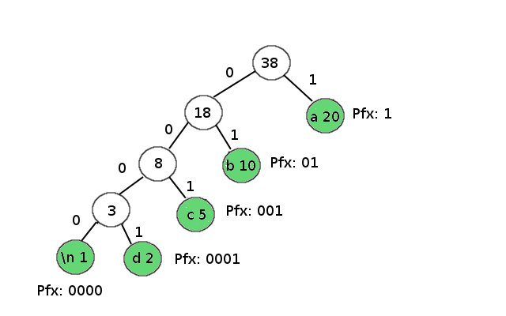
Algorithm terminates. Prefix tree!

Slide 48
Analysis
Character | Frequency | Bitstring
newline | 1 | 0000
a | 20 | 1
b | 10 | 01
c | 5 | 001
d | 2 | 0001
Based on prefix tree:
We can encode text using:
20 * 1 ( a ) + 10 * 2 ( b ) + 5 * 3 ( c ) +
2 * 4 ( d ) + 1 * 4 (newline)
= 20 + 20 + 15 + 8 + 4
= 67 bits = 8.375 bytes < 20 bytes!!

Slide 49
8.375 vs 20 bytes = space savings > 50%

Slide 50
Idea is really really simple, right?

Slide 51
But implementation is tough =) A lot of bit fiddling

Slide 52
Code is done but need to rebase to make commits look nice

Slide 53
Implementation is in C (awesome language for such purposes)

Slide 54
https://github.com/yanhan/cs2010
git://github.com/yanhan/cs2010.git

