Slide 1
Life of a CS2010 Lab TA

Slide 2
Slides = roll your own

Slide 3
Different tutors = different content

Slide 4
Just ask around. Ask what our colleagues cover.

Slide 5
I’m sure we’re the 2 best TAs around

Slide 6
PS2 Issues

Slide 7
Late Submissions
No excuses
First time: -5 marks
Second time: -10 marks
Third time: -15 marks
And so on.

Slide 8
PS 2 General Issues
Style style style
Try reading your code now
Tutor is _not_ debugger
Ugly code deserves little / no feedback
I will try to give feedback by next Monday
Receive nothing = no feedback

Slide 9
PS2 General Issues #2
Use of “inappropriate” data structures
PS2 – PriorityQueue
TreeSet / TreeMap – O(log n) for most ops
Will face slight penalty (-5 marks) for future submissions

Slide 10
PS2 General Issues #3
Floating point computations
Don’t worry too much
Use smth like:
double epsilon = x – y;
if (epsilon < 0.0000001) {
return );
} else if (epsilon < 0) {
return -1;
} else {
return 1;
}

Slide 11
PS2 General Issues #4
Copying and pasting Steven’s code

Slide 12
PS3 Reminders

Slide 13
PS3 Submissions
Please zip up a _folder_ and not files
Eg. For ps3, put your files in a folder titled “ps3” (lower case letters pls) and compress it.
Only .java files and text files. No .class files

Slide 14
How should I zip/rar/compress my ps3
Just zip the files in my current folder so they will go all over the place during decompression!
Put them in a folder titled “PS3” before compressing
Put them in a folder titled “ps3” before compressing

Slide 15
General advice on PSes
Test, test, test
Highly encouraged to share output on IVLE
Use Java API if it isn’t the focus for the PS
Eg. For Prim’s algorithm, use the java.util.PriorityQueue
Makes it simpler for tutor to see what’s wrong with your algorithm (if any)

Slide 16
Uva Problems

Slide 17
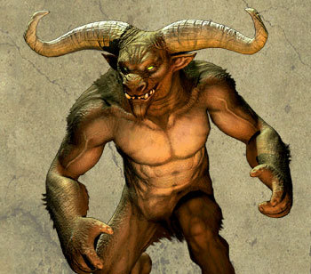
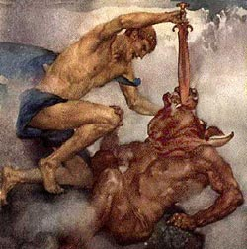
Uva 168 – Theseus and the Minotaur

Slide 18
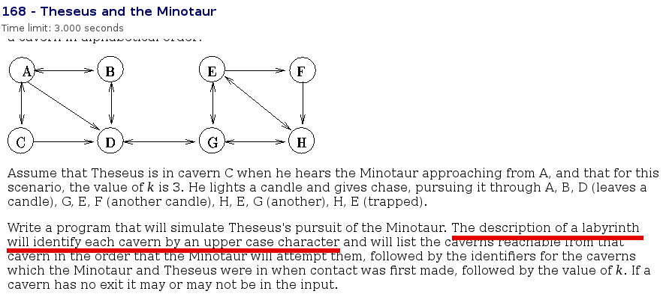
Uva 168 – Theseus and the Minotaur
Limit: 26 vertices

Slide 19
What graph data structure is appropriate for this
Adjacency Matrix
Adjacency List
I don’t know

Slide 20
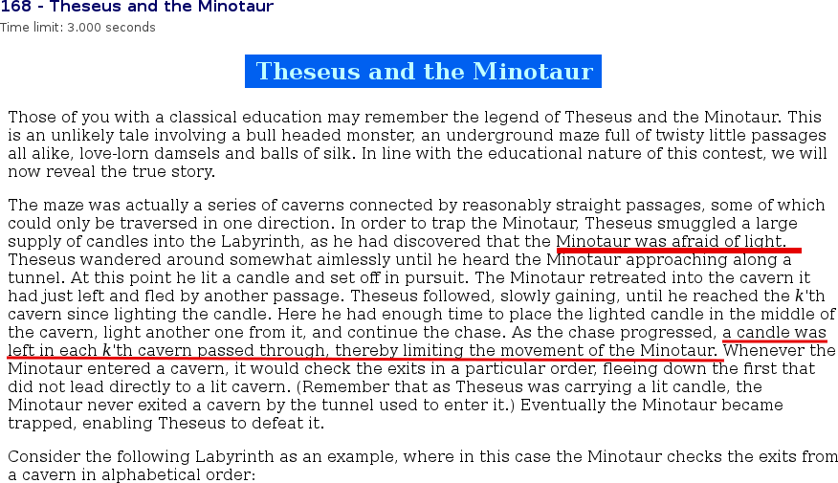
Uva 168 – Theseus and the Minotaur
Afraid of light + candles left in every kth cavern by Theseus

Slide 21
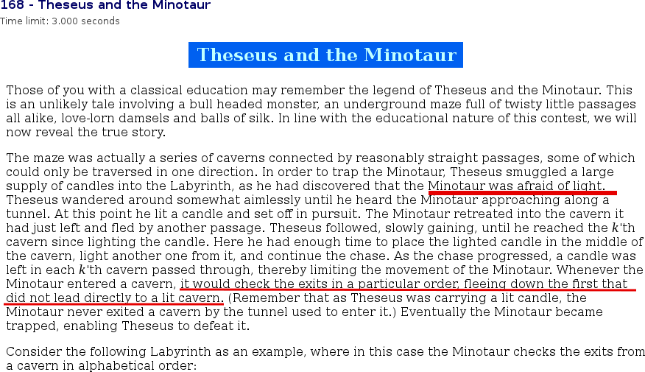
Uva 168 – Theseus and the Minotaur
Flee down 1st exit without light

Slide 22
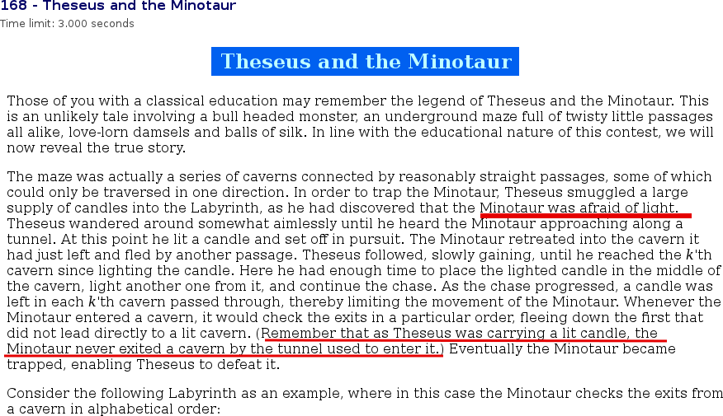
Uva 168 – Theseus and the Minotaur
Cannot go to Theseus’ location!

Slide 23
Uva 168 – Theseus and the Minotaur
Since limit is 26, use Adjacency Matrix!
Just a graph traversal problem
Theseus and minotaur are adjacent at the start
Then Theseus “chases” after minotaur

Slide 24
Uva 168 – Theseus and the Minotaur
Minotaur goes to 1st exit without light
Remember to “light candles” at every kth tavern (vertex_cnt % k == 0)
Eventually, minotaur will have nowhere to run

Slide 25
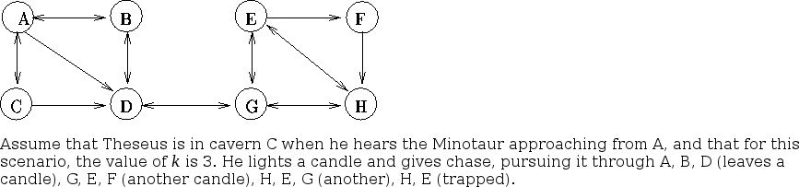
Uva 168 – Theseus and the Minotaur

Slide 26
Do you think you can solve this problem
Absolutely
No way man…
I will solve it in under 20 min!
I have already solved it duh

Slide 27
Another Uva problem

Slide 28
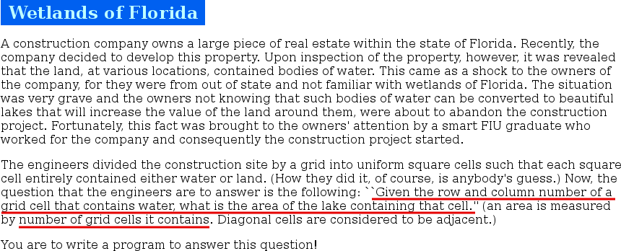
Uva 469 – Wetlands of Florida

Slide 29
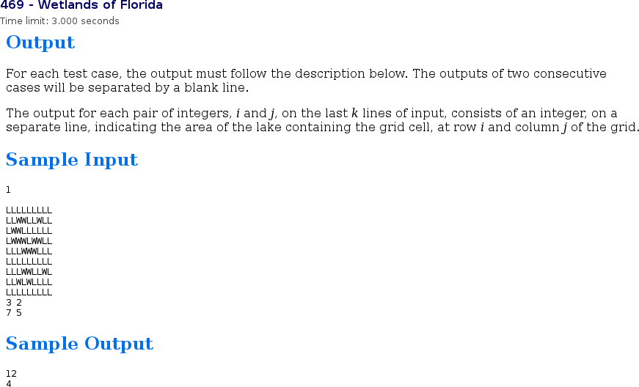
Uva 469 – Wetlands of Florida

Slide 30
Can you spot the graph?

Slide 31
Uva 469 – Wetlands of Florida
Implicit graph!
No need for adj matrix / list

Slide 32
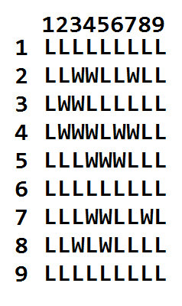
Uva 469 – Wetlands of Florida
Idea: Use Breadth First Search

Slide 33
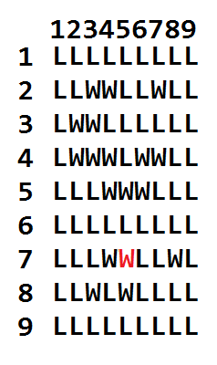
Uva 469 – Wetlands of Florida
Eg, 7 5

Slide 34
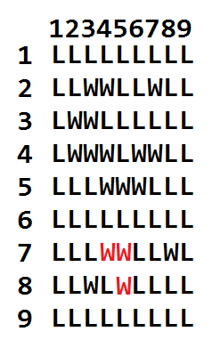
Uva 469 – Wetlands of Florida
Next layer

Slide 35
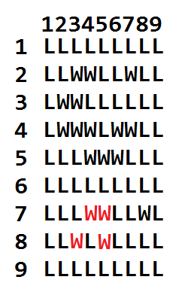
Uva 469 – Wetlands of Florida
Diagonals are adjacent too

Slide 36
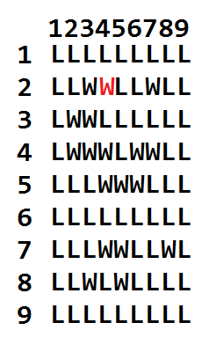
Uva 469 – Wetlands of Florida
Another example (2,4)

Slide 37
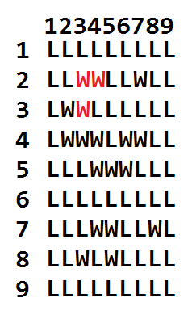
Uva 469 – Wetlands of Florida

Slide 38
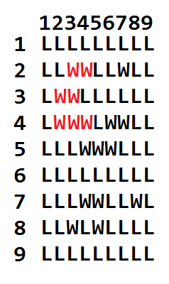
Uva 469 – Wetlands of Florida

Slide 39
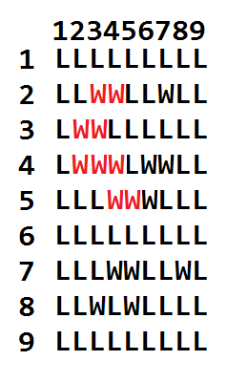
Uva 469 – Wetlands of Florida

Slide 40
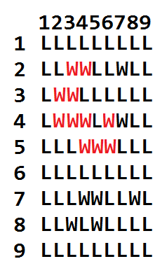
Uva 469 – Wetlands of Florida

Slide 41
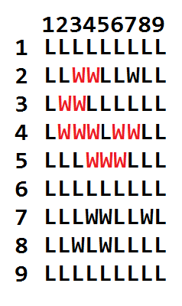
Uva 469 – Wetlands of Florida

Slide 42
Will you try out the above Uva problems?
Yea why not
No way in hell
It’s good enough to understand them

Slide 43
A note on Uva problems
Input must be parsed
Can have little details which make your code wrong (need to read problem very carefully)
Presentation errors (missing newline, extra newline)
UVA is not Java friendly

Slide 44
A note on Uva problems #2
Don’t be disheartened if you can’t solve
It’s really just meant for practicing your algorithms

Slide 45
Uva Problems - Solutions
I have solutions but…
They are in C - haha another reason why you should really learn C =)
And I will _not_ put on my github
Akin to breaking magician’s code
But you can ask me privately for solutions

Slide 46
Exams
Don’t you love them

Slide 47
How well prepared are you for your midterms
All set and ready to go
I still need some practice
I’m gonna die!!!
There’s a midterm quiz???

Slide 48
Expect the unexpected

Slide 49
Flip through whole script once before starting. See what’s easy and what’s hard.

Slide 50
Do the easy stuff first

Slide 51
Revise on big O notation. They are giveaway questions.

Slide 52
Knowledge of fundamental sorting + searching algorithms is assumed

Slide 53
Have helpsheets with some code.

Slide 54
Everything on the paper can be solved with what you already learnt in the course.

Slide 55
When in doubt, just write down what you think. You will be awarded marks.

Slide 56
In my CS2020 experience…

Slide 57
Help sheet = Help $!@#

Slide 58
Good luck for midterms!

