Slide 1
How to Increase SAT Participation Percentage in the US
Nguyen Pham

Slide 2
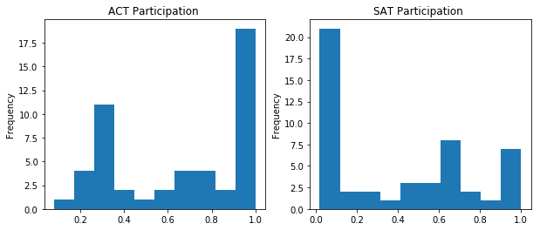
Notes:
1. This is a histogram
2. It is not normally distributed
3. ACT has more 100% Participation vs SAT 100% Participation
4. SAT Participation is low. We must ask the question why is this?
5. We might assume because the SATs are not mandatory in the low participation states, so only those who do take the test probably have there own reasons to do so whether it’s because college requires it, scholarship requires it, day of the test failing on a weekday or weekend, cost of the test, and so on….
5. In the data set for SAT, only 4 states had 100% Participation.
6. NOTE: Maryland was removed from the dataset because the data collected was incorrect because the scores were out of the normal range for both ACT and SAT.

Slide 3
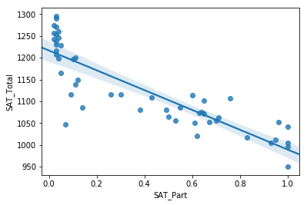
Notes:
This is a scatter plot of the SAT_Total vs SAT_Participation
There is a negative correlation with the SAT participation vs the SAT Totals
Thus, we can’t sell on the fact that if you make it mandatory for high school graduation and SAT scores to increase.

Slide 4
Connecticut
100% Participation in the SAT
Average Total Score: 1041
All High School Juniors are required to take the SAT
Notes:
Researching why a state got 100% participation.
Connecticut was a good candidate

Slide 5
Utah
SAT Participation = 3%
High SAT scores 1238
ACT Participation = 100%
ACT Cost = Free
Notes:
Researching ACT 100% Participation.
Completely free in Utah
Results in a high SAT score, but SAT participation only 3%
Because ACT is free to take, why take SAT? SAT needs to be more competitive

Slide 6
Recommendations
Notes:
Unfortunately, with the limited data given, I cannot give a scientific recommendation for improving the SAT participation percentage without further research. There seems to be some weak correlation between higher scores and low participation and if the state has high SAT participation than it low ACT participation.
We need more data over a period of time.
State level high school graduation requirements.
Look at low, mid, and high tier for cost of SAT
Increase incentives for taking SAT, scholarships, work with venture capitalist to only accept SATs as the standard
Research which day of the week is most accessible for students to take the exam.

Slide 7
Resources
https://magoosh.com/hs/act/2017/states-provide-act-free/
https://www.edweek.org/ew/section/multimedia/states-require-students-take-sat-or-act.html
https://www.nytimes.com/2015/08/07/nyregion/connecticut-to-require-all-11th-graders-to-take-the-sat.html

