Slide 1
Enterprise Computing Assignment 1
Fayan Leonardo Pardo Ladino
ID: 414934

Slide 2
Cloud Database access
URL: ec-1.cx3ybesgvhcj.eu-central-1.rds.amazonaws.com
Username: admin
Password: Enterpriselab1

Slide 3
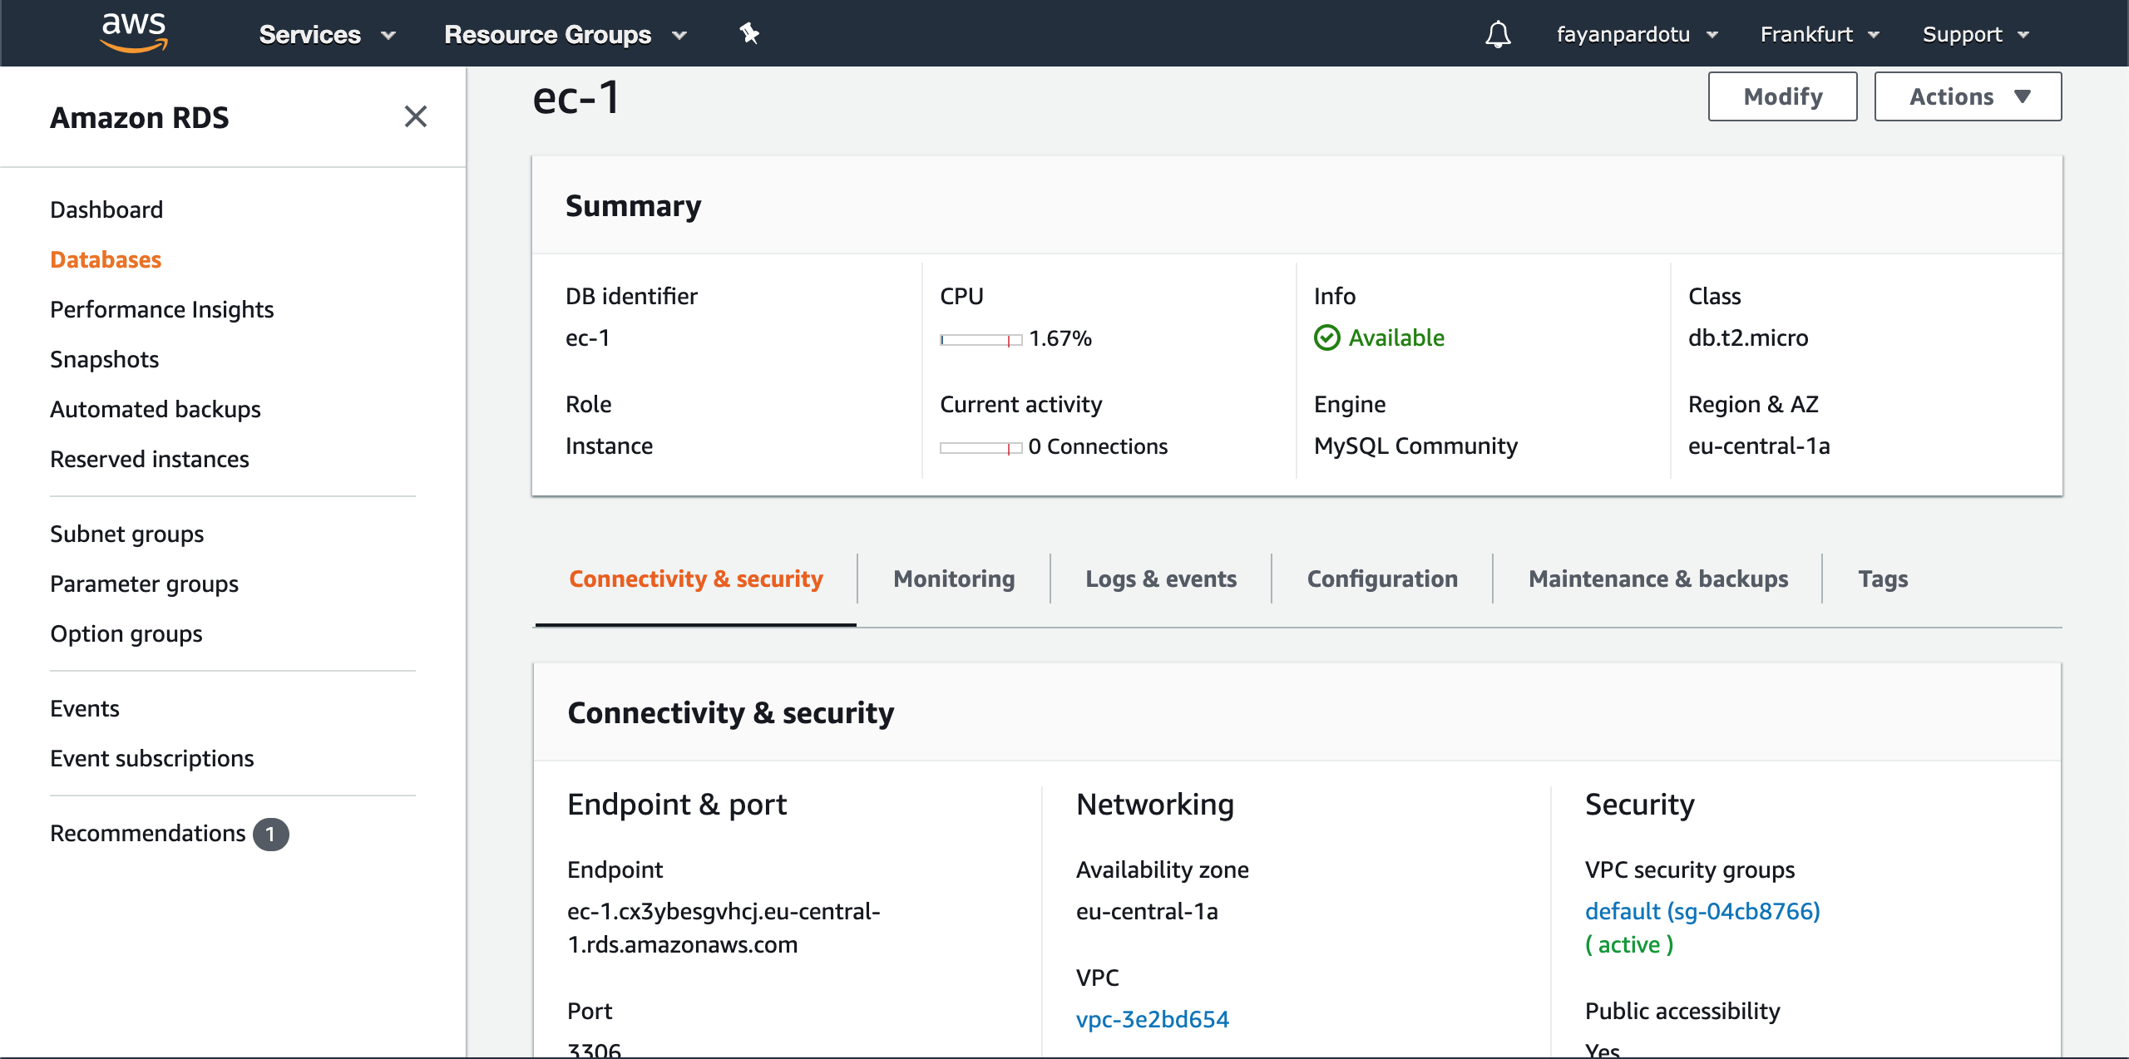
Cloud Dashboard

Slide 4
How to build the clients
The code is built as a maven Project. The steps to compile and to run are the following:
Unzip the file (it should contain the src folder and the pom.xml file)
Compile with “mvn clean install”
Run the Airline client with “mvn exec:java@airline”
Run the Passenger client with “mvn exec:java@passenger”

Slide 5
Database design
The database has 3 tables:
Flights: it will store the flights of the airline. The airline client will be able to create flights providing the flightId, the from and to fields.
Seats: it will store the seats of the flights created. It will contain the row, col, user id of the passenger who booked it (if empty is 0) and the id of the flight as foreign key.
Passenger: it will store the passengers that want to book with the passenger client. The passenger client will be able to create passengers providing the name and username fields.

Slide 6
Code design
The source code will have 2 main classes, one for the airline (AirlineCli) and one for the passengers (PassengerCli). These 2 main classes will contain the main logic of the project that will be explained later.
It will contain a Database class that will contain the Database connection (with the AWS needed parameters) and the common methods used by the main classes to connect to the cloud DB.
It will also contain the models related to each table in the DB: Flight, Passenger and Seat. With these it will be easer to manage the information retrieved from the DB.

Slide 7
Code Design: AirlineCli
The flow of this client will be:
List and let the user choose between the available flights or create a new one (method chooseFlight)
If the option to create a new flight is chosen the method createFlight will ask the user for the needed fields to create a flight and it will create in the DB the flight and the seats of this new flight. Once this process is finished it will ask the user if he wants to make another action and in case of confirmation the flow will restart.
If the user chooses an existent flight the client will retrieve the seats from the DB and print them. Then it will ask the user to choose one seat to see the passenger who booked it. (method chooseFlightSeat).
After printing the seat information it will ask the user if he wants to make another action and in case of confirmation the flow will restart.

Slide 8
Code design: PassengerCli
The flow of the passenger client will be:
List and let the user choose between the available passengers or create a new one (choosePassenger).
If the user chooses to create a new passenger the method createPassenger will ask the user for information and create a new passenger that will be written in the DB. Once this process is finished it will ask the user if he wants to make another action and in case of confirmation the flow will restart.
If the user chooses a passenger then, the client will list and let the user choose between the available flights (method chooseFlight).
After choosing a flight the client will retrieve the seats from the DB and print them. Then it will ask the user to choose one or several seats to book a seat. (method chooseFlightSeat).
After choosing the seats a confirmation step will prompt. Right before asking the client will check again the seat availability in the DB with a ”SELECT … FOR UPDATE” query to lock the seats queried. If one of these seats is already booked the client will prompt an error message and restart the flow. If one of the seats is reserved by another user (waiting for confirmation in another client), the current client will wait for the other client DB commit or rollback to give the final result of the query. If the client denies the confirmation step, the client will unlock the seats with a rollback otherwise it will commit the seats booking. (method bookSeats)
After finishing all this process the client will ask the user if he wants to make another action and in case of confirmation the flow will restart.

Slide 9
Assignment questions
Conceptually discuss how such an invariant could be guaranteed. Should enforcement happen in the database or clients?
It can be guaranteed by locking the seats the passenger wants to book. If another passenger tries to query the same seats, he will have to wait for the first user to unlock the seats.
This enforcement should be done in the database, forcing it in the clients is really difficult as it would need a coordination and communication between all of the clients concurrently running. Given that all of them are connecting to the same database, enforcing this in the database will reduce complexity.

Slide 10
Assignment questions
Implement one of the solutions you discussed above within your system. Test your implementation in a sensible way and document your testing procedure and results.
After implementing I tested by running 2 passenger clients concurrently. Firts one of the clients runs until it reaches the confirmation step, then the other client do the same and tries to book the same seat. The second one had to wait for the first one to book or unlock the seats.
I also tested using the same procedure but both booking several seats having a common booked seat. Again the second one had to wait for the first one to book or unlock the seats.
I aslo checked what happened if they selected several seats but none in common at the same time. Both could book the seats.

