Slide 1
Scala and the Kafka Streams DSL: the Beauty and the Beast?
Carsten Seibert
Zurich Scala Meetup, 24.9.2019

Slide 2

About me
In the IT business since 1993
Different areas of business
Semi conductor
Stock exchange
Banking / Fintech
Addicted to Scala since 2013
… and a long history with Java before
Passionate about
Scala – of course ;)
Even driven microservice architectures
Agile and evolutionary development
Pizza and a glass of good wine!

Slide 3
The Beauty and the Beast …
Notes:
Show of hands
who thinks that Scala is the beauty?
who thinks that Scala is the beast

Slide 4
Scala is the Beauty …
… but Scala can also be a bit of a diva
Tuple22
implicit resolution
Macros
Stack traces
compile time
But all these flaws will be gone with Scala 3 and it will shine again ;)

Slide 5
Kafka – Very brief
A distributed persistent message log
With an eco system around it
KSQL
Schema Registry
Kafka Connect
…

Slide 6
Topics and Partitions - Producing
Topics are created with a number of partitions
A producer publishes to a topic
Kafka determines the partition (by default)
Order guaranteed per partition, NOT per topic!
https://kafka.apache.org/documentation.html

Slide 7
Topics and Partitions - Consuming
Individual consumers belong to a consumer group (by consumerGroupId)
Kafka assigns partitions to members of a consumer group
Kafka rebalances this assignment if the members of a consumer group change
https://cloud.ibm.com/docs/services/EventStreams?topic=eventstreams-apache_kafka

Slide 8
What is stream processing?
“Stream processing is the processing of data in motion, or in other words, computing on data directly as it is produced or received.”
“The majority of data are born as continuous streams: sensor events, user activity on a website, financial trades, and so on – all these data are created as a series of events over time.”
https://www.ververica.com/what-is-stream-processing

Slide 9
The Kafka client stack
Scala Streams DSL
Java Streams DSL
Streams Processor API
Java consumer / producer

Slide 10
Stream processing with Kafka
in topic -> net of operations (topology) -> out topic
"atomic" operation
KStream vs KTable
KStream: events as published to the topic (changelog of a table)
KTable: only the latest value for a key is provided (snapshot of a stream)
=> Like some of major databases do!
Stateless vs stateful operations
https://docs.confluent.io/current/streams/concepts.html
Notes:
This is how databases works: commit log is the stream, tables represent the state, a DB can use the

Slide 11
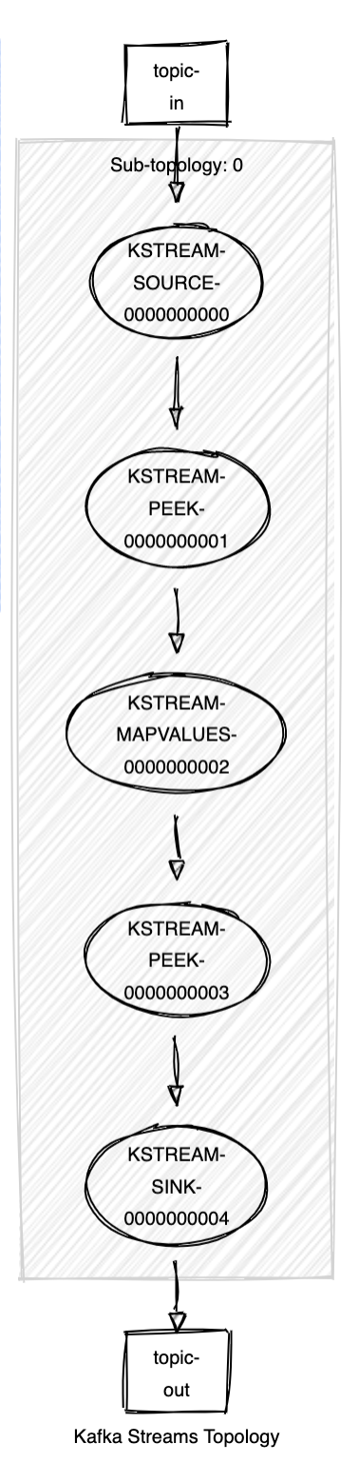
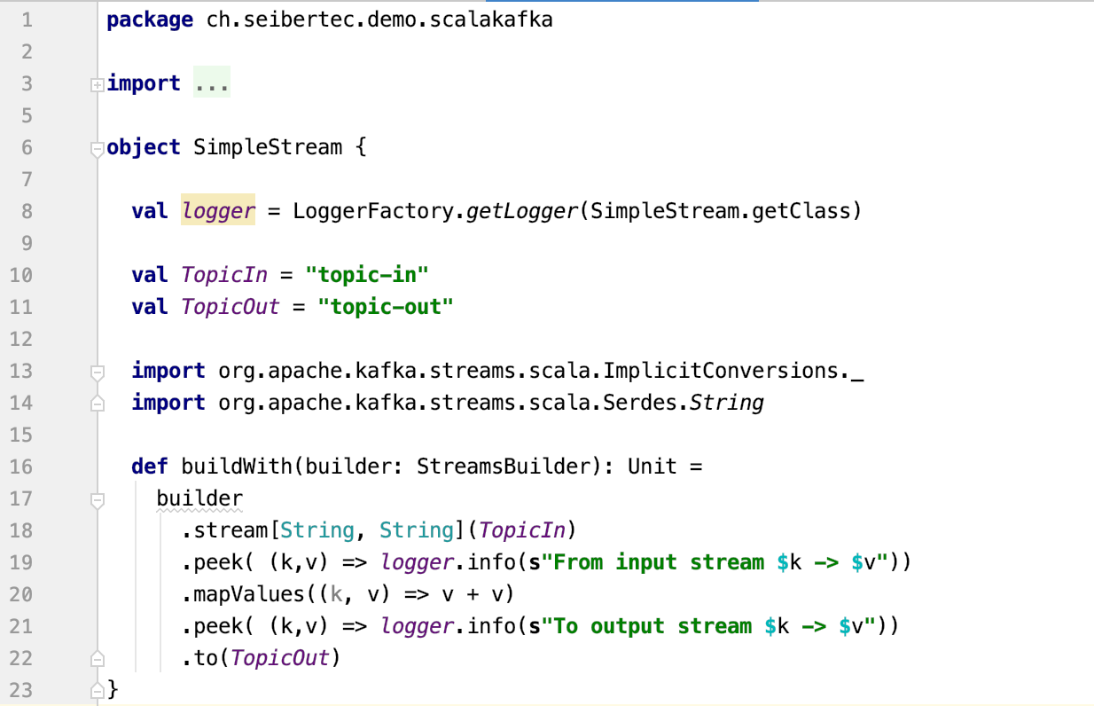
The first DSL – A very simple flow
Notes:
+ Explain
* builder pattern, fluid API with "proper" typing
* in/out type
* serialization / deserialization
* show resulting topology (kafka viz)

Slide 12
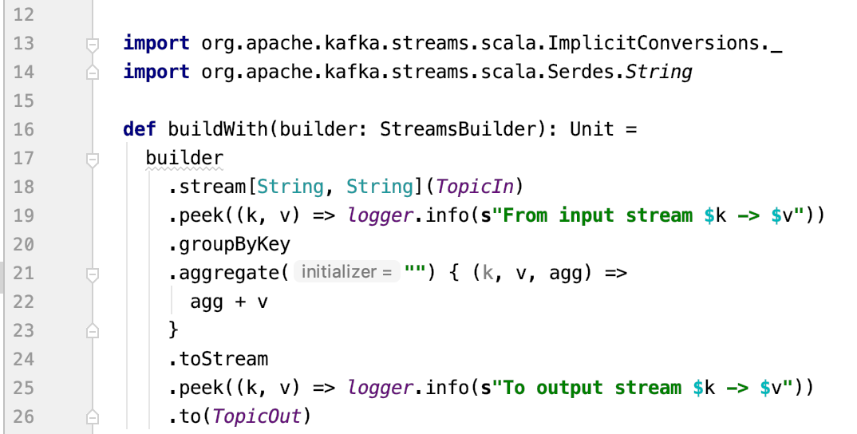
DSL - Aggregation
Notes:
+ Explain
* Grouping, KTable
* statefulness !!!
* null !! (beasty!)

Slide 13
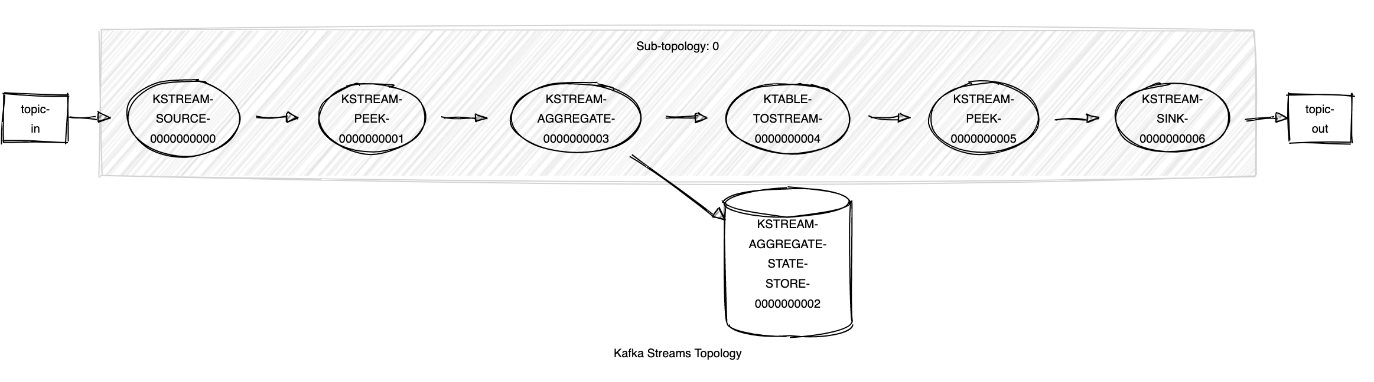
DSL – Aggregation – cont’d
Notes:
+ Explain
* Grouping, KTable
* statefulness !!!
* null !! (beasty!)

Slide 14
DSL – leftJoin (simplified)
Joiner: value 1 + value 2
Join Window
TopicIn
(“k1”,”v1”)
TopicToJoin
(“k1”,”v2”)
TopicOut
(”k1”,”v1null”)
(”k1”,”v1v2”)
Join Window
TopicIn
(“k1”,”v1”)
TopicToJoin
(“k1”,”v2”)
TopicOut
(”k1”,”v1null”)
Notes:
Event time vs processing time
co-partitioning

Slide 15
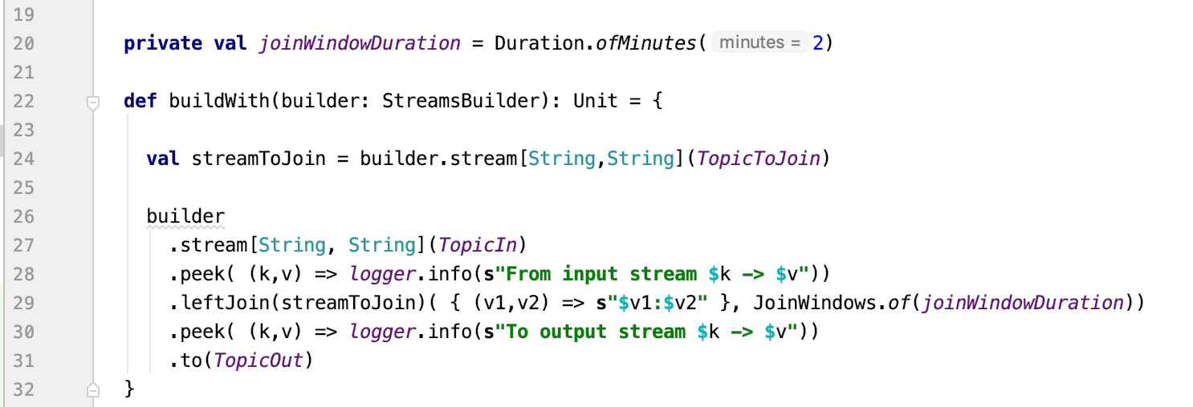
DSL - Join
Further reading: https://docs.confluent.io/current/streams/developer-guide/dsl-api.html#stateful-transformations
Notes:
* GlobalKTable for non-co-partitioned (=> eventual consistent!)
* KStream vs KTable (compaction on topic!), "duality"
- trigger: tream/stream - both sides vs stream/table - stream onl

Slide 16
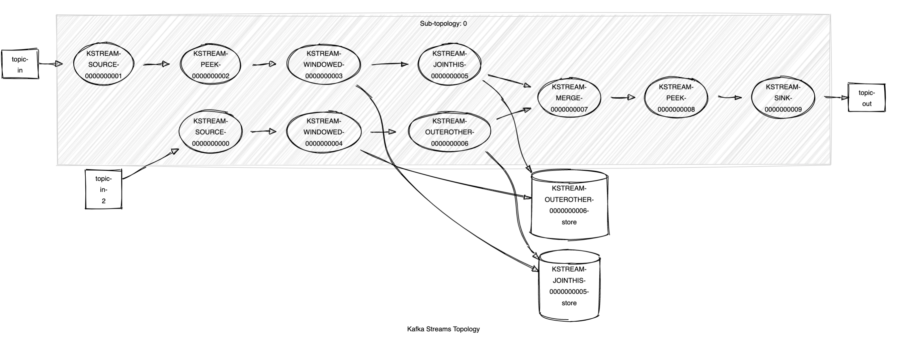
DSL – Join – cont’d

Slide 17
Other DSL operations
filter / filterNot
branch
foreach
…

Slide 18
Time for some real code!!

Slide 19
(My) Conclusions
Beauty
Fascinating programming model with seamless scalability
Nice functional abstraction
Excellent test support on several levels
Beast
DSL operation sometime limited
Usage of “null”, branch function
The nice abstraction sometimes hides the inherent complexity
A beast with a good heart!

Slide 20
Questions?
Thanks!
mailto:seibert@seibertec.ch

Slide 21
Still there?

Slide 22
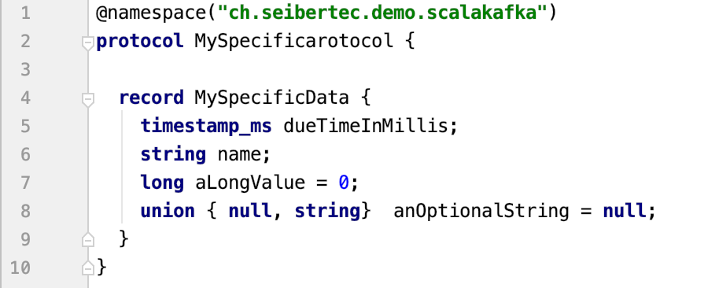
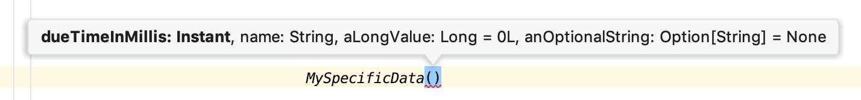
Serialization revisited: Avro

Slide 23
Serialization revisited: forward / backward compatibility
Newer producer, older consumer
Publisher
v1
v2
v1
v2
Consumer
Newer consumer, older producer => forward compatitibility & replay of older messages
Publisher
v1
v2
v1
v2
Consumer
Notes:
Backward:
- New version:
adding: ok, older consumer cant’t access
removing: must be anticipathed from

