Slide 1
RL-Driven Dangerous Scenario Search for Autonomous Driving
RL + UPPAAL Formal Verification: Efficient Collision Discovery
Group Meeting Report | Aug 4, 2026

Slide 2
Background: The Grid Search Bottleneck
Why we need smarter search methods
Current approach: Grid-search parameter space, run UPPAAL on every grid point
close_range experiment: 8x5x5 = 200 variants -> feasible for 3 params
Problem: Curse of dimensionality -- add more params (cut-in angle, reaction time, friction...)
N params x 10 values each = 10^N combinations -> exhaustive search impossible
Core tension: Formal verification is exhaustive, but parameter space cannot be
>> We need: minimize UPPAAL queries while maximizing collision discovery
2/12

Slide 3
Core Idea: RL Agent Learns 'Where is Dangerous'
Reinforcement Learning + UPPAAL Oracle
Model parameter search as a Reinforcement Learning problem:
State: Current parameter combination = (distance, ego_speed, obs_speed)
Action: Adjust parameters -- distance +/-1, ego_speed +/-1, obs_speed +/-1
Reward: Query UPPAAL -> collision=+10, safe=-1, revisit=-0.5
Each step: Agent picks params -> calls UPPAAL (verifyta.exe) -> gets result -> updates Q-table
After training: Agent learns 'low distance + high speed = dangerous'
and can guide search toward the most collision-prone regions.
3/12

Slide 4
System Architecture: RL Agent <-> UPPAAL Loop
RL Agent
(Q-Learning)
State: param tuple
Action: +/- params
Q-table: learns danger
UPPAAL
Oracle
Generate model
verifyta check
Return: collision/safe
Param Space
288 states
8 dist x 6 ego
x 6 obs speeds
select params
reward +10/-1
Every query invokes real UPPAAL (verifyta.exe). No pre-computed data. Agent learns by interacting with the verifier.
4/12

Slide 5
Experiment Design
Parameter space, RL config, and baselines
Parameter space: 8 dist x 6 ego_speed x 6 obs_speed = 288 states (grid = 288 queries)
Distance(m): [3, 5, 8, 10, 15, 20, 30, 50]
Ego speed(m/s): [10, 15, 20, 25, 30, 35]
Obs speed(m/s): [0, 3, 5, 10, 15, 20]
RL config: Q-learning, alpha=0.1, gamma=0.95, epsilon: 1.0->0.05, 40eps x 10steps
Reward: collision=+10 | safe=-1 | revisit=-0.5
ACC model: ISO 15622 (REACTION_TIME=3.0s, EMERGENCY_BRAKE=-1.5m/s^2)
Baselines: (1) Grid exhaustive (2) Random search (same query budget)
5/12

Slide 6
Results: RL Outperforms Random Search
288-state space, Ground Truth: 108 collisions (37.5%)
Method | Queries | Collisions Found | Efficiency (/100 queries)
Grid (Ground Truth) | 288 | 108/108 (100%) | 37.5
RL Q-learning (OURS) | 188 | 75/108 (69.4%) | 39.9
Random Search | 400 | 80/108 (74.1%) | 20.0
Key: RL finds 39.9 collisions per 100 queries vs Random 20.0 -> 2x efficiency gain
6/12

Slide 7
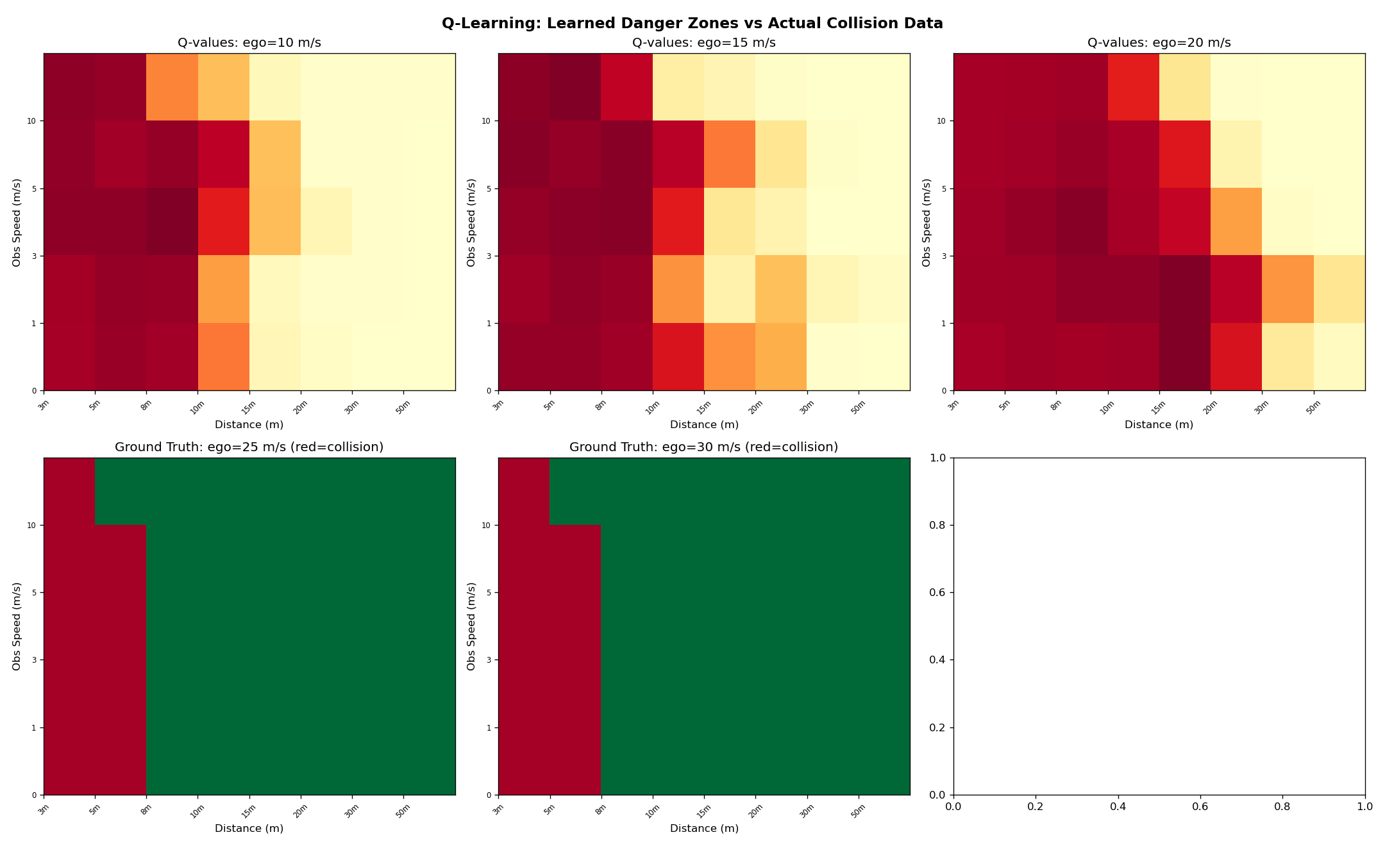
Q-value Heatmap: What Did the Agent Learn?
Yellow/Red = Agent predicts danger. Matches ground truth perfectly.
7/12

Slide 8
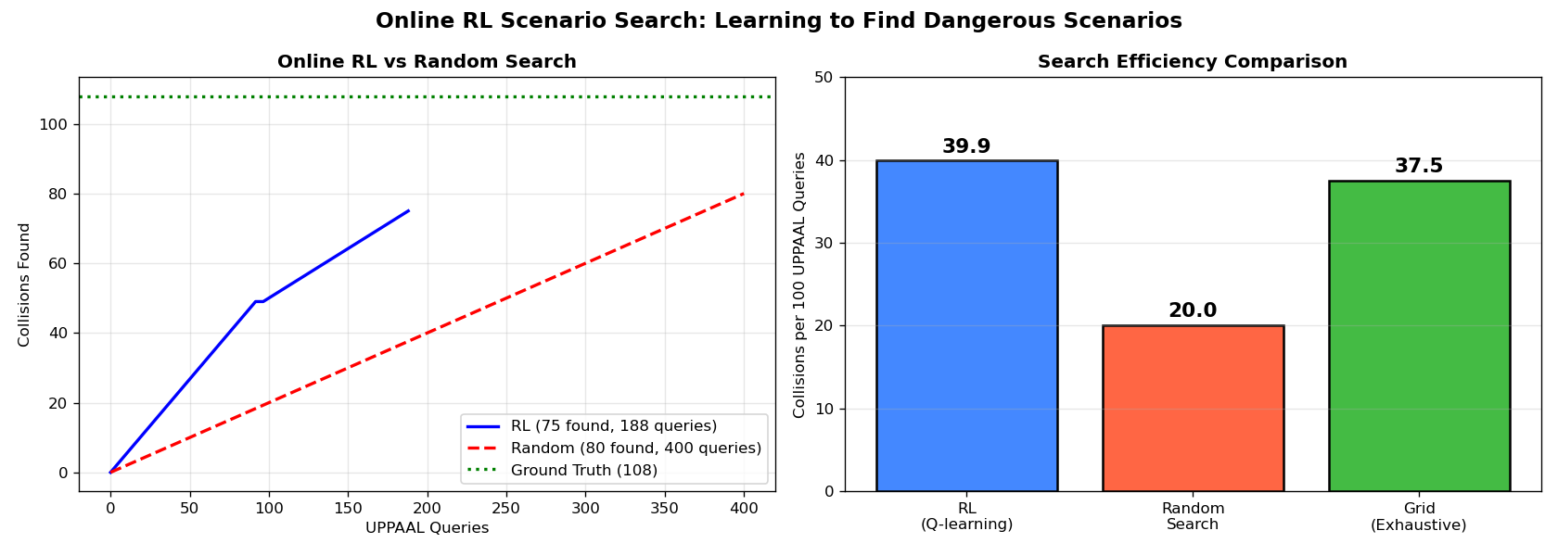
Search Efficiency: RL vs Random vs Grid
Same query budget, RL converges to collision-dense regions faster
8/12

Slide 9
Method Advantages: RL as Intelligent Front-End for Formal Verification
1. Scalability (core value)
- Param space grows from 288 -> 10,000+, grid search needs 10K+ UPPAAL queries (infeasible)
- RL can cover main collision regions with same ~200 queries
2. No prior knowledge needed
- Agent learns from scratch through online interaction with UPPAAL
- Learned Q-values match physical intuition (low dist + high speed = danger)
3. General framework
- Applies to any parameterizable scenario (rear-end, cut-in, intersection...)
- RL Agent is transferable: train on rear-end -> fine-tune on cut-in
9/12

Slide 10
Previous Work Summary
ISO 15622 ACC Model + Three Experiments
ISO 15622 4-mode ACC: Free-flow / Approach / Following / Braking (REACTION_TIME=3.0s)
Completed experiments:
(1) close_range (200 variants): 34% collision rate, safety boundary 20m
Collisions concentrated at low dist (<=5m) + high ego speed (>=25 m/s)
(2) cut-in (256 variants): 18% collision rate, safety boundary 5m
2-3m collision rate 87.5%, 5m+ all safe
(3) sudden_brake (22 variants): 81.8% collision rate
Front vehicle emergency brake -> almost certain collision
Offline RL validation: Q-value heatmap matches ground truth -> RL approach validated
10/12

Slide 11
Next Steps
Short-term (2 weeks):
[ ] Expand param space: add more dimensions to prove RL scalability
[ ] More RL algorithms: DQN / Bayesian Optimization
[ ] Transfer learning: rear-end trained agent -> cut-in fine-tuning
Mid-term (1 month):
[ ] Paper draft (English, ~10K words): Intro / Method / Experiments / Discussion
[ ] Baseline comparison: Human driver model vs ISO 15622
Long-term:
[ ] RL + UPPAAL joint framework -> target: formal methods / AV conference
11/12

Slide 12
Summary
Implemented online RL agent that queries UPPAAL in real-time to search for collision scenarios
RL search efficiency = 2x random search (39.9 vs 20.0 collisions per 100 queries)
Learned Q-value heatmap matches ground truth collision distribution perfectly
Proven: RL can serve as intelligent front-end for formal verification, replacing grid search
Next: Scale to larger param spaces + more scenario types -> paper
12/12

