Slide 1





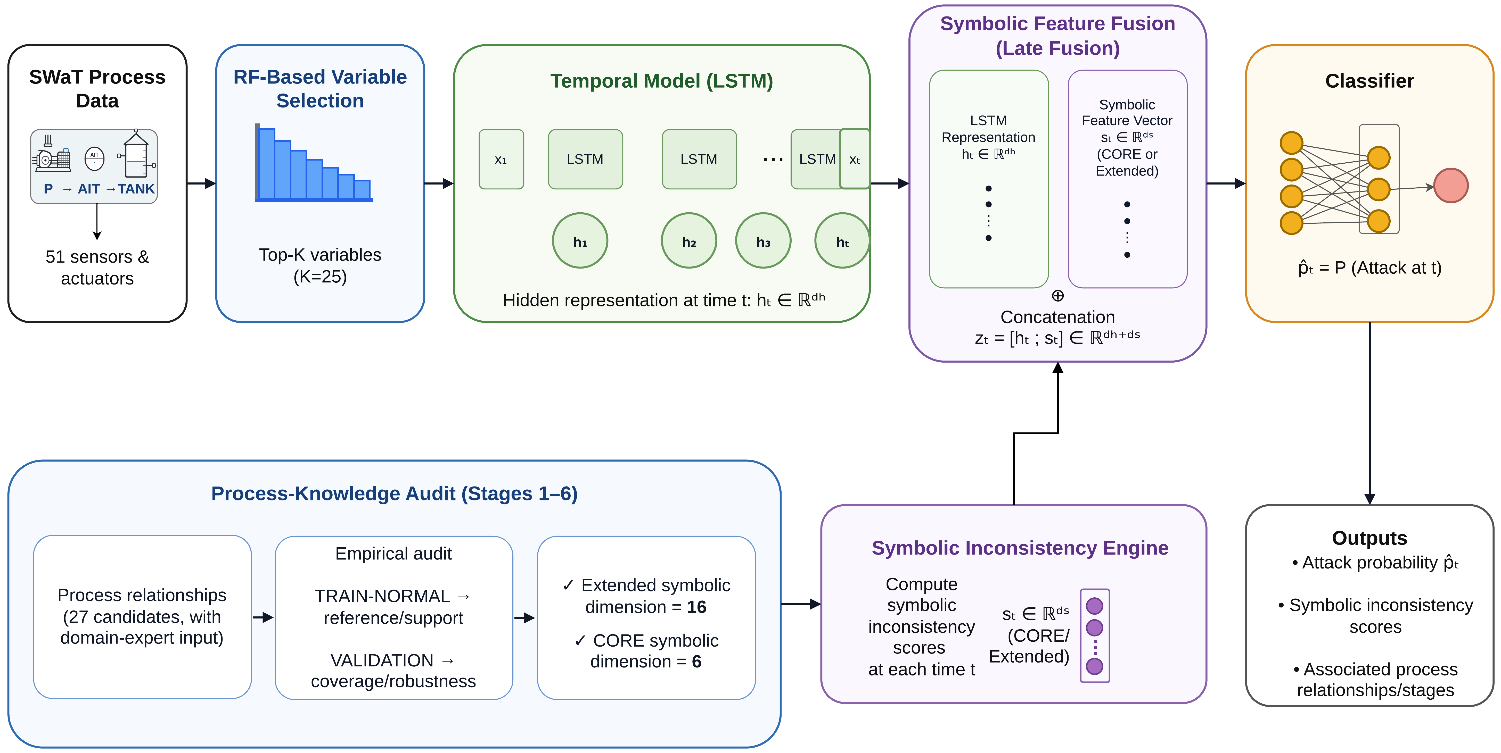
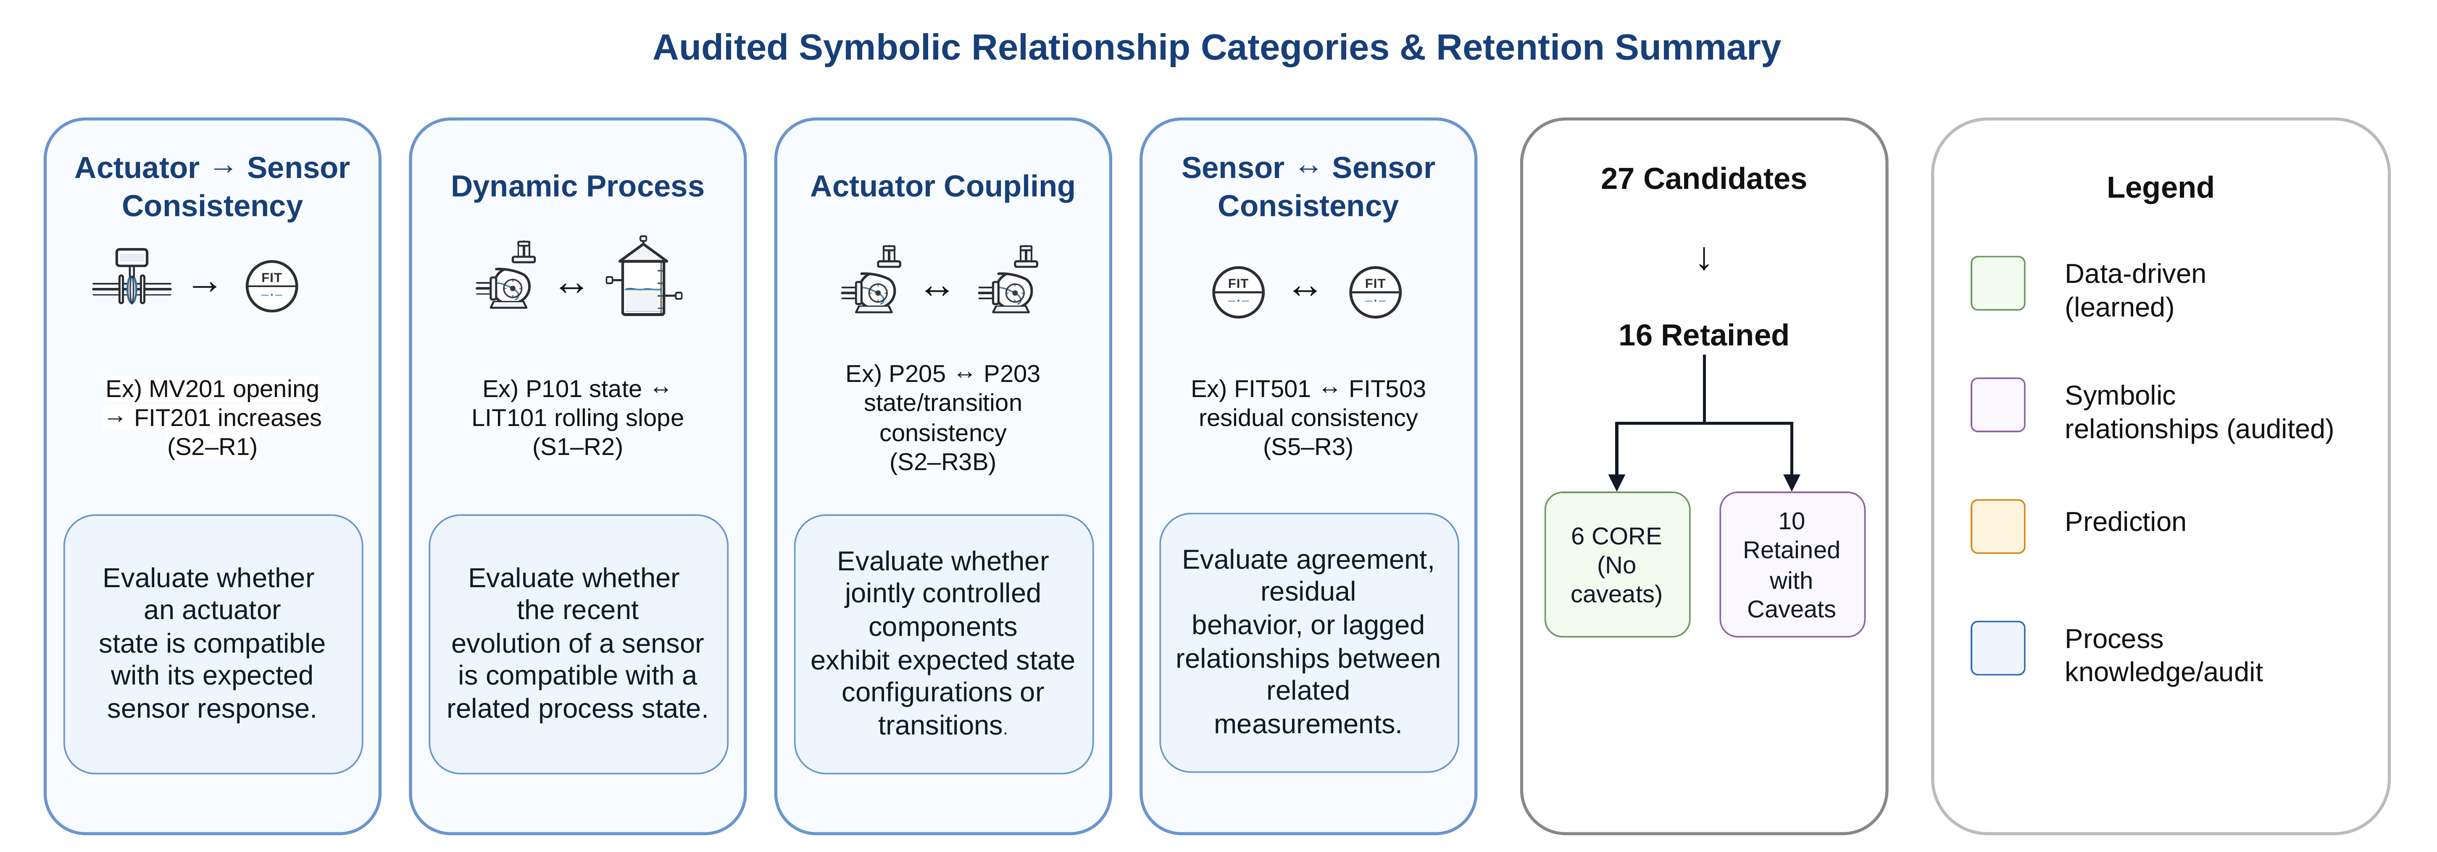

Auditing Process Knowledge for
Parsimonious and Explainable
Industrial Cyberattack Detection
Project Website
Hyunwook Kim¹, Keith Wilkinson², Renjith Prasad¹,
Aahan Rathod¹, Chathurangi Shyalika¹ and Amit Sheth¹
GitHub Repository
¹ AI Institute, University of South Carolina, USA ² San Francisco Public Utilities Commission, USA
AAAI Fall Symposium 2026: Parsimonious Scientific Machine Learning
Motivation and Contribution
Process-Knowledge Audit
Industrial control systems (ICSs) need temporal attack detection that operators can interpret. We audit engineering relationships before adding them to a detector.
Six relationships pass every audit check and form the conservative CORE. We combine their scores with a 25-variable LSTM.
Key finding: more process knowledge is not better. CORE (6 relationships) beats using all 16 retained.
What is a process-knowledge audit? Engineers can write many physically plausible rules about a plant (e.g., “if valve MV201 opens, flow FIT201 should rise”), but some are rarely observed, unstable over time, or redundant. The audit tests every candidate rule against normal operating data and admits only reliable ones into the detector as deviation scores.
1 Empirical support. Does the relationship show a clear, measurable effect in TRAIN data (effect size, correlation, enough samples)?
2 Validation coverage. Does it apply to at least 90% of VALIDATION samples and score low on normal data? If not, it is labeled Limited.
3 Robustness. Is it stable from TRAIN to VALIDATION, with well-represented normal data and a time lag inside the tested range?
4 Redundancy. Does it add information that other retained relationships do not already provide?
27 candidates → 6 CORE + 10 retained with caveats + 2 limited + 9 rejected
Architecture and Hybrid Detection Framework
Audited Relationship Categories and Retention
How to read: each candidate relationship falls into one of four categories and is turned into a score of how far the plant departs from it. Six pass every check (CORE). Ten pass with documented caveats. Together, the 16 retained form the Extended set.
LSTM: 120 observations (approximately 120 s), 64 hidden units. Final classifier: linear layer + sigmoid.
Method Details
Data and Chronological Protocol
SWaT: 51 sensors and actuators across six water-treatment stages; 449,919 attack-collection observations with 35 attack events.
Chronological split: boundaries fall in normal operation, so no attack event spans two partitions.
TEST stays held out: scaling, variable ranking, audit, tuning, and threshold use TRAIN and VALIDATION only.
Temporal Branch (LSTM)
Variable selection: Random Forest (500 trees) ranks the 51 variables on TRAIN; K = 25 is chosen on VALIDATION (94.6% of importance).
Model: windows of L = 120, stride 1; one LSTM layer, 64 hidden units, dropout 0.2.
Training: Adam (10⁻³), batch 256, up to 30 epochs, early stopping, weighted loss; five random seeds.
Symbolic Branch and Fusion
Scores: each retained relationship gives a deviation score; larger means further from normal behavior.
Fusion: the window’s final scores (6 for CORE, 16 for Extended) are concatenated with the 64-d LSTM output, then a linear layer and sigmoid give the attack probability.
Threshold: chosen on VALIDATION to maximize MCC, then fixed for TEST.
Held-Out Detection Results
Chronological Evaluation
Fixed chronological TEST partition. Mean ± standard deviation over five seeds.
TRAIN: 270,000 observations, 22 attacks
VALIDATION: 68,319 observations, 3 attacks
TEST: 111,600 observations, 10 attacks
No sequence or attack crosses a split boundary. TEST remains held out during development.
Model | Raw / symbolic | MCC | F1 | ROC-AUC
Full LSTM | 51 / 0 | 0.135 ± 0.082 | 0.066 ± 0.043 | 0.621 ± 0.084
Selected LSTM | 25 / 0 | 0.183 ± 0.101 | 0.137 ± 0.111 | 0.520 ± 0.049
NS CORE | 25 / 6 | 0.247 ± 0.063 | 0.161 ± 0.063 | 0.600 ± 0.052
NS Extended | 25 / 16 | 0.155 ± 0.123 | 0.084 ± 0.098 | 0.577 ± 0.041
Generalization over time: mean MCC
CORE has the highest mean TEST MCC and F1 among these four models. Full LSTM has the highest mean ROC-AUC.
CORE vs Selected LSTM: paired MCC, F1, and AUC differences are not statistically significant across five seeds (p ≥ 0.0625).
Operator-Facing Process Evidence
Limitations and Next Steps
Six CORE relationships identify where process behavior deviates:
All four models miss six of ten TEST attack intervals, covering 78.4% of attack observations. Absolute performance remains weak and is not deployment-ready.
A symbolic deviation indicates abnormal process behavior. It cannot distinguish an attack from equipment or sensor failure.
Next: evaluate other processes and operating modes, accounting for attack severity and detection delay relative to physical timescales.
Stage | Relationship | Evidence type
S1 | MV101–FIT101 | Valve–flow consistency
S1 | P101–LIT101 | Pump–level dynamics
S1 | FIT101–LIT101 | Flow–level dynamics
S2 | MV201–FIT201 | Valve–flow consistency
S2 | P205–P203 | Actuator coupling
S5 | FIT501–FIT503 | Sensor residual consistency
Parsimony reduces the number of engineering relationships. Chronological generalization remains unresolved.
Notes:
Sources: user-supplied manuscript, RP: Auditing Process Knowledge for Parsimonious and Explainable Industrial Cyberattack Detection, FSS-26_Paper_XXX_1825.pdf, Tables 1–3 and methods/results. Layout adapted from supplied AAMAS Demo: SmartPilot poster PDF. Logo source: https://www.sfpuc.gov/themes/custom/sfwater/img/scm_logo.svg . Author order supplied by the user from accepted-paper metadata, Paper 1825. Affiliation remains pending. Figure 1 is the original vector graphic from page 3 of the supplied manuscript.

