Slide 1
TZ
Tên thành viên | MSSV
Phan Hồng Thịnh | 1900007549
Lê Thanh Tú | 1900000141
Trịnh Minh Thuận | 1900008754
Phan Thanh Thiên | 1900009380
Nguyễn Thế Truyền | 1911549351

Slide 2
TZ COMPANY
WEBSITE DESIGN

Slide 3

WEBSITE DESIGN
Design (design) and cut html (create interface). In particular, the design part will be the main responsibility of the designers. They will use specialized software for graphic design such as software: Ps, Ai, Dn, etc. These software will assist them in creating interfaces in the form of basic images.For interface building, programmers will be responsible for using code tools such as HTML, Javascript, CSS to analyze and create a reasonable interface for the website. After building the interface with the HTML tool, the customer will receive a website that has not been used yet.This interface is only capable of receiving operations such as clicking, leaving the page, some other effects, etc. However, a static website cannot yet be able to store information as well as retrieve data. such as making a purchase, registering or searching a website, etc.

Slide 4
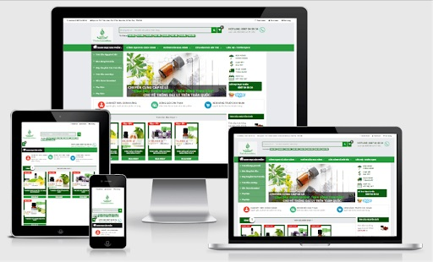
DESIGN OBJECTIVES
1. Expand the ability to interact with customers
2. Build the reputation of the business
3. Get feedback from customers more convenient
4. Easy to implement marketing plan
5. Platform for product sales
6. Provide useful information to customers
7. Increase competitiveness for internet market
8. Website design helps businesses save costs
9. Interactive 24/7 customer support
10.. Build promotion and raise brand awareness

Slide 5
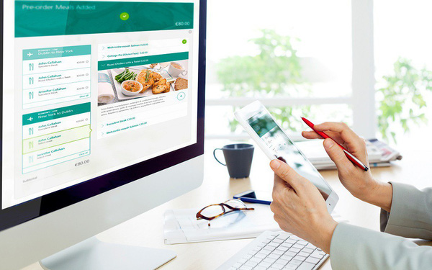
The purpose of the company's website design
-The purpose of web design to keep up with the trend The trend of searching for information to buy and sell online is increasing rapidly. Therefore, in order to catch up with this trend, companies and businesses need to build effective online marketing strategies. Therefore, website design is one of the fertile markets to help promote the business of companies and businesses.
-Purpose to support customers Website design will help customers update the latest product lines and services. At the same time, the website will help convey information from the producer to the consumer without facing any barriers. Besides, this is also a very low-cost marketing method that still brings high work efficiency. Because this is an indispensable option, the website certainly meets the basic needs of the business.

Slide 6

The goal of building the company's website
Increase customer reach
Increase customer reach
Increase interactivity
Effective business promotion
Efficient customer service
Platform for product sales
Branding
Identify potential customers
Easy to recruit
Increase competitiveness
Update information quickly
Easily get feedback from customers
Product analysis

Slide 7
General policies and regulations
Website design service process (website design on request):
+ Step 1: Receive customer requirements: color, layout, function, content of the website.
+ Step 2: Survey, evaluate website and design quotation, hosting price and domain name - schedule an appointment to discuss with customers.
+ Step 3: Build a sample website demo for customers to see – customers deposit 50% of the website value in advance. ( 1-3 days )
+ Step 4: After designing the demo, we receive more requests from the customer, add detailed content and functions (complete 90% - 95% of the website) - receive 100% of the web money (3 - 5 days )
+ Step 5: Hand over the website to the customer's domain name, proceed to guide the customer on how to manage the website (add content, upload products and how to edit website content).
+ Step 6: Website warranty period – if the customer maintains the website every year at website design in Hue, we will provide a permanent technical warranty and support customer use, if the customer has additional functional requirements Depending on the difficulty required, it may be free or additional 1 support cost.

Slide 8

+ Payment via Vietcombank
+ Lifetime website warranty support after handing over (if customers still maintain the website at thietkewebtaihue.com)
+ Customers are not allowed to arbitrarily change the intensive javascript or php programming structure in the website.
+ Transfer website code via Google Driver or Upload directly to your Hosting.
+ Website design only builds websites, creates articles and demo products to help customers, if you upload all the content, you will be charged.
+ Start doing step 4 we will receive 100% of the website design fee (including design fee + domain name fee + Hosting fee)

Slide 9
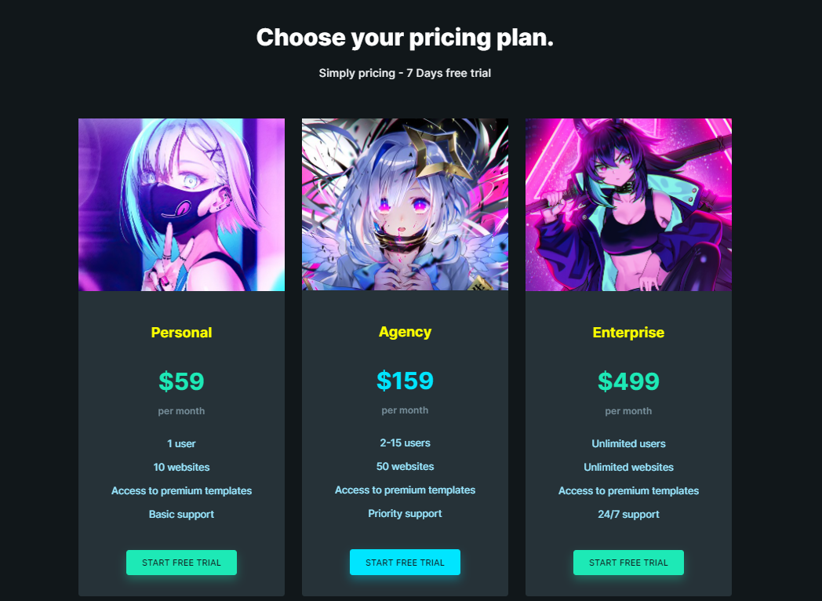
Service when designing

