Slide 1

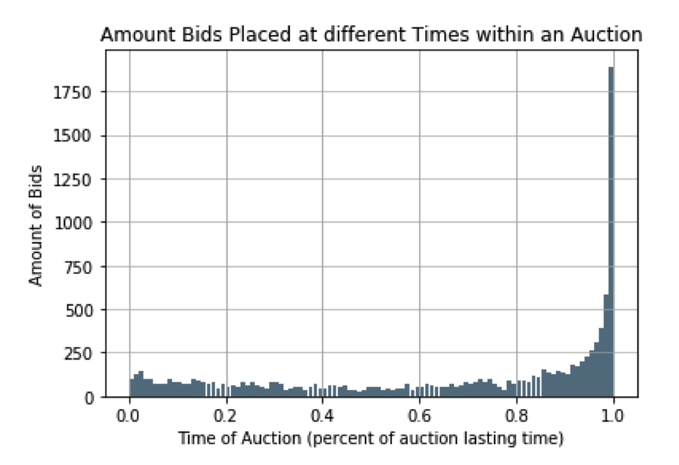
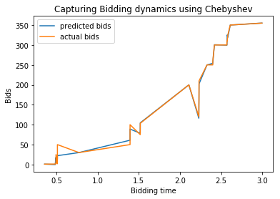
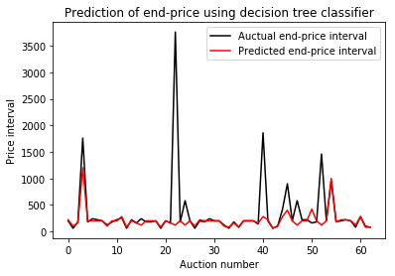
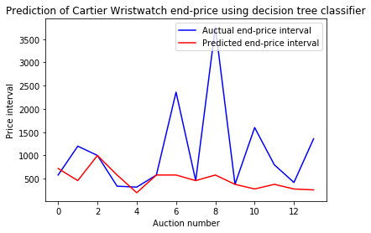
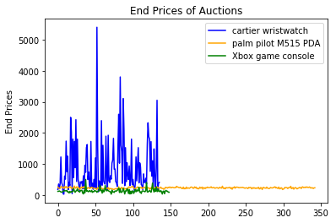
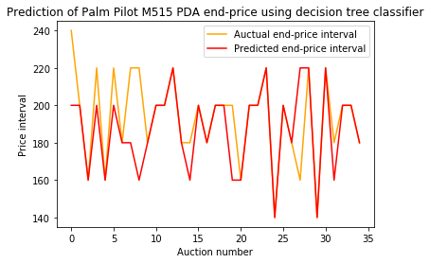
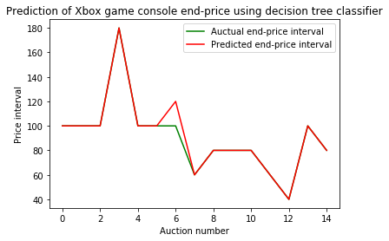
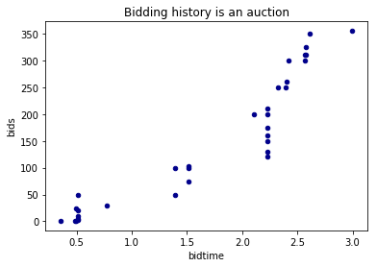
Does dynamics in an auction matter in predicting the end-price?
Boyang Qu
University of Chicago, Social Science Division
Introduction
Data
Methods
Results
The eBay dataset employed contains 628 auctions ended between December 2012 and January 2013, including 136 auctions of Cartier wristwatch (Cartier), 343 auctions of palm pilot M515 PDA (PDA), and 149 auctions of Xbox game console (Xbox).
Figure 1(a) shows the end-price of auctions for items within each of the three categories, and figure 1(b) shows the bidding history in a PDA auction.
Online auctions has been widely studied today, and a wide variety of algorithms have been proposed to predict the end-price. However, most past research treats data from online auctions as cross-sectional and ignores the dynamics of an ongoing auction.
This study focuses on two dynamics of an ongoing auction: the dynamics of bidding in the current auction and of other auctions.
Dynamics in the current auction
Two groups of parameters are used to capture this dynamics.
Number of early and late bids (0.02 of total lasting time suggested by figure 2a).
Coefficients from 33-degree Chebyshev polynomial estimation on bidding history (figure 2b)
Dynamics of other auctions
Two parameters are used to capture this dynamics.
End-price of the last recently-ended auction of a same-category item.
Average end-price of ten recent auctions of similar items.
Multiclass Classification
Three classifiers are used to predict the end-price in $20 intervals (less than 10% of average price of Cartier, PDA, and Xbox items).
Decision tree classifier
Supporter vector machine classifier
K-nearest neighbors classifier
Table 1. Suggests that Decision Tree classifier is the best classifier for prediction for items of all categories.
Table 1. Classifier accuracy averages from 10-trials.
The end-price of items in categories with drastically oscillated price is hard to predict (figure 3).
Parameters representing the dynamics yield relatively accurate prediction, indicating the importance of dynamics in end-price prediction.
 | Decision tree | SVM | KNN
Overall | 0.27 | 0.12 | 0.10
Cartier | 0.43 | 0.10 | 0.15
PDA | 0.75 | 0.49 | 0.06
Xbox | 0.73 | 0.13 | 0.03
(a)
(b)
Figure 2. (a) Aggregated Bidding History. (b) Chebyshev estimation of a Cartier auction.
Research Question
(a)
The goal is to explore that does dynamics happening during an ongoing auctions play an important role in predicting the final price?
(b)
Figure 3. Actual price interval versus Predicted price interval.
Figure 1. (a) End prices of all auctions. (b) Bids arrived within one auction.

