Slide 1
TIC TAC TOE
Boyapally Praveen

Slide 2
AGENDA
Introduction​
Objective
Procedure
Conclusion
Output

Slide 3
Introduction
The Tic Tac Toe game is a game for two players, called "X" and "O", who take turns marking the spaces in a 3×3 grid. "X" is the user and "O" is the system which is done using "Random". The player who succeeded in placing three respective marks in a 3x3 grid is the winner. It is done using the "JAVA" programming language where we create a user interface using Java Swing Concept.

Slide 4
OBJECTIVE
Tic-Tac-Toe game is an easy game which is mostly played among children and it also helps them to improve their concentration. The objective of this tic-tac-toe game java project is to build a tic-tac-toe game so you can play it without wasting paper and improve your concentration.

Slide 5
PROCEDURE
Execute the program using command prompt.
Click any one of the 3x3 grid boxes then "X" will be marked on the grid.
System automatically counters the game by showing "O" on the box.
Play the game until all the boxes are over.
If "X" wins it shows Winner is "X". Else "O" wins it shows Winner is "O".
If no one wins then game is Draw.
Process repeats.

Slide 6
CONCLUSION
It is a simple game which is done by using java programming language and swing concept. It is a time pass flick.

Slide 7

OUTPUT

Slide 8
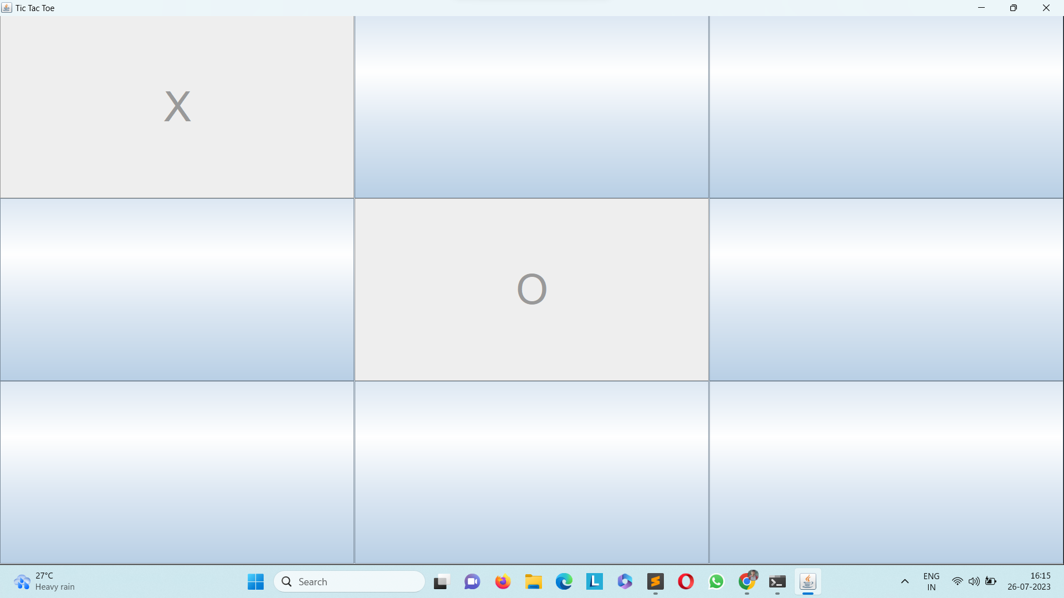
OUTPUT

Slide 9
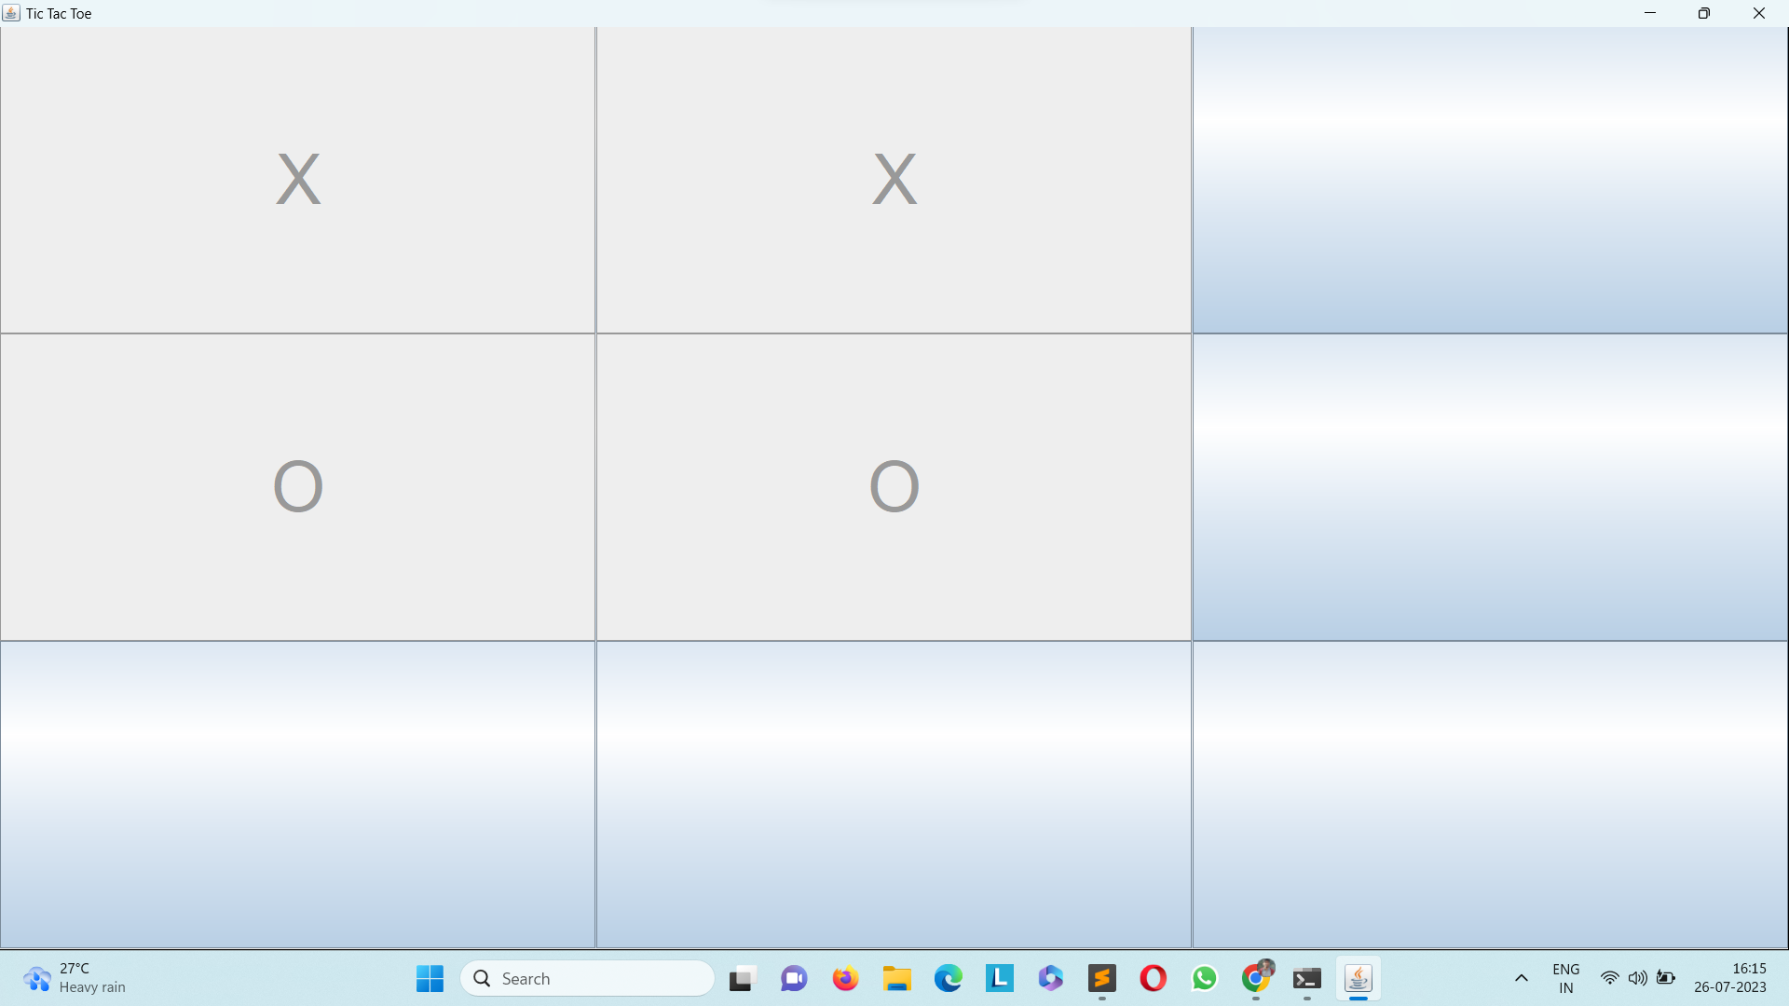
OUTPUT

Slide 10
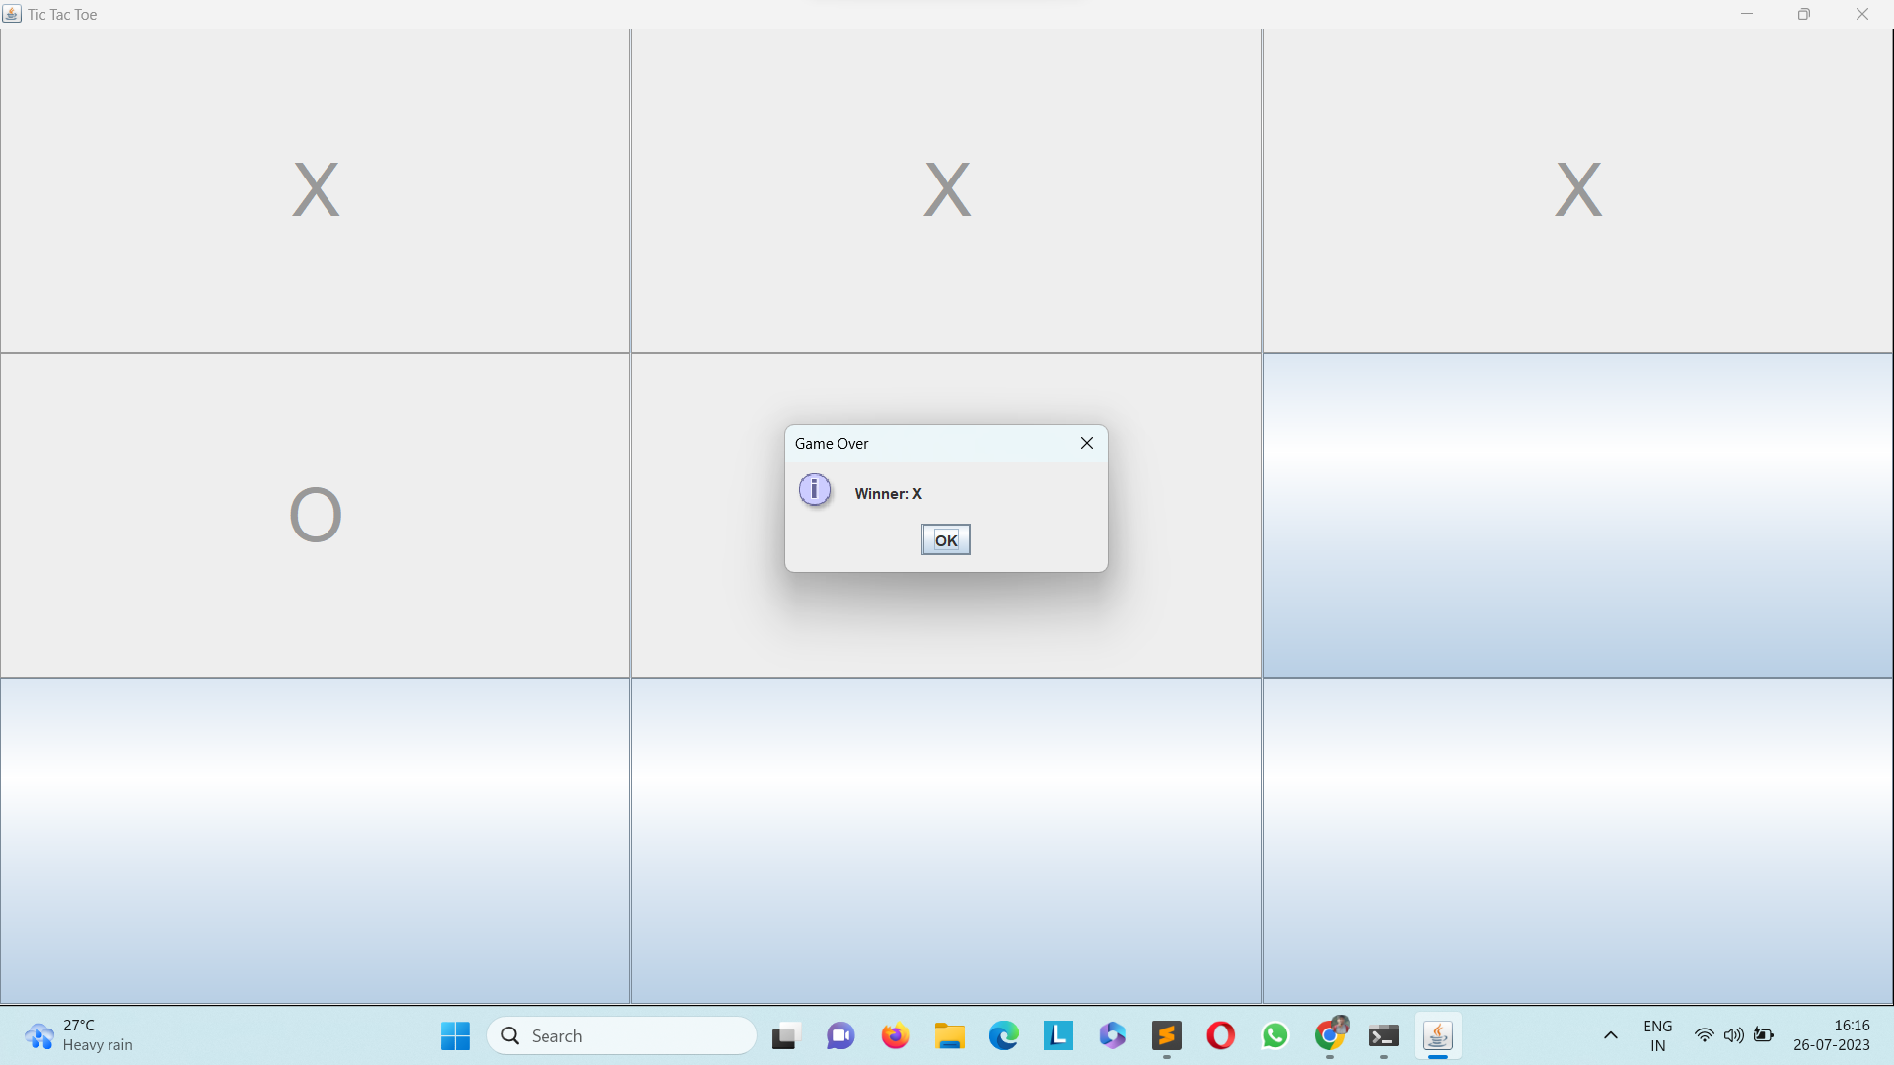
OUTPUT

Slide 11
THANK YOU
Boyapally Praveen
Boyapallypraveengoud5@gmail.com

