Slide 1

The Future of Interactive Technology: Integrating AI with Holograms
This paper explores the convergence of artificial intelligence (AI) and holographic technology, presenting a vision for a future where AI-powered holograms revolutionize human-computer interaction.

Slide 2
Convergence of AI and Holographic Technology
The fusion of AI and holography promises to create a paradigm shift in how we interact with technology. AI's ability to learn, adapt, and generate intelligent responses, combined with the immersive and interactive nature of holographic displays, paves the way for a new era of human-computer interaction.
Artificial Intelligence (AI)
Holographic Technology
AI algorithms power the intelligence behind holographic interactions, enabling personalized experiences, natural language processing, and advanced data analysis.
Holographic displays create three-dimensional, lifelike projections, providing an immersive and interactive experience that transcends traditional 2D interfaces.

Slide 3

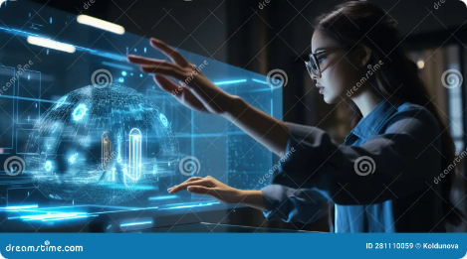
Revolutionizing Human-Computer Interaction
AI-powered holograms have the potential to revolutionize how we interact with technology, making it more intuitive, personalized, and engaging. By integrating AI capabilities with immersive holographic displays, we can create a seamless and natural user experience.
1
Intuitive Interaction
Personalized Experiences
3
Enhanced Accessibility
Holographic interfaces can be controlled with gestures, voice commands, and even eye tracking, providing a more natural and intuitive way to interact with technology.
AI algorithms can learn user preferences and tailor interactions to individual needs, providing a more personalized and engaging experience.
Holographic displays can provide alternative ways to access information, making technology more accessible to people with disabilities.

Slide 4

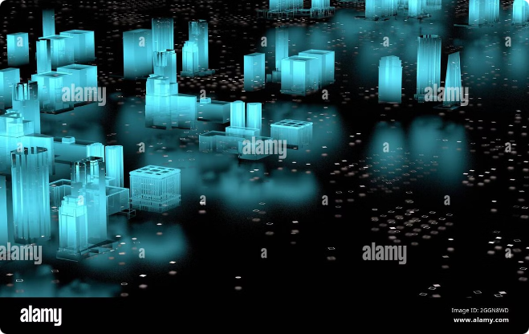
Immersive Holographic Displays
Holographic displays are capable of creating lifelike 3D projections, offering a more immersive and engaging visual experience compared to traditional 2D screens. These displays can be used to create interactive environments, virtual worlds, and realistic simulations.
1
3D Projection
Holographic displays use lasers or other light sources to project 3D images, creating the illusion of depth and realism.
2
Immersive Environments
Users can interact with holographic projections in a three-dimensional space, creating a more immersive and engaging experience.
3
Interactive Applications
Holographic displays enable users to manipulate virtual objects, navigate virtual spaces, and interact with data in a more intuitive way.

Slide 5

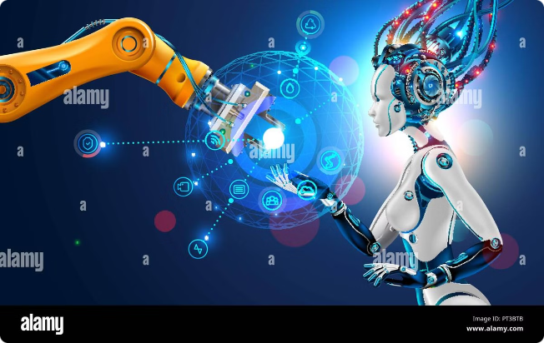
Advanced AI Capabilities
AI algorithms play a crucial role in enabling the intelligence and functionality of holographic systems. From natural language processing to advanced data analysis, AI empowers holographic interactions with a wide range of capabilities.
Natural Language Processing
Data Analysis and Learning
AI-powered holographic systems can understand and respond to natural language, allowing users to interact with technology in a more intuitive way.
AI algorithms can analyze data from user interactions and learn from previous experiences, adapting to individual preferences and providing personalized responses.
Contextual Awareness
AI can use sensor data to understand the user's environment and context, providing relevant and timely information.

Slide 6

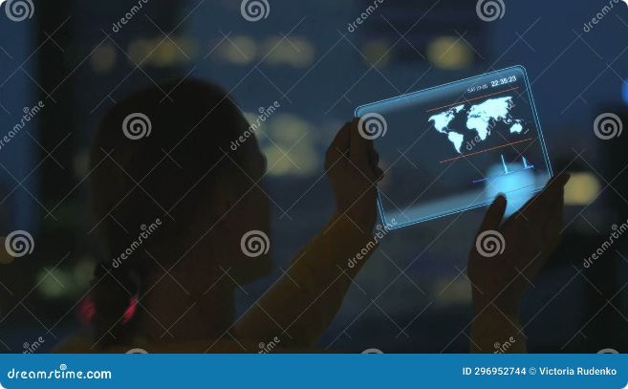



Intuitive and Personalized Interaction
The integration of AI with holographic technology enables a more intuitive and personalized user experience. AI algorithms can learn user preferences, adapt to individual needs, and provide context-aware responses.
Gesture Recognition
Holographic interfaces can be controlled with natural gestures, providing a more intuitive and engaging way to interact with technology.
Voice Recognition
AI-powered voice recognition allows users to control holographic systems with natural language commands.
Personalized Responses
AI algorithms can learn user preferences and tailor interactions to individual needs, providing a more personalized experience.

Slide 7

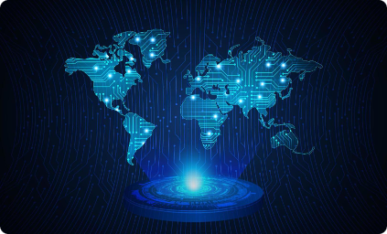




Transformative User Experience
AI-powered holograms have the potential to transform how we interact with technology, offering a more immersive, personalized, and engaging experience. This new paradigm of interaction can revolutionize industries from entertainment and education to healthcare and manufacturing.
Immersive Gaming
Interactive Education
Advanced Healthcare
Product Design and Development
Holographic displays can create more realistic and engaging gaming experiences, allowing players to interact with virtual worlds in a more immersive way.
Holographic technology can enhance education by providing interactive learning experiences, bringing history, science, and other subjects to life.
AI-powered holograms can assist in medical diagnosis, surgical planning, and patient education, improving healthcare outcomes.
Holographic displays can be used to create prototypes and test designs in a virtual environment, speeding up product development and reducing costs.

Slide 8

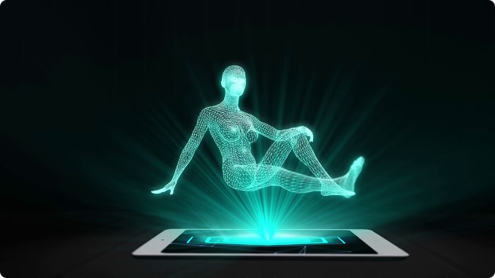
Envisioning the Future of AI-Powered Holograms
The future of AI-powered holograms is bright, with applications extending beyond our current imagination. As AI continues to evolve and holographic displays become more affordable and accessible, we can expect to see a wide range of innovations that will transform how we live, work, and interact with the world around us.
Industry
Application
Entertainment
Immersive concerts, interactive games, and virtual reality experiences.
Education
Interactive learning environments, simulations, and virtual field trips.
Healthcare
Medical diagnosis, surgical planning, and patient education.
Manufacturing
Product design, prototyping, and virtual assembly lines.

