Slide 1


Slide 2


Slide 3
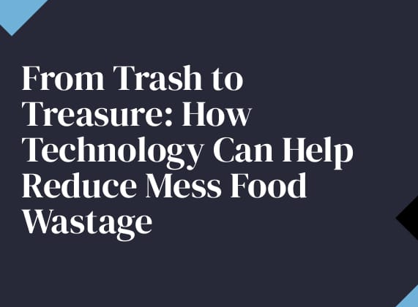

Slide 4
Objectives:
Reduce food waste
To check the expiry date
Reduce health problem
Method to reprocess the spoil food

Slide 5
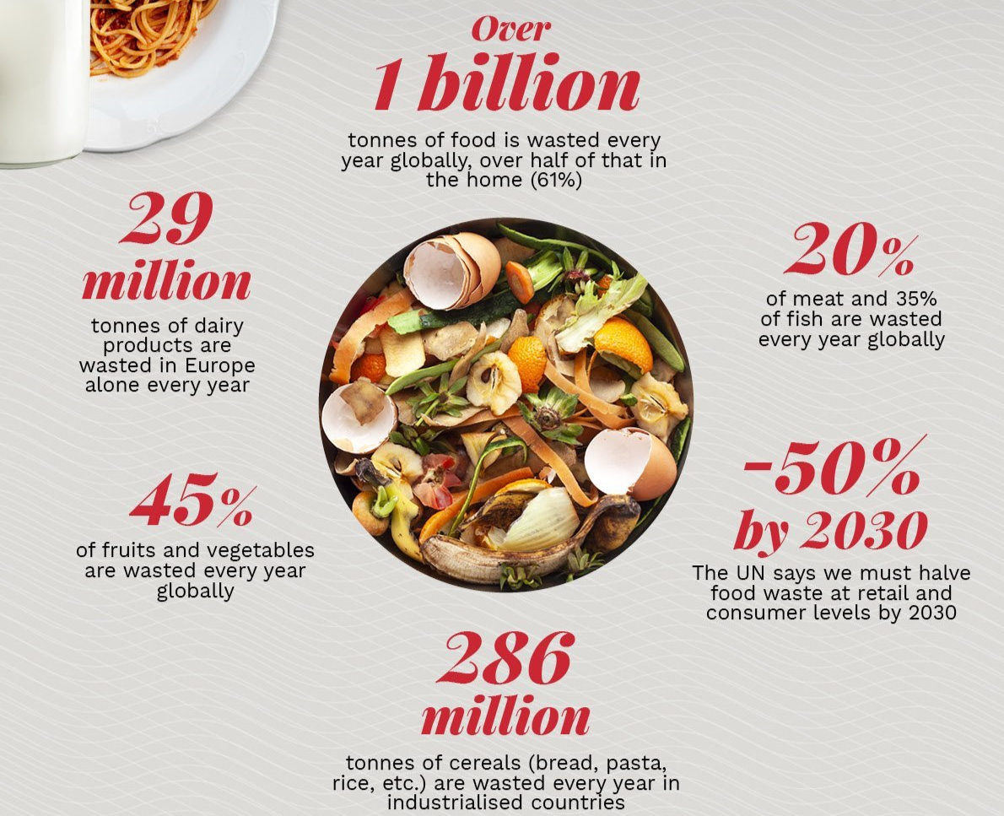

Slide 6
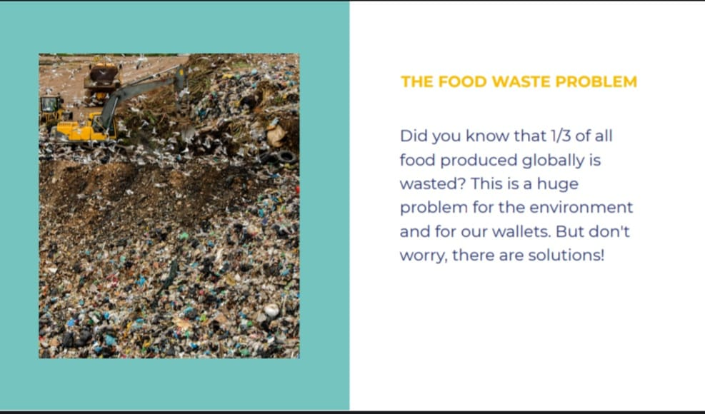

Slide 7
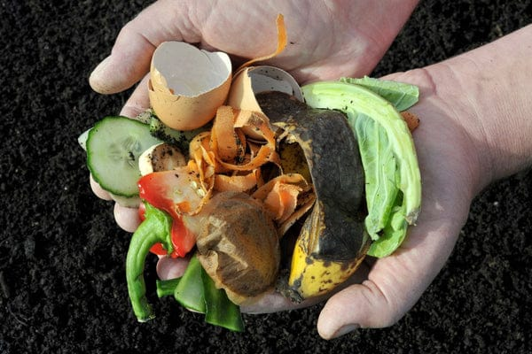
Disadvantages in the existing system:
Confusing labels
Wastage of food
Food pollution
Health issues

Slide 8
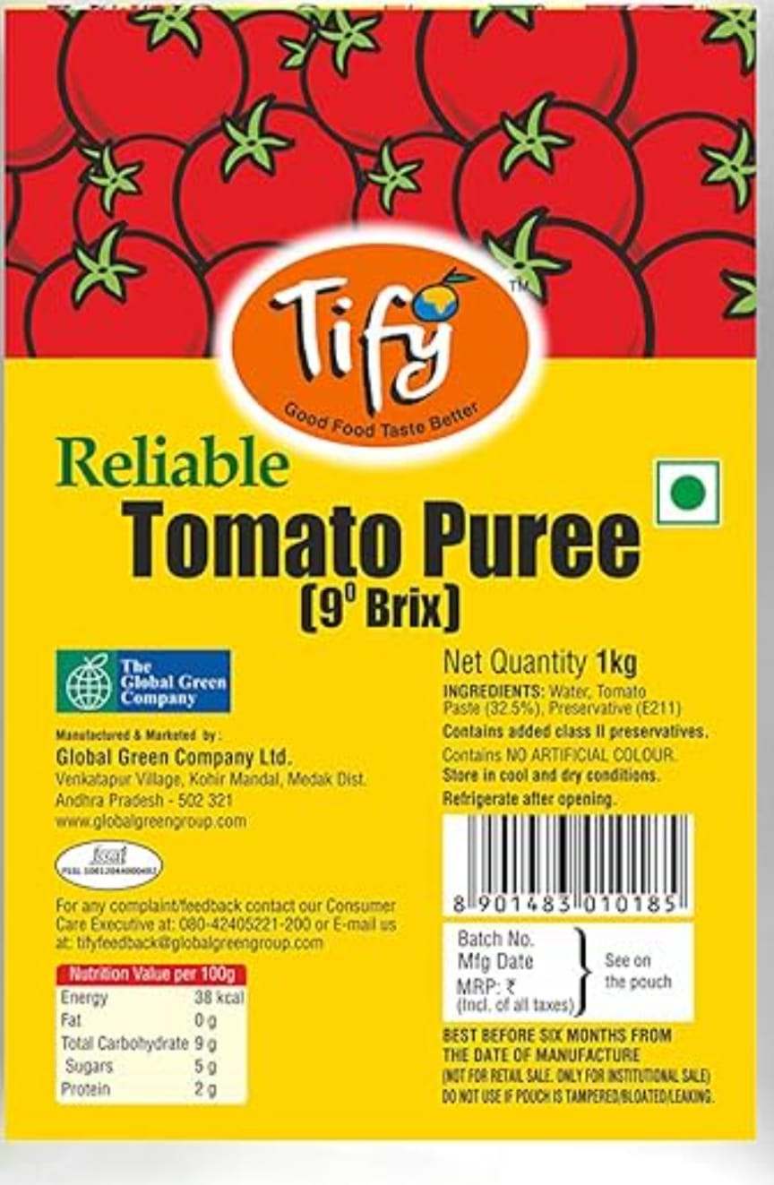
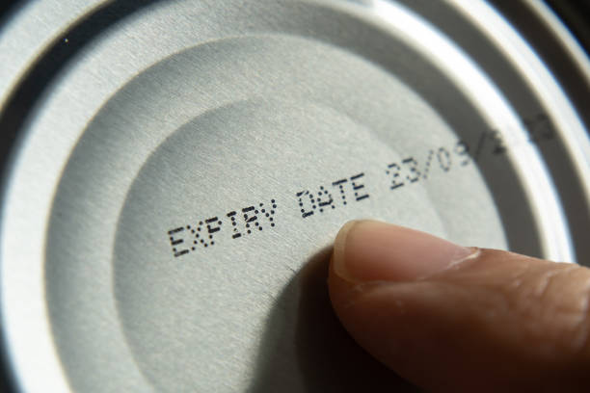
Sell-by, best-by, use-by, best-before dates – you’ve seen each of these labels at the grocery store, but what do they all mean? If I buy an item on the sell-by date, when does it actually “go bad?” And is something truly “spoiled” after the best-before date? These labels confuse customers and lead many of us to throw away food prematurely. In fact, date label confusion accounts for about 7% of all consumer waste

Slide 9
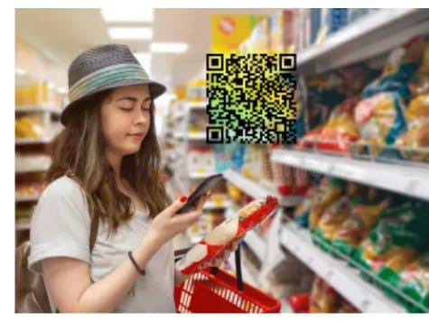
Checking expired date

Slide 10
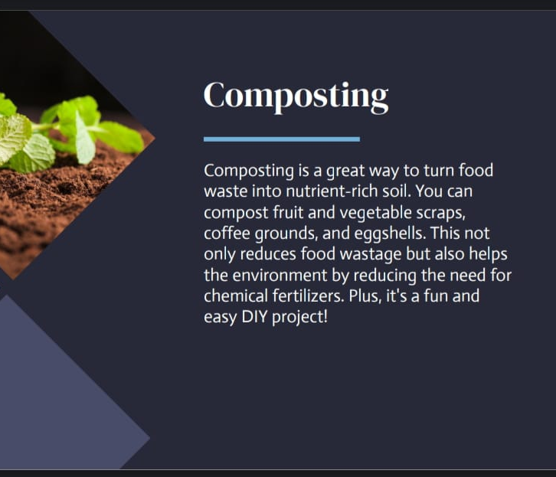
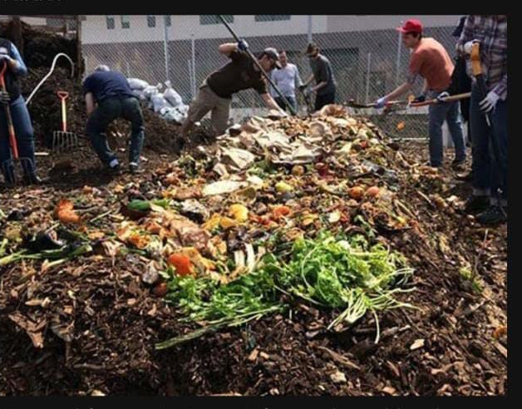

Slide 11
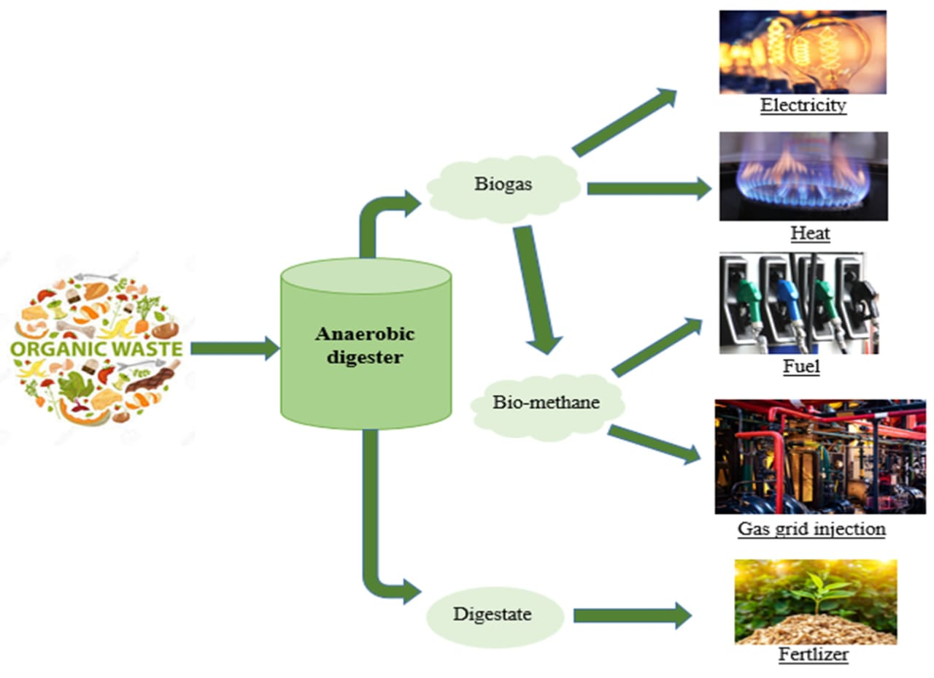
Preparation of bio gas

Slide 12
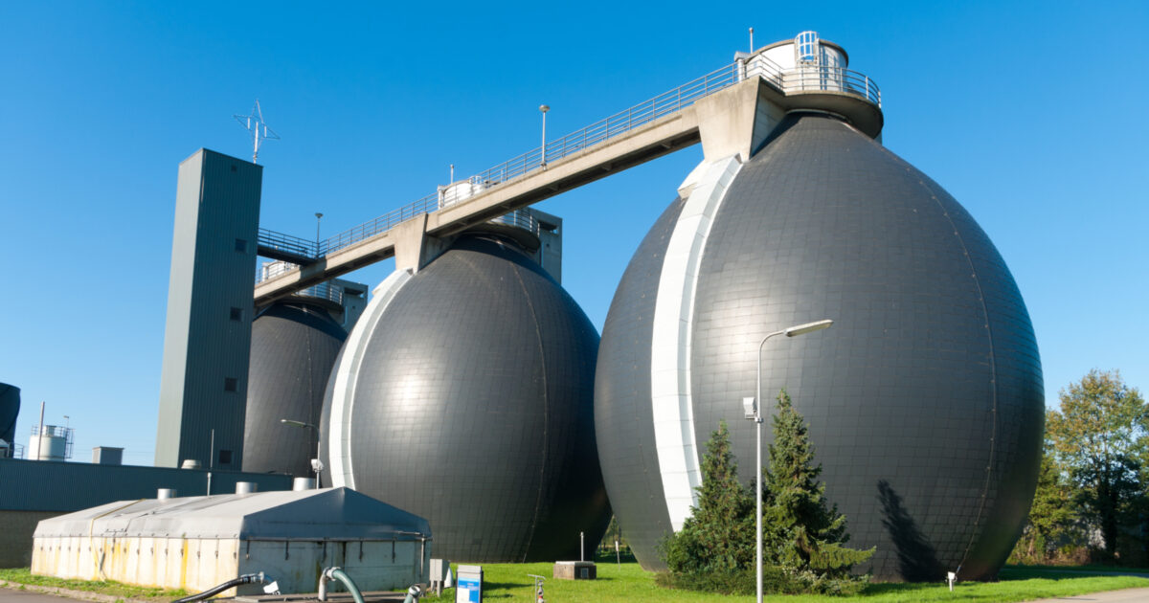
Bio gas

Slide 13
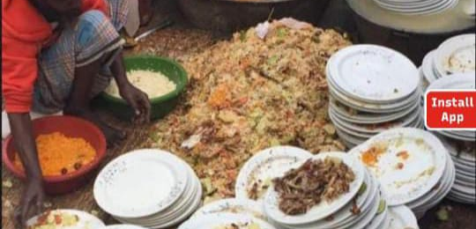

Food scheme
In marriages ,family functions so much food is wasted for that creating communities for food savage where the food is wasted then contact near community and they will take and supply to the any old age homes or child homes ... when the food is spoiled and they will take to bio gas production industries or compost that food .And also who waste the food unnecessarily for that create an app then any one people will send a photo by wasting the food that person will be punishable .

Slide 14
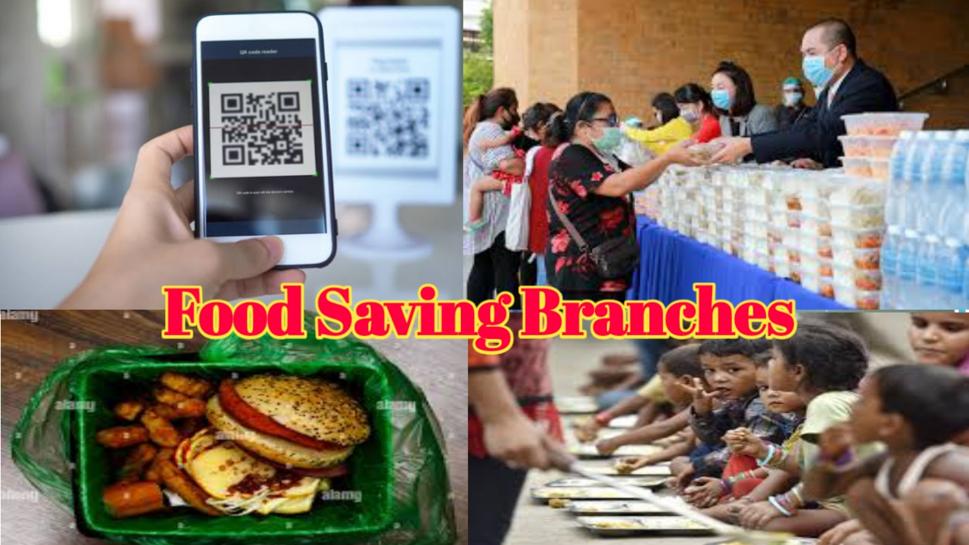

Slide 15
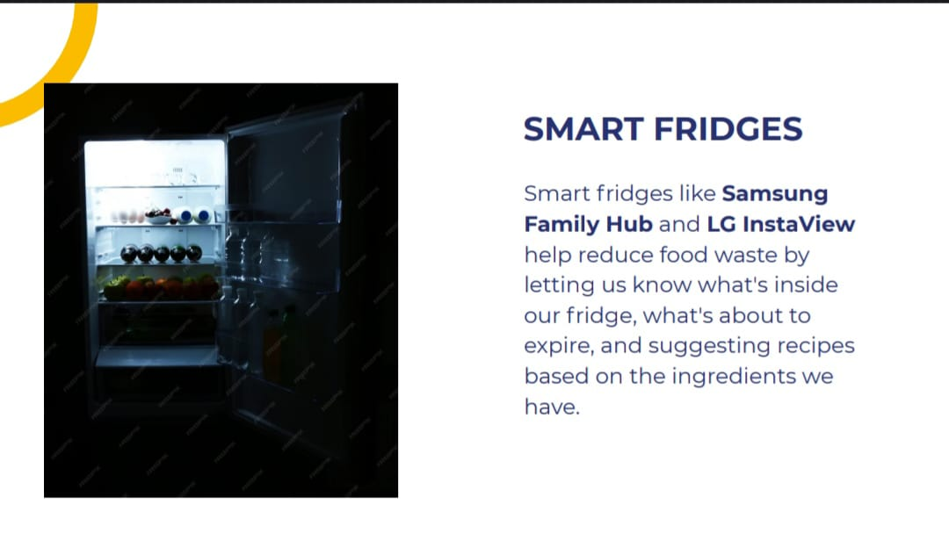
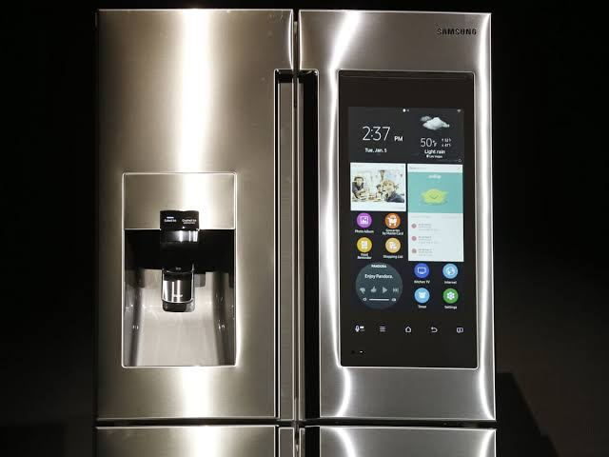

Slide 16
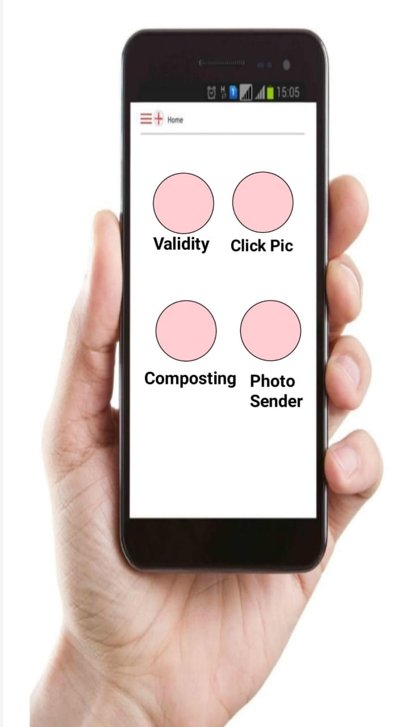

Slide 17
