Slide 1

Java 8 Hands on Workshop
FIRST Robotics Training
July 12, 2017
Jeanne Boyarsky
Twitter @jeanneboyarsky
Blog: http://www.selikoff.net

Slide 2
This PowerPoint is part of a hands on workshop for teaching fluency with Java 8 stream basics.
Disclaimer: Some of this material is copyright of Jeanne Boyarsky, Scott Selikoff and/or Wiley Publishing
Twitter: @jeanneboyarsky

Slide 3
Pre-req:
Basic Java knowledge is required. If you can implement this method using a loop, you are good:
public int countStringsThatAreFourChars(
List<String> list) {
}
Twitter: @jeanneboyarsky

Slide 4
Groovy vs Java
print(
list
.grep{ j -> j.disabled }
.collect { j-> j.name }
)
list.stream()
.filter(j -> j.disabled)
.map(j -> j.name)
.forEach(
System.out::println);
Twitter: @jeanneboyarsky
Notes:
Key points
Quick preview of streams
Syntax and flow will come naturally by the end of the session
Note that Java and Groovy use similar but different syntax/method names (aka be careful if primarily a Groovy developer)
Not expected to understand the details/syntax
Appreciate that there isn’t a loop or if statement. Just the declarative statements.

Slide 5


TryYourIde.java
(5 mins)
Local IDE
or
https://www.compilejava.net
https://github.com/boyarsky/java-8-streams-by-puzzles
Run src/TryYourIde class
Prints Do stuff and Do more stuff
Twitter: @jeanneboyarsky
Notes:
Goal of this “slide” is to ensure all attendees are able to run a Java 8 program – either in their local IDE or online.
Online IDEs:
compilejava.net – easiest to use – make sure not to have package names
ideone.com – has ads, remove public keyword from class to work
https://commons.wikimedia.org/wiki/File:Interactive_icon.svg
Image from https://commons.wikimedia.org/wiki/File:Gnome-edit-paste.svg

Slide 6
Lambda vs Boilerplate
filter(new Predicate<Job>() {
public boolean test(Job j) {
return ! j.disabled;
}
})
filter(j -> ! j.disabled)
Twitter: @jeanneboyarsky

Slide 7
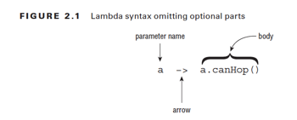
Basic Lambdas
Twitter: @jeanneboyarsky

Slide 8
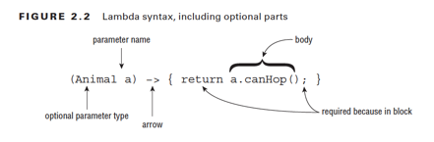
Full Lambda Syntax
Twitter: @jeanneboyarsky

Slide 9
Java 8 Lambda Syntax Rules
Must have parens unless exactly one parameter
If listing type, must be consistent
If multiple statements: requires braces, return and semicolon
() -> true
a -> a.startsWith("test")
(String a) -> a.startsWith("test")
(a, b) -> a.startsWith("test")
(String a, String b) -> { return a.startsWith("test"); }
Twitter: @jeanneboyarsky

Slide 10

What’s wrong?
a, b -> a.startsWith("test")
a -> { a.startsWith("test"); }
a -> { return a.startsWith("test") }
(String a, b) -> a.startsWith("test")
-> a.startsWith("test”)
Twitter: @jeanneboyarsky
Notes:
Answers:
Need parens since two parameters
Need return statement since braces
Need semi-colon since braces
Need type for neither or both params
Need parameter
https://goo.gl/images/5X5VL2

Slide 11
Using variables
interface Gorilla { String move(); }
class GorillaFamily {
String walk = "walk";
void everyonePlay(boolean baby) {
String approach = "amble";
//approach = "run";
play(() -> walk);
play(() -> baby ? "hitch a ride" : "run");
play(() -> approach);
}
void play(Gorilla g) {
g.move();
}
}
1) Instance var
2) Class var
3) Effectively final
method param
or local var
Twitter: @jeanneboyarsky

Slide 12
LambdaFillInTheBlanks.java
(10-15 mins)
Medium - Fill in the blank so
prints the number 1:
long count = Stream.of(
"IBM", "Oracle", "Pivotal")
.filter(___________________)
.count();
System.out.println(count);
Easy - Fill in the blank so prints out the numbers less than 3:
Stream.of(1, 2, 3, 5, 8)
.filter(__________)
.forEach(System.out::println);
Easy - Fill in the blank so prints out the
animals that are 4 characters is length:
Stream.of("cat", "dot", "fish", "rabbit")
.filter((p) -> { ___________ })
.forEach(System.out::println);
Challenge - How many ways can you write a lambda that takes one String parameter named “s” and returns the result of s.isEmpty()?
Twitter: @jeanneboyarsky
Notes:
Answers:
Easy: n -> n < 3
Easy: return p.length() == 4;
Medium: There are many correct answers such as n -> n.startsWith("I")
Challenge: I can think of 6 ways:
Predicate<String> p1 = s -> s.isEmpty();
Predicate<String> p2 = (s) -> s.isEmpty();
Predicate<String> p3 = (String s) -> s.isEmpty();
Predicate<String> p4 = s -> { return s.isEmpty(); };
Predicate<String> p5 = (s) -> { return s.isEmpty(); };
Predicate<String> p6 = (String s) -> { return s.isEmpty(); };

Slide 13


Predicate?
Twitter: @jeanneboyarsky

Slide 14
Find the Functional Interface(s)
interface Swimmer {
double getSwimSpeed();
}
interface Slower {
double getCrawlSpeed();
String toString();
default int getSlowestSpeed() { return 0; }
static int getFastestSpeed() { return 10; }
}
interface Faster extends Slower {
double getFasterSpeed();
}
Twitter: @jeanneboyarsky
Notes:
Key Points
Swimmer is a functional interface
Only one method and it is abstract
Slower is a functional interface
getCrawlSpeed() is abstract
toString() is not abstract because inherited from Object
getSlowestSpeed() and getFastestSpeed() are not abstract
Faster is not a functional interface
It has one abstract method declared but inherits another

Slide 15
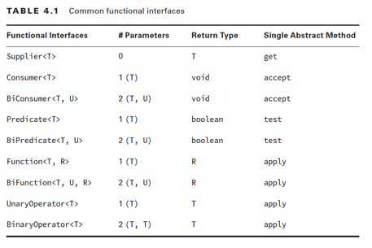
Common Functional Interface(s)
+ existing
interfaces
like
Comparable
Twitter: @jeanneboyarsky
Notes:
Key points
Don’t need to memorize this.
Note that the common combinations exist.
If writing code that uses streams, you don’t actually need to know the functional interface name. Compiler infers it.
Do need to know these methods if writing libraries

Slide 16
FunctionalInterfacesFillInTheBlanks.java
(10-15 mins)
Easy: Predicate<String> p = _________________;
Easy: Function<String, Integer> f = ________________;
Medium: Consumer<Double> c = ________________;
Hard: Supplier<Integer> s = _______________;
Challenge: How many ways can you fill in this blank?
_____________ ex = x -> "".equals(x.get(0));
Twitter: @jeanneboyarsky
Notes:
Many answers such as:
Easy: s -> s.isEmpty()
Easy: s -> s.length()
Medium: d -> System.out.println(d)
Hard: () -> new Random().nextInt() or () -> 1
Challenge: I can find three:
Predicate<List<String>>
Function<List<String>, Boolean>
Consumer<List<String>>

Slide 17
Method References
Infer lambdas for:
Static methods
Constructors
Instance methods on a particular instance
Instance methods on the lambda param
Twitter: @jeanneboyarsky

Slide 18
Static References
Consumer<List<Integer>> lambda =
l -> Collections.sort(l);
Consumer<List<Integer>> methodRef = Collections::sort;
Twitter: @jeanneboyarsky

Slide 19
Constructor References
Supplier<ArrayList> lambda =
() -> new ArrayList();
Supplier<ArrayList> methodRef = ArrayList::new;
Twitter: @jeanneboyarsky

Slide 20
Instance References
String str = "abc";
Predicate<String> lambda =
s -> str.startsWith(s);
Predicate<String> methodRef = str::startsWith;
Twitter: @jeanneboyarsky

Slide 21
Instance References 2
Predicate<String> lambda =
s -> s.isEmpty();
Predicate<String> methodRef = String::isEmpty;
Twitter: @jeanneboyarsky

Slide 22
MethodReferencesFillInTheBlanks.java
(10-15 mins)
Easy: Fill in the blank to print with a lambda and method reference.
Stream.of(“", "b", ”bc”).forEach(_________);
Hard: How many of these can you use a method reference to fill in the blank? (the string is empty, the string is not empty, the string ends with ‘c’)
Stream.of(“", "b", ”bc").filter(_________)
.forEach(System.out::println);
Twitter: @jeanneboyarsky
Notes:
Answers:
Easy: System.out::println and x -> System.out.println(x)
Hard: One
Stream.of("", "b", "bc").filter(String::isEmpty).forEach(System.out::println);
String is not empty requires a lambda (or you to write a static method) because it uses an operator
String ends with ‘c’ requires a lambda (or you to write a static method) because it uses a parameter

Slide 23

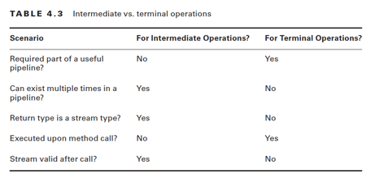
Parts of a Stream Pipeline
Twitter: @jeanneboyarsky
Notes:
Go over the three parts of a stream pipeline

Slide 24
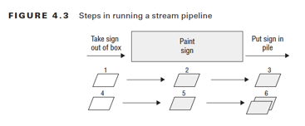

Example of a Stream Pipeline
Twitter: @jeanneboyarsky
Notes:
Walk through the factory example

Slide 25
Comparing code
List<String> filtered = new ArrayList<>();
for (String name : list) {
if (name.length() == 4)
filtered.add(name);
}
Collections.sort(filtered);
List<String> result = filtered.subList(0, 2);
for (String name : result)
System.out.println(name);
list.stream()
.filter(n -> n.length() == 4)
.sorted().limit(2)
.forEach(System.out::println);
Twitter: @jeanneboyarsky
Notes:
Compare loop to lambda code

Slide 26
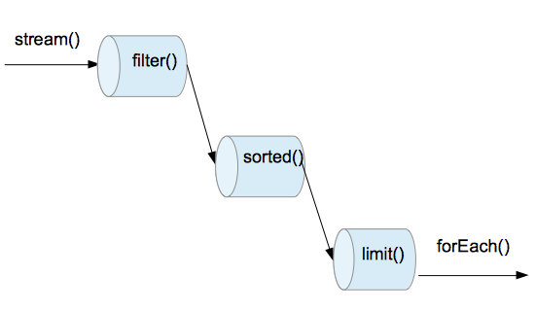
Example of a Chain
Twitter: @jeanneboyarsky
Notes:
Map the previous example to the three parts of a pipeline

Slide 27
What happens if missing?
If no source?
If no intermediate operations?
If no terminal operation?
Twitter: @jeanneboyarsky
Notes:
Answers:
If no source, can’t start
If not intermediate operations ok.
If no terminal operations, the stream isn’t run.

Slide 28
Creating a Finite Stream
Stream<String> empty = Stream.empty();
Stream<Integer> singleElement =
Stream.of(1);
Stream<Integer> fromArray =
Stream.of(1, 2, 3);
List<String> list =
Arrays.asList("a", "b", "c");
Stream<String> fromList = list.stream();
Twitter: @jeanneboyarsky

Slide 29
Creating an Infinite Stream
Stream<Double> randoms =
Stream.generate(Math::random);
Stream<Integer> oddNumbers =
Stream.iterate(1, n -> n + 2);
Twitter: @jeanneboyarsky

Slide 30
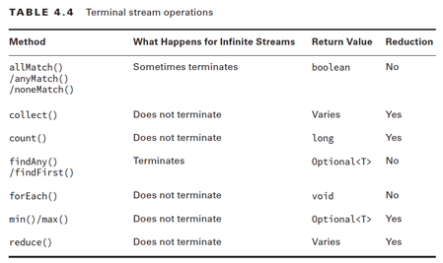
Terminal Operations
Twitter: @jeanneboyarsky

Slide 31
Puzzle – No Intermediate Operations
(10 mins)
Easy:
Using the puzzle 1 handouts, arrange so the code prints
true true 3
boolean b1 = ______.___________;
boolean b2 = ________.__________;
long l = ________.________;
System.out.println(b1 + " " + b2 + " " + l);
Twitter: @jeanneboyarsky
Notes:
Answer:
Using the puzzle 1 handouts, arrange so the code prints
true true 3
boolean b1 = Stream.empty().allMatch(p -> true);
boolean b2 = Stream.generate(String::new).anyMatch(p -> true);
long l = Stream.of(1,2,3).count();
System.out.println(b1 + " " + b2 + " " + l);

Slide 32
TranslateSearch.java
(5-10 mins)
Easy:
Translate this method to a one liner using
streams and lambdas:
private static boolean isZeroInList(
List<BigDecimal> list) {
for (BigDecimal decimal : list) {
if (decimal.equals(BigDecimal.ZERO))
return true;
}
return false;
}
Medium: Repeat using a method reference
instead of a lambda
Twitter: @jeanneboyarsky
Notes:
Answer:
return list.stream().anyMatch(b -> BigDecimal.ZERO.equals(b));
return list.stream().anyMatch(BigDecimal.ZERO::equals);

Slide 33
Intermediate Operations
filter(p -> p.isEmpty())
limit(3)
skip(2)
map(x -> x.size())
distinct()
sorted()
sorted((a,b) -> a.compareTo(b))
peek(x -> System.out.println(x))
Twitter: @jeanneboyarsky

Slide 34
Puzzle – Intermediate Operations
(10 mins)
Medium:
Using the puzzle 2 handouts, arrange so the
code prints: true false 3
UnaryOperator<Integer> op = x -> x + 1;
Predicate<Integer> pred = x -> x > 5;
boolean b1 = Stream.iterate(1, op). ______. ______;
boolean b2 = Stream.iterate(1, op)
. ______. ______. ______;
long l = Stream.generate(() -> 1). ______. ______;
System.out.println(b1 + " " + b2 + " " + l);
Twitter: @jeanneboyarsky
Notes:
Answer:
UnaryOperator<Integer> op = x -> x + 1;
Predicate<Integer> pred = x -> x > 5;
boolean b1 = Stream.iterate(1, op).skip(2).anyMatch(pred);
boolean b2 = Stream.iterate(1, op).limit(2).skip(1).allMatch(pred);
long l = Stream.generate(() -> 1).limit(3).count();
System.out.println(b1 + " " + b2 + " " + l);

Slide 35
CountMatches.java
(10-15 mins)
Easy:
Translate this method to a one liner using
streams and lambdas:
private static long numberMatches(List<String> list) {
long count = 0;
for (String string : list) {
if (string.contains("g"))
count++;
}
return count;
}
Challenge: Repeat using a method reference instead of a lambda
Twitter: @jeanneboyarsky
Notes:
Answer:
return list.stream().filter(s -> s.contains("g")).count();
With method references:
private static long numberMatches(List<String> list) {
return list.stream().filter(CountMatches::containsG).count();
}
private static boolean containsG(String string) {
return string.contains("g");
}

Slide 36
MoreLogic.java
(10 mins)
Medium:
Implement the method to print “walrus” using the logic described:
public static void main(String[] args) {
List<String> matchingList = Arrays.asList(
"calf", "dolphin", "manatee", "ocra", "walrus", "whale");
printMe(matchingList);
}
private static void printMe(List<String> list) {
// Print the third distinct element alphabetically
// that is over 4 characters long
}
Hard: Write “the old way”
Twitter: @jeanneboyarsky
Notes:
Answer
Medium:
list.stream().filter(s -> s.length() > 4)
.sorted()
.distinct()
.skip(2)
.limit(1)
.forEach(System.out::println);
Hard:
TreeSet<String> set = new TreeSet<>(list);
List<String> sortedList = new ArrayList<>();
for (String string : set) {
if (string.length() > 4) {
sortedList.add(string);
}
}
System.out.println(sortedList.get(2));

Slide 37
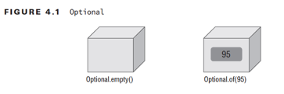
Optional
Twitter: @jeanneboyarsky

Slide 38
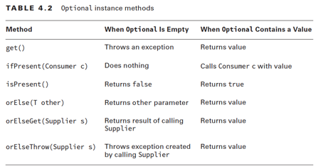
Optional APIs
Twitter: @jeanneboyarsky

Slide 39
Optional Terminal Operations
Twitter: @jeanneboyarsky

Slide 40
Puzzle – Optional
Hard:
Using the puzzle 3 handouts, arrange so the
code prints: 1 6 -1
Optional<Integer> o1 = Stream.generate(() -> 1)
. ______;
Optional<Integer> o2 = Stream.iterate(1, x -> x + 1)
. ______. ______. ______;
Optional<Integer> o3 = Stream.iterate(1, x -> x + 1)
. ______. ______. ______;
System.out.println(o1.orElse(-1) + " "
+ o2.orElse(-1) + " " + o3.orElse(-1));
Challenge: Why are there two correct answers?
Twitter: @jeanneboyarsky
Notes:
Answer:
Optional<Integer> o1 = Stream.generate(() -> 1).findAny();
Optional<Integer> o2 = Stream.iterate(1, x -> x + 1).map(x -> x * 2).limit(3).max((a, b) -> a -b);
Optional<Integer> o3 = Stream.iterate(1, x -> x + 1).limit(5).filter(x -> x > 8).findFirst();
Or
Optional<Integer> o1 = Stream.generate(() -> 1).findFirst();
Optional<Integer> o2 = Stream.iterate(1, x -> x + 1).map(x -> x * 2).limit(3).max((a, b) -> a -b);
Optional<Integer> o3 = Stream.iterate(1, x -> x + 1).limit(5).filter(x -> x > 8).findAny();
For the first line, findAny() or findFirst() give the same result because all the entries are 1. For the last line, either gives the same result because the stream is empty at that point.
System.out.println(o1.orElse(-1) + " " + o2.orElse(-1) + " " + o3.orElse(-1));

Slide 41
Collectors
collect(Collectors.toList())
collect(Collectors.toSet())
collect(Collectors.toMap(
keyFunction, valueFunction))
collect(Collectors.groupingBy(func))
collect(Collectors.partitioningBy(func))
collect(Collectors.joining())
collect(Collectors.joining(”, "))
Twitter: @jeanneboyarsky

Slide 42
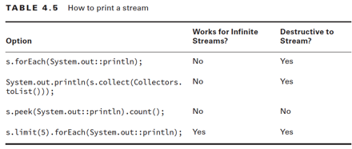
Printing a Stream
Twitter: @jeanneboyarsky

Slide 43
Squares.java
(5-10 mins)
Easy:
Translate this method to a one liner using
streams and lambdas:
private static List<String> convert(List<Integer> list) {
List<String> result = new ArrayList<>();
for (Integer number : list) {
if (number % 2 == 0)
result.add(number + "*" + number + "=" + (number * number));
}
return result;
}
Challenge: Can you figure out how to make the return type a LinkedList?
Twitter: @jeanneboyarsky
Notes:
Answer:
return list.stream()
.filter(n -> n%2 ==0)
.map(n -> n + "*" + n + "=" + (n*n))
.collect(Collectors.toList());
Challenge answer:
return list.stream()
.filter(n -> n%2 ==0)
.map(n -> n + "*" + n + "=" + (n*n))
.collect(Collectors.toCollection(LinkedList::new));

Slide 44
OddsAndEvens.java
(10 mins)
Medium:
Implement this method using streams and lambdas. (Remember % is the modulus operator).
public static void main(String[] args) {
System.out.println(split(Arrays.asList(1, 4, 8, 13)));
System.out.println(split(Arrays.asList(1, 3)));
}
private static
Map<Boolean,List<Integer>> split(List<Integer> list) {
// partition the list into odds and evens
}
Hard: Change partioningBy to groupingBy. What’s the difference?
Challenge: Implement this method without streams.
Twitter: @jeanneboyarsky
Notes:
Answer
Easy:
return list.stream().collect(Collectors.partitioningBy(x -> x % 2 == 0));
Hard:
Grouping by doesn’t include the key if there are no matches
Challenge:
Map<Boolean,List<Integer>> result = new HashMap<>();
result.put(Boolean.FALSE, new ArrayList<>());
result.put(Boolean.TRUE, new ArrayList<>());
for (Integer integer : list) {
boolean key = integer %2 == 0;
result.get(key).add(integer);
}
return result;

Slide 45
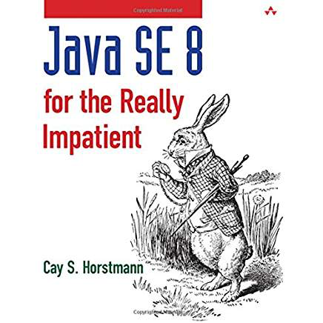
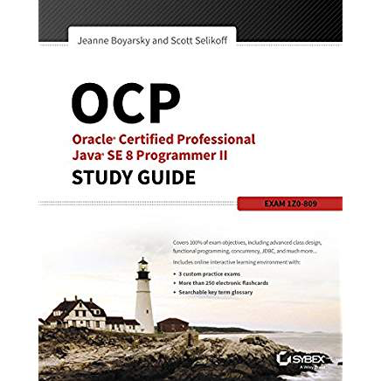
Next Steps to Learn
Primitive streams
Reduce()
Summary Statistics
Advanced collect()
Twitter: @jeanneboyarsky

Slide 46
Questions
?
Twitter: @jeanneboyarsky

