Slide 1


Chapter 2
Communicating
Over The Network

Slide 2
Note for Instructors
These presentations are the result of a collaboration among the instructors at St. Clair College in Windsor, Ontario.
Thanks must go out to Rick Graziani of Cabrillo College. His material and additional information was used as a reference in their creation.
If anyone finds any errors or omissions, please let me know at:
tdame@stclaircollege.ca.

Slide 3
Communicating Over the Network
The Platform for Communications

Slide 4
Elements of Communication
People communicate in many different ways.
Vocal, a look, a hand signal, body language…
All of the methods have three things in common.
There is source for the message or a sender.
There is a destination for the message or a receiver.
There is a channel that consists of the media that provides the pathway for the message.

Slide 5
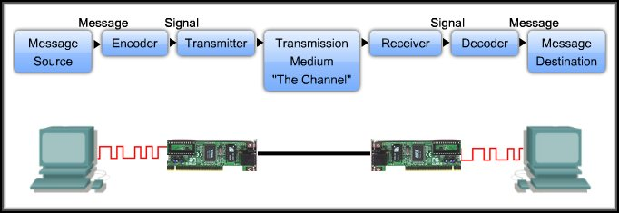
Elements of Communication
Devices communicate in exactly the same way.

Slide 6
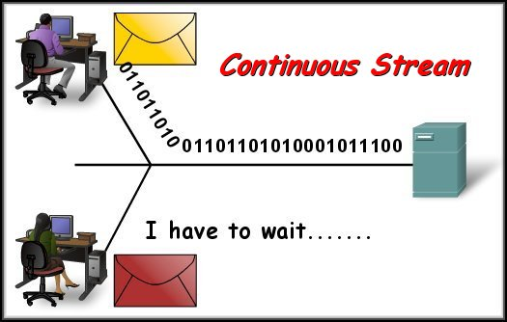
Communicating the Messages
In theory, a network communication could be sent as one continuous stream of 1’s and 0’s.
No other device would be able to send or receive messages on the same network.
Significant delays
Inefficient use of the channel
A lost message entirely retransmitted.

Slide 7
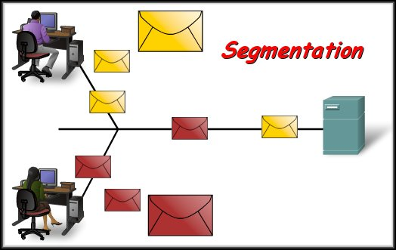
Communicating the Messages
A better approach is called Segmentation.
The data stream is divided into smaller, more manageable segments.
Segmentation has two benefits:
Multiplexing:
Different transmissions can be interleaved on the network.
Reliability

Slide 8
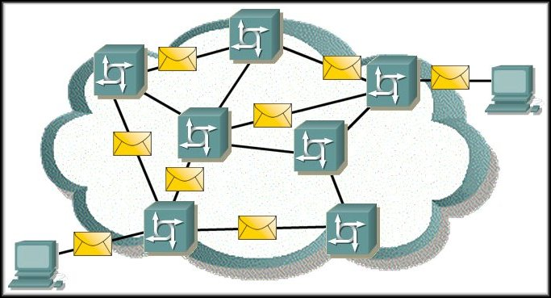
Communicating the Messages
In a packet switched network like the Internet.
Segmentation and Reliability:
Increases the reliability of network communications.
Separate pieces of each message can travel across different paths to destination.
Path fails or congested, alternate path can be used.
Part of the message fails to make it to the destination, only the missing parts need to be retransmitted.

Slide 9
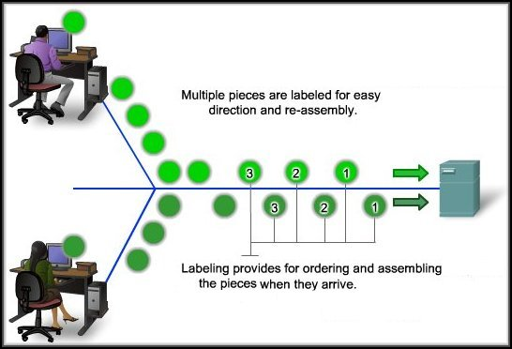
Communicating the Messages
Segmentation Disadvantage: Added level of complexity.
The label is a unique sequence number.
Handled by protocols that format and address the message.

Slide 10
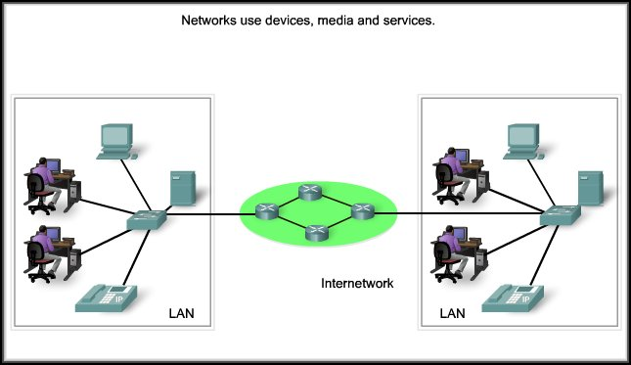
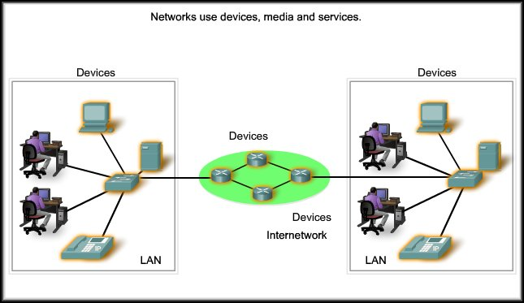

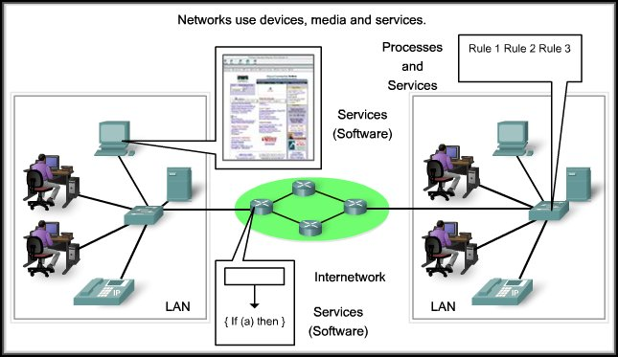
Components of the Network

Slide 11
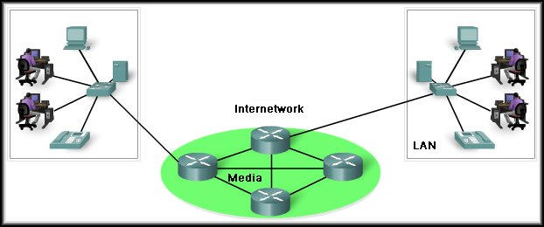
End Devices
Work Stations, Servers, Laptops, Printers, VoIP Phones, Security Cameras, PDAs......
Any device that allows us to interface with the network.
End devices are referred to as hosts and are either the source or destination of a message.

Slide 12
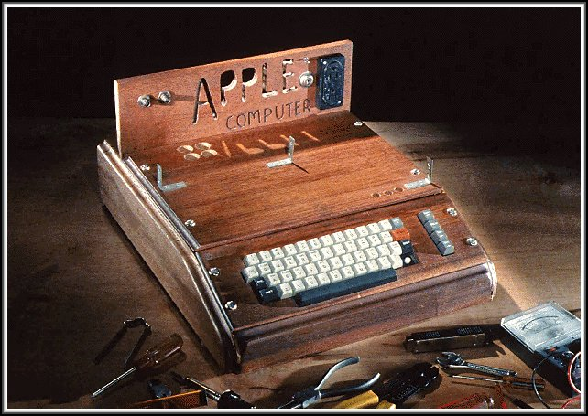
End Devices
Servers
End Devices:
A host can be a client, a server or both.
The software installed on the device determines its role.
Servers:
Software that enables them to provide information and services (E-mail, Web Pages) to other hosts on the network.
Client:
Software installed that enables them to request and display the information obtained from the server.
Clients

Slide 13
Intermediary Devices
Routers, Switches, Hubs, Wireless Access Points, Communication Servers, Security Devices.
Any device that provides connectivity to the network, connectivity to other networks or links between network segments.

Slide 14






Intermediary Devices
Manage data as it flows through the network.
Some use the destination host address and network interconnection information to find the best path through the network.
Routers
Switches
Firewalls
Access Points
Hubs
Multiplexers

Slide 15
Intermediary Devices
Regenerate and retransmit data signals.
Maintain information about what pathways exist through the network and internetwork.
Notify other devices of errors and communication failures.
Direct data along alternate pathways when there is a link failure.
Classify and direct messages according to QoS priorities.
Permit or deny the flow of data, based on security settings.

Slide 16
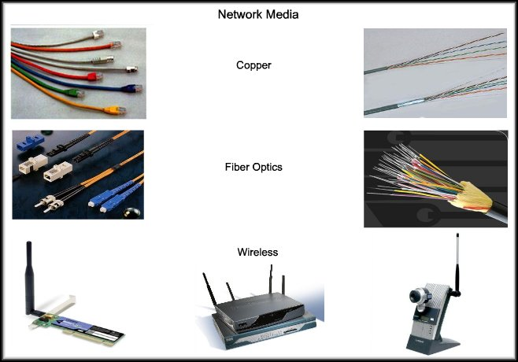
Media
The medium provides the channel over which the messages travel from source to destination.
Metallic wires within cables
Glass or plastic fibers
Wireless Transmission

Slide 17
Media
The signal encoding that must occur is different for each type of media.
Electrical impulses with specific patterns
Pulses of light in the infrared or visible ranges
Patterns of electromagnetic waves

Slide 18
Media
Different network media have different features and benefits.
Not all network media are appropriate for the same purpose.
You must make the appropriate choice to provide the proper channel.
Distance it can carry the signal
Environment
Bandwidth
Cost of the media
Installation costs
Cost of connectors and devices

Slide 19
Communicating Over the Network
LANs, WANs and Internetworks

Slide 20
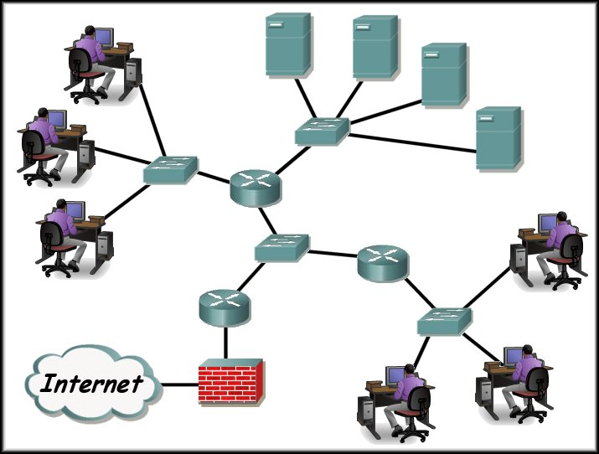
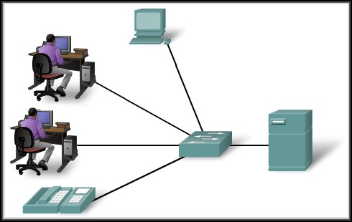
Local Area Networks
An individual network usually spans a single geographical area, providing services and applications to people within a common organizational structure, such as a single business, campus or region.

Slide 21
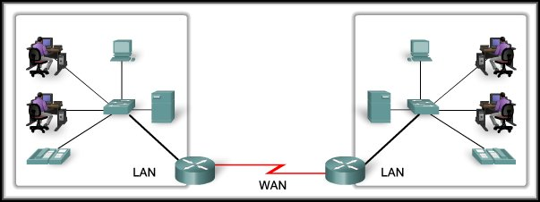
Wide Area Networks
Networks that connect LANs in geographically separated locations. Usually implemented with leased connections through a telecommunications service provider (TSP) network.
A TSP traditionally transports voice and data on different networks. Now, providers are offering converged network services.
HDLC, PPP, T1, DS3, OC3, ISDN, Frame Relay

Slide 22
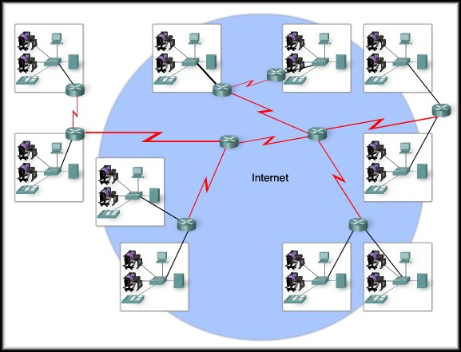
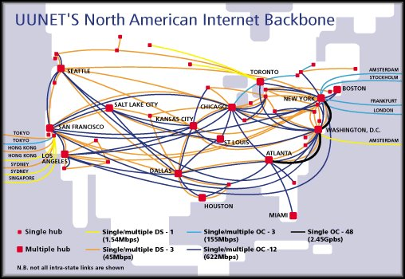
The Internet : A Network of Networks
Internet Service Providers (ISPs) connect their customers to the Internet through their network infrastructure.
The Internet, then, is a collection of ISPs co-operating with each other to form one large converged internetwork.

Slide 23
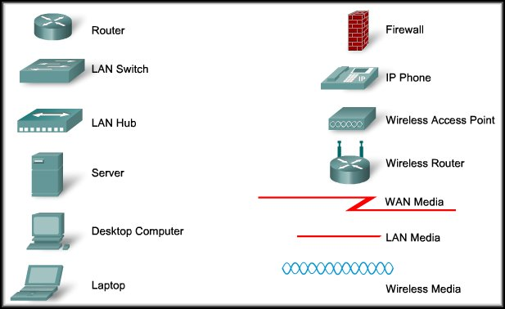
Network Representations
Specialized terminology is used to describe how these devices and media connect to one another.

Slide 24
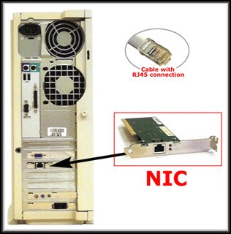
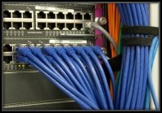
Network Representations
Network Interface Card (NIC):
Provides the physical connection to the network at the PC or other host device.
Physical Port:
A connector or outlet on a networking device where the media is connected to a host or other networking device.

Slide 25
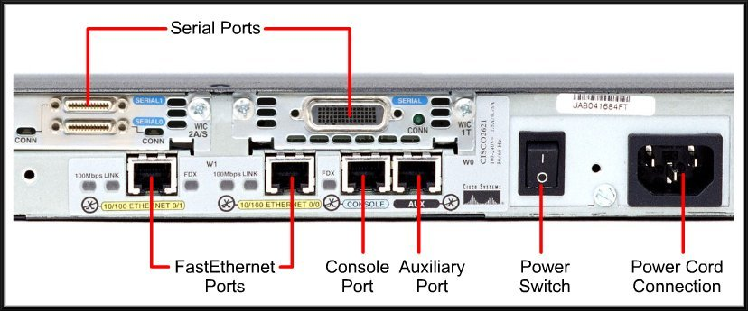
Network Representations
Interface:
Specialized ports on an internetworking device that connect to individual networks.
Because routers are used to interconnect networks, the ports on a router are referred to as network interfaces.

Slide 26
Communicating Over the Network
Protocols

Slide 27
Rules That Govern Communications
Protocols:
Are the rules that govern communications.
The format or structure of the message.
The method by which networking devices share information about pathways with other networks.
How and when error and system messages are passed between devices.
The setup and termination of data transfer sessions.

Slide 28
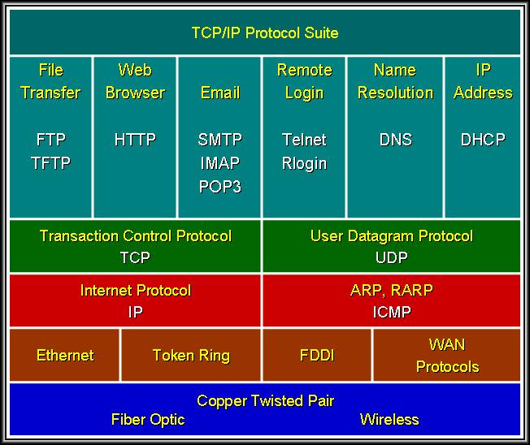
Protocol Suites
Protocol Suite:
A group of inter-related protocols that are necessary to perform a communication function.
Cannot function without a set of standards that network vendors can follow.
Institute of Electrical and Electronics Engineers (IEEE):
Develops standards in telecommunications, information technology and power generation.
Examples: 802.3 (Ethernet), 802.11 (WLAN)
Internet Engineering Task Force (IETF)
Internet standards, RFCs (Request for Comments)
Example: TCP, IP, HTTP, FTP

Slide 29
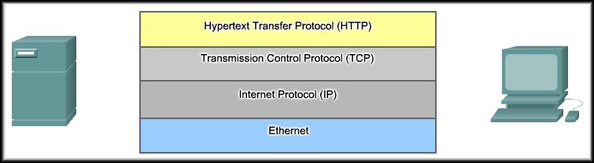
Interaction of Protocols
Each protocol at each layer of the protocol suite work together to make sure messages are received and understood by both devices.

Slide 30
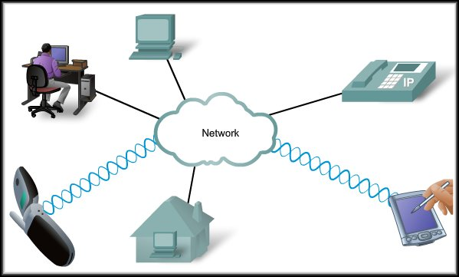
Technology Independent Protocols
Protocols are not dependent upon any specific technology.
They describe what must be done to communicate but not how its is to be carried out.

Slide 31
Communicating Over the Network
Using Layered Models

Slide 32
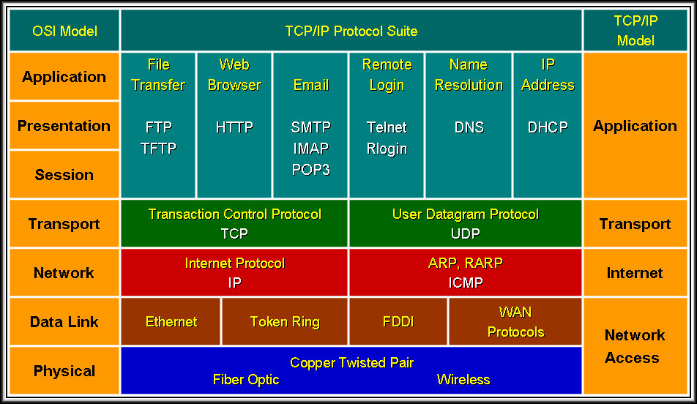
Layered Models
Layered models separate the functions of specific protocols.

Slide 33
Benefits of a Layered Model
Benefits of a Layered Model:
Have defined information that they act upon and a defined interface to the layers above and below.
Fosters competition because products from different vendors can work together.
Prevents technology or capability changes in one layer from affecting other layers above and below.
Provides a common language to describe networking functions and capabilities.

Slide 34
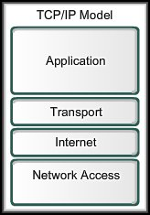
Protocol and Reference Models
Protocol Model:
Closely matches the structure of a particular protocol suite.
The set of related protocols in a suite typically represents all the functionality required to interface the human network with the data network.
The TCP/IP model is a protocol model because it describes the functions that occur at each layer of protocols only within the TCP/IP suite.

Slide 35
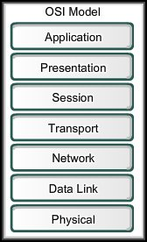
Protocol and Reference Models
Reference Model:
Provides a common reference for maintaining consistency within all types of network protocols and services.
Not intended to be an implementation specification.
Primary purpose is to aid in clearer understanding of the functions and process involved.

Slide 36
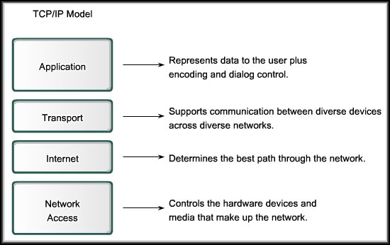
TCP/IP Model
Open Standard
No one company controls it.
Governed by IETF Working Groups
Standards proposed using Request for Comments (RFCs).

Slide 37
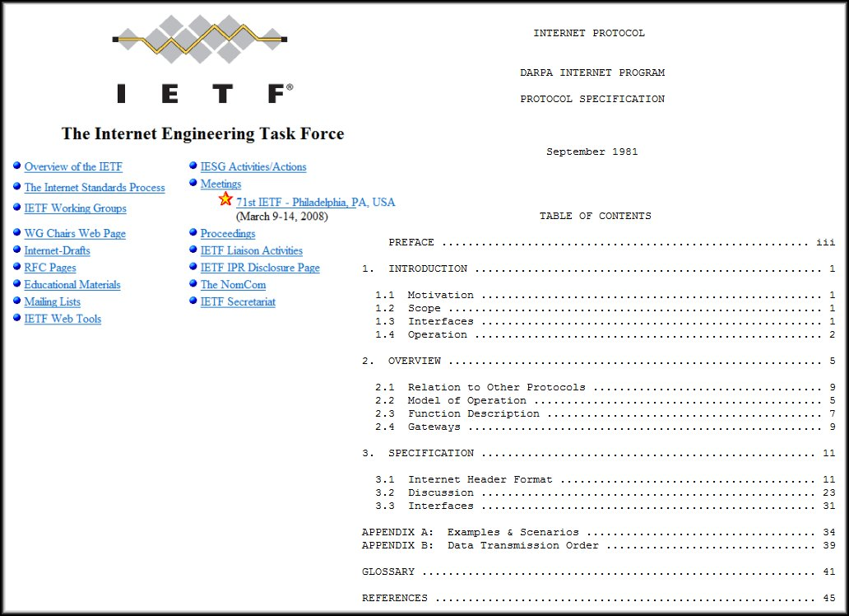
Request For Comments RFC

Slide 38
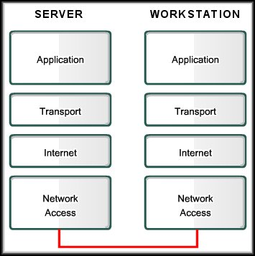
The Communication Process
Create Data
Pass data to application
Segment and Encapsulate
Decapsulate and Reassemble
Generate on to the media
Receive from the media
Transport through the segment

Slide 39
Protocol Data Units and Encapsulation
Segmentation and Encapsulation
Email Message
Data
Data
Data
Header
Data
Header
Data
Header
Data
Trailer
0010100111011001010000011111010100010101

Slide 40
Protocol Data Units and Encapsulation
Decapsulation and Reassembly
Email Message
Data
Data
Data
Data
Header
Data
Header
Data
Header
Data
Trailer
0010100111011001010000011111010100010101

Slide 41
Protocol Data Units and Encapsulation
Protocol Data Units
Email Message
Data
Header
Data
Segment
Header
Data
Packet
Header
Data
Trailer
Frame

Slide 42
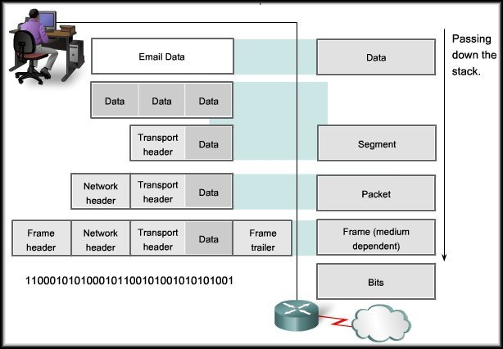
Protocol Data Units and Encapsulation
The Diagram on Page 51 in the text is incorrect.
This is the correct diagram.

Slide 43
Communicating Over the Network
The OSI Model

Slide 44
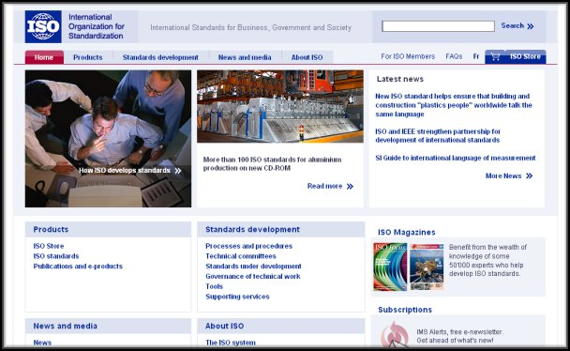
OSI Model
The International Organization for Standardization (ISO) released the Open Systems Interconnection (OSI) reference model in 1984.
www.iso.org for more information

Slide 45
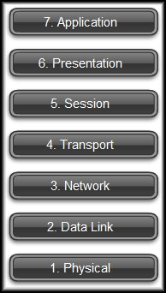
OSI Model
Breaks network communication into smaller, more manageable parts.
Makes learning it easier to understand.
Prevents changes in one layer from affecting other layers.
Standardizes network components to allow multiple vendor development and support.
Allows different types of network hardware and software to communicate with each other.
It is a descriptive scheme.

Slide 46
OSI Model - Example - FYI
Descriptive Scheme: Can be used to describe the functionality and interaction of different protocol suites.
Application
SNA
IBMNM
SMB
Presentation
NETBIOS
Session
IBM’s SNA
Transport
Network
RPL
Data Link
DLSW
SDLC
LLC
Physical
WAN
LAN

Slide 47
OSI Model – Example - FYI
Descriptive Scheme: Can be used to describe the functionality and interaction of different protocol suites.
Application
VTP
FTAM
X.400
X.500
ACSE
ROSE
RTSE
Presentation
ISO-PP
ISO
Session
ISO-SP
Transport
ISO-TP (TP0, TP1, TP2, TP3, TP4)
NETBIOS
Network
CLNP
ES-IS
IS-IS
IDRP
Data Link
LLC Layer Type 1 and 2 Protocols
Physical
LAN / Wan Physical Media

Slide 48
OSI Model – Example - FYI
Descriptive Scheme: Can be used to describe the functionality and interaction of different protocol suites.
Application
FTP, Telnet, SMTP, POP3, IMAP4, HTTP, X-Windows
SNMP, TFTP, BOOTP, DHCP
Presentation
Session
NETBIOS
DNS
TCP/IP
Transport
TCP
UDP
Network
ICMP RIP IGMP
IP
Data Link
ARP / RARP
LLC
Physical
LAN / Wan Physical Media

Slide 49
OSI Model
Usually referenced by layer number
Layers |  | CISCO | MICROSOFT
7 | Application | All | Away
6 | Presentation | People | Pizza
5 | Session | Seem | Sausage
4 | Transport | To | Throw
3 | Network | Need | Not
2 | Data Link | Data | Do
1 | Physical | Processing | Please
These two layers are not commonly referred to in most instances.

Slide 50
OSI Model
Layers |  | CISCO | MICROSOFT
7 | Application | All | Away
6 | Presentation | People | Pizza
5 | Session | Seem | Sausage
4 | Transport | To | Throw
3 | Network | Need | Not
2 | Data Link | Data | Do
1 | Physical | Processing | Please
Primary concern: Communications between applications
Primary concern: Moving raw data cross the network

Slide 51
Communicating Over the Network
Network Addressing

Slide 52
OSI Model
OSI Model Layer | Addressing
Application | Encoded Application Data (Usually referred to as the Upper Layers)
Presentation
Session
Transport | Source and Destination: Process Address
Network | Source and Destination: Logical Network Address
Data Link | Source and Destination: Device Physical Address
Physical | Timing and Synchronization Bits

Slide 53
Getting Data to the End Device
Encapsulation Process and Addressing
7.
6.
Email Message
Encoded Data
5.
4.
Header
Data
Process
3.
Header
Data
Logical
2.
Header
Data
Trailer
Physical
1.
Addressing always includes both the Source and Destination Addresses.

Slide 54
Getting Data to the End Device
Layer 2 Addressing
Delivery on a single local network.
Unique on the network and represents the device.
Codes placed on the NIC by the manufacturer.
Referred to as the physical address or the MAC address.
7.
6.
5.
4.
3.
Source and Destination Physical or MAC Address
2.
Header
Data
Trailer
1.

Slide 55
Getting Data to the End Device
Layer 2 Header
Destination MAC Address | Source MAC Address |  |  |  |  | Data

Slide 56
Getting Data Through The Network
Layer 3 Addressing
Move data from one local network to another local network.
Addresses must identify both the network and the host on that network.
Used by routers to determine the best path to the destination host.
7.
6.
5.
4.
3.
Header
Data
Source and Destination Logical Network Address (IP, IPX, etc.)
2.
1.

Slide 57
Getting Data Through the Network
Layer 2 Header
Destination MAC Address | Source MAC Address | Destination Logical Address | Source Logical Address |  |  | Data
Layer 3 Header

Slide 58
Getting Data to the Right Application
Layer 4 Addressing
Identifies the specific process or service running on the destination host that will act on the data.
Multiple, simultaneous applications.
7.
6.
5.
4.
Header
Data
Process
3.
Under TCP/IP, a port number to identify the application.
Port 80: HTTP (Web Browser)
Port 25: SMTP (Email)
Port 194: IRC (Internet Relay Chat)
2.
1.

Slide 59
Getting Data to the Right Application
Layer 2 Header
Layer 4 Header
Destination MAC Address | Source MAC Address | Destination Logical Address | Source Logical Address | Destination Process Address | Source Process Address | Data
Layer 3 Header

Slide 60

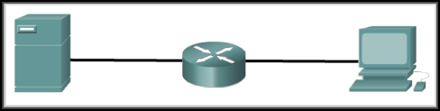
Putting It All Together
Port
Logical
MAC
MAC
Destination MAC Address | Source MAC Address | Destination Logical Address | Source Logical Address | Destination Process Address | Source Process Address | Data

Slide 61
Comparing the OSI and TCP/IP Models
OSI Model |  | Layer Function | Protocol Data Unit | Device | TCP/IP Model
7 | Application | User Functionality | Character |  | Application
6 | Presentation | Character Representation
5 | Session | Manage Data Exchange
4 | Transport | Services to segment, transfer and reassemble the data | Segment |  | Transport
3 | Network | Network addressing and best path determination | Packet | Router | Internet
2 | Data Link | Methods for reliable frame exchange over a common media | Frame | Switch | Network Access
1 | Physical | Describe physical characteristics to transmit bits over a common media | Bit | Hub

Slide 62

Brain a little fuzzy?
You need to learn to crawl before you can walk and walk before you can run.
We are starting with the theory and concepts and will move on to the actual design and implementation of networks.

