Slide 1


Chapter 5
Spanning Tree Protocol (STP) Part I

Slide 2
Note for Instructors
These presentations are the result of a collaboration among the instructors at St. Clair College in Windsor, Ontario.
Thanks must go out to Rick Graziani of Cabrillo College. His material and additional information was used as a reference in their creation.
If anyone finds any errors or omissions, please let me know at:
tdame@stclaircollege.ca.

Slide 3
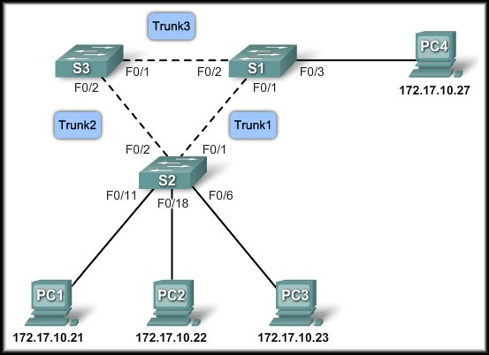
Spanning Tree Protocol (STP)
Redundant Layer 2 Topologies

Slide 4
Redundant Layer 2 Topologies
As businesses become increasingly dependent on the network, the availability of the network infrastructure becomes a critical business concern.
Redundancy is the solution for achieving the necessary availability.
Layer 2 redundancy improves the availability of the network by implementing alternate network paths by adding equipment and cabling.
Having multiple paths for data to traverse the network allows for a single path to be disrupted without impacting the connectivity of devices on the network.

Slide 5

Redundancy

Slide 6
Redundancy
Redundant paths create loops in the network.
How are they controlled?
Spanning Tree Protocol

Slide 7
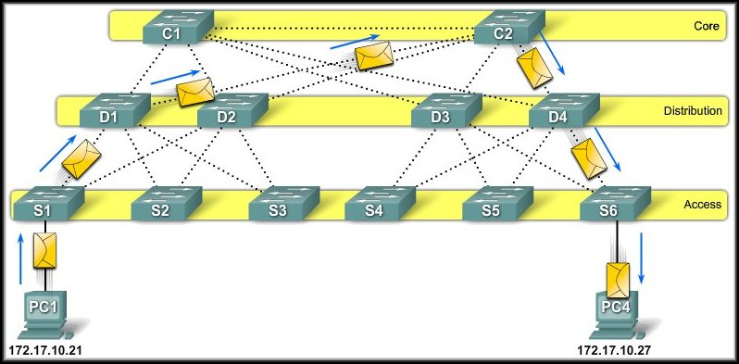
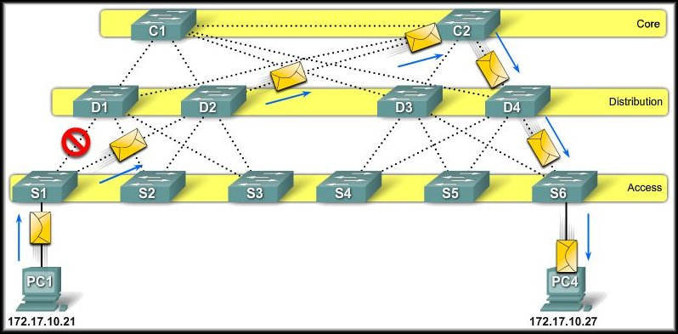
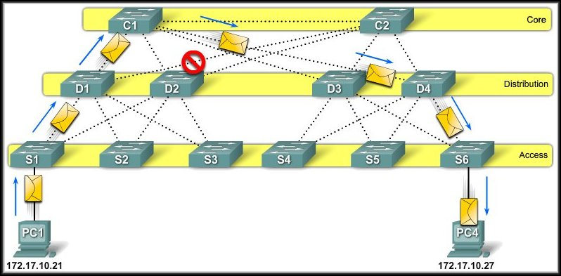
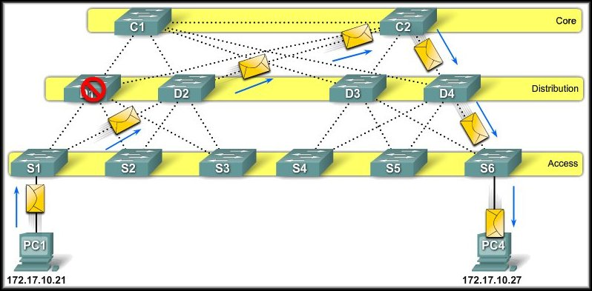
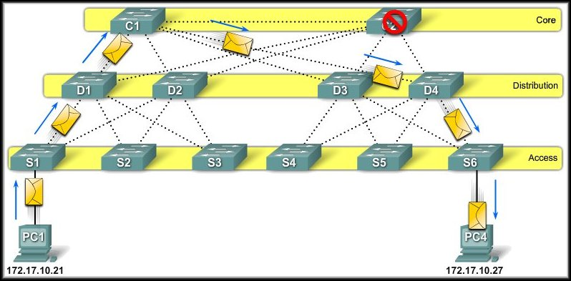
Redundancy
The Spanning Tree Protocol (STP) is enabled on all switches.
STP has placed some switch ports in forwarding state and other switch ports in blocking state.
Forward
Blocked

Slide 8
Issues with Redundancy
Redundancy is an important part of the hierarchical design.
When multiple paths exist between two devices on the network and STP has been disabled on those switches, a Layer 2 loop can occur.
If STP is enabled on these switches, which is the default, a Layer 2 loop would not occur.

Slide 9
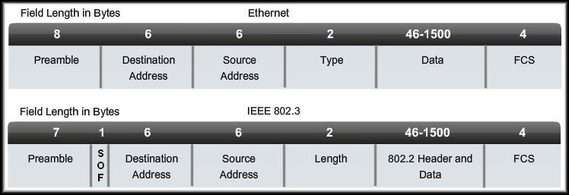
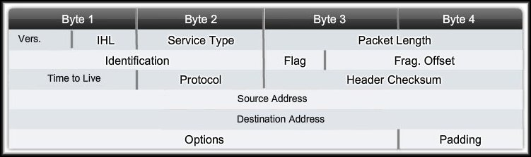
Issues with Redundancy
Ethernet frames do not have a Time-To-Live (TTL) parameter like IP packets.
As a result, if they are not terminated properly on a switched network, they continue to bounce from switch to switch endlessly.

Slide 10
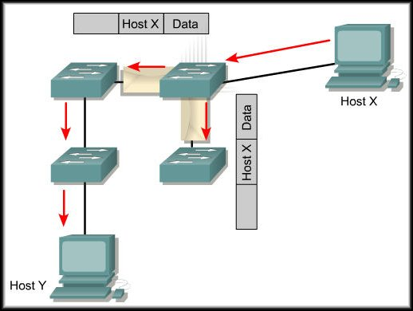
Issues with Redundancy
Remember that switches use the Source MAC address to learn where the devices are and enters this information into their MAC address tables.
Switches will flood the frames for unknown destinations until they learn the MAC addresses of the devices.

Slide 11
Issues with Redundancy
Additionally, multicasts and broadcasts are also flooded out all ports except the receiving port. (Multicasts will not be flooded if the switch has been specifically configured to handle multicasts.)

Slide 12
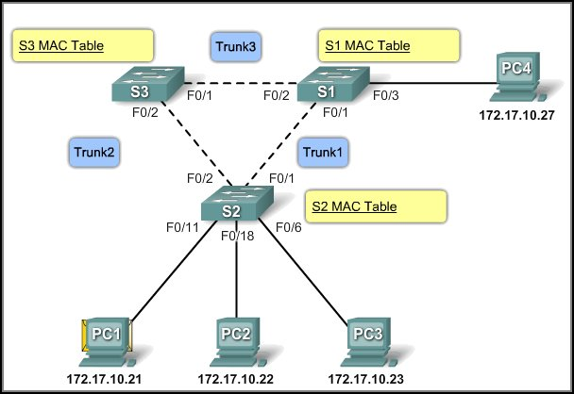
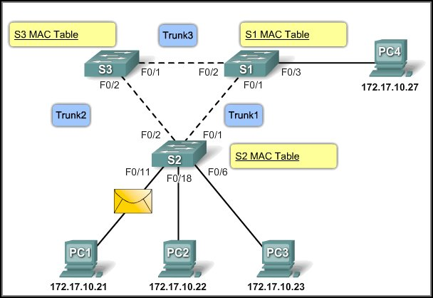
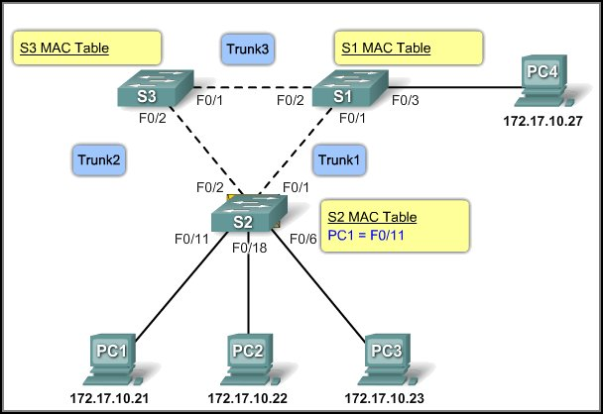
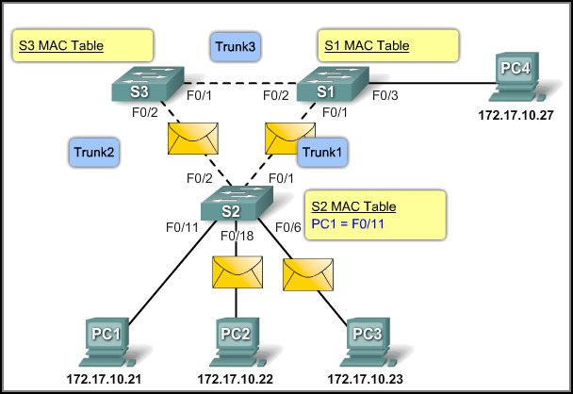
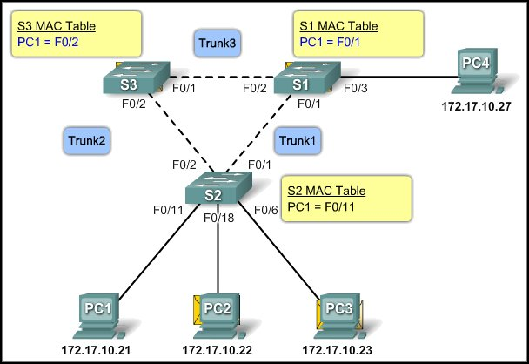
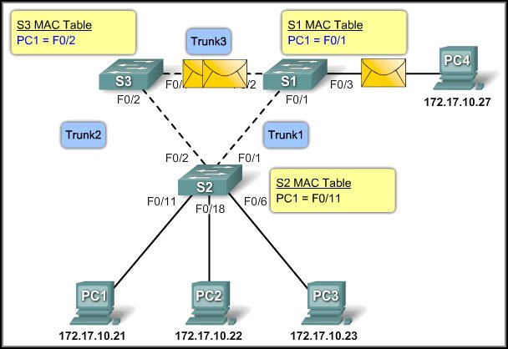
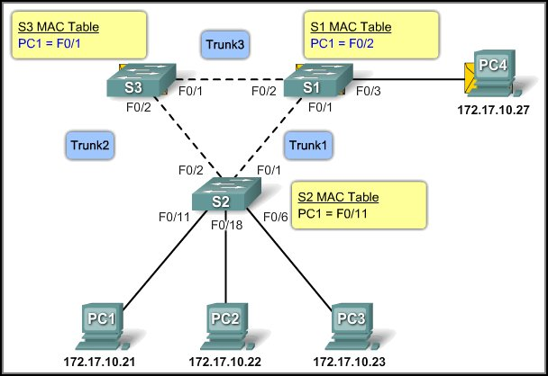
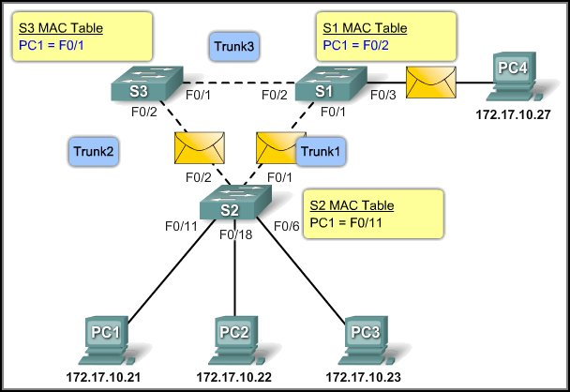
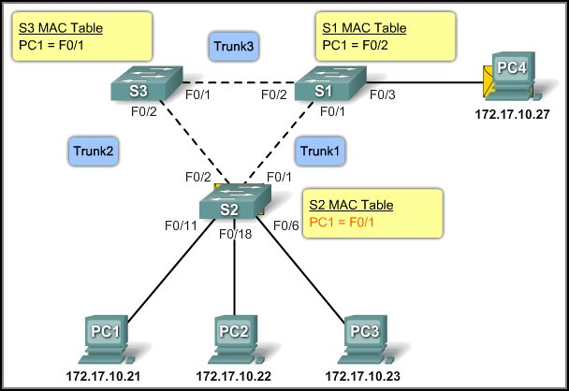
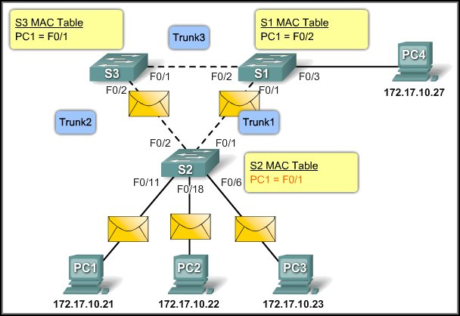
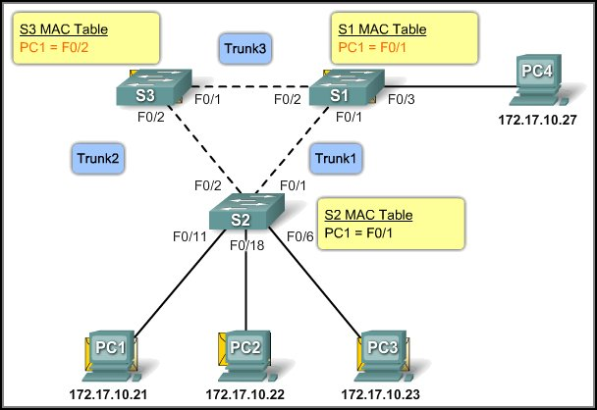

Issues with Redundancy
S2 floods the broadcast out all ports except the receiving port.
S3 and S1 update their MAC tables with the wrong information
S3 and S1 forward the broadcast back to S2.
S2 receives the frame and updates the MAC table.
S2 updates its MAC table with the wrong information
S2 floods the broadcast again
S3 and S1 update their MAC tables
S3 and S1 now flood the broadcast.
PC1 sends a broadcast.
S3 and S1 update their MAC tables again with the wrong information

Slide 13
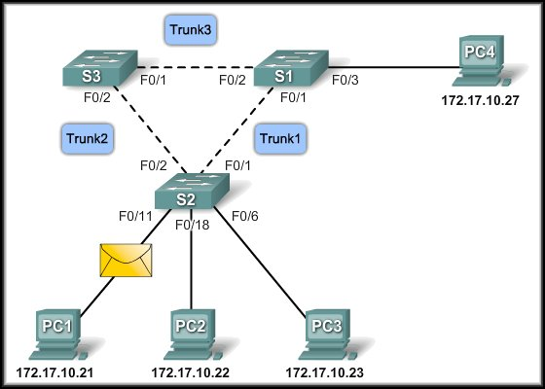
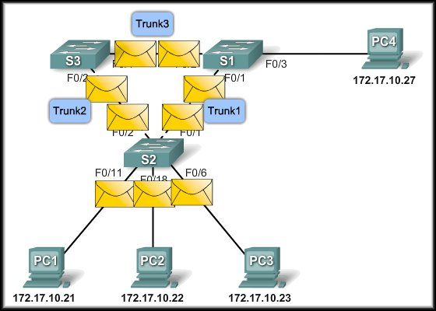
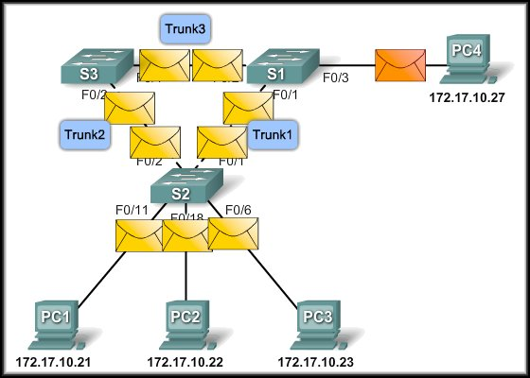
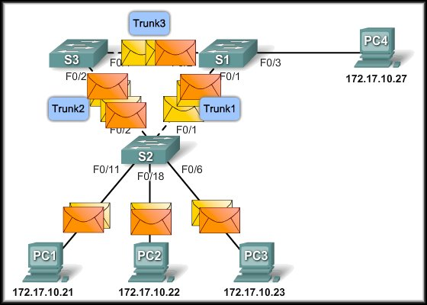
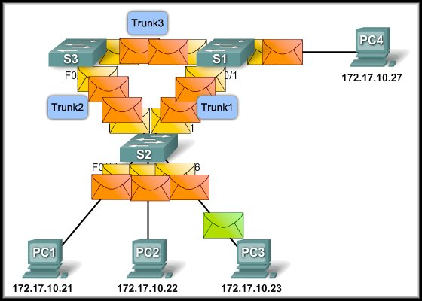
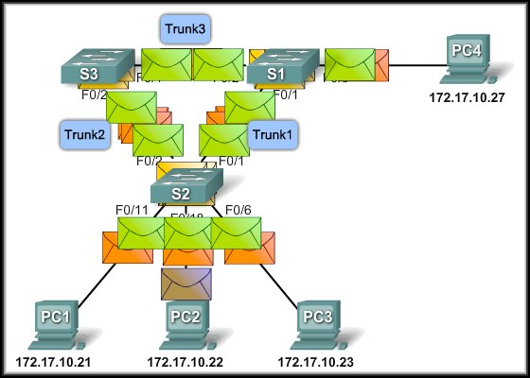
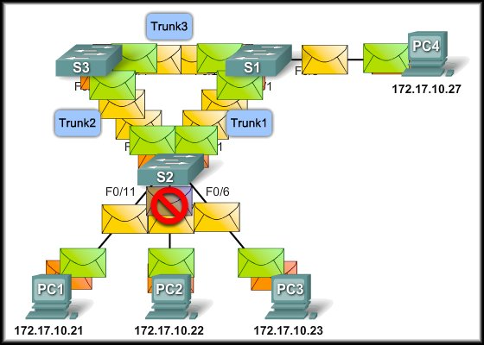
Issues with Redundancy
Broadcast Storms:
In fact, the entire network can no longer process new traffic and comes to a screeching halt.
Because of the high level of traffic, it cannot be processed.
PC3 sends a broadcast and creates yet another loop
No STP so a loop is created
PC1 sends a broadcast
PC4 sends a broadcast
PC2 sends a broadcast
Another loop

Slide 14
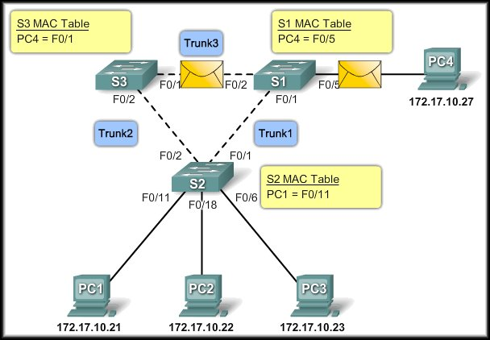
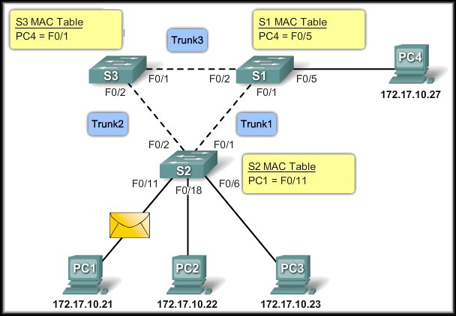
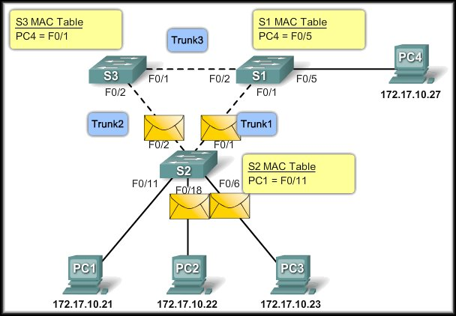
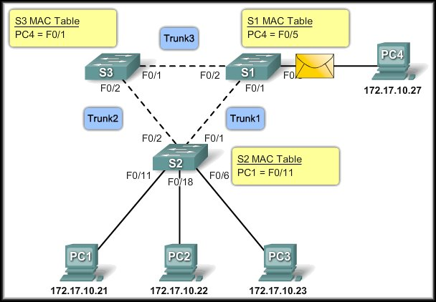
Issues with Redundancy
Duplicate Unicast Frames:
End result….
PC4 receives two copies of the same frame. One from S1 and one from S3.
S2 has no entry for PC4 so the frame is flooded out the remaining ports
Both S3 and S1 have entries for PC4 so the frame is forwarded
S1 also forwards the frame it received from S3
PC1 sends a unicast frame to PC4

Slide 15
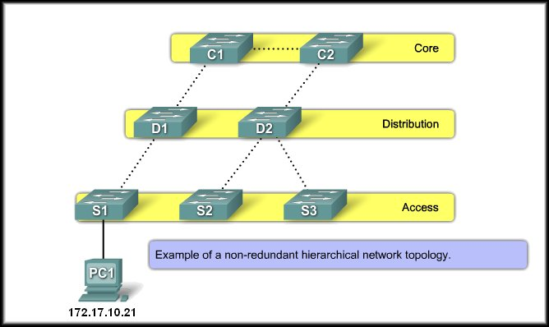
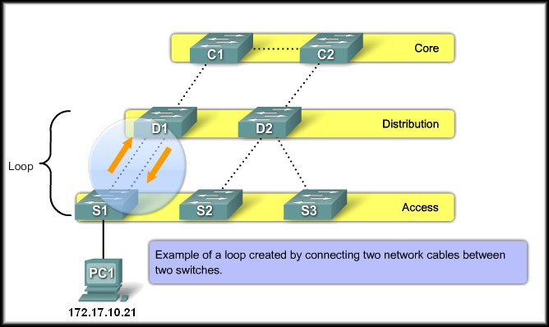
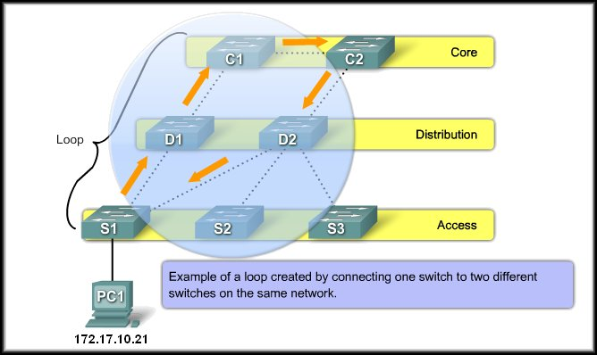
Real-World Redundancy Issues
Loops in the Wiring Closet:
Usually caused by an error in cabling.

Slide 16
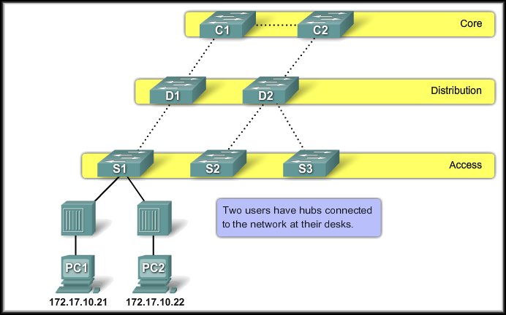
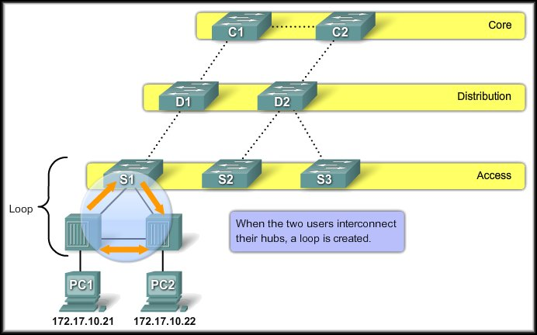
Real-World Redundancy Issues
Loops in Cubicles:
Some users have a personal switch or hub.
Affects all of the traffic on S1

Slide 17
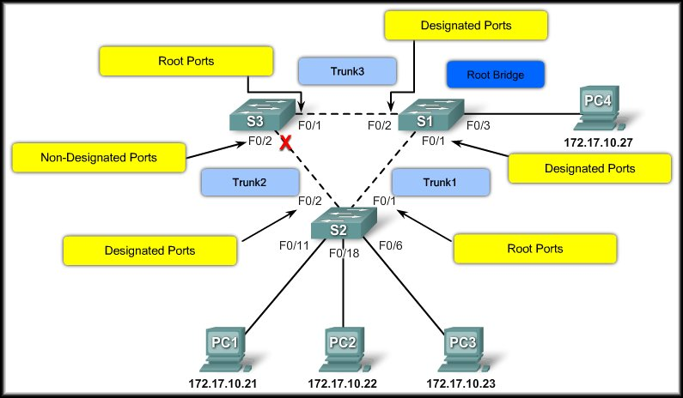
Spanning Tree Protocol (STP)
Introduction to STP

Slide 18
Introduction to STP
Redundancy:
Increases the availability of the network topology by protecting the network from a single point of failure.
In a Layer 2 design, loops and duplicate frames can occur, having severe consequences.
The Spanning Tree Protocol (STP) was developed to address these issues.
STP ensures that there is only one logical path between all destinations on the network by intentionally blocking redundant paths that could cause a loop.
The switches running STP are able to compensate for failures by dynamically unblocking the previously blocked ports and permitting traffic to traverse the alternate paths.

Slide 19
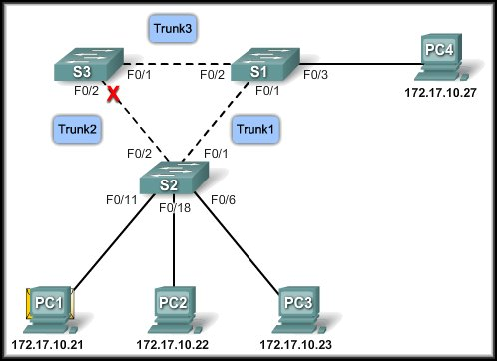

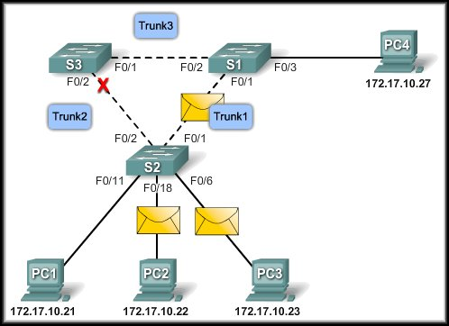
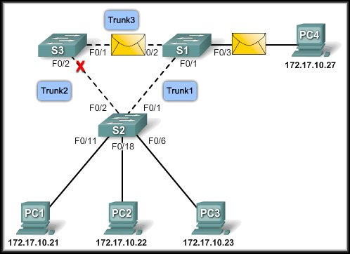

Spanning-Tree Algorithm (STA)
STP Topology – Avoiding a loop:
STP is in use and S3 has placed port F0/2 in blocking state to avoid a loop.
PC1 sends a broadcast.
S2 forwards the broadcast – but not to S3.
S1 forwards the broadcast.
Because F0/2 is in blocking state, the broadcast is not forwarded back to S2. – NO LOOP!

Slide 20
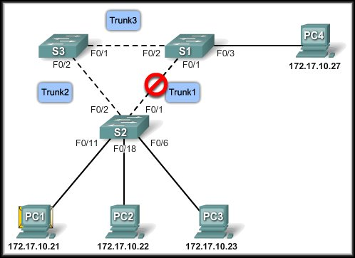
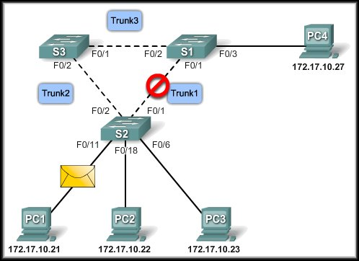
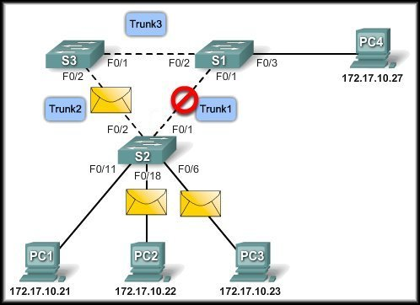
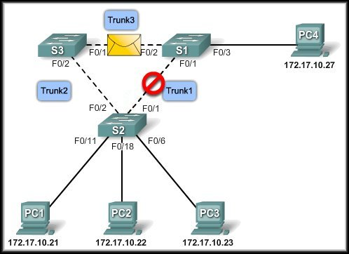
Spanning-Tree Algorithm (STA)
STP Topology – Network Failure:
S3 port activated
Trunk 1 Failure
S3 port back to blocking mode.
PC1 Sends a broadcast.
Trunk 1 comes back up.
S2 forwards the broadcast.
S3 and S1 forward the broadcast.

Slide 21
Spanning-Tree Algorithm (STA)
Terminology:
Root Bridge:
A single switch used as the reference point for all calculations.
Root Ports:
The switch port closest to the root bridge.
Designated Port:
All non-root ports that are still permitted to forward traffic on the network.
Non-designated Ports:
All ports configured to be in a blocking state to prevent loops.

Slide 22
Spanning-Tree Algorithm (STA)
STP uses the Spanning Tree Algorithm (STA) to determine which switch ports on a network need to be configured for blocking to prevent loops.
Through an election process, the algorithm designates a single switch as the root bridge and uses it as the reference point for all calculations.
The election process is controlled by the Bridge-ID (BID).
Bridge Priority | MAC Address
2
6

Slide 23
Root Bridge
Election Process:
All switches in the broadcast domain participate.
After a switch boots, it sends out Bridge Protocol Data Units (BPDU) frames containing the switch BID and the root ID every 2 seconds.
The root ID identifies the root bridge on the network.
By default, the root ID matches the local BID for all switches on the network.
In other words, each switch considers itself as the root bridge when it boots.

Slide 24
Root Bridge
Election Process:
As the switches forward their BPDU frames, switches in the broadcast domain read the root ID information from the BPDU frame.
If the root ID from the BPDU received is lower than the root ID on the receiving switch, the receiving switch updates its root ID identifying the adjacent switch as the root bridge.
The switch then forwards new BPDU frames with the lower root ID to the other adjacent switches.
Eventually, the switch with the lowest BID ends up being identified as the root bridge for the spanning-tree instance.

Slide 25
Best Path
Now that the root bridge has been elected, the STA starts the process of determining the best paths to the root bridge from all destinations in the broadcast domain.
The path information is determined by summing up the individual port costs along the path from the destination to the root bridge.
The default port costs are specified by the IEEE and defined by the speed at which the port operates.
Link Speed | Cost
10Gbps | 2
1Gbps | 4
100Mbps | 19
10Mbps | 100

Slide 26
Best Path
You are not restricted to the defaults.
The cost of a path can be manually configured to specify that a specific path is the preferred path instead of allowing the STA to choose the best path.
Realize, however, that changing the cost of a particular path will affect the results of the STA.
The ‘no’ form of the following command will return the cost to its default value.
switch(config)#interface fa0/1
switch(config-if)#spanning-tree cost [value]
switch(config-if)#end

Slide 27
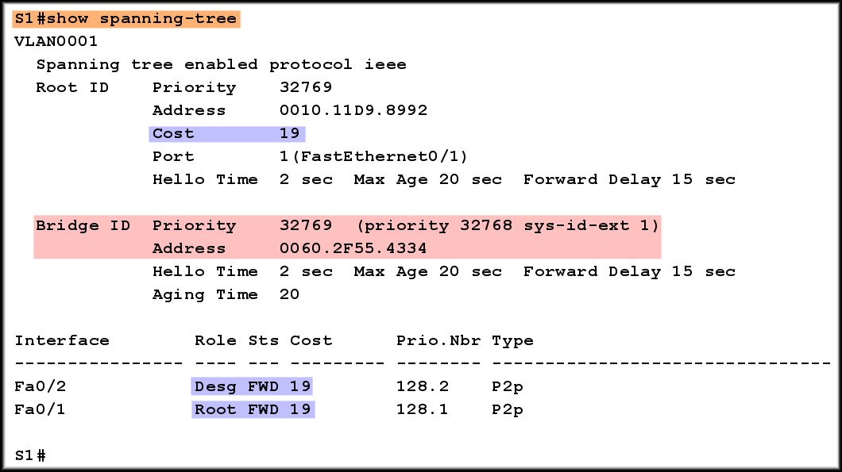
Best Path
Verifying the port and path cost.
Port Cost
Path Cost

Slide 28
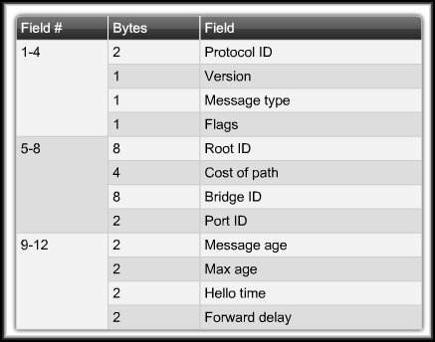
STP Bridge Protocol Data Unit
STP determines a root bridge for the spanning-tree instance by exchanging Bridge Protocol Data Units (BPDU).
Identifies the root bridge and the cost of the path to the root bridge.

Slide 29
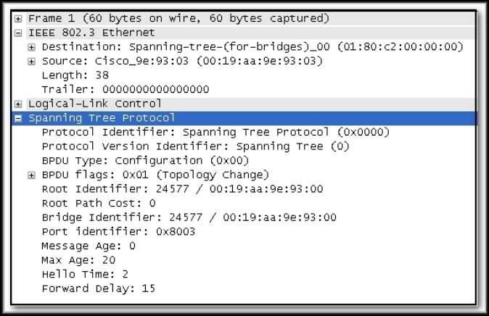
STP Bridge Protocol Data Unit
STP determines a root bridge for the spanning-tree instance by exchanging Bridge Protocol Data Units (BPDU).

Slide 30
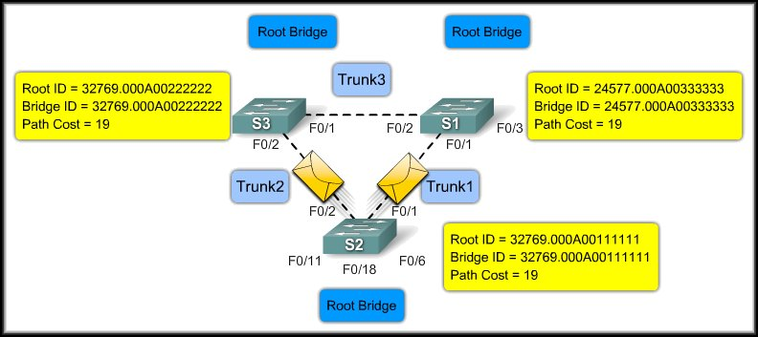
BPDU Process
Root Bridge Election Process:
S3 believes S2 is the root bridge.
S1 still thinks it is the root bridge.

Slide 31
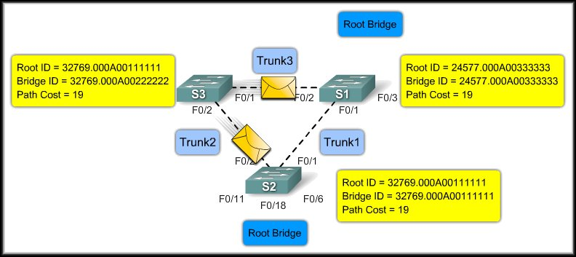
BPDU Process
Root Bridge Election Process:
S2 and S1 both think that they are the root bridge.

Slide 32
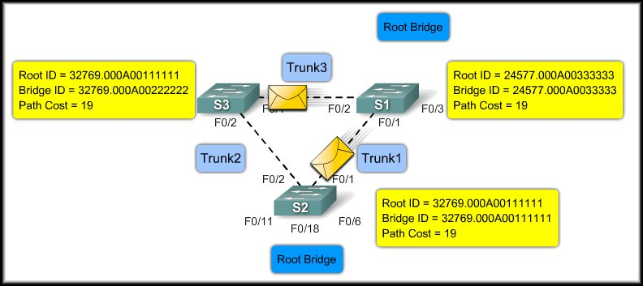
BPDU Process
Root Bridge Election Process:
S3 recognizes S1 as the root. S2 recognizes S1 as the root.

Slide 33

BPDU Process
Root Bridge Election Process:
If the root bridge fails, the election process begins again.

Slide 34

Bridge ID
Early STP implementation – no VLANs.
That means that there is a separate instance of STP for each VLAN.
Changed to include VLAN ID.

Slide 35
Bridge ID

Slide 36
Bridge ID
Bridge Priority:
A customizable value that you can use to influence which switch becomes the root bridge. (Another rigged election!)
The switch with the lowest priority, which means lowest BID, becomes the root bridge.
The lower the priority value, the higher the priority.

Slide 37

Bridge ID
Bridge Priority:
Notice that the addition of the VLAN ID leaves fewer bits available for the bridge priority (4 instead of 16).
As a result, the bridge priority is assigned in multiples of 4096.
The priority is added to the extended system value (VLAN ID) to uniquely identify the priority and VLAN of the BPDU frame.
+

Slide 38
Bridge ID
Bridge Priority:
For example:
The default bridge priority is 32,769.
(4096 * 8) + VLAN 1 ( native VLAN)
If I assign bridge priority 24,576 for VLAN 1 (4096 *6), the bridge priority becomes 24,567.
This switch will become the root bridge.
+

Slide 39

Bridge ID
Bridge Priority:
Default Priority: Election based on MAC Address

Slide 40

Bridge ID
Bridge Priority:
Modified Priority: Election based on priority.

Slide 41

Configure and Verify the Bridge ID
Two Methods to configure the Bridge ID:
Method 1:
Ensures that the switch has the lowest priority value after determining the lowest value on the network.
Ensures that the switch will become the root bridge if the primary fails. This one assumes that all other switches have the default value.

Slide 42
Configure and Verify the Bridge ID
Two Methods to configure the Bridge ID:
Method 2:
VLAN ID Number
Priority value

Slide 43





Configure and Verify the Bridge ID

Slide 44
Port Roles
The root bridge is elected for the spanning-tree instance.
The location of the root bridge in the network topology determines how port roles are calculated.
Root Port:
The switch port with the best path to forward traffic to the root bridge.
Designated Port:
The switch port that receives and forwards frames toward the root bridge as needed. Only one designated port is allowed per segment.
Non-designated Port:
A switch port that is blocked, so it is not forwarding data frames.

Slide 45
Port Roles
The STA determines which port role is assigned to each switch port.
To determine the root port on a switch:
The switch compares the path costs on all switch ports participating in the spanning tree.
When there are two switch ports that have the same path cost to the root bridge:
The switch uses the customizable port priority value, or the lowest port ID to break the tie.
The port ID is the number of the connected port.

Slide 46



Port Roles – Root Port
For Example:
Default Port Priority = 128
F0/1 Priority = 128,1

Slide 47

Port Roles – Root Port
You can specify the root port:
Configure Port Priority:
Priority values 0 - 240, in increments of 16.
Default port priority value is 128.
The lower the port priority value, the higher the priority.

Slide 48

Port Roles – Root Port
Verifying the Port Priority:

Slide 49
STP Port States and BPDU Timers
Port States:
The spanning tree is determined by the exchange of the BPDU frames between the interconnected switches.
Each switch port:
Five possible port states.
Three BPDU timers.
WHY?
The spanning tree is determined immediately after the switch has finished booting.
Going directly from a blocking state to a forwarding state could create a temporary loop.
The five states and the timers address this issue.

Slide 50
STP Port States and BPDU Timers
Port States:
Blocking:
The port is a non-designated port and does not participate in frame forwarding.
Listening:
STP has determined that the port can participate in frame forwarding according to the BPDU frames that the switch has received thus far.
Learning:
The port prepares to participate in frame forwarding and begins to populate the MAC address table.

Slide 51

STP Port States and BPDU Timers
Port States:
Forwarding:
The port is considered part of the active topology and forwards frames and also sends and receives BPDU frames.
Disabled:
The Layer 2 port does not participate in STP and does not forward frames.

Slide 52

STP Port States and BPDU Timers
BPDU Timers:
The amount of time that a port stays in the various port states depends on the BPDU timers.
Only the switch in the role of root bridge may send information through the tree to adjust the timers.

Slide 53


STP Port States and BPDU Timers
BPDU Timers:
At power up:
Every switch port goes through the blocking, listening and learning states.
The ports then stabilize to the forwarding or blocking state.
During a topology change:
A port temporarily implements the listening and learning states for a specified period.
Power up Delay
Maximum of
15 + 15 = 30 Seconds

Slide 54
STP Port States and BPDU Timers
BPDU Timers:
There is a race between operating systems and CPU manufacturers.
CPU manufacturers keep making the chips faster, while, at the same time, operating systems keep slowing down.
As a result the BPDU timer delays can affect DHCP.
A network device is often booted and ready to use the network before the switch port becomes active.
This can prevent the device from immediately obtaining a useable IP configuration from DHCP.

Slide 55

Cisco PortFast
Cisco has addressed this issue with their PortFast technology.
The port is configured as an access port.
The port transitions from blocking to forwarding state immediately, bypassing the listening and learning states.
PortFast is disabled by default.
It should be used only on access ports.
If you enable PortFast on a port connecting to another switch, you risk creating a spanning-tree loop.

Slide 56
Putting It All Together
STP Convergence:
Convergence is the time it takes for the network to:
Determine which switch is going to assume the role of the root bridge.
Set switch ports to their final spanning-tree port roles where all potential loops are eliminated.
Three Steps:
Elect a root bridge.
Elect the root ports.
Elect the Designated and Non-designated ports.

Slide 57


Putting It All Together - Step 1
Elect a Root Bridge:
Root ID 32769.00A222
Bridge ID 3279.00A222
Root ID 32769.00A111
Bridge ID 3279.00A222
Root ID 24577.00A333
Bridge ID 24577.00A333
Root
Root ID 32769.00A111
Bridge ID 3279.00A111
Root
Root ID 32769.00A111
Bridge ID 3279.00A111
Root ID 32769.00A111
Bridge ID 3279.00A111
Root

Slide 58

Putting It All Together – Step 1
Elect a Root Bridge:
Root ID 32769.00A111
Bridge ID 3279.00A222
Root ID 24577.00A333
Bridge ID 24577.00A333
Root
Root ID 32769.00A111
Bridge ID 3279.00A222
Root ID 32769.00A111
Bridge ID 3279.00A222
Root ID 32769.00A111
Bridge ID 3279.00A111
Root

Slide 59

Putting It All Together – Step 1
Elect a Root Bridge:
Root ID 32769.00A111
Bridge ID 3279.00A222
Root ID 24577.00A333
Bridge ID 3279.00A222
Root ID 24577.00A333
Bridge ID 24577.00A333
Root ID 24577.00A333
Bridge ID 24577.00A333
Root
Root ID 24577.00A333
Bridge ID 24577.00A333
Root ID 32769.00A111
Bridge ID 3279.00A111
Root ID 24577.00A333
Bridge ID 3279.00A111
Root

Slide 60

Putting It All Together – Step 2
Throughout the root bridge election, the path cost has also been updated.
All links are 100Mbps. Cost = 19
Root Ports:
Root ID 24577.00A333
Bridge ID 3279.00A222
Root ID 24577.00A333
Bridge ID 24577.00A333
R
Root
38
19
38
R
Root ID 32769.00A111
Bridge ID 3279.00A111
Root ID 24577.00A333
Bridge ID 3279.00A111

Slide 61
Putting It All Together – Step 3
Designated and Non-designated Ports:
Root ID 24577.00A333
Bridge ID 3279.00A222
Root ID 24577.00A333
Bridge ID 24577.00A333
R
D
D
Root
S1 is the root bridge so both ports become designated ports.
Root ID 24577.00A333
Bridge ID 3279.00A222
D
R
Root ID 32769.00A111
Bridge ID 3279.00A111
Root ID 24577.00A333
Bridge ID 3279.00A111
Root ID 24577.00A333
Bridge ID 3279.00A111

Slide 62
Putting It All Together – Step 3
Root ID 24577.00A333
Bridge ID 3279.00A222
Designated and Non-designated Ports:
Root ID 24577.00A333
Bridge ID 3279.00A222
Root ID 24577.00A333
Bridge ID 24577.00A333
R
D
ND
Root
X
D
Root ID 24577.00A333
Bridge ID 3279.00A111
D
R
Root ID 32769.00A111
Bridge ID 3279.00A111
Root ID 24577.00A333
Bridge ID 3279.00A111

Slide 63

Putting It All Together
Root
R
D
Verifying STP Configuration:
ND
D
X
D
R

Slide 64

Putting It All Together
Verifying STP Configuration:
Root
R
D
ND
D
X
D
R

Slide 65

Putting It All Together
Root
R
D
Verifying STP Configuration:
ND
D
X
D
R

