Slide 1

NOVA调度器
千易雲(北京)教育科技有限公司

Slide 2
什么是调度器？
  调度器又被称为过滤加权调度器，是一个拥有把nova-API调用映
  射为Open Stack功能的组件，会根据诸如CPU构架、可用域的物
  理距离、内存、负载等作出调度决定。过滤器调度器支持过滤和
  加权，以在需要创建新实例的地方做出明智的决定。此调度器仅
  支持计算节点的工作。

Slide 3
调度器如何工作？
  OpenStack通过nova-scheduler来实现将实例部署到哪台计算节
  点上。Filter scheduler 是 nova-scheduler 默认的调度器，调度
  过程分为两步：
    通过过滤器（filter）选择满足条件的计算节点（运行nova-compute）
    通过权重计算（weighting）选择在最优（权重值最大）的计算节点上创建 Instance。

Slide 4
过滤器如何工作？
  在过滤调度过程中，调度程序遍历所有已找到的计算节点，并根
  据一组过滤器对它们进行评估。由此产生的主机列表由秤重排序
  。然后，调度器为请求的实例数量选择主机，选择最重要的主机
  。对于特定的过滤器，对于特定的主机，筛选器匹配用户对主机
  状态的请求，加上每个过滤器定义的额外的魔法(下面详细描述)
  。如果调度程序无法找到下一个实例的候选对象，则意味着没有
  合适的主机可以调度该实例。过滤器调度程序必须非常灵活，以
  支持所需的各种过滤和加权策略。如果这种灵活性不足，您可以
  实现自己的过滤算法。

Slide 5
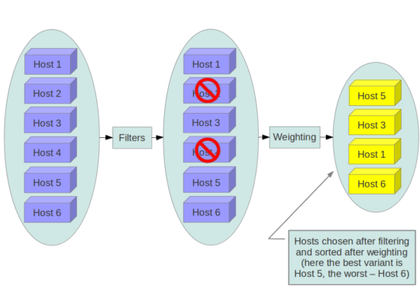
过滤器如何工作？
过滤示意图

Slide 6
过滤器的相关配置
  计算服务Filters的策略通过配置nova.conf配置文件中[DEFAULT]部分的
  配置项scheduler_available_filters来定义可用的过滤器。默认配置的是
  所有filters。配置如下：
  scheduler_available_filters = nova.scheduler.filters.all_filters
  这个配置项可以在nova.conf中多次出现，比如你可以通过Python实现自
  定义的filter（myFilter.MyFilter），只需要在配置文件中增加这个filter即
  可。
  scheduler_available_filters = nova.scheduler.filters.all_filters
  scheduler_available_filters = myfilter.MyFilter

Slide 7
过滤器的相关配置
  另外还有一个选项 scheduler_default_filters，用于指定 scheduler 真正
  使用的 filter，默认值如下：
  scheduler_default_filters = RetryFilter, AvailabilityZoneFilter,
  RamFilter, DiskFilter, ComputeFilter, ComputeCapabilitiesFilter,
  ImagePropertiesFilter, ServerGroupAntiAffinityFilter,
  ServerGroupAffinityFilter
  Filter scheduler 将按照列表中的顺序依次过滤。

Slide 8
官方提供哪些标准过滤器
  AllHostsFilter - 没有过滤，调度所有可用的主机
  ImagePropertiesFilter - 根据实例镜像中定义的元数据属性过滤主机
  AvailabilityZoneFilter - 通过主机匹配实例属性中指定的可用性区域，使用逗号来指定多个区
  域。可用区域可由用户自行定义，例如可以将一个机架定义为一个可用区域，所有计算节点
  初始都被放在一个叫做nova的系统默认可用区域中
  ComputeCapabilitiesFilter - 根据主机的一些关键硬件属性执行调度，如：CPU厂商、架构、
  内核数量、指令集特性、Socket类型等
  AggregateInstanceExtraSpecsFilter -将主机所属的主机聚合的元数据属性，与创建虚拟机的
  instance_type中的extra_specs属性作比较。同时，在extra_specs属性中，支持一些伪操作
  符（nova\scheduler\filters\extra_specs_ops.py），比如extra_specs={'mem':'>= 512'}，那么
  host所属的主机聚合的metadata={'mem':'1024'}时，就允许创建虚拟机
Notes:
官方原文：
AllHostsFilter - does no filtering. It passes all the available hosts.
ImagePropertiesFilter - filters hosts based on properties defined on the instance’s image. It passes hosts that can support the properties specified on the image used by the instance.
AvailabilityZoneFilter - filters hosts by availability zone. It passes hosts matching the availability zone specified in the instance properties. Use a comma to specify multiple zones. The filter will then ensure it matches any zone specified.
ComputeCapabilitiesFilter - checks that the capabilities provided by the host compute service satisfy any extra specifications associated with the instance type. It passes hosts that can create the specified instance type.
AggregateInstanceExtraSpecsFilter - checks that the aggregate metadata satisfies any extra specifications associated with the instance type (that have no scope or are scoped with aggregate_instance_extra_specs). It passes hosts that can create the specified instance type. The extra specifications can have the same operators as ComputeCapabilitiesFilter. To specify multiple values for the same key use a comma. E.g., “value1,value2”
ComputeFilter - passes all hosts that are operational and enabled.
CoreFilter - filters based on CPU core utilization. It passes hosts with sufficient number of CPU cores.
AggregateCoreFilter - filters hosts by CPU core number with per-aggregatecpu_allocation_ratio setting. If no per-aggregate value is found, it will fall back to the global default cpu_allocation_ratio. If more than one value is found for a host (meaning the host is in two different aggregates with different ratio settings), the minimum value will be used.
IsolatedHostsFilter - filter based on image_isolated, host_isolated and restrict_isolated_hosts_to_isolated_images flags.
JsonFilter - allows simple JSON-based grammar for selecting hosts.
RamFilter - filters hosts by their RAM. Only hosts with sufficient RAM to host the instance are passed.
AggregateRamFilter - filters hosts by RAM with per-aggregate ram_allocation_ratio setting. If no per-aggregate value is found, it will fall back to the global default ram_allocation_ratio. If more than one value is found for a host (meaning the host is in two different aggregates with different ratio settings), the minimum value will be used.
DiskFilter - filters hosts by their disk allocation. Only hosts with sufficient disk space to host the instance are passed. disk_allocation_ratio setting. The virtual disk to physical disk allocation ratio, 1.0 by default. The total allowed allocated disk size will be physical disk multiplied this ratio.
AggregateDiskFilter - filters hosts by disk allocation with per-aggregatedisk_allocation_ratio setting. If no per-aggregate value is found, it will fall back to the global default disk_allocation_ratio. If more than one value is found for a host (meaning the host is in two or more different aggregates with different ratio settings), the minimum value will be used.
NumInstancesFilter - filters compute nodes by number of running instances. Nodes with too many instances will be filtered. max_instances_per_host setting. Maximum number of instances allowed to run on this host. The host will be ignored by the scheduler if more than max_instances_per_host already exist on the host.
AggregateNumInstancesFilter - filters hosts by number of instances with per-aggregate max_instances_per_host setting. If no per-aggregate value is found, it will fall back to the global default max_instances_per_host. If more than one value is found for a host (meaning the host is in two or more different aggregates with different max instances per host settings), the minimum value will be used.
IoOpsFilter - filters hosts by concurrent I/O operations on it. hosts with too many concurrent I/O operations will be filtered. max_io_ops_per_host setting. Maximum number of I/O intensive instances allowed to run on this host, the host will be ignored by scheduler if more than max_io_ops_per_host instances such as build/resize/snapshot etc are running on it.
AggregateIoOpsFilter - filters hosts by I/O operations with per-aggregate max_io_ops_per_hostsetting. If no per-aggregate value is found, it will fall back to the global default max_io_ops_per_host. If more than one value is found for a host (meaning the host is in two or more different aggregates with different max io operations settings), the minimum value will be used.
PciPassthroughFilter - Filter that schedules instances on a host if the host has devices to meet the device requests in the ‘extra_specs’ for the flavor.
SimpleCIDRAffinityFilter - allows a new instance on a host within the same IP block.
DifferentHostFilter - allows the instance on a different host from a set of instances.
SameHostFilter - puts the instance on the same host as another instance in a set of instances.
RetryFilter - filters hosts that have been attempted for scheduling. Only passes hosts that have not been previously attempted.
TrustedFilter (EXPERIMENTAL) - filters hosts based on their trust. Only passes hosts that meet the trust requirements specified in the instance properties.
TypeAffinityFilter - Only passes hosts that are not already running an instance of the requested type.
AggregateTypeAffinityFilter - limits instance_type by aggregate.This filter passes hosts if no instance_type key is set or the instance_type aggregate metadata value contains the name of the instance_type requested. The value of the instance_type metadata entry is a string that may contain either a single instance_type name or a comma separated list of instance_type names. e.g. ‘m1.nano’ or “m1.nano,m1.small”
ServerGroupAntiAffinityFilter - This filter implements anti-affinity for a server group. First you must create a server group with a policy of ‘anti-affinity’ via the server groups API. Then, when you boot a new server, provide a scheduler hint of ‘group=<uuid>’ where <uuid> is the UUID of the server group you created. This will result in the server getting added to the group. When the server gets scheduled, anti-affinity will be enforced among all servers in that group.
ServerGroupAffinityFilter - This filter works the same way as ServerGroupAntiAffinityFilter. The difference is that when you create the server group, you should specify a policy of ‘affinity’.
AggregateMultiTenancyIsolation - isolate tenants in specific aggregates. To specify multiple tenants use a comma. Eg. “tenant1,tenant2”
AggregateImagePropertiesIsolation - isolates hosts based on image properties and aggregate metadata. Use a comma to specify multiple values for the same property. The filter will then ensure at least one value matches.
MetricsFilter - filters hosts based on metrics weight_setting. Only hosts with the available metrics are passed.
NUMATopologyFilter - filters hosts based on the NUMA topology requested by the instance, if any.

Slide 9
官方提供哪些标准过滤器
  ComputeFilter - 根据主机的状态和服务的可用性过滤
  CoreFilter - 看host上的vcpu个数能否满足创建虚拟机的instance_type中的vcpu个数。
  AggregateCoreFilter - 根据host所属的aggregate的metadata-> cpu_allocation_ratio，选取最
  小值作为比率
  RamFilter - 根据主机内存大小进行调度，只有拥有足够的RAM来承载实例的主机才会通过
  DiskFilter - 根据主机磁盘容量进行调度，只有拥有足够磁盘容量来承载实例的主机才会通过
  IoOpsFilter - 通过并发I/O操作对其进行筛选，有太多并发I/O操作的主机将被过滤。
  更多过滤器介绍可以在官方社区文档库中查看。

Slide 10
权重器如何工作
  过滤器调度程序在其工作期间使用所谓的权重。权重器是一种从
  有效主机组中选择最合适的主机的方法，它给列表中的所有主机
  提供权重。为了优先考虑一个更重要的因素，所有的权重者必须
  定义一个乘数，在计算节点的权重之前应用。所有的权值都是事
  先规格化的，这样乘数就可以很容易地应用。

Slide 11
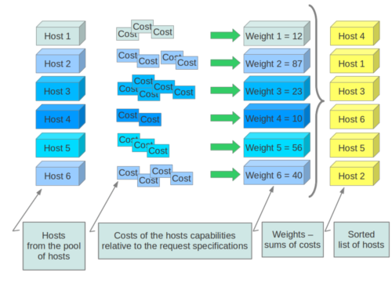
权重器如何工作
加权示意图

Slide 12
总 结
  通过反复过滤和称重，过滤器调度程序制作一个本地的可接受主
  机列表。每次选择主机时，它实际上会消耗它的资源，因此后续
  的选择也可以相应地进行调整。如果客户请求大量实例，这是很
  有用的，因为每个实例需要计算权重。
  在最后，过滤器调度程序通过它们的权重对选定的主机进行排序
  ，并尝试在选定的主机上提供实例。注：在nova.tests.scheduler
  中找到更多使用过滤器调度器和标准过滤器的例子。

Slide 13
谢 谢

