Slide 1
WebGPU Rendering Engine
(WebGPU-Vulkan-Android)
Car rendering showcase
Thundersoft Japan
Tyrion Bao

Slide 2
Rendering result

Slide 3
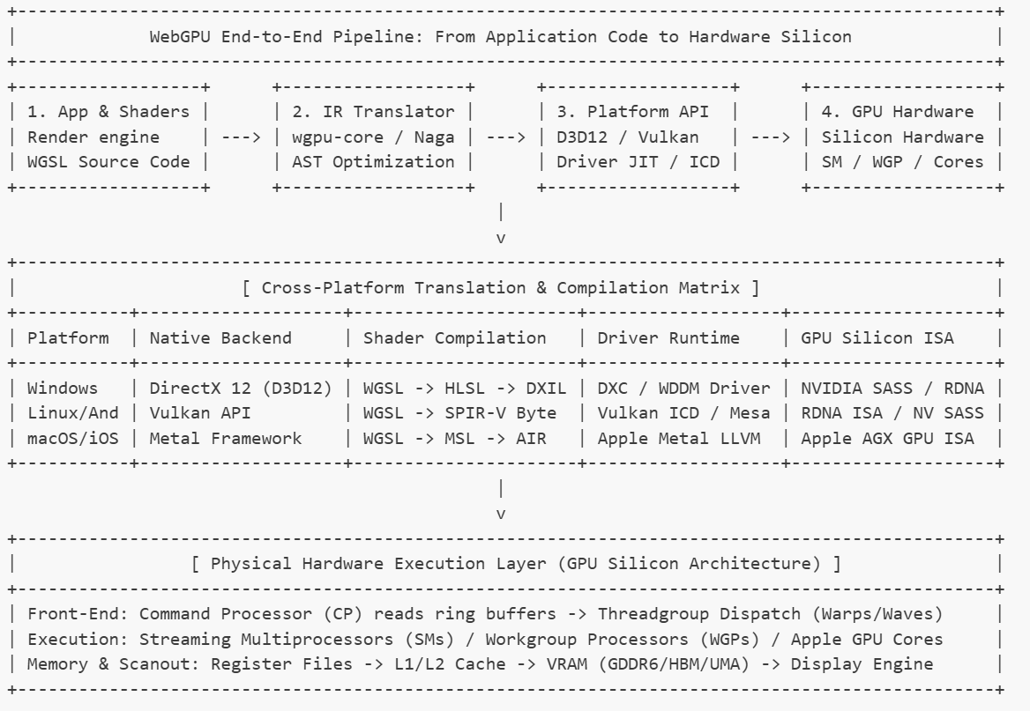
High level overview

Slide 4
Core Functionality

Slide 5
Detailed Analysis by category
Visual analysis
Performance analysis
Performance analysis
AI potential analysis
Teamwork analysis

Slide 6
Teamwork analysis
One button click from blender to renderable
AI-native rendering engine

Slide 7
Other technology I learnt from the experience
Google Antigravity IDE
MCP for blender/Blender
GLTF file format
Python
Rust
Vulkan rendering backend

Slide 8
Personal note in the end
My technical goal is to deeply engage with AI development pipeline while understanding matters from an academic viewpoint so I can perform necessary customization when necessary
My personal career goal will lean to engine optimization or client-facing technical consulting
I define myself as a render engineer who is fully capable of using unity/UE/Kanzi or build customized rendering pipeline to maximize the potential of any hardware

Slide 9
Thanks!

