Slide 1

CONCEPTUAL
ARCHITECTURE
Bitcoin Core
Pereira D, Susilo A, Shrestha K
Bridson-Boyczuk A, Fung C, Wuthrich I
CISC 322 W22 Professor Bram Adams
19/02/2023
https://youtu.be/RBb-izebZV4

Slide 2
Team FTX
Devin Pereira
Alex Susilo
Kanchan Shrestha
Cyrus Fung
Adlai Bridson-Boyczuk
Isaiah Wuthrich
01
02
Evolution
External Interfaces
Speaker
Peer Discovery & Connection Manager
Division of Responsibilities for Developers
Limitations & Lessons Learned
Presentation Aesthetics
03
04
Wallet & Peer components
Derivation Process
Use Cases & Sequence Diagrams
Group Leader
Abstract
Introduction & Overview
Transaction & Blocks
Blockchain
05
06
Validation & Storage Engine
Conclusion
Speaker
Miner & Mempool
Concurrency

Slide 3
Introduction
Understanding the architecture of Bitcoin Core is vital to understanding how Bitcoin works as a digital currency
System must be highly secure and stable
11 main components
Transaction, Block, Blockchain, Validation Engine, Storage Engine, Wallet, Miner, Mempool, Connection Manager, Node
Layered architecture for nodes, with each individual node connected in a peer-to-peer fashion

Slide 4
Derivation Process
01
02
03
04
Searching
Analysis
Draft
Finalize
Find relevant sources for research
Analyze sources for useful information
Create an initial draft with what we gathered
Collaborate to edit and make changes

Slide 5
Alternatives
Agreed on Peer-to-Peer architecture and the components/relationships
Are there other styles working with P2P?
We believed there to be some elements of Publish-Subscribe
Miner component needed to communicate with other nodes before it could move on in its process
Discarded because it did not match the other aspects of Pub-sub

Slide 6
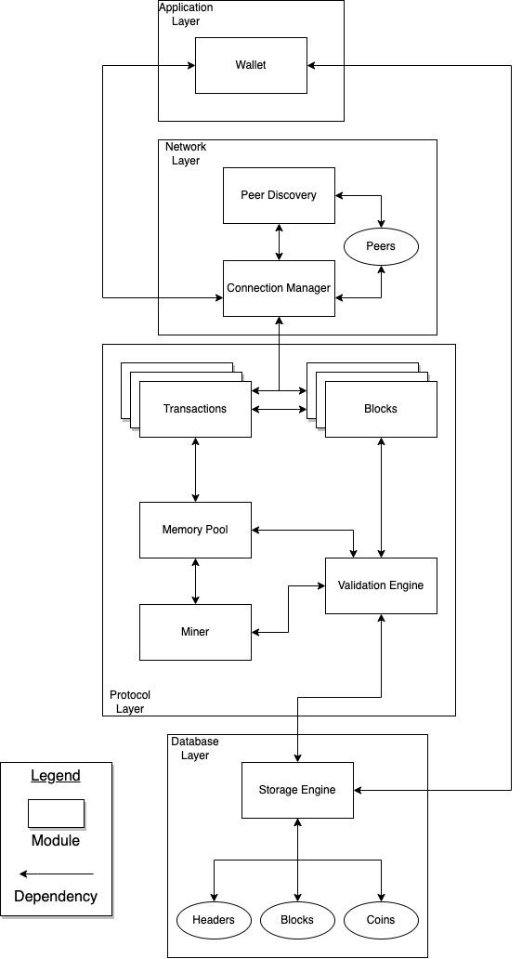
Peer-to-Peer + Layered Style

Slide 7
Transactions
Core component of Bitcoin Core and Bitcoin protocol
Represents transfer of value from one Bitcoin address to another
Transactions have inputs (credits to an account) and outputs (debits from an account)
Outputs are called UTXOs (unspent transaction outputs) and are consumed as inputs when another transaction is made
Transactions are broadcast to all nodes on the Bitcoin network and are added to their mempools
Miners validate them using their validation engine and include them into blocks

Slide 8
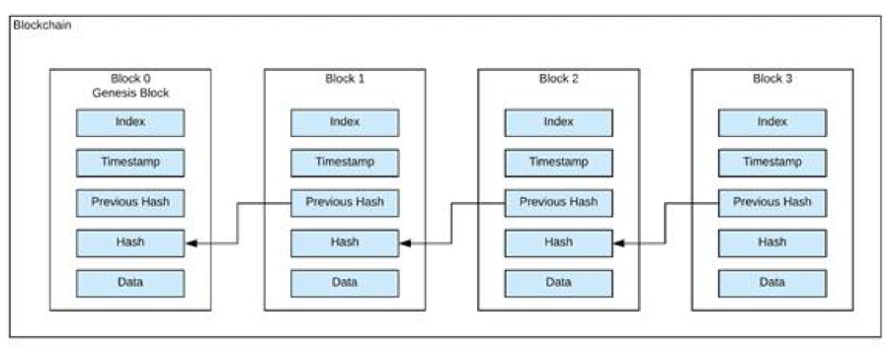
Blocks and Blockchain
Transactions are wrapped into blocks
Blocks are cryptographically linked through their hashes
Sequential linking of blocks is what forms the structure known as the “Blockchain”
Each node has a copy of the blockchain
Transactions are validated when miners add them to blocks and they are included in the blockchain

Slide 9
Validation & Storage Engines
Integrity and Reliability
Validation Engine
Storage Engine
Ensuring transactions and blocks are valid
Verifies each created block has valid proof-of-work
Adheres to consensus rules
Responsible for validating new transactions prior to being added to a block
Maintains up-to-date copy of blockchain
LevelDB (Efficient and Scalable)
Also responsible for maintenance of other DS like the UTXO database

Slide 10
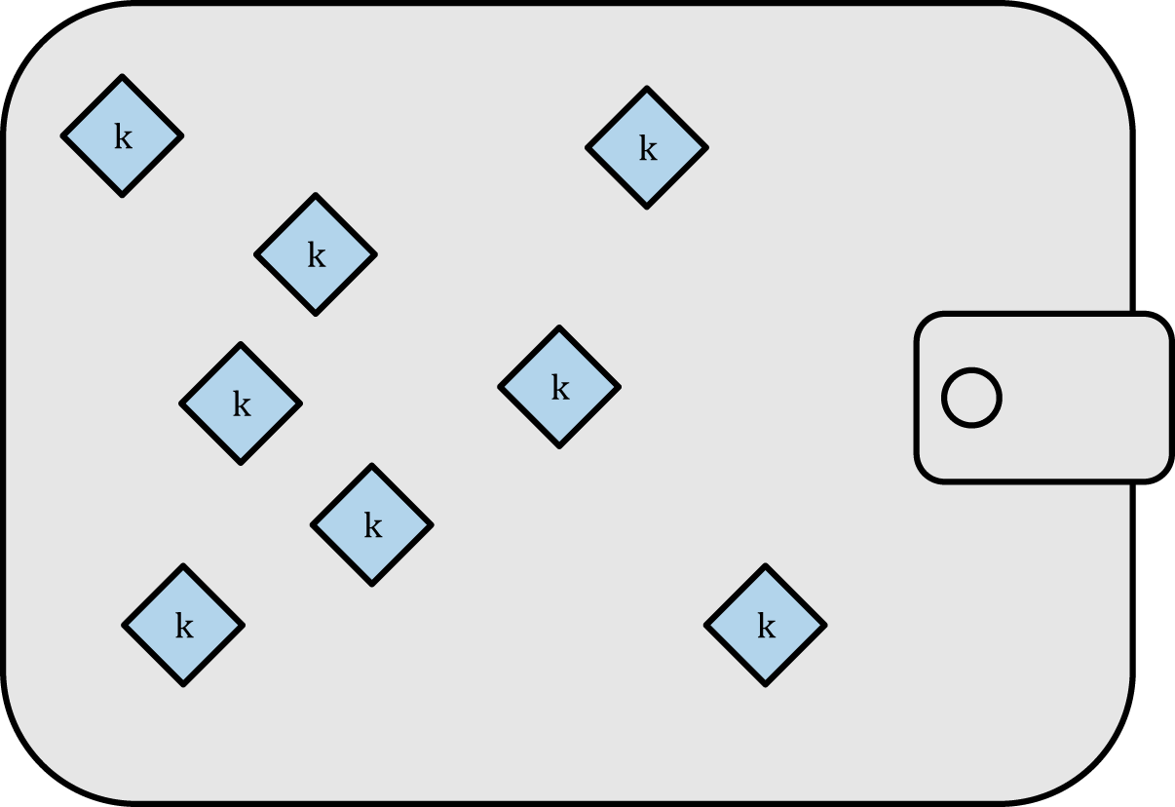
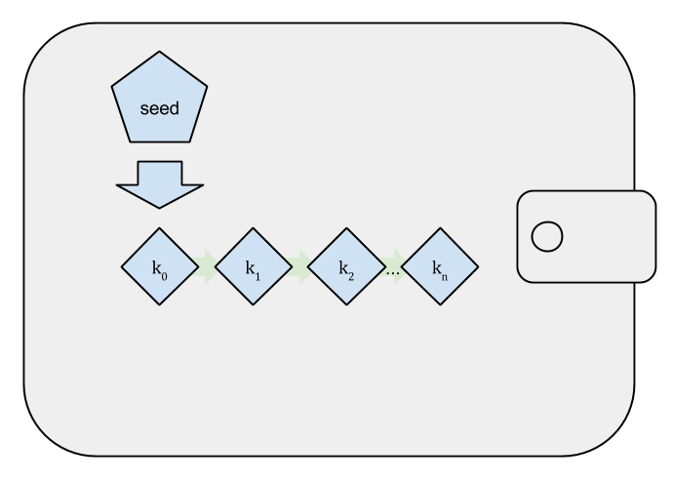
Wallet
Wallet Types
Non-deterministic
Deterministic
Random unconnected keys
All keys derived from a “seed”

Slide 11
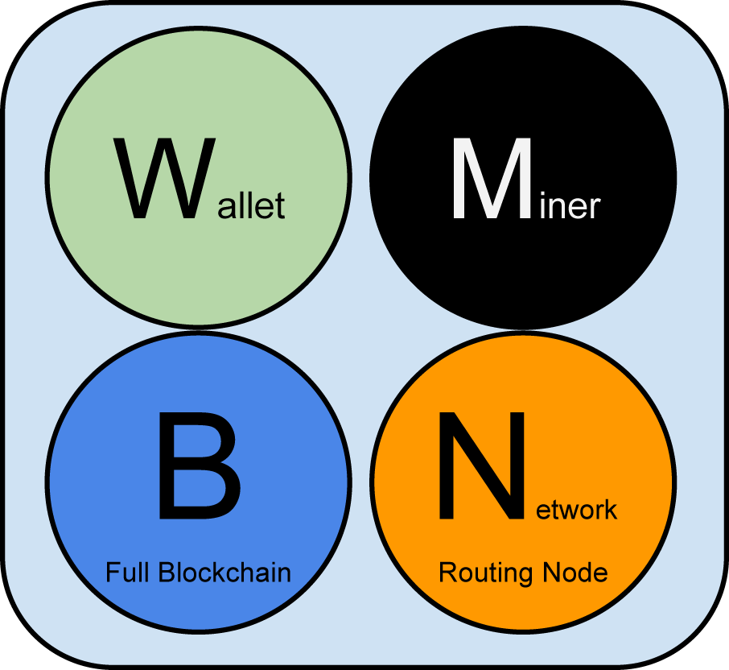
Peers
Peers nodes in the bitcoin network and are equal but can have different roles depending on the functionality they support
Nodes consists of up to four functions: routing, the blockchain database, mining, and wallet services.

Slide 12
Peer Discovery
Domain Name System Seeds
List of nodes
Bootstrap the network
DNS Seeds
Hardcoded into the system
Used as a fallback
DISCOVERY
IP Addresses
Peer Exchange
Shares information about connected peers
Increases resilience to failure
PEX

Slide 13
Connection Manager
Handle Peers
Security
Network Partitioning
Ability to optimize number of connections
Filter incoming and outgoing connections
Determine and detect reconnection

Slide 14
Mining and the Mempool
01
02
03
04
Verify Tx
Proof-of-work
Share
Reward
Transactions are verified and stored in Mempool
Proof-of-work is solved and is block formed
Block is added to the blockchain
Miner compensated with bitcoin

Slide 15
External Interfaces
Interface Functionality
Built-in wallets
Unauthenticated API
Trusted peer
GUI
CLI
Authenticated API
Lightweight wallets

Slide 16
CONCURRENCY
Ease of Use
Safety
01
Transactions must be sent and received in a timely manner.
02
The addition of new blocks on the blockchain increase the safety of previous transactions.

Slide 17
Concurrency

Slide 18
Division of Responsibilities
Loosely Organized
Priority Hierarchy
Focuses
Fundamentals
01
03
P2P Style - Decentralized nature
Loose organized form of collaboration
Enables informal conventions
Essential modules at the top
“Consensus Rules” & “Network Layer”
Less important put into backlog
02
04
Security, Stability, Development
Responsibilities may not be exclusive
Multiple focus participation possible
General understanding of the software
Follow coding standards
Provide clear/concise documentation

Slide 19
Use Case 1: Bitcoin Transaction

Slide 20
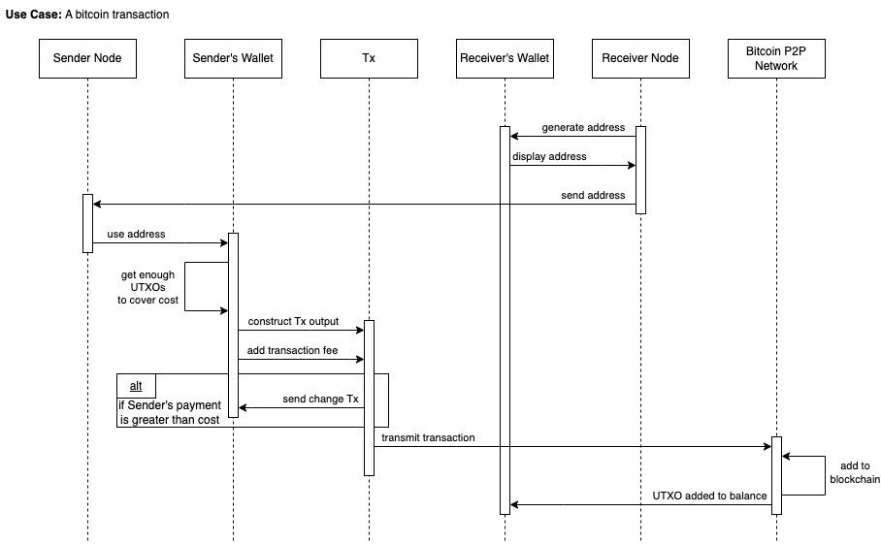

Slide 21
Use Case 2: Bitcoin Mining

Slide 22
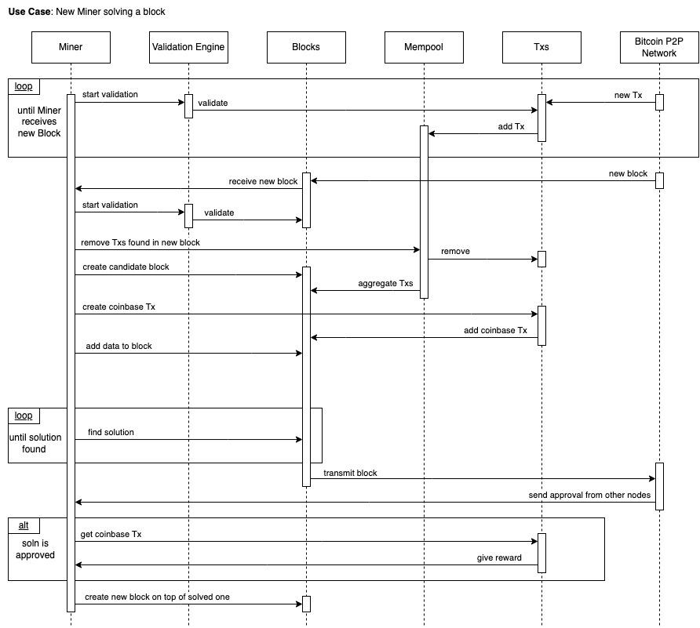

Slide 23
Limitations
& Lessons Learned
Officiality
Teamwork
Validity
Broader View
L1
LL1
No official documentation
Filter through unreliable sources
Reflective of conceptual arc
Working backwards
Open Communication
Bi-weekly meetings
L2
LL2
Testing was impossible
Sample multiple examples
Infer results
Social impacts
Economical impacts
Potential for future

Slide 24
Conclusions
Layered Architecture
Peer-to-peer Network
Components
Concurrency & Evolution
Interactions
Moving Forward
Bitcoin Core comprises of 11 main components
Organized in primarily in a layered architecture
This architecture makes use of a peer-to-peer network of nodes
We discussed the interactions between the system and it’s users, its developers, and other components
Concurrency and evolution necessary for Bitcoin Core to maintain functionality
We are excited to delve deeper into the concrete architecture in the subsequent report

