Slide 1
YOUR LOGO
Pattern: title slide
AI for Computational Pathology
and Spatial Omics
From whole-slide images and cell graphs to a survival model and a draft report
Presenter Name, Role
Department, Institution
Meeting name · Month DD, YYYY
Notes:
PATTERN: title slide. The first slide carries the talk title, the presenter, affiliation and date; it has no topic-title chrome and no page number.
Design rules shown: logo placeholder top left; title in a horizontal band with a thin accent bar on its left (0.1 x 1.86 in) and a full-width accent rule near the bottom (y 6.83); the title wraps onto two lines inside one text box; presenter, affiliation and date right-aligned under the title. The presenter's name appears only here (and in literature citations), never in notes, code or other slides.
Illustrative example: a design example, not a real study. Placeholders (n = XX) stand where a real deck would put numbers from its own result tables.

Slide 2
YOUR LOGO
Agenda
Pattern: agenda / roadmap
01
Background
Why tissue architecture matters
02
Data and methods
Slides, spatial omics and the survival model
03
Results
Risk score and model comparison
04
Report-drafting agent
LLM / VLM agent that writes a draft report
05
Limitations and next steps
What the results can and cannot support
1
Notes:
PATTERN: agenda / roadmap. Show it after the title, and again at each section start with that section highlighted, so the audience always knows where they are. Four to six sections; more is a table of contents.
Design rules shown: numbered rows; the current section has an accent numeral, black name, tint band and accent edge bar; the other sections are muted grey; one short subtitle per section, no bullets. Reuse the same geometry on every repeat so only the highlight moves.
Illustrative example: a design example, not a real study. Placeholders (n = XX) stand where a real deck would put numbers from its own result tables.

Slide 3
YOUR LOGO
Pattern: section divider
02
Data and methods
Slides, spatial omics and the survival model
2
Notes:
PATTERN: section divider. Use it between major blocks of a long talk (20 minutes or more) as a pause; in a short talk the repeated agenda slide does the same job.
Design rules shown: no topic title, nothing to read except the number and the section name (the same words as on the agenda); one accent numeral, a thin grey rule, white space. The page number stays.
Illustrative example: a design example, not a real study. Placeholders (n = XX) stand where a real deck would put numbers from its own result tables.

Slide 4
YOUR LOGO
Background
Pattern: big statement
Whole-slide images can be learned from slide-level labels alone, without drawing a single region.
Weak supervision: attention-based multiple-instance learning finds the regions that drive a slide label
Scale: one label per slide makes routine archives usable, not only annotated sets
Open question: the same idea for outcome (survival), and for spatial omics next to H&E
Lu, Ming Y., et al. Nature Biomedical Engineering 5.6 (2021): 555–570
3
Notes:
PATTERN: big statement. Use it to open the background with the one sentence the audience should accept before the study makes sense; two or three bullets give the support, a citation backs the claim.
Design rules shown: the statement is a complete sentence in 30 pt bold black next to a thin accent bar; bullets 18 pt grey with a bold lead phrase; the citation sits in the source position, 9 pt serif, journal in italics, format 'Surname, Given, et al. Journal vol.issue (year): pages'. No separate conclusion box: the statement is the take-home line.
Reference: CLAM, data-efficient weakly supervised computational pathology on whole-slide images; PMID 33649564, doi 10.1038/s41551-020-00682-w (checked against PubMed metadata).
Illustrative example: a design example, not a real study. Placeholders (n = XX) stand where a real deck would put numbers from its own result tables.

Slide 5



YOUR LOGO
Problem, Approach and Impact
Pattern: problem → approach → impact
PROBLEM
APPROACH
IMPACT
Spatial context is lost
Learn from the tissue
Stratify patients by risk
Tile models average away where cells sit
Foundation-model tiles plus cell graphs, trained on outcome
A reproducible score and a draft report for review
Goal: a risk score from routine slides and spatial data that a pathologist can check.
4
Notes:
PATTERN: problem → approach → impact. Use it once, early, to frame the whole talk in three steps the audience can repeat. Each column answers one question: what is wrong, what we do, what changes.
Design rules shown: three equal columns on one grid; one icon per column, same size (0.9 in) and same colour; a small accent tag, a short header (four or five words) and two lines of body text; thin grey arrows between the columns; a single take-home line at the bottom.
Icons: lucide/scan-eye, lucide/brain-circuit, lucide/users (ISC).
Illustrative example: a design example, not a real study. Placeholders (n = XX) stand where a real deck would put numbers from its own result tables.

Slide 6
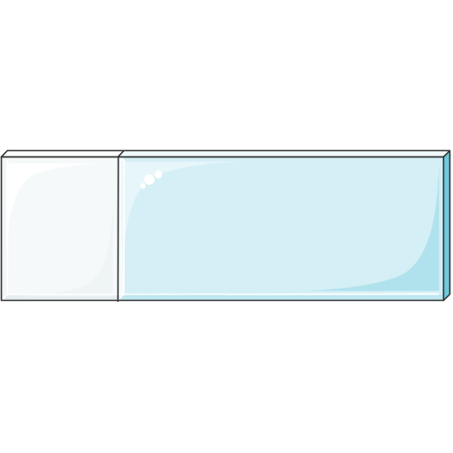
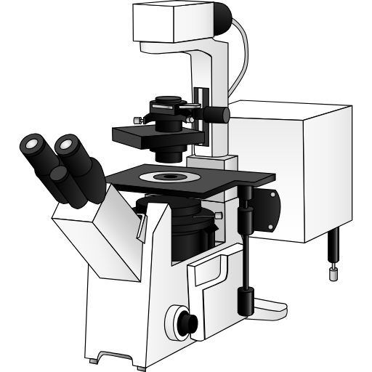
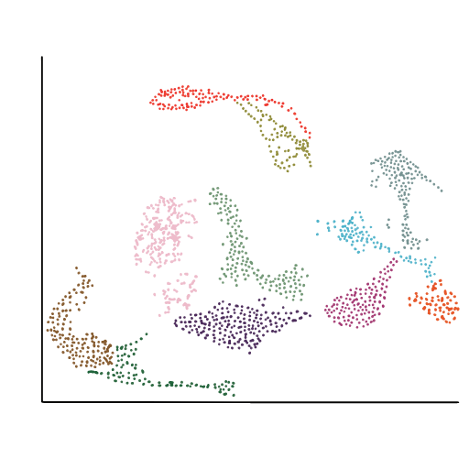

YOUR LOGO
Data Modalities
Pattern: data modalities grid
H&E whole-slide images
Multiplex imaging
Single-cell phenotypes
Clinical and outcome
Scanned at 40×, one per resection
40-plex protein panel on a subset
Cell types called from the panel
Stage, therapy, recurrence-free survival
n = XX slides
n = XX regions
n = XX cells
n = XX patients
Four modalities from the same patients, linked by patient ID; multiplex data exist for a subset only.
Icons: Bioicons — glass slide by Servier Medical Art (CC BY 3.0); confocal microscope by DBCLS TogoTV (CC BY 4.0)
5
Notes:
PATTERN: data modalities grid. Use it before the methods, so the audience knows what goes in and how much of each there is. One card per modality; four in a row, or 2 x 2 when each card needs two lines more.
Design rules shown: equal cards on one grid with a thin accent top edge; one illustration per card at the same size (1.5 in square box) from one icon source; a header, one line of detail and the count in accent. Counts are placeholders (n = XX) here; in a real deck they come from the cohort table and are the same numbers as on the cohort slide.
Icons: Bioicons glass-slide (Servier Medical Art, CC BY 3.0) and confocal-microscope (DBCLS TogoTV, CC BY 4.0) need attribution, given on the source line and on the credits slide; single-cell-umap (James Lloyd) and patient (Marcel Tisch) are CC0.
Illustrative example: a design example, not a real study. Placeholders (n = XX) stand where a real deck would put numbers from its own result tables.

Slide 7





YOUR LOGO
Methods — Slide to Survival
Pattern: methods flow
1 · Tile
2 · Embed
3 · Aggregate
4 · Score
5 · Survival
Tissue tiles at 20×; background masked out
Frozen pathology foundation model; one vector per tile
Attention MIL or cell graph pools tiles per slide
Linear Cox head: one risk score per patient
Cox model and KM by median score; 5-fold CV
MIL (multiple-instance learning): the slide label is known, the tile labels are not
Foundation model: pretrained on unlabelled tiles; its weights stay frozen, only later layers train
Folds split by patient, so tiles of one patient are never in both training and test
Tiling and embeddings are fixed before outcomes are seen; only the aggregator and the Cox head are trained on survival.
MIL: multiple-instance learning; KM: Kaplan–Meier; CV: cross-validation.
6
Notes:
PATTERN: methods flow. Use it for a processing pipeline of three to five steps; each card says what is done and the key parameter, never a result.
Design rules shown: one row of equal step cards 0.32 in apart with a small grey arrow between them; accent header '1 · Step' in 14 pt white bold; tint body in 13 pt near-black; one accent icon per card, same size and position (0.6 in, top left of the body); definitions as 14 pt bullets under the row; one take-home line.
Icons: tabler/grid-scan, tabler/cube-spark, lucide/network, tabler/chart-histogram, lucide/trending-down (MIT / ISC). Parameters (20×, 5 folds) are illustrative settings, not results.
Illustrative example: a design example, not a real study. Placeholders (n = XX) stand where a real deck would put numbers from its own result tables.

Slide 8




YOUR LOGO
Framework Overview
Pattern: framework diagram
PROCESSING
H&E slides
Tile + embed
Attention MIL
Fusion
+ Cox head
Risk score
per patient
Multiplex imaging
Segment cells
Cell graph GNN
Attention maps
per slide
Clinical data
Encode covariates
Image, cell-graph and clinical features are fused into one patient-level risk score.
MIL: multiple-instance learning; GNN: graph neural network.
7
Notes:
PATTERN: framework diagram (inputs → processing band → outputs). Use it once as the map of the whole analysis; later slides zoom into one part of it.
Design rules shown: the processing layer is a tint band; steps inside it are white boxes joined by thin grey arrows; outside the band only thick accent arrows, exactly one per input and one per output; inputs on the left, outputs on the right, rows aligned on the same centre lines. Every icon is its own image and every label a native text box, so the diagram can be edited in PowerPoint.
Icons: lucide/microscope, tabler/stack-2, lucide/clipboard-list (inputs); tabler/chart-histogram, tabler/photo-scan (outputs).
Illustrative example: a design example, not a real study. Placeholders (n = XX) stand where a real deck would put numbers from its own result tables.

Slide 9







YOUR LOGO
Report-drafting Agent
Pattern: agent loop
Tools the agent can call
1 · Plan
VLM slide reader
Describes a region the model attended to
Feature store
Returns the patient's risk score and inputs
4 · Draft report
LLM agent
2 · Use tools
Guideline lookup
Retrieves the reporting criteria text
Stop: draft goes to a pathologist for sign-off
3 · Observe
The agent drafts the report; a pathologist signs it off, and every statement points to a tool output.
LLM: large language model; VLM: vision-language model.
8
Notes:
PATTERN: agent loop. Use it to explain an LLM / VLM agent: what it plans, which tools it may call, what it observes and when it stops. A loop reads as iteration; a straight line would hide that the agent revises.
Design rules shown: four numbered steps on a diamond, one accent icon each (same size, 0.65 in), joined by thin grey arrows; the agent itself in the centre in grey; the tool list on the right as icon + bold name + one line; the stop condition (human sign-off) in a tint box. All shapes and arrows are native and editable.
Icons: lucide/list-checks, lucide/toolbox, lucide/scan-eye, lucide/message-square-text, lucide/bot, lucide/book-open-text (ISC); tabler/photo-scan, tabler/api (MIT).
Illustrative example: a design example, not a real study. Placeholders (n = XX) stand where a real deck would put numbers from its own result tables.

Slide 10





YOUR LOGO
Study Design — Patient Timeline
Pattern: timeline
Diagnosis
t = 0; biopsy confirms cancer
Adjuvant therapy
Chemotherapy or hormone therapy
Event or censoring
Recurrence or death
Time from diagnosis
Surgery
Tissue scanned and imaged
Follow-up
Visits until event or last contact
Recurrence-free survival runs from diagnosis to recurrence or death; in GBSG2, 299 of 686 patients had an event and the rest were censored at last follow-up.
Source: GBSG2 trial (lifelines load_gbsg2); event counts
9
Notes:
PATTERN: timeline / study design. Use it to define the time axis of a survival analysis (time zero, exposure window, event, censoring) or to show project phases. Three to six milestones.
Design rules shown: one horizontal axis with an arrow head; round markers on the axis, filled accent for the two that define the endpoint (time zero and event), white with a grey ring for the rest; labels alternate above and below so they never collide; one icon per milestone from one icon source, all the same size; a thin grey stem joins each marker to its label.
Numbers: 686 patients and 299 recurrence-or-death events from lifelines load_gbsg2; the timeline itself is the illustrative study's design, not GBSG2's.
Icons: Health Icons biopsy, tissue, hospital, regular-patient, chart-line (CC0).
Illustrative example: a design example, not a real study. Placeholders (n = XX) stand where a real deck would put numbers from its own result tables.

Slide 11
YOUR LOGO
Prior Approaches vs This Work
Pattern: two-column comparison
Prior approaches
This work
Labels needed
Pixel-level annotation
Slide-level outcome only
Spatial context
Tile features averaged
Cell graph keeps neighbours
Modalities
H&E only
H&E, multiplex and clinical
Validation
Often external cohorts
Internal 5-fold CV so far
Report
Written by hand
Agent drafts, human signs off
This work trades external validation for richer inputs; the gap is listed under limitations.
CV: cross-validation.
10
Notes:
PATTERN: two-column comparison (prior approaches vs this work, or pros vs cons). Use it when the audience needs the difference on a few named criteria, not a literature review.
Design rules shown: one row per criterion with the criterion name on the left, so the two columns are read across, not down; markers drawn from native shapes (accent check = has it, grey cross = lacks it, grey dash = partly) instead of symbol-font glyphs that may be missing on another machine; 'This work' column on a tint band with an accent header; rows separated by thin rules. Be honest: show where prior work is better (validation here) and say so in the take-home line.
Illustrative example: a design example, not a real study. Placeholders (n = XX) stand where a real deck would put numbers from its own result tables.

Slide 12
YOUR LOGO
Limitations
Pattern: limitations
LIMITATION
WHAT IT AFFECTS
1
Single-centre cohort
Other scanners, stains and sites are untested
2
No external validation yet
Performance is cross-validated on one cohort
3
Multiplex data on a subset (n = XX)
Fusion model trained on fewer patients
4
Agent reports not yet graded
Draft accuracy unknown; drafts only
These results are exploratory; an external cohort is needed before any clinical claim.
11
Notes:
PATTERN: limitations. Use it before the summary, so the take-home messages are heard with their caveats. Three or four limitations, each paired with what it affects; a list without consequences reads as ritual.
Design rules shown: calm grey styling (no accent: limitations are not highlights); numbered rows with the limitation in bold and its consequence in the right column; thin rules between rows; the take-home line names the status of the results (exploratory) and what is needed next.
Illustrative example: a design example, not a real study. Placeholders (n = XX) stand where a real deck would put numbers from its own result tables.

Slide 13
YOUR LOGO
Summary
Pattern: key takeaways
1
Routine slides and spatial data feed one risk score
Tiling and embeddings fixed; only the aggregator and Cox head see outcomes (methods flow)
2
Cell graphs add the spatial context that tile averages lose
C-index XX vs XX, 5-fold CV (n = XX patients); placeholders for this example
3
An agent drafts the report; a pathologist signs it off
Every statement links back to a tool output (agent loop)
C-index: concordance index; CV: cross-validation.
12
Notes:
PATTERN: key takeaways. Use it as the last content slide: three numbered messages the audience should leave with, each backed by one line of evidence from an earlier slide.
Design rules shown: accent numerals (44 pt) as the only colour; each takeaway a short bold claim in black, then one grey evidence line; thin rules between rows; no conclusion box, because the takeaways are the conclusion. No number may appear here that was not on an earlier result slide, and the wording keeps the earlier qualifiers (candidate, exploratory).
Illustrative example: a design example, not a real study. Placeholders (n = XX) stand where a real deck would put numbers from its own result tables.

Slide 14


YOUR LOGO
Next Steps
Pattern: next steps / roadmap
Next 3 months
3–6 months
6–12 months
External validation
Grade agent reports
Release
Second cohort, other scanner
Frozen model, no retraining
Blinded scoring of n = XX
Errors logged per tool
Code and model card
Preprint, no placeholders
External validation comes first; its result decides whether the later steps go ahead.
13
Notes:
PATTERN: next steps / roadmap. Use it at the end of a progress talk: three time-boxed cards, the first one highlighted because it is the decision point.
Design rules shown: equal cards on one grid under a thin grey time arrow; a dark header with the timeframe (accent only for the first, the current priority); one icon, a short title and two bullets per card; the take-home line says what the plan depends on.
Icons: lucide/users, lucide/list-checks, lucide/code (ISC; code is MIT via Feather).
Illustrative example: a design example, not a real study. Placeholders (n = XX) stand where a real deck would put numbers from its own result tables.

Slide 15

YOUR LOGO
Pattern: questions / thank you
Thank you
Questions and discussion
contact@institution.org
github.com/<org>/<repo>
Notes:
PATTERN: questions / thank you. Use the same frame as the title slide so the talk visibly closes; leave it up during questions, with a way to reach the team and the code.
Design rules shown: same logo, accent bar and bottom rule as the title slide; no page number; contact as a generic address (a team or lab address, not a person's name); small grey icons in front of each contact line.
Illustrative example: a design example, not a real study. Placeholders (n = XX) stand where a real deck would put numbers from its own result tables.

Slide 16
YOUR LOGO
Supplementary — Model Settings
Pattern: supplementary (hidden)
Component | Setting | Value | Fixed before outcomes?
Tiling | Tile size; magnification | 256 × 256 px; 20× | Yes
Tissue mask | Threshold on saturation | Otsu | Yes
Foundation model | Encoder; embedding dimension | Frozen ViT; XX | Yes
Attention MIL | Hidden units; dropout | XX; XX | Yes
Cell graph | Edges; neighbours per cell | k-nearest neighbours; k = XX | Yes
Cox head | Penalty; learning rate; epochs | L2 XX; XX; XX | Tuned in inner folds
Cross-validation | Folds; split unit; random_state | 5; patient; 0 | Yes
Agent | Model; temperature; max tool calls | XX; 0; XX | Yes
All settings except the Cox penalty were fixed before outcome data were used; random_state is recorded in run_meta.json.
MIL: multiple-instance learning; ViT: vision transformer; L2: ridge penalty.
14
Notes:
PATTERN: supplementary slide, hidden in the slide show (slide.hidden = true, show="0"). Use it for the dense settings table you expect a question about; it stays in the file and the PDF but is skipped when presenting.
Design rules shown: same chrome as a main slide (topic title, conclusion, abbreviations); the three-line table may be denser (13 pt, nine rows) because it is read on demand; first column bold and left-aligned, the others centred. Values marked XX are placeholders; the settings shown are illustrative choices.
Illustrative example: a design example, not a real study. Placeholders (n = XX) stand where a real deck would put numbers from its own result tables.

Slide 17
YOUR LOGO
Credits
Pattern: credits
Source | Icons used in this deck | Licence
Health Icons (healthicons.org) | biopsy, tissue, hospital, regular-patient, chart-line | CC0 1.0
Lucide (lucide.dev) | scan-eye, brain-circuit, users, network, trending-down, microscope, clipboard-list, list-checks, toolbox, message-square-text, bot, book-open-text, code | ISC (code: MIT, Feather)
Tabler Icons (tabler.io/icons) | grid-scan, cube-spark, chart-histogram, stack-2, photo-scan, api | MIT
Bioicons (bioicons.com) | glass-slide — Servier Medical Art (smart.servier.com) | CC BY 3.0
 | confocal-microscope — DBCLS TogoTV | CC BY 4.0
 | single-cell-umap — James Lloyd; patient — Marcel Tisch | CC0 1.0
Data: GBSG2 trial counts (686 patients, 299 recurrence-or-death events) via lifelines load_gbsg2.
Reference: Lu, Ming Y., et al. Nature Biomedical Engineering 5.6 (2021): 555–570.
All other content is an illustrative example; values marked XX are placeholders.
15
Notes:
PATTERN: credits. Use it as the very last slide (after the supplementary slides) whenever the deck uses third-party icons, images or data: list every source actually used with its licence, and the author for attribution licences (CC BY). CC BY icons are also credited on the slide where they appear.
Design rules shown: one three-line table (source, items, licence), first column left, others centred; data and literature sources in plain text below. Authors of icons and references are the only person names in the deck besides the presenter placeholder.
Illustrative example: a design example, not a real study. Placeholders (n = XX) stand where a real deck would put numbers from its own result tables.

