Slide 1
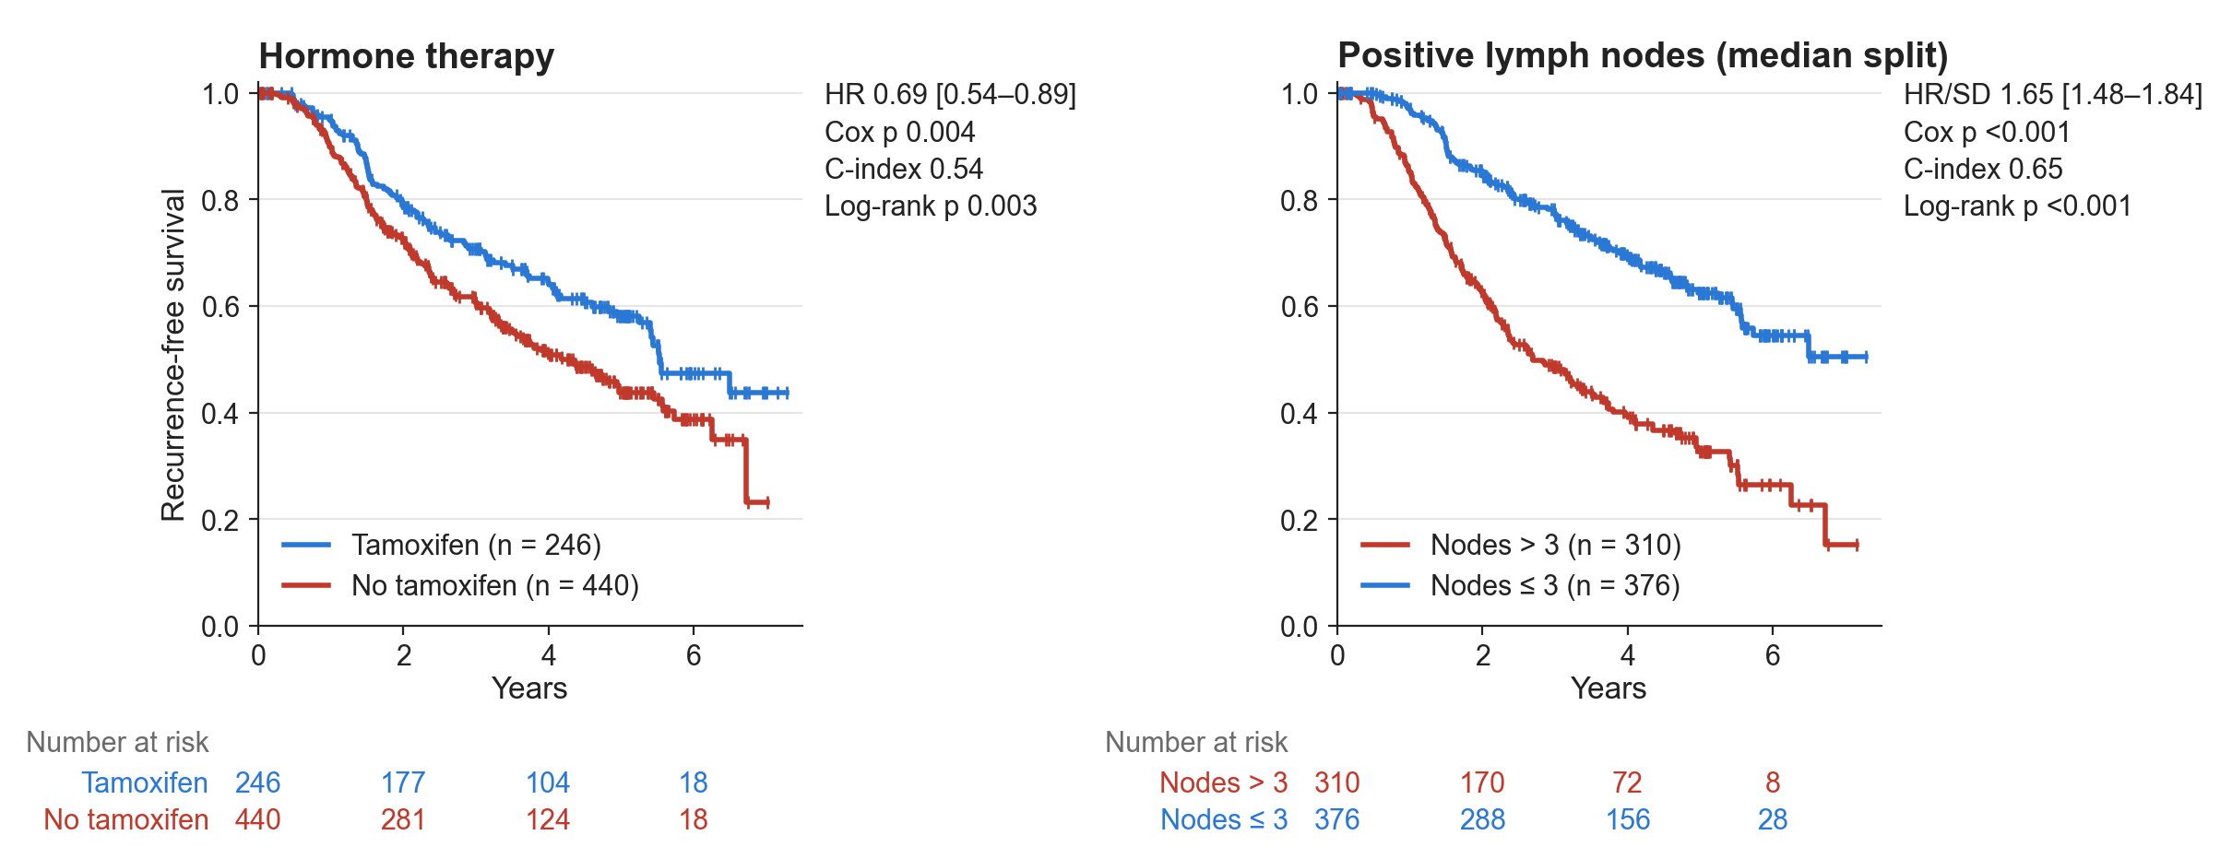
YOUR LOGO
Recurrence-free Survival
Pattern: assertion–evidence
Tamoxifen is associated with longer, and more positive nodes with shorter, recurrence-free survival (HR 0.69 [0.54–0.89], p = 0.004; HR 1.65 [1.48–1.84] per SD, p < 0.001; n = 686, 299 events).
Source: GBSG2 trial (lifelines load_gbsg2); Kaplan–Meier, univariate Cox and log-rank, recurrence-free survival
HR: hazard ratio; SD: standard deviation; C-index: concordance index.
1
Notes:
PATTERN: assertion–evidence. Use it for the main result of a section: one figure, one sentence.
Design rules shown: the title names the topic, not the finding; the figure is drawn at its on-slide size (12.1 x 4.6 in, 200 dpi) and placed 1:1, never scaled; the single bold conclusion at the bottom carries the effect size with interval, p, n and events; the source line sits bottom right in 9 pt serif.
Numbers: km_example run_meta (hormone_therapy: HR 0.695 [0.544–0.888], Cox p 0.0036, log-rank p 0.0034; log_pnodes: HR per SD 1.650 [1.479–1.841], Cox p 3.5e-19). HR for tamoxifen is yes vs no; nodes per SD of log(1 + nodes).
Wording: observational association, so 'associated with', not 'improves'.

Slide 2
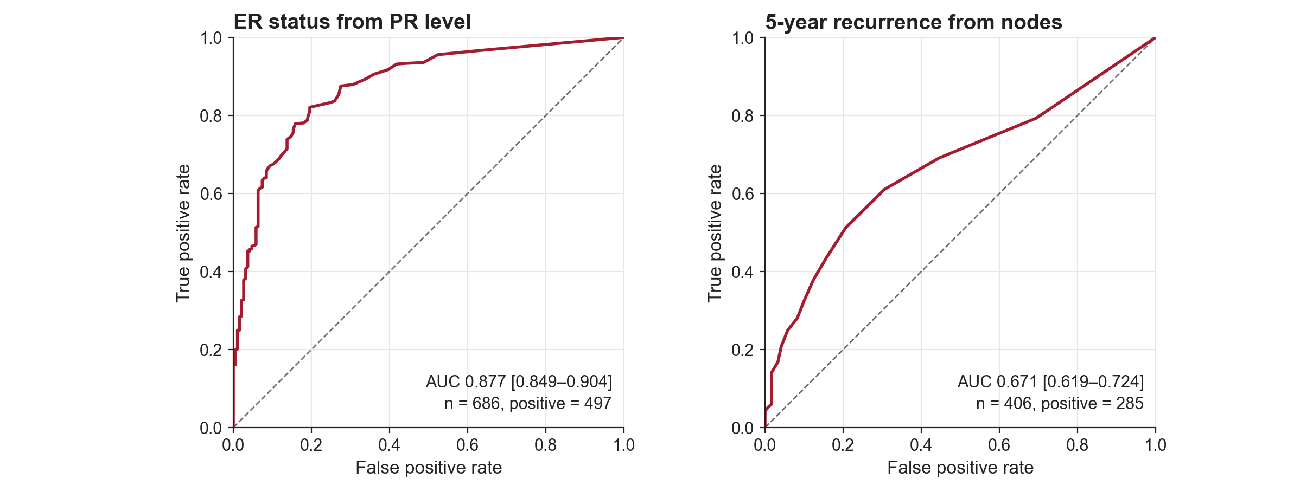
YOUR LOGO
Discrimination — ROC
Pattern: two panels, one conclusion
PR level separates ER status well (AUC 0.877 [0.849–0.904]; 497 of 686 ER-positive), whereas nodes predict 5-year recurrence only moderately (AUC 0.671 [0.619–0.724]; 285 of 406 recurred).
Source: GBSG2 trial (lifelines load_gbsg2); ROC with 2,000-sample bootstrap 95% CI, random_state 0
ROC: receiver operating characteristic; AUC: area under the curve; PR: progesterone receptor; ER: oestrogen receptor.
2
Notes:
PATTERN: two panels side by side with one shared conclusion. Use it when two analyses answer the same question (here: how well does one variable discriminate) and the comparison is the point.
Design rules shown: both ROC panels are square and the same size, drawn in ONE native full-width figure (12.1 x 4.6 in); each panel states AUC [95% CI], n and positives; the diagonal marks chance.
Why not two separate figures: roc_example.png is already full width (12.1 in) and auc_bars_example.png is half width (5.9 in), so together they would need 18 in. Result figures are never scaled, so the pair would not fit; the two-panel ROC figure is used instead (the AUC bars appear on the figure + takeaways slide).
Numbers: roc_example run_meta. ER-positive = oestrogen receptor >= 10 fmol/mg (n = 686, 497 positive). 5-year panel: recurrence or death before 5 years (285) vs followed >= 5 years event-free; patients censored before 5 years are excluded (n = 406). Bootstrap: 2,000 resamples, percentile CI, random_state 0.
Caution: PR and ER are correlated receptor assays, so AUC 0.877 shows co-expression, not a clinical test.

Slide 3
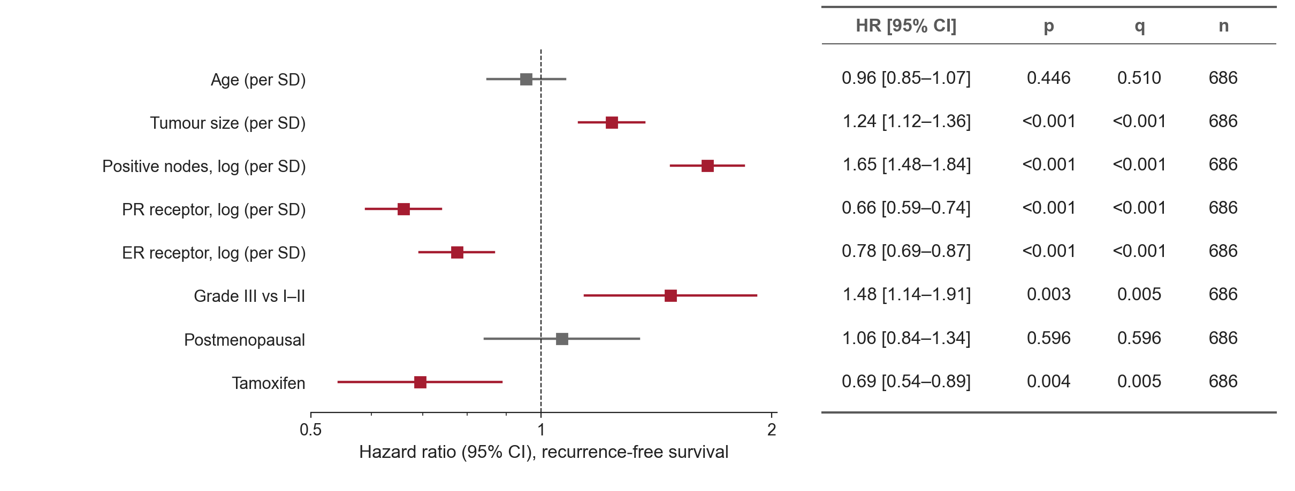
YOUR LOGO
Clinical Factors — Univariate Cox
Pattern: forest plot
More positive lymph nodes are most strongly associated with shorter recurrence-free survival (HR 1.65 [1.48–1.84] per SD, q < 0.001; n = 686, 299 events).
Source: GBSG2 trial (lifelines load_gbsg2); univariate Cox, recurrence-free survival
HR: hazard ratio; CI: confidence interval; SD: standard deviation; PR: progesterone receptor; ER: oestrogen receptor; q: Benjamini–Hochberg adjusted p.
3
Notes:
PATTERN: forest plot, full width. Use it for many effect sizes on one scale (one row per factor).
Design rules shown: log x axis with a reference line at 1; the number column on the right is a three-line table with centred columns; only rows with q < 0.05 are drawn in the accent colour, the rest grey; HR is per SD for continuous and yes vs no for binary factors, fixed once for the whole deck.
Numbers: forest_example run_meta (8 univariate Cox models, Benjamini–Hochberg q over the 8). Strongest: positive nodes, log(1 + nodes) per SD, HR 1.650 [1.479–1.841], p 3.5e-19.
'Strongest' means largest |log HR| per SD in univariate models; it is not adjusted for the other factors.

Slide 4
YOUR LOGO
Cohort Characteristics
Pattern: native three-line table
Characteristic | All n = 686 | Tamoxifen n = 246 | No tamoxifen n = 440
Age, years, median (IQR) | 53 (46–61) | 58 (50–63) | 50 (45–59)
Postmenopausal, n (%) | 396 (58%) | 187 (76%) | 209 (48%)
Tumour size, mm, median (IQR) | 25 (20–35) | 25 (20–35) | 25 (20–35)
Grade III, n (%) | 161 (23%) | 50 (20%) | 111 (25%)
Positive nodes, median (IQR) | 3 (1–7) | 3 (1–7) | 3 (1–7)
Recurrence or death, n (%) | 299 (44%) | 94 (38%) | 205 (47%)
Women given tamoxifen were older (median 58 vs 50 years) and more often postmenopausal (76% vs 48%); tumour size, grade and nodes were similar (n = 686).
Source: GBSG2 trial (lifelines load_gbsg2); descriptive statistics by hormone therapy
IQR: interquartile range.
4
Notes:
PATTERN: native three-line table. Use it for a cohort table or any small grid of numbers the audience reads cell by cell; native tables stay editable and sharp, unlike a table pasted as an image.
Design rules shown: three rules only (thick top, thin under header, thick bottom), no vertical lines, no fill; first column left-aligned, all other columns centred (header and values share a centre); header bold, same size as the body; n per group in the header; ranges with an en dash.
Numbers: recomputed from lifelines load_gbsg2 (same code as fig_table in make_example_figures.py).
Over-reading: the age and menopause imbalance means the univariate tamoxifen HR may be confounded; see the multivariable supplementary slide.

Slide 5
YOUR LOGO
Study at a Glance
Pattern: key numbers
686
299
0.69
patients
recurrence-or-death events
HR, tamoxifen vs none
Node-positive breast cancer
44% of patients
95% CI 0.54–0.89; p = 0.004
Tamoxifen is associated with longer recurrence-free survival (HR 0.69 [0.54–0.89], p = 0.004; n = 686, 299 events).
Source: GBSG2 trial (lifelines load_gbsg2); univariate Cox, recurrence-free survival
HR: hazard ratio; CI: confidence interval.
5
Notes:
PATTERN: key numbers ('big number'). Use it sparingly: opening a results section, or the one slide people should remember. Three numbers at most; each needs a one-line label and its context (interval, denominator).
Design rules shown: large numerals in the single accent colour, labels in grey, no decoration; conclusion and source still present, so the big number is never shown without its n and interval.
Numbers: n and events from load_gbsg2; 44% = 299/686; median observed time (not reverse Kaplan–Meier follow-up) 3.0 years; HR from km_example run_meta (0.695 [0.544–0.888], p 0.0036).

Slide 6
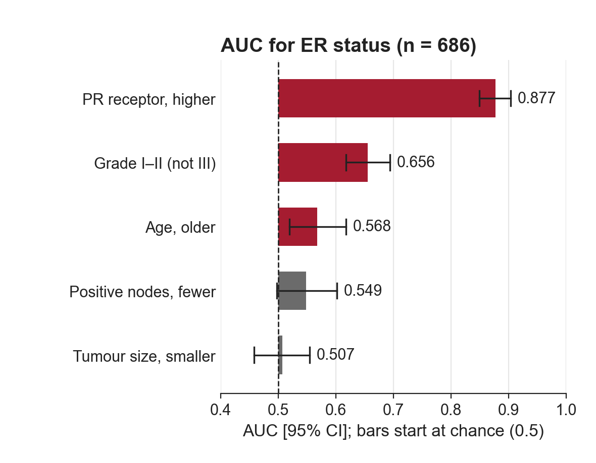
YOUR LOGO
Single Predictors of ER Status
Pattern: figure + takeaways
Takeaways
PR level is by far the strongest (AUC 0.877)
Grade and age add little (AUC 0.656, 0.568)
Nodes and tumour size: CIs include 0.5
Of five clinical variables, only PR level discriminates ER status well (AUC 0.877 [0.849–0.904]; 497 of 686 ER-positive).
Source: GBSG2 trial (lifelines load_gbsg2); AUC with 2,000-sample bootstrap 95% CI, random_state 0
AUC: area under the curve; CI: confidence interval; ER: oestrogen receptor; PR: progesterone receptor.
6
Notes:
PATTERN: figure + takeaways split. Use it when a half-width figure needs two or three reading hints that do not fit into one sentence. The takeaways guide the eye; the conclusion still states the one finding.
Design rules shown: the figure is drawn half width (5.9 x 4.6 in) and placed 1:1 on the left; at most three short grey bullets at 18 pt on the right; bars start at chance (0.5); accent = CI excludes 0.5.
Numbers: auc_bars_example run_meta (n = 686, 497 ER-positive, 2,000 bootstrap resamples, random_state 0). Grade I–II [0.618–0.694], age [0.519–0.618], nodes [0.498–0.602], tumour size [0.458–0.554].
Over-reading: the direction of the flipped predictors (grade, nodes, size) was read off the same data, so AUCs near 0.5 are descriptive only.

Slide 7
YOUR LOGO
Reading the Kaplan–Meier Panel
Pattern: callout
Number at risk
Patients still event-free and followed at 0, 2, 4 and 6 years. Only 18 per arm remain at 6 years.
By 6 years only 18 women per arm remain at risk, so the curves beyond 6 years rest on few patients (n = 686, 299 events).
Source: GBSG2 trial (lifelines load_gbsg2); Kaplan–Meier, univariate Cox and log-rank, recurrence-free survival
HR: hazard ratio; SD: standard deviation; C-index: concordance index.
7
Notes:
PATTERN: callout / annotated figure. Use it when the audience must learn to read a figure type (first KM in a talk, an unfamiliar plot), or when one region carries the message.
Design rules shown: the figure itself is unchanged and placed 1:1; the highlight is a thin accent rectangle and the callout a small native text box joined by a thin line, so both stay editable and can be removed; the callout sits in white space and covers no data.
Numbers: at-risk counts drawn in km_example (follow-up >= t): tamoxifen 246, 177, 104, 18; no tamoxifen 440, 281, 124, 18 at 0, 2, 4, 6 years.

Slide 8
YOUR LOGO
Clinical Factors — Univariate Cox
Pattern: progressive emphasis 1/2
Hazard ratios range from 0.66 per SD (PR receptor) to 1.65 per SD (positive nodes) across eight clinical factors (n = 686, 299 events).
Source: GBSG2 trial (lifelines load_gbsg2); univariate Cox, recurrence-free survival
HR: hazard ratio; CI: confidence interval; SD: standard deviation; PR: progesterone receptor; ER: oestrogen receptor; q: Benjamini–Hochberg adjusted p.
8
Notes:
PATTERN: progressive emphasis, step 1 of 2. Use two consecutive slides with the same figure in the same position instead of an animation: step 1 shows the whole picture, step 2 adds a highlight and a new conclusion. It survives PDF export and printed handouts, where animations are lost.
Design rules shown: the figure does not move between the two slides (identical x, y, size), so flipping between them reads as a build; the highlight is a semi-transparent accent box over the q < 0.05 rows only; the conclusion changes with the emphasis.
Numbers: forest_example run_meta. q < 0.05: tumour size, nodes, PR, ER, grade III, tamoxifen (largest q = 0.0048 for grade III and tamoxifen). Not significant: age (q 0.510), postmenopausal (q 0.596).

Slide 9
YOUR LOGO
Clinical Factors — Univariate Cox
Pattern: progressive emphasis 2/2
Six of eight factors have q < 0.05 (all q ≤ 0.005): larger tumours, more nodes and grade III with shorter, higher receptor levels and tamoxifen with longer recurrence-free survival.
Source: GBSG2 trial (lifelines load_gbsg2); univariate Cox, recurrence-free survival
HR: hazard ratio; CI: confidence interval; SD: standard deviation; PR: progesterone receptor; ER: oestrogen receptor; q: Benjamini–Hochberg adjusted p.
9
Notes:
PATTERN: progressive emphasis, step 2 of 2. Use two consecutive slides with the same figure in the same position instead of an animation: step 1 shows the whole picture, step 2 adds a highlight and a new conclusion. It survives PDF export and printed handouts, where animations are lost.
Design rules shown: the figure does not move between the two slides (identical x, y, size), so flipping between them reads as a build; the highlight is a semi-transparent accent box over the q < 0.05 rows only; the conclusion changes with the emphasis.
Numbers: forest_example run_meta. q < 0.05: tumour size, nodes, PR, ER, grade III, tamoxifen (largest q = 0.0048 for grade III and tamoxifen). Not significant: age (q 0.510), postmenopausal (q 0.596).

Slide 10
YOUR LOGO
Feature Definitions
Pattern: feature-definition table
Feature | Low → high | What is computed (unit) | Higher value | Lower value | HR > 1 means
Age | 21 → 80 years | Age at entry (years) per SD = 10.1 years | Older | Younger | Older recur sooner
Tumour size | 3 → 120 mm | Largest diameter (mm) per SD = 14.3 mm | Larger | Smaller | Larger recur sooner
Positive nodes | 1 → 51 nodes | log(1 + nodes) per SD = 0.72 | More nodes | Fewer nodes | More nodes recur sooner
PR receptor | 0 → 2,380 fmol/mg | log(1 + PR, fmol/mg) per SD = 1.93 | More PR | Less PR | More PR recur sooner
Grade III | I–II → III | Grade III vs I–II yes vs no | Grade III | Grade I–II | Grade III recur sooner
Continuous features are scaled per SD in this cohort (n = 686), so HR > 1 means a one-SD higher value goes with shorter recurrence-free survival.
Source: GBSG2 trial (lifelines load_gbsg2); ranges and SDs over all 686 patients
HR: hazard ratio; SD: standard deviation; PR: progesterone receptor.
10
Notes:
PATTERN: feature-definition table. Use it before the first result that uses engineered or transformed features, so 'HR 1.65 per SD' can be read without the methods section.
Design rules shown: three-line table; first column left (bold feature names), all other columns centred; the 'Low → high' column gives the observed range (text here; a pair of small icons can replace it when suitable ones exist); the last column turns the sign of the HR into plain words.
Numbers: min, max and SD recomputed from load_gbsg2 (SD of log1p values for nodes and PR). The 'HR > 1 means' column defines how to read the sign; the observed direction for PR is HR < 1 (forest plot).

Slide 11
YOUR LOGO
Model Comparison — C-index
Pattern: model comparison
Cox model | Variables | Apparent C-index | 5-fold CV C-index
Positive nodes | 1 | 0.645 | 0.646
Nodes + size + grade | 3 | 0.655 | 0.650
All clinical | 8 | 0.698 | 0.688
All clinical = nodes, tumour size, grade III, age, postmenopausal, PR, ER and tamoxifen. Apparent C-index: fitted and evaluated on the same 686 patients.
Adding all eight clinical variables raises the apparent C-index from 0.645 (nodes only) to 0.698 on the same patients (n = 686, 299 events); 5-fold CV gives 0.688.
Source: GBSG2 trial (lifelines load_gbsg2); multivariable Cox, Harrell's C; KFold(5, shuffle, random_state 0)
C-index: concordance index; CV: cross-validation; PR: progesterone receptor; ER: oestrogen receptor.
11
Notes:
PATTERN: model comparison table. Use it to compare nested models on one metric; order rows from simplest to fullest so the gain per added block reads top to bottom.
Design rules shown: three-line table, numbers to three decimals in every column; the apparent C-index is labelled as apparent (same patients), next to a cross-validated value; the conclusion says 'same patients'.
Numbers: recomputed from load_gbsg2. Continuous variables standardised (per SD); nodes, PR and ER as log(1 + x). Apparent C-index = lifelines concordance_index_ of the fitted model. CV: sklearn KFold(5, shuffle=True, random_state=0), standardisation from the training fold, Harrell's C on the test fold, mean over folds (fold SD 0.052, 0.061, 0.043).
Over-reading: there is no external validation set; the gain of 0.04–0.05 is within the fold-to-fold spread.

Slide 12
YOUR LOGO
Tamoxifen — Adjusted Hazard Ratio
DRAFT – to be confirmed
Pattern: draft
Cox model for tamoxifen | HR [95% CI] | p | n (events)
Univariate | 0.69 [0.54–0.89] | 0.004 | 686 (299)
Adjusted for 7 clinical variables | 0.68 [0.53–0.88] | 0.003 | 686 (299)
Adjusted for positive nodes, tumour size, grade III, age, postmenopausal status, PR and ER (continuous per SD).
After adjustment for seven clinical variables the tamoxifen HR barely changes (0.68 [0.53–0.88] vs 0.69 unadjusted, p = 0.003; n = 686, 299 events).
Source: GBSG2 trial (lifelines load_gbsg2); multivariable Cox, recurrence-free survival
HR: hazard ratio; CI: confidence interval; PR: progesterone receptor; ER: oestrogen receptor.
12
Notes:
PATTERN: draft. Use the grey 'DRAFT – to be confirmed' tag on any slide whose numbers are not yet final, so nobody copies them into a report; remove the tag only after the checks below are done.
⚠️ CAVEAT (to confirm before removing the DRAFT tag): proportional hazards not yet checked for the adjusted model; the adjustment set was chosen for this example, not prespecified; hormone therapy was not randomised for every patient in GBSG2, so residual confounding remains.
Numbers: univariate HR from km_example run_meta; adjusted HR recomputed from load_gbsg2 (lifelines CoxPHFitter, 8 covariates, HR 0.681 [0.529–0.877], p 0.0029).

Slide 13
YOUR LOGO
Supplementary — Univariate vs Multivariable
Pattern: supplementary (hidden)
Variable | Univariate HR [95% CI] | p | q | Multivariable HR [95% CI] | p
Age (per SD) | 0.96 [0.85–1.07] | 0.446 | 0.510 | 0.92 [0.77–1.10] | 0.341
Tumour size (per SD) | 1.24 [1.12–1.36] | <0.001 | <0.001 | 1.05 [0.94–1.18] | 0.348
Positive nodes, log (per SD) | 1.65 [1.48–1.84] | <0.001 | <0.001 | 1.58 [1.41–1.78] | <0.001
PR receptor, log (per SD) | 0.66 [0.59–0.74] | <0.001 | <0.001 | 0.67 [0.58–0.78] | <0.001
ER receptor, log (per SD) | 0.78 [0.69–0.87] | <0.001 | <0.001 | 1.06 [0.91–1.24] | 0.456
Grade III vs I–II | 1.48 [1.14–1.91] | 0.003 | 0.005 | 1.09 [0.83–1.44] | 0.524
Postmenopausal | 1.06 [0.84–1.34] | 0.596 | 0.596 | 1.22 [0.86–1.75] | 0.266
Tamoxifen | 0.69 [0.54–0.89] | 0.004 | 0.005 | 0.68 [0.53–0.88] | 0.003
Nodes, PR receptor and tamoxifen stay associated in the multivariable model (HR 1.58, 0.67, 0.68; all p ≤ 0.003); tumour size, grade III and ER do not (n = 686, 299 events).
Source: GBSG2 trial (lifelines load_gbsg2); univariate (forest_example) and 8-variable Cox
HR: hazard ratio; CI: confidence interval; SD: standard deviation; PR: progesterone receptor; ER: oestrogen receptor; q: Benjamini–Hochberg adjusted p.
13
Notes:
PATTERN: supplementary slide, hidden in the slide show. Use it for the dense supplementary table you expect a question about; it stays in the file and can be jumped to, but is skipped when presenting.
Design rules shown: still one topic title, one conclusion and a source; the table may be denser (13 pt, 9 rows) because it is read on demand, not presented. Hidden with pptxgenjs slide.hidden = true (show="0").
Numbers: univariate from forest_example run_meta; multivariable recomputed from load_gbsg2 (same 8 covariates, continuous per SD). q only for the univariate screen (8 tests).
Over-reading: ER loses its association once PR is in the model (the two receptors are correlated); this is not evidence that ER is irrelevant.

