Slide 1
Build for the Future
Boyd Multerer
June 2015

Slide 2
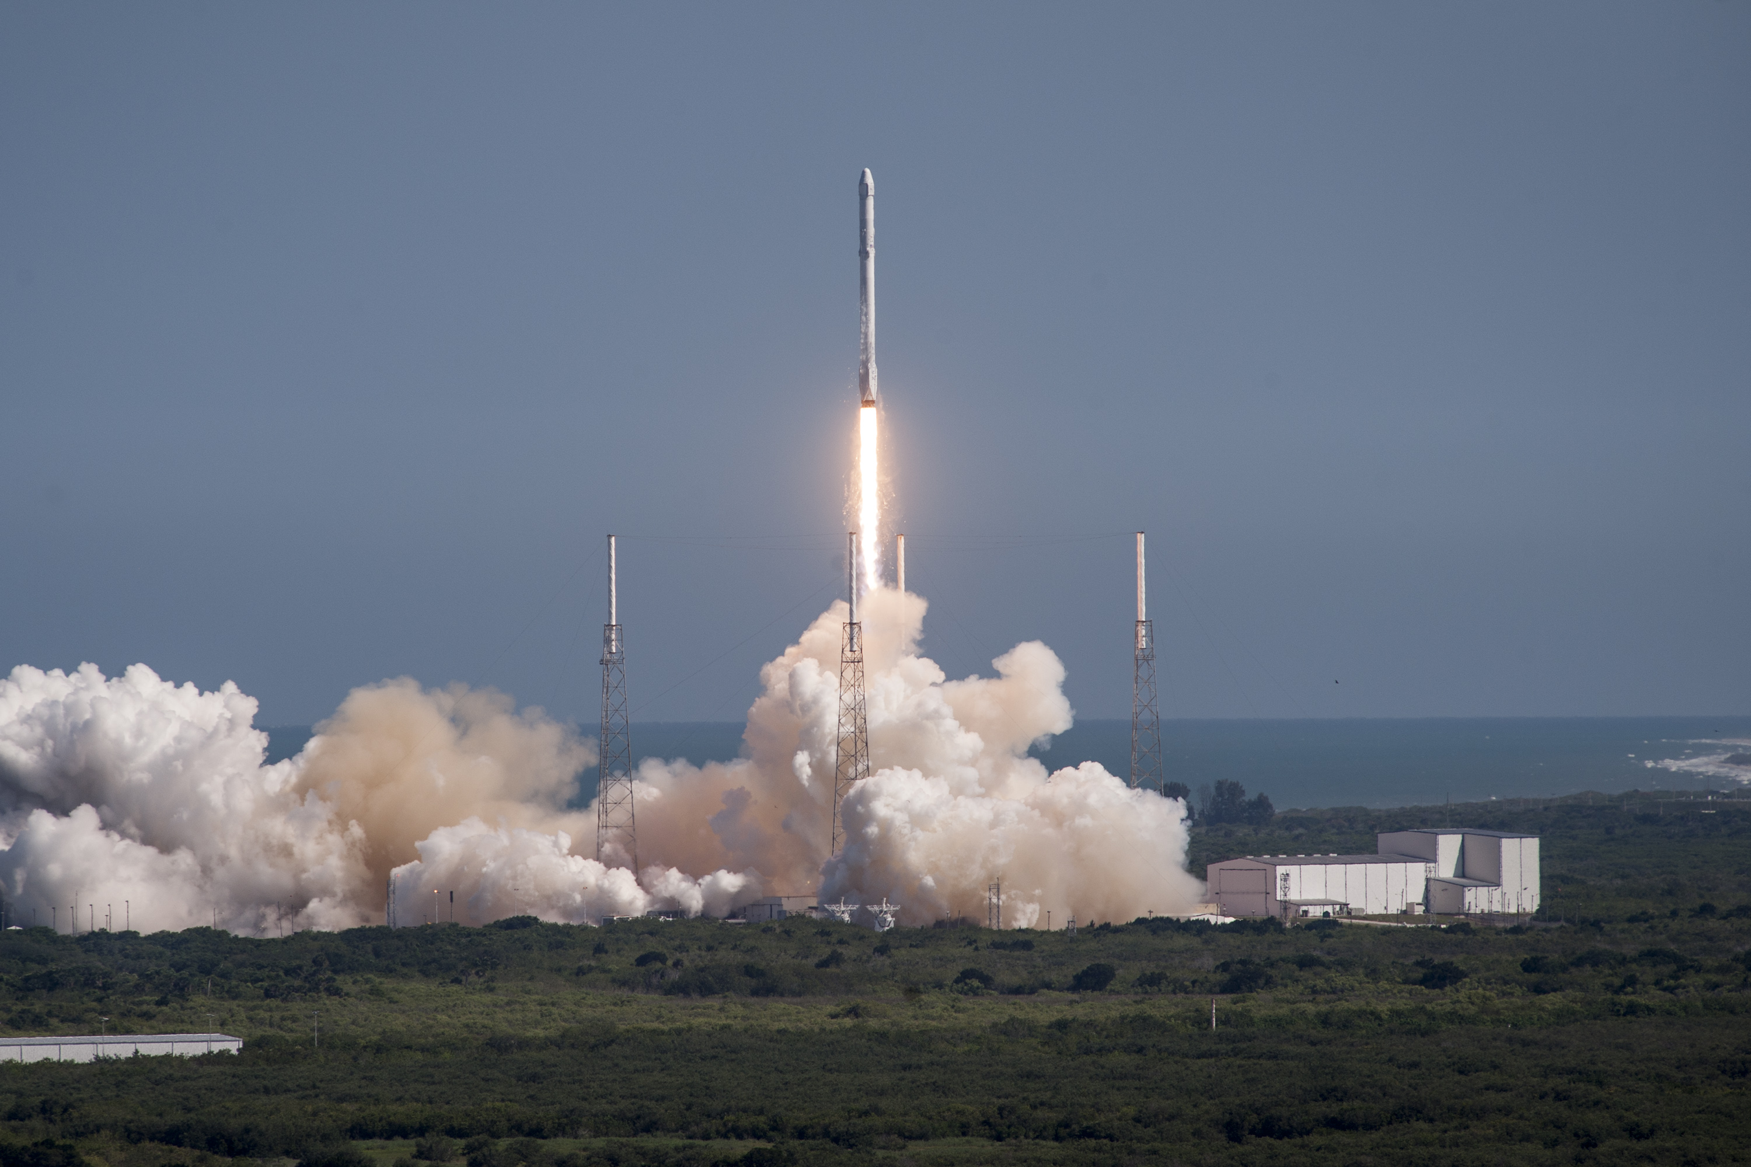
Image by spacex.com
Notes:
Change to picture of hut with solar charger

Slide 3
Predict through your timeline
Start
Ship
Exit

Slide 4
Trends Exercise
Identify trends you have no control of
Choose a few for your timeframe
Make predictions
Course correct
Notes:
1: Trends that are technical carry less risk

Slide 5
Trends

Slide 6
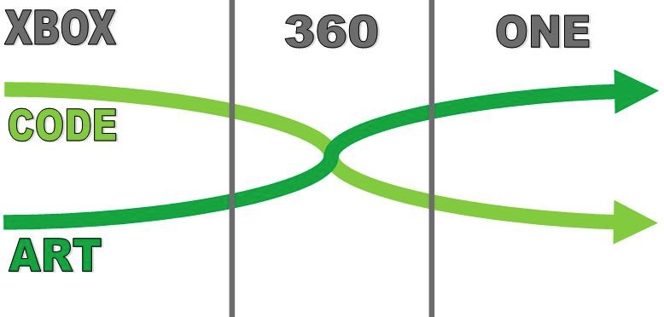
AAA Game Development Risk

Slide 7
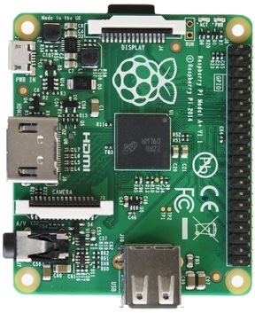
Hardware
Hardware research dominated by mobile
Low power / cost, 1st
compute & storage, 2nd
IoT 20B - 50B by 2020
PC GPUs are an outlier

Slide 8
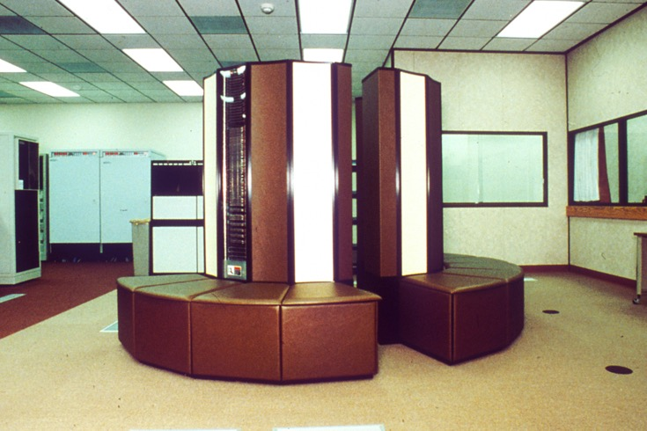

GPU Compute vs Textures

Slide 9
Emerging World Tech
New audiences going straight to wireless
Users pay for data outside game ecosystem
Cost of data is significant
Can easily cost as much as the original game
Total Cost of Gaming

Slide 10
Image by spacex.com
Notes:
Change to picture of hut with solar charger

Slide 11
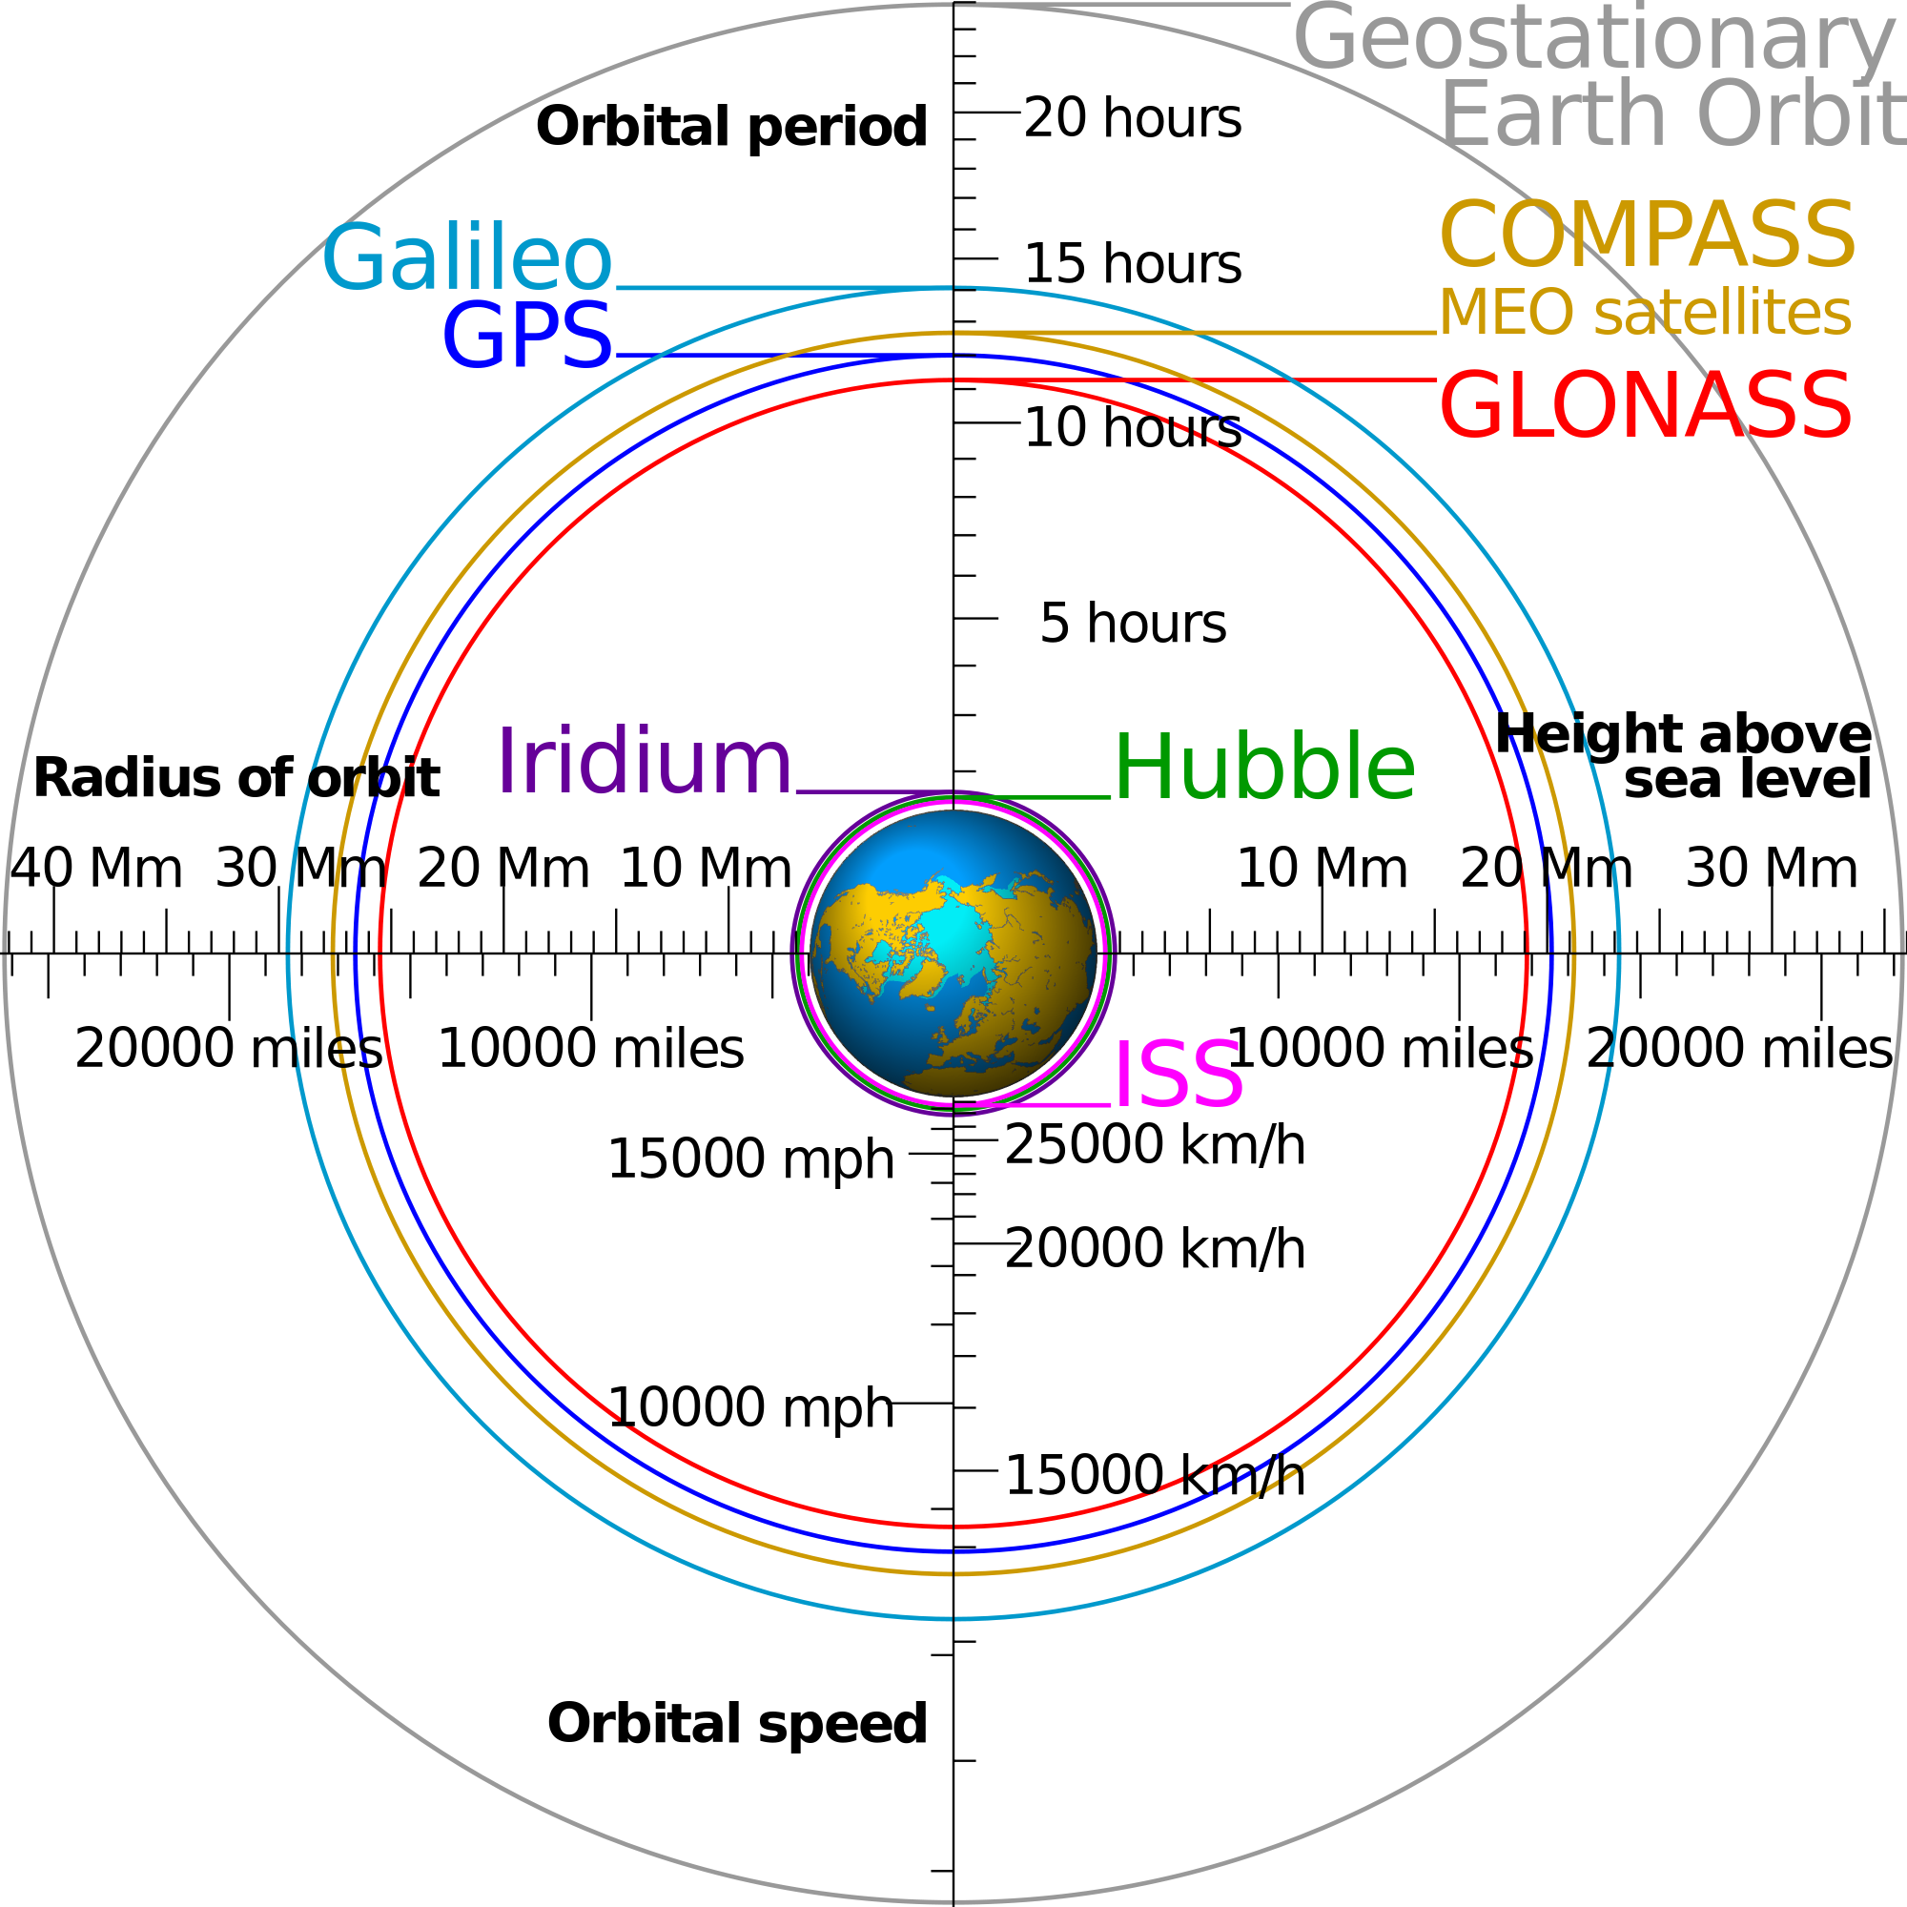
Communication Facts
Geo 35,786 km, ~240ms
LEO 1,100 km, ~7ms
C In Space
299793 km/s
C in Glass
197231 km/s
Wikipedia:Cmglee
Notes:
Geosynch - 42,164 km from center of earth
LEO – 160 to 2000 km
SpaceX aiming at 1100 km
Image from Wikipedia user Cmglee

Slide 12
Predictions & Suggestions

Slide 13
Larger audiences than ever
Hardware costs dropping
Due to E&D from phone manufacturing
Universal network access
Cellular already reaching remote regions
Satellite will enable true global reach
-> Rethink distribution strategies

Slide 14
Access is gated by Art
Art is the biggest risk to developing your game
Distribution cost no longer covered by game
-> Focus team on minimizing art size
-> Invest in art size reduction technologies
-> linkers, compressors, computed art
-> Take advantage of distribution caching

Slide 15
Wrapping up
Really about investment strategies
All predictions involve risk
Focus on a few that matter
Collect data as you go, then course correct

Slide 16
fin
Blog: http://boyd.multerer.com
Twitter: @BoydMulterer
This slide deck can be found at…
https://github.com/boydm/presentations

