Slide 1
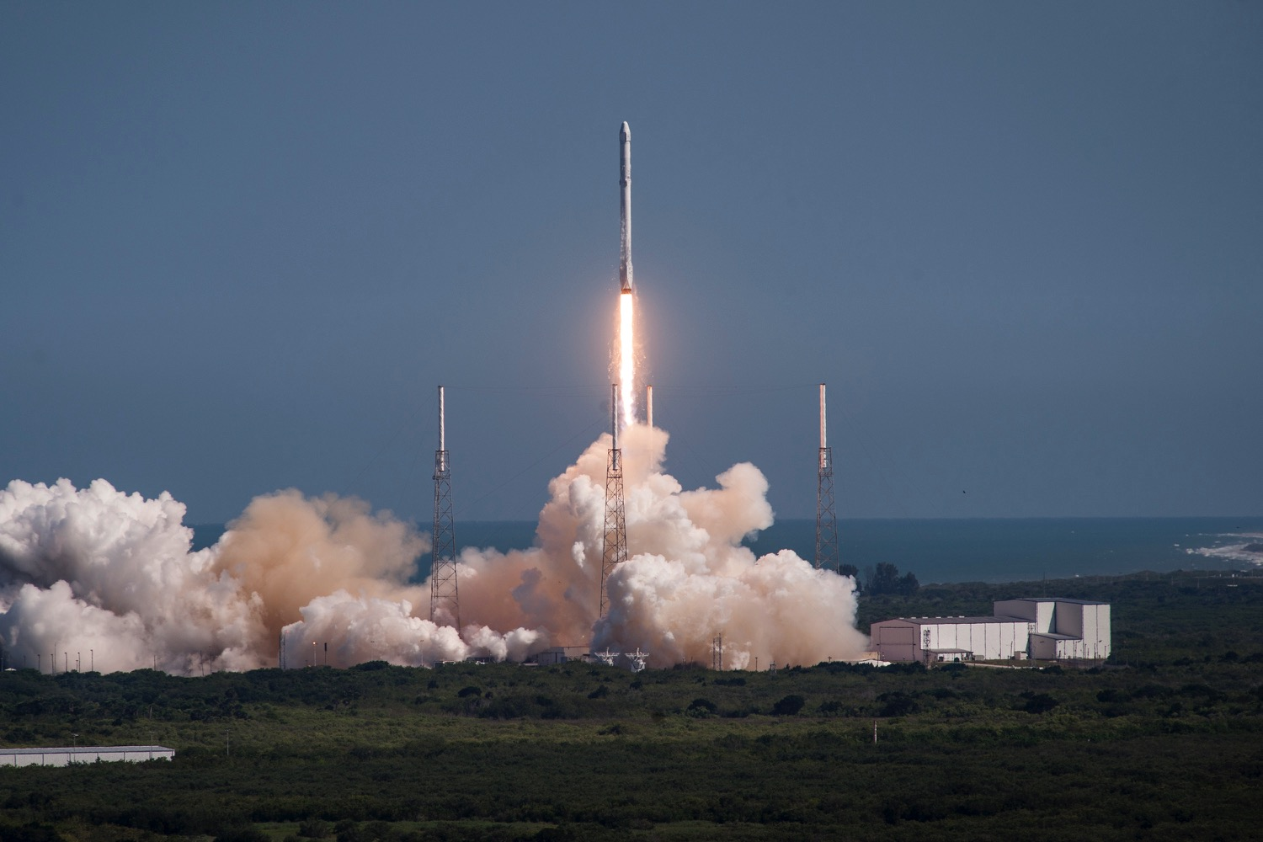
Image from spacex.com

Slide 2
Boyd Multerer
FMX, May 2015

Slide 3

Pattern

Slide 4
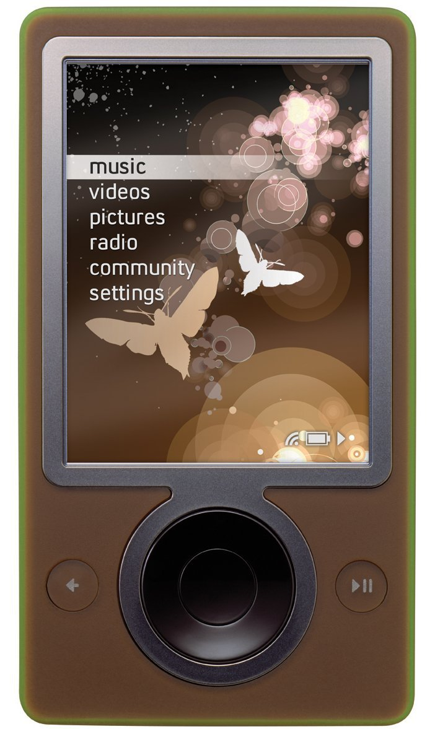
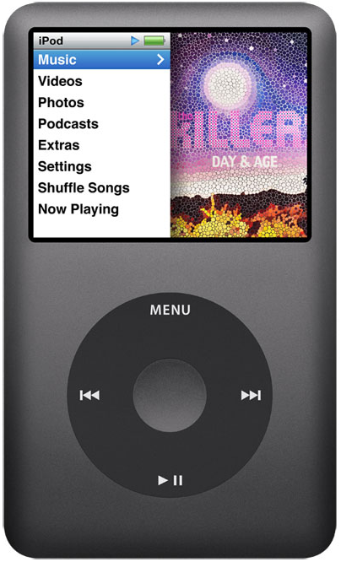
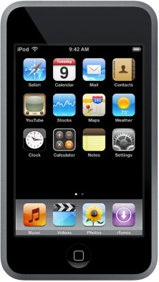
Anti-Pattern

Slide 5
Trends Exercise
Identify trends you have no control of
Choose 3 or 4 for your timeframe
Make predictions
Course correct
Notes:
1: Trends that are technical carry less risk

Slide 6
Predictions

Slide 7
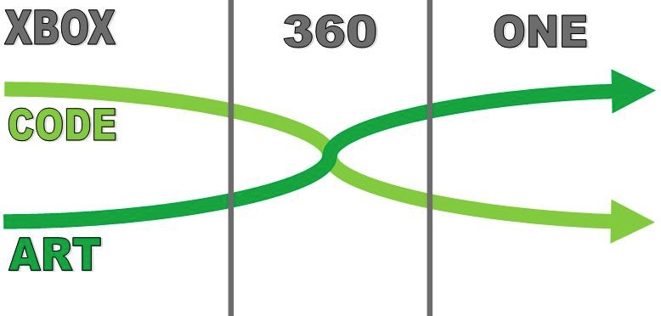
Game Development Risk

Slide 8
Innovation
Notes:
Is some subtly here.
Consoles have indie games, but that isn’t the primary business model
AAA is where the money is on a console.

Slide 9
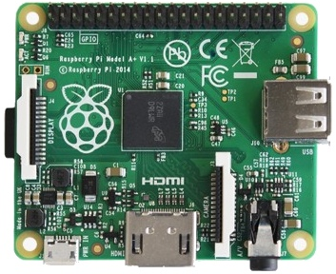
Hardware
Hardware research dominated by mobile
Low power / cost, 1st
compute & storage, 2nd
IoT – 50B devices by 2020
PC GPUs are an outlier

Slide 10
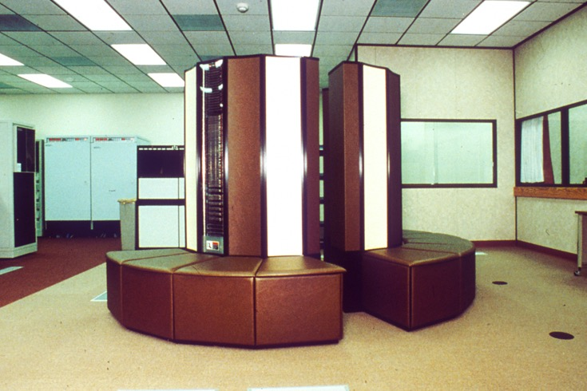

GPU Compute vs Textures

Slide 11
Customer Segmentation
Price Insensitive AAA Gamer | Hardware: +$2000 Hi wattage video cards Hi cost gaming computer | Games: $50+ Best graphical fidelity 100s to choose from
Price Sensitive AAA Gamer | Hardware: ~$300 Power constrained package Low cost console | Games: $50+ Good graphical fidelity 100s to choose from
Mobile Gamer Social, casual, innovative | Hardware: $0 - $800 Low power devices Prices run low to middle | Games: $0 - $5 Wants fun, innovation, but not willing to pay much 1000s to choose from
Notes:
Chart is really state of things now
What are the implicatinos???
Over 10 years?

Slide 12
Image from spacex.com

Slide 13
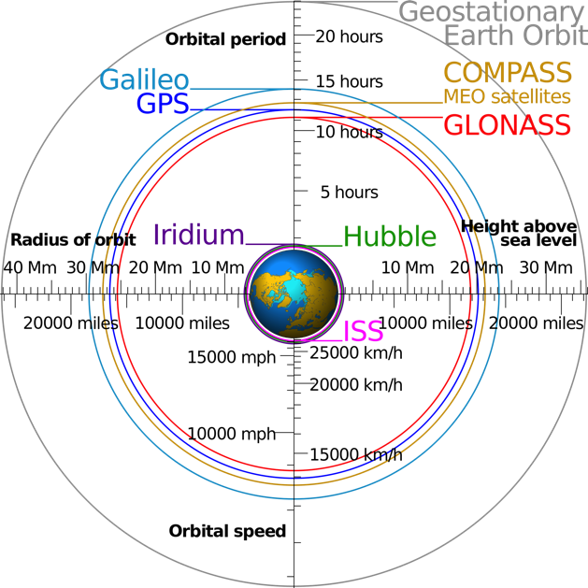
Communication Facts
Geo 35,786 km, ~240ms
LEO 1,100 km, ~7ms
C In Space – 1.0
299792.5 km/s
C in Glass – 1.52
455684.5 km/s
Wikipedia:Cmglee
Notes:
Geosynch - 42,164 km from center of earth
LEO – 160 to 2000 km
SpaceX aiming at 1100 km
Image from Wikipedia user Cmglee

Slide 14
Ubiquitous Connectivity
Tune after Shipping
The end of DRM
Logic in cloud can’t be stolen
Rethink CDN Strategies & fencing
Bidirectional communication everywhere
Rethink the way we size our audiences

Slide 15
Wrapping up
Really about investment strategies
All predictions involve risk
Focus on a few that matter
Collect data as you go, then course correct

Slide 16
fin
Blog: http://boyd.multerer.com
(I update it sometimes…)
Twitter: @BoydMulterer
This slide deck can be found at…
http://github.com/boydm/presentations

Slide 17
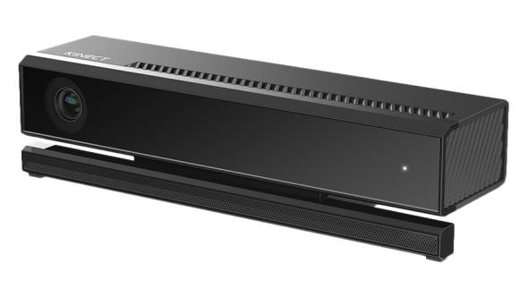
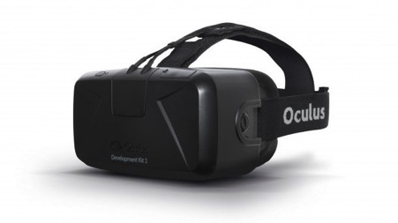
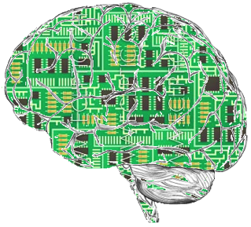
Neruogaming
Natural Input
Read body language
Natural Output
3D Stereoscopic
Haptic feedback
Emotive AI
AIs aware of and interacting with emotions

Slide 18
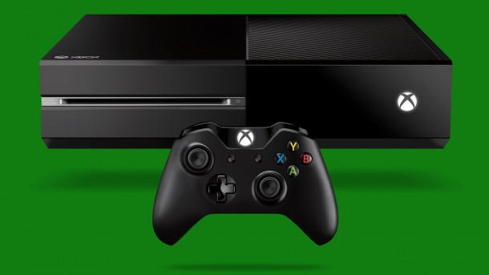

Slide 19
Goals
Be competitive when you ship
Not when you start
Take advantage of what is happening
Don’t be a victim
Gain strategic advantage
Most people don’t track trends

