Slide 1
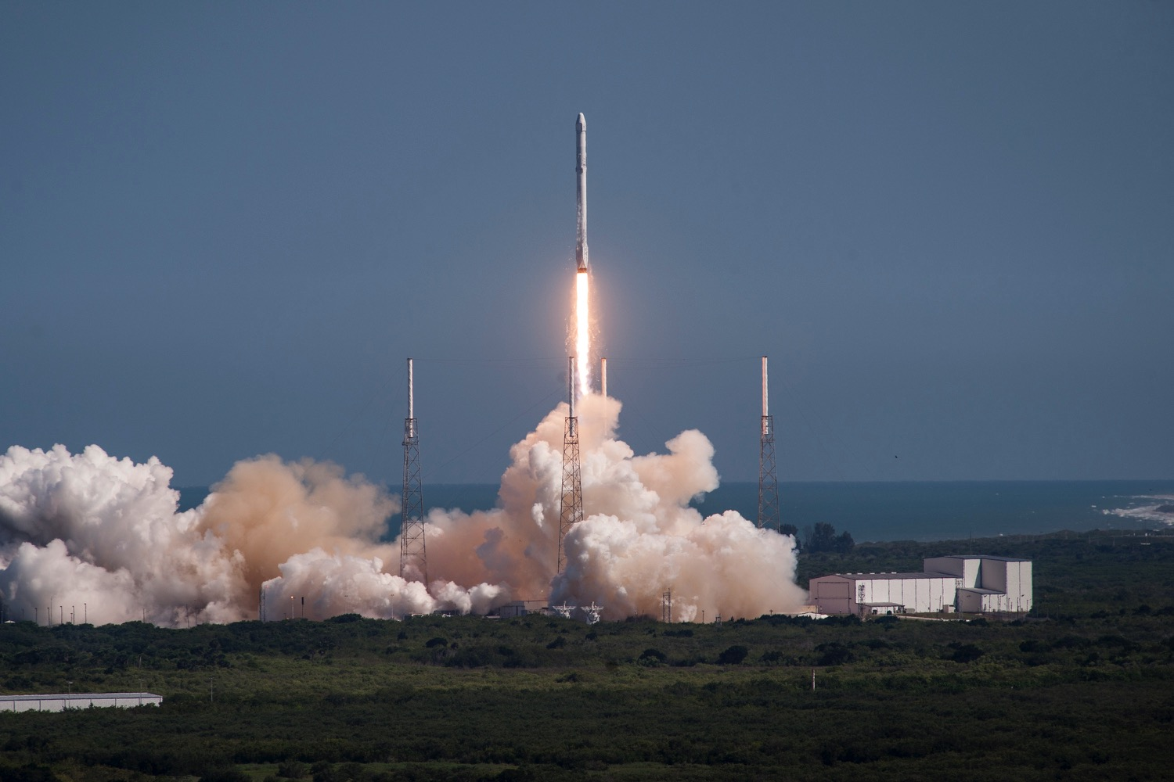
Image from spacex.com

Slide 2
Predictions for Great Exits
Boyd Multerer
FMX, May 2015

Slide 3
Predict through your timeline
Start
Ship
Exit

Slide 4

Pattern

Slide 5
Trends Exercise
Identify trends you have no control of
Choose 3 or 4 for your timeframe
Make predictions
Course correct
Notes:
1: Trends that are technical carry less risk

Slide 6
Predictions

Slide 7
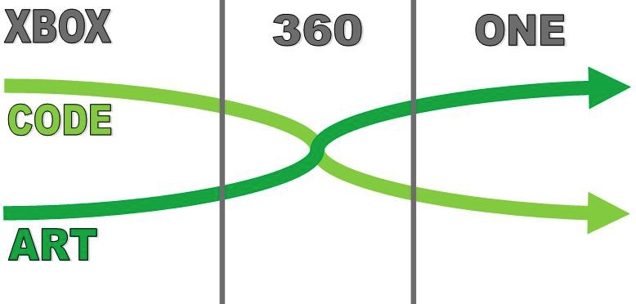
AAA Game Development Risk

Slide 8
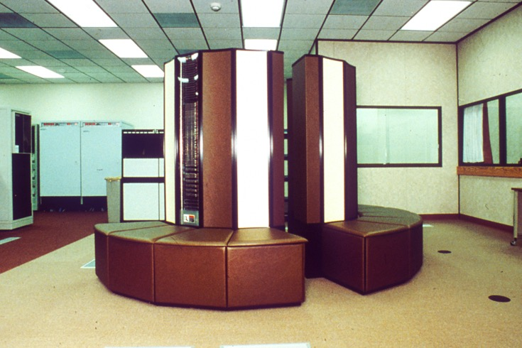

GPU Compute vs Textures

Slide 9
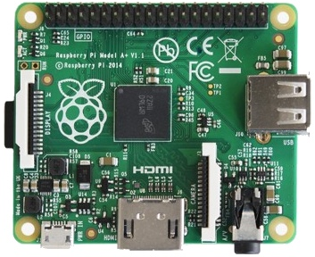
Hardware
Hardware research dominated by mobile
Low power / cost, 1st
compute & storage, 2nd
IoT – 50B devices by 2020
PC GPUs are an outlier

Slide 10
Customer Segmentation
Price Insensitive AAA Gamer | Hardware: +$2000 Hi wattage video cards Hi cost gaming computer | Games: $50+ Best graphical fidelity 100s to choose from
Price Sensitive AAA Gamer | Hardware: ~$300 Power constrained package Low cost console | Games: $50+ Good graphical fidelity 100s to choose from
Mobile Gamer Social, casual, innovative | Hardware: $0 - $800 Low power devices Prices run low to middle | Games: $0 - $5 Wants fun, innovation, but not willing to pay much 1000s to choose from
Notes:
Chart is really state of things now
What are the implicatinos???
Over 10 years?

Slide 11
Innovation
Notes:
Is some subtly here.
Consoles have indie games, but that isn’t the primary business model
AAA is where the money is on a console.
Bring up TV and Music Here

Slide 12
The world according to Bob Lefsetz
Nobody wants to watch the Discovery Channel. 2.9 million people viewed “Naked and Afraid.” But a hundred million paid for it. More than a buck a month. The CEO made $156 million. Now what?
Lawsuits.
Piracy is disruptive, sure it’s theft, but it breaks the logjam. You might be bitching you’re making less money on recorded music, but you’re simultaneously complaining about your cable bill.
Subscribe here: http://www.lefsetz.com/lists/?p=subscribe&id=1

Slide 13
Image from spacex.com

Slide 14
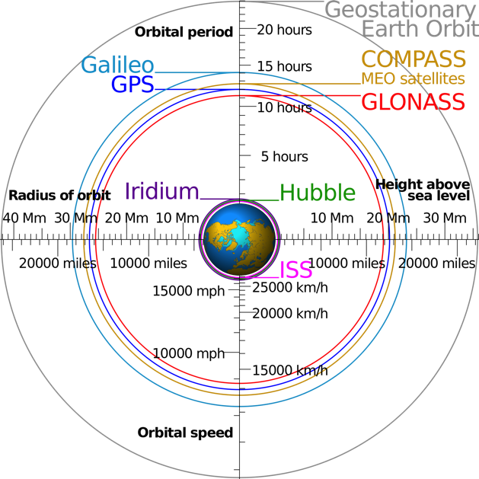
Communication Facts
Geo 35,786 km, ~240ms
LEO 1,100 km, ~7ms
C In Space – 1.0
299792.5 km/s
C in Glass – 1.52
455684.5 km/s
Wikipedia:Cmglee
Notes:
Geosynch - 42,164 km from center of earth
LEO – 160 to 2000 km
SpaceX aiming at 1100 km
Image from Wikipedia user Cmglee

Slide 15
Ubiquitous Connectivity
Tune after Shipping
The end of DRM
Logic in cloud can’t be stolen
Rethink CDN Strategies & fencing
Bidirectional communication everywhere
Rethink the way we size our audiences

Slide 16
Wrapping up
Really about investment strategies
All predictions involve risk
Focus on a few that matter
Collect data as you go, then course correct

Slide 17
fin
Blog: http://boyd.multerer.com
(I update it sometimes…)
Twitter: @BoydMulterer
This slide deck can be found at…
https://github.com/boydm/presentations

