Slide 1

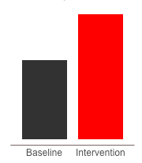
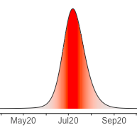
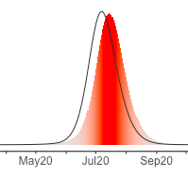
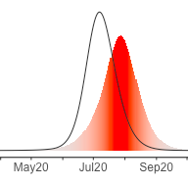
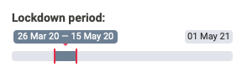
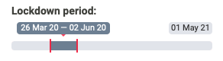

Lockdown delays epidemic peak at an extremely high cost
Working days lost due to extended lockdown
Excess Daily Mortality
Lockdown extended
Further extension
Extending beyond Eid reduces spread across country
What can be done during the time bought by the lockdown?

Slide 2



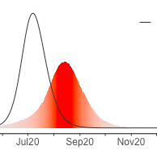
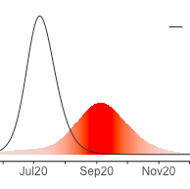
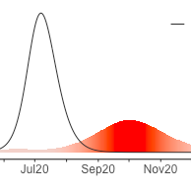
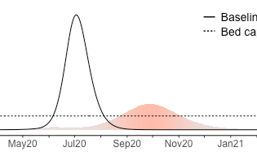
Isolation & home quarantining measures reduce mortality,
allows economy restart & does not overwhelm health system
Increased quarantine adherence reduces mortality
Excess Daily Mortality
Intervention package:
Home quarantining sick people & family for 14 days
Measures to improve compliance (government messaging, legal enforcement, community support, testing) would dramatically improve outcomes
Epidemic peak is reduced
Health System able to cope with demand
Hospital bed capacity

Slide 3
Take home messages:
Lockdown delay inevitable epidemic but at extremely high cost that cannot be maintained
Epidemic peak is expected 6-8 weeks after lockdown lifted
Daily mortality during epidemic expected to reach 10x that pre-Covid
A strategy urgently needs developing to lift lockdown without catastrophic mortality
A package of control interventions – primarily syndromic isolation and home quarantining plus additional measures such as mask use and social distancing - can reduce transmission.
Interventions will both delay and reduce peak, limiting peak daily mortality to 3x pre-Covid
But impacts depend upon compliance, therefore efforts needed to maximize compliance

Slide 4

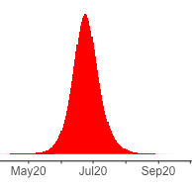
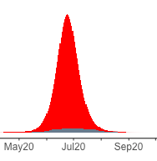
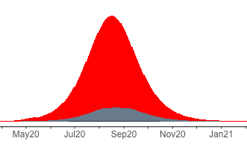
Laboratory tests only confirm a small proportion of Covid cases
Increased testing capacity
Case detection
20,000 laboratory tests/day
Almost all cases undetected at current testing levels
With cases reduced under quarantining measures, laboratory testing better reflects epidemiological situation
Increased testing capacity & control measures needed to monitor disease situation

