Slide 1

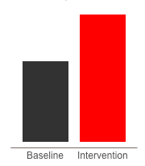
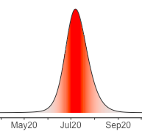
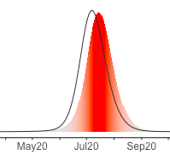
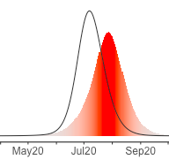
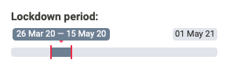
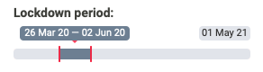

Lockdown delays epidemic peak at an extremely high cost
Working days lost due to extended lockdown
Excess Daily Mortality
Lockdown extended
Further extension
Extending beyond Eid reduces spread across country
What can be done during the time bought by the lockdown?

Slide 2



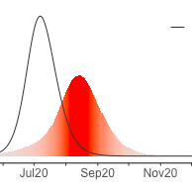
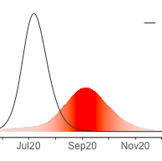
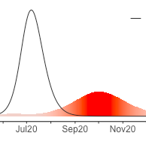
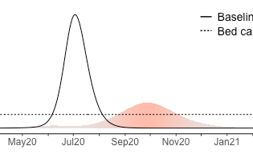
Isolation & home quarantining measures reduce mortality,
allows economy restart & does not overwhelm health system
Increased quarantine adherence reduces mortality
Excess Daily Mortality
Intervention package:
Home quarantining sick people & family for 14 days
Measures to improve compliance (government messaging, legal enforcement, community support, testing) would dramatically improve outcomes
Epidemic peak is reduced
Health System able to cope with demand
Hospital bed capacity

Slide 3
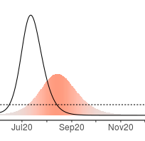
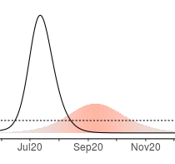
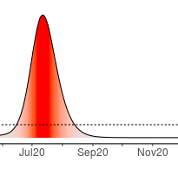
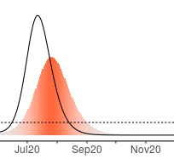
Isolation & home quarantining measures reduce mortality,
allows economy restart & does not overwhelm health system
Increased quarantine adherence reduces mortality
Excess Daily Mortality
Hospital bed capacity
Epidemic peak is reduced
Demand still exceeds hospital capacity
Intervention package:
Home quarantining sick people & family for 14 days
Measures to improve compliance (government messaging, legal enforcement, community support, testing) would dramatically improve outcomes

Slide 4




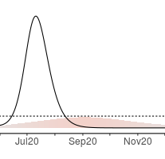
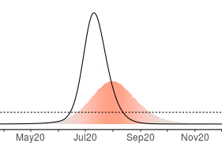
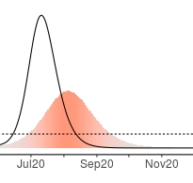
Mask wearing as an additional measures that complements Isolation & home quarantining measures and supports the health system
Compliance with home quarantining sick with family for 14 days
Cloth masks
@ 30 taka
1 month reuse
Surgical masks
@ 50 taka, 2 per day
3,000 taka/month
Improved cloth masks
@250 taka
1 month reuse
Excess Daily Mortality
20% Efficacy
80% Compliance
30% Efficacy
50% Compliance
40% Efficacy
80% Compliance
Hospital bed capacity
Mask types
Masks can reduce transmission and prevent health systems being overwhelmed
Innovation would be valuable to improve efficacy and compliance (vs current availability)

Slide 5
Mask wearing alone is insufficient
QUARANTING - NO MASKS
MASKS ONLY
MASKS & QUARANTINING
Compliance with home quarantining sick with family for 14 days
Improved cloth masks
50% Efficacy 80% Compliance
Hospital bed capacity
Mask wearing is needed together with Isolation & home quarantining

Slide 6
Take home messages:
Lockdown delays inevitable epidemic but at extremely high cost that cannot be maintained
Epidemic peak is expected 6-8 weeks after lockdown lifted
Daily mortality during epidemic expected to reach 10x that pre-Covid
A strategy urgently needs developing to lift lockdown without catastrophic mortality
A package of control interventions – primarily syndromic isolation and home quarantining plus additional measures such as mask use and social distancing - can reduce transmission.
Interventions will both delay and reduce peak, limiting peak daily mortality to <2x pre-Covid
But impacts depend upon compliance, therefore efforts needed to maximize compliance
Mask designed and produced to improve efficacy in reducing transmission and comfort to improve compliance could be an extremely cost-effective measure that would complement community supported quarantining

Slide 7

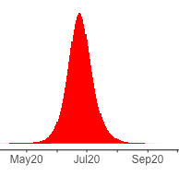
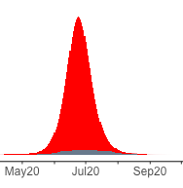
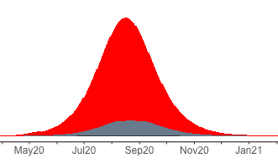
Laboratory tests only confirm a small proportion of Covid cases
Increased testing capacity
Case detection
20,000 laboratory tests/day
Almost all cases undetected at current testing levels
With cases reduced under quarantining measures, laboratory testing better reflects epidemiological situation
Increased testing capacity & control measures needed to monitor disease situation

