Slide 1
Post-exposure vaccine modelling
Katie Hampson, Martha Luka, Eleanor Rees, Elaine Ferguson
University of Glasgow, UK

Slide 2
Background
Data from which to forecast PEP demand is very poor
Most countries do not track PEP use (exceptions like Madagascar)
Most countries track bites, but data often incomplete/ lacks zero reports, & bites from all health facilities are very different to bites from facilities with PEP
Demand expected to change under Gavi intervention, with differences due to sociocultural, economic, epidemiological & health system factors
Forecasting methods should draw on available data where possible, but be revised based on PEP use with Gavi support

Slide 3
Key conclusions for PEP forecasting
PEP needs expected to vary considerably between (and within) countries according to:
Current provisioning
Free vs charged
Access (decentralized, private v government providers etc)
Stockout frequency & duration
Human: dog ratio (dog population variability)
Rabies awareness & sensitization through Gavi support
Rabies incidence
Bite patient data important for calibrating forecasts (requires direct engagement & review)
Check facility-level subnational data / IBCM to investigate risk
Check national data for completeness and variation
Recalibrate forecasts with data from rollout as health seeking changes likely to vary widely
Expect +/-20% variation per annum (based on patient data)
Vial size (1 mL vs 0.5mL) makes little difference to total vial needs, but 1mL vials have more resilience in settings prone to surges
Impact of compliance is minor compared to within country/year variation
Notes:
In terms of forecasting –expect variation between and within countries affected by current HS and sensitization
& the local and national dog pop var
BITE PATIENT DATA important for calibration, revise on rollout (MONITOR CLOSELY!)
Caveat - improving PEP access can decouple relationship with risk if not managed carefully…..

Slide 4
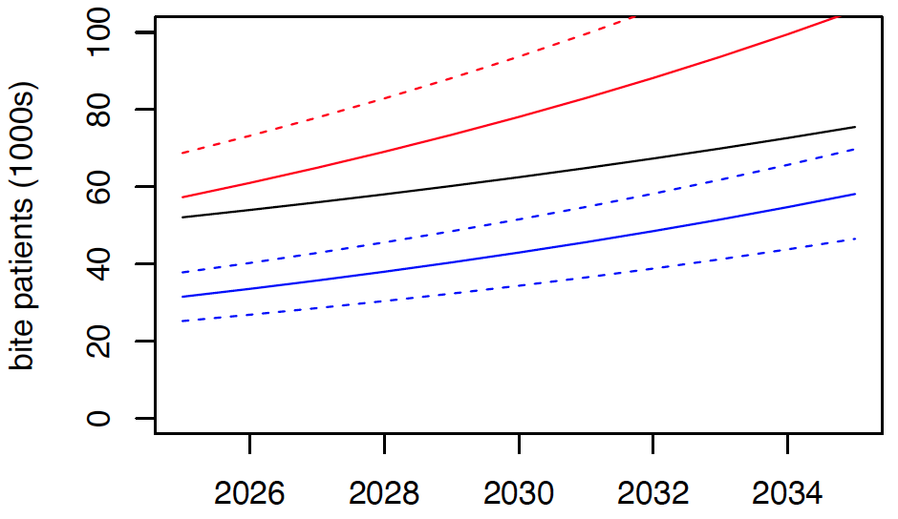
Tanzania – projecting bite patients
Examples of country-specific models requested from WHO/Gavi
Projected bite patients under Gavi-supported vaccines
UNCERTAINTIES
Data:
Total bites (IDSR) are ~20-80% higher than calibrated IBCM records.
Includes many facilities without PEP.
Double counts patients at local clinics (no PEP) that travel to hospitals (for PEP)
Yearly variation +/- 20%
Model:
Unclear how PEP seeking will change with free and in-stock PEP
Unclear how changes will affect compliance with regimens
IDSR not seeking PEP
IDSR SQ
IBCM-calibrated seeking PEP

Slide 5
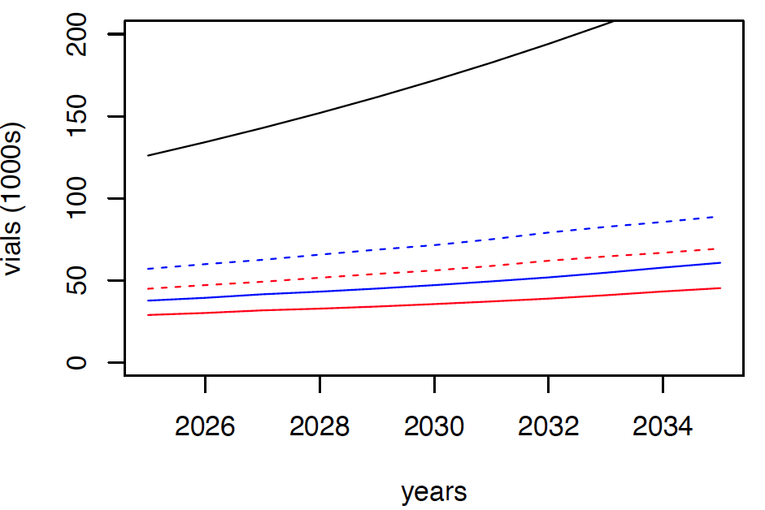
Tanzania – projecting vaccine vials
Examples of country-specific models requested from WHO/Gavi
Scenarios
IM regimen (updated Essen requires 4 visits v 5 (SQ)
ID updated TRC requires 4 visits
ID IPC requires 3 visits (abridged from TRC)
Centralized - PEP only at government district hospitals
Decentralized – PEP also at 3 additional facilities
Assume only 1 mL vials are used (qualitatively similar but smaller differences expected with 0.5 ml vials)
Only show projections calibrated from IBCM but data review required
Only show projections assuming full compliance
- partial compliance uses ~25% less vials
IM delivery
Dashed - decentralized
Solid - centralized
ID updated TRC
ID 1-week IPC

Slide 6
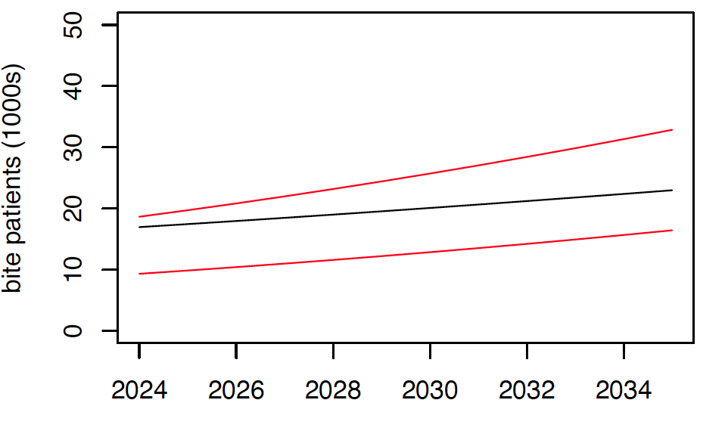
Zambia – projecting bite patients
Examples of country-specific models requested from WHO/Gavi
Projected bite patients under Gavi-supported vaccines
UNCERTAINTIES
Data:
Investigate how DHIS2 bites relate to patients that obtain PEP
Model:
Unclear how PEP seeking will change with free and in-stock PEP
Gavi-upper projection
SQ projected bites
Gavi-lower projection

Slide 7
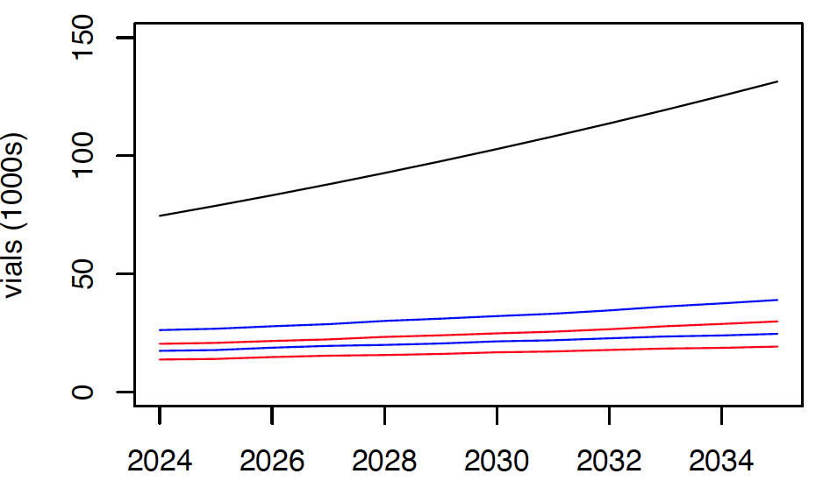
Zambia – projecting vaccine vials
Examples of country-specific models requested from WHO/Gavi
Scenarios
IM regimen (updated Essen requires 4 visits v 5 (SQ)
ID updated TRC requires 4 visits
ID IPC requires 3 visits (abridged from TRC)
Assume only 1 mL vials are used
Examine range with/ without PEP calibration
Only show projections for full PEP compliance
IM delivery
ID updated TRC range
ID 1-week IPC range

Slide 8
Sense checks
Epidemiological:
Back of envelope:
PEP(rabid) = Dog pop * Incidence * P(bite_rabid) * P(seek_rabid – varies by HDI & policy)
PEP(healthy) = Dog pop * Incidence * P(bite_healthy) * P(seek_healthy – varies by HDI & policy)
Bite patient presentations:
Calibrate by proportion rabid & dog population, considering variation by settings
High proportion (charged & poor access) up to 50%
Medium proportion (free & poor access OR charged but accessible) up to 10-20%
Low proportion (free & accessible, typically in countries with HDI >0.6) <5%

Slide 9
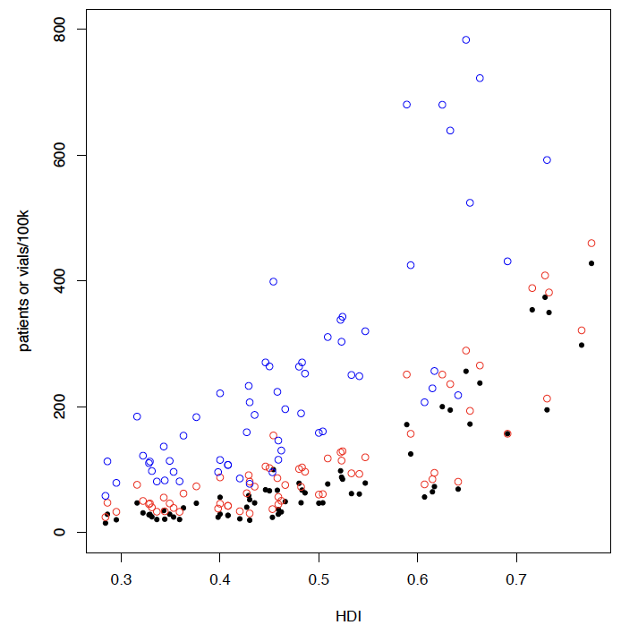
Sense checks
Gavi-eligible country projections (vs Human Development Index)
shown for 2030 only
Projected annual 1mL vial demand using IPC regimen with Gavi support to improve access
Projected annual bite patients under Gavi support
Projected annual bite patients under status quo
Spreadsheets project vial use & bite patients per year (2024:2033) for 67 countries from VIS learning agenda

Slide 10
Background slides

Slide 11
Modeling to support post-exposure prophylaxis (PEP) forecasting
Demand planning for vaccine production
Depends on scale (national, subnational, local), time horizon (ideally 5+ years) & shelf-life
Operationalizing rollout
PEP in clinics affected by patient throughput, regimens used & (re)supply rates
Monitoring impact & prospects for elimination
Care seeking & access to care by those at risk (bitten by rabid dogs)
Risk status of bite patients (bites from rabid versus healthy animals)
Dog vaccination effort to control transmission in reservoir
Pharma, Gavi, UNICEF
Country stakeholders, governments, practitioners
International, national & local communities
Many interdependencies between 1-3:
- Typically vaccine cost driven down by demand (purchasing power), with investment in volume at scale
Current situation is a market failure, but Gavi investment in PEP is an opportunity to catalyse positive feedback
What are Gavi’s modelling requirements?
Notes:
Vaccine production particularly important for pharma/ suppliers

Slide 12
Key Questions
What PEP regimen should be used?
How should PEP be supplied?
How many doses will be needed?
Notes:
Key Qs

Slide 13
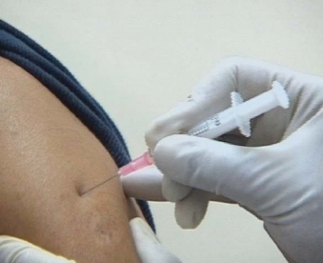
Key Questions
What PEP regimen should be used?
Regimens – complex & national treatment guidelines vs practice vary by (& within) country
Routes of administration - IM vs ID
Vial size – 1ml or 0.5ml affects efficiency and prices
Throughput (wastage) – perceived wastage / discarded vials
Potential to treat more people during emergencies/shortages
Intermuscular (IM) - 1 vial per injection
Intradermal (ID) - 0.1 ml per injection
vials can be shared if used within 6-8 hours (same day)
Notes:
What regimen – annoyingly complex but surprisingly simple result…..

Slide 14
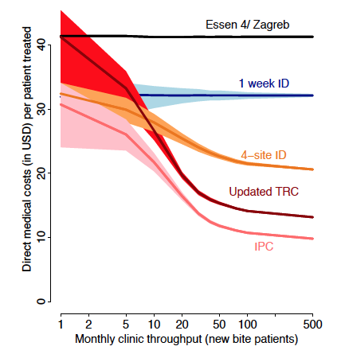
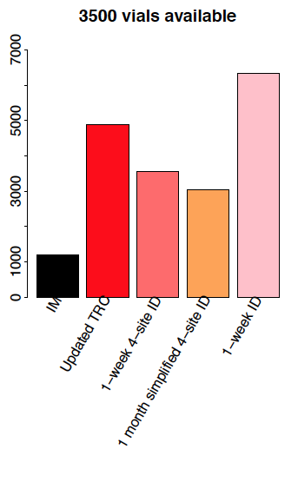
Conclusions in April 2018 WHO position paper:
New WHO position
Limited vaccine supply
Former ID recommendation
Direct medical costs per patient $
most LMICs
Patients treated
Monthly clinic throughput (new bite patients)
Regimens
ID most cost-effective in all settings – IPC (1-week ID regimen) always uses at least 25% less vials than IM
(although some opened vials discarded under ID, overall, many more vials used under IM)
Hampson et al. Vaccine (2018)
Notes:
Overall – v clear policy recommendations….

Slide 15
Key Questions
What PEP regimen should be used?
How should PEP be supplied?
How many doses will be needed?
- ID always the better choice – treats more patients, fewer vials & visits, more resilient against stockouts/ surges
- Gavi investment will: mitigate payment challenges of vial sharing; support health worker training & insulin needles
Gavi should request producers to label vials for ID use
Notes:
Key Qs

Slide 16
Key Questions
What PEP regimen should be used?
How should PEP be supplied?
How many doses will be needed?
- ID always the better choice – treats more patients, fewer vials & visits, more resilient against stockouts/ surges
- Gavi investment will: mitigate payment challenges of vial sharing; support health worker training & insulin needles
- Gavi should request producers to label vials for ID use
- Presentations increase if PEP free & accessible (policies, practices & geography) & awareness/ sensitization about risk & need
- PEP use depends on practitioner constraints: available in clinic, patient demand (incl. cost) & epidemiological judgement
To what extent should PEP be ‘decentralized’?
Notes:
Key Qs

Slide 17
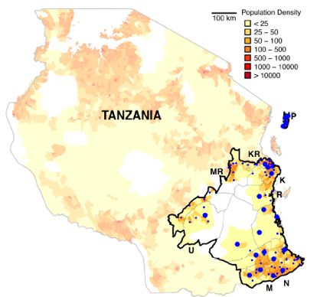
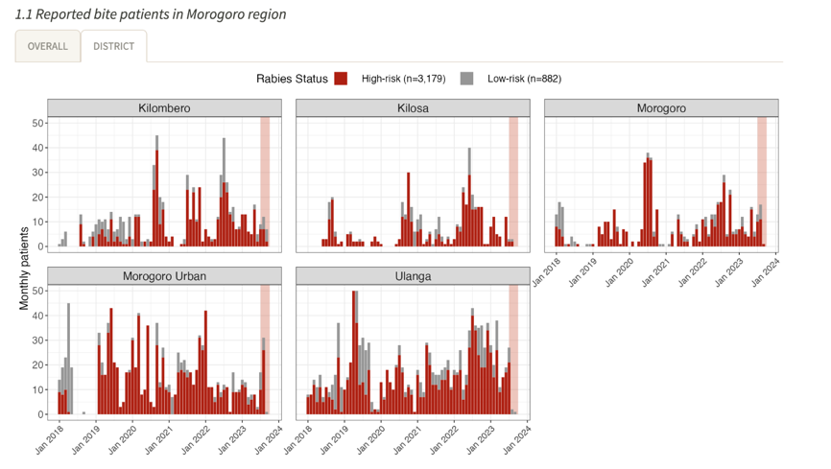
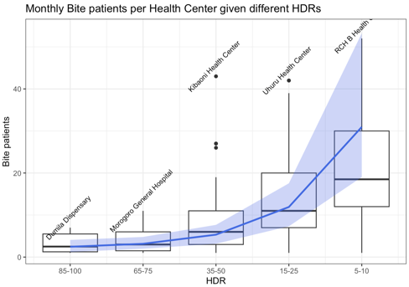
Dog population variability:
Urban/ rural
Religion
Livelihood
Consider patient data: Tanzania
Human: dog ratio: ~20 range: 5 to 100+
Bite patient incidence - 5-90/ 100,0000/ yr
190 facilities supplying vaccine ~$100/ course
~350,000 population/ facility
IBCM 2019-current
Most patients (>70%) are high-risk due to high PEP costs & low availability, few ‘worried well’ (<30% patients)
Many (>30%) travel outside district (to regional hospitals) because of stockouts
Expect increased patients with free PEP (seen 2010-2015 during BMGF project)
Notes:
Give you some example projections from 2 countries with subnational data
TZ v variable in dog population & density – a few concentrated urban centres & largely split, with more Christian dog-owning populations inland, vs more muslim coastal communities with fewer dogs (& bites!)
Can see how bite presentations vary with HDR, most are high risk at clinics with PEP (course ~$100), & quite considerable variation affected by localized rabies outbreaks, stockouts cause 30% of bite victims to travel outside their district for PEP

Slide 18
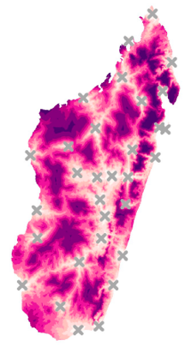
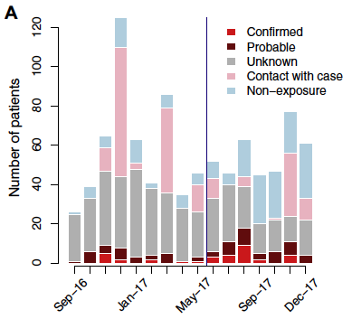

Dog population variability:
Urban/ rural
Religion
Livelihood
Consider patient data: Madagascar
Human: dog ratio: 17-30
Bite patient incidence - 85/ 100,0000/ year
31 Health facilities supplying free vaccine
~1 million population/ facility
IBCM 2016-2017
Higher bite incidence due to ‘worried well’ (x5)
More patients low risk for rabies due to free PEP in stock
Expect patients to increase with more (decentralized) facilities
Rajeev et al. 2019 Vaccine; PLoS NTDs 2021
Notes:
Madagascar long used ID regimens that are free to patients, but only 1 facility per million people!
Largely Christian dog-owning population (contrast!) - higher bite incidence, but greater number due to low-risk bites (given excessively to people near a human case (almost never in TZ)

Slide 19
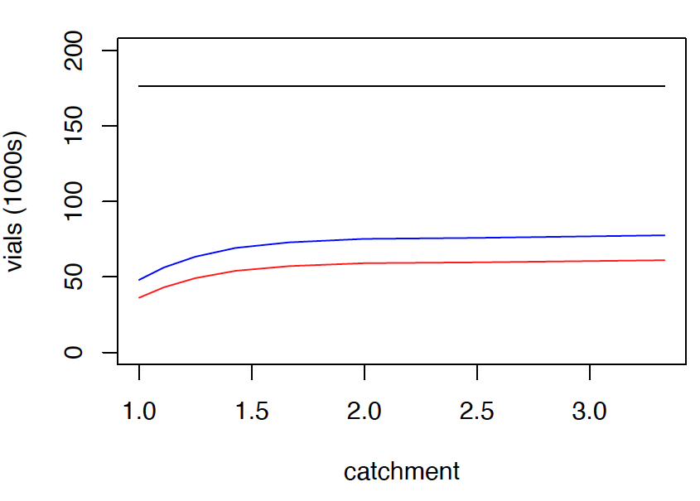
To what extent should PEP be ‘decentralized’?
Consider change in current practice in Tanzania (67 million population) to decentralize PEP
IM
Updated TRC ID
IPC (1-week ID)
Madagascar
31 facilities
1/1,000,000 population
Reach of EPI
>1,600 facilities in Tanzania
1/<50,000 population
190 facilities 500 facilities
1/350,000 population 1/130,000 population
Consider Madagascar (29 million population) with 31 facilities (~1 facility/ 1,000,000 population)
Relatively little impact on vial use → much improved patient access
Main challenge is supply chain (but EPI reaches much further than examples here)
Notes:
To look at this Q for Tanzania we examined how vials used would increase with reduced sharing – current to decentralized (at level that was considered feasible for Gates project)
Relative increase, but not much compared to IM
Consider similar increases for Madagascar….

Slide 20
Key Questions
What PEP regimen should be used?
How should PEP be supplied?
How many doses will be needed?
- ID always the better choice – treats more patients, fewer vials & visits, more resilient against stockouts/ surges
- Gavi investment will: mitigate payment challenges of vial sharing; support health worker training & insulin needles
- Gavi should request producers to label vials for ID use
- Gavi should support access in main hospitals serving >200k, decentralizing below is country prerogative
- decentralizing increases vial use/ patient, but still cost saving, increases compliance & feasible with EPI system
- Awareness/ sensitization should be supported by IBCM practitioner training
Notes:
Key Qs

Slide 21
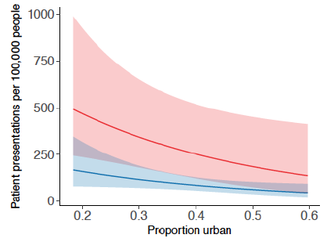
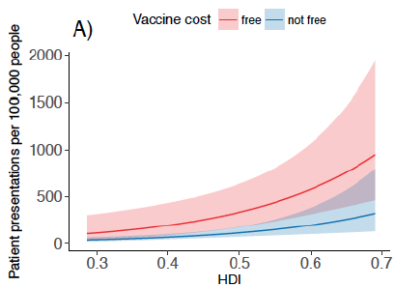
Across countries, bite patients (at clinics) depends on HDI & vaccine policies (free/ charged) including access (compare urban vs rural)
How many doses will be needed?
Setting | Human: dog ratio
Rural christian | 4-10
Rural muslim | 25-50
Urban christian | 10-30
Urban muslim | >70
Key determinants:
Human: dog ratio
Accessibility of PEP
Rabies incidence
Rabies awareness
Highly variable dog populations:
Variation by urbanization & religion:
Country | % urban | % christ/other
Burkina Faso | 30 | 35
Cameroon | 54 | 75
Ethiopia | 19 | 63
Ghana | 54 | 71
Cote d'Ivoire | 54 | 50
Kenya | 26 | 86
Lao PDR | 39 | 95
Madagascar | 35 | 85
Malawi | 16 | 80
Mali | 40 | 5
Nigeria | 48 | 50
Pakistan | 39 | 4
Senegal | 44 | 3
Tanzania | 32 | 63
Zambia | 41 | 95
Notes:
Most difficult Q to answer – likely varies a lot!
Bite patient incidence sensitive to current health system & PEP policy

Slide 22
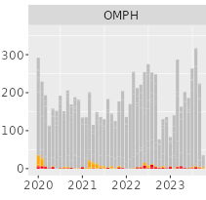
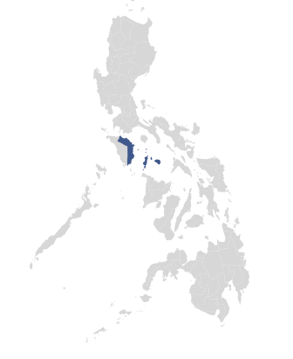
Tanzania
Uncoupling of PEP demand from rabies incidence needs consideration
Philippines
Similar rabies incidence
Ratio of bite patients
low risk (healthy) v high risk (likely rabid)
1:3 v 100:3
- Only dog vaccination can reduce exposure incidence
- IBCM may reduce unnecessary PEP use & improve PEP access for those at risk
But IBCM implementation challenging & needs tailoring to local contexts
Notes:
See IBCM examples from clinics in Tanzania on LHS and Philippines on the RHS
In Tanzania ¼ patients are worried well, vs 97/100 in PHL; PEP access improved and pop sensitized, but still rabies deaths bc those in need still not accessing… & rabies incidence not controlled through MDV
IBCM is a tool that can help…& important to monitor risk….but not easy; implementation will vary by setting

Slide 23
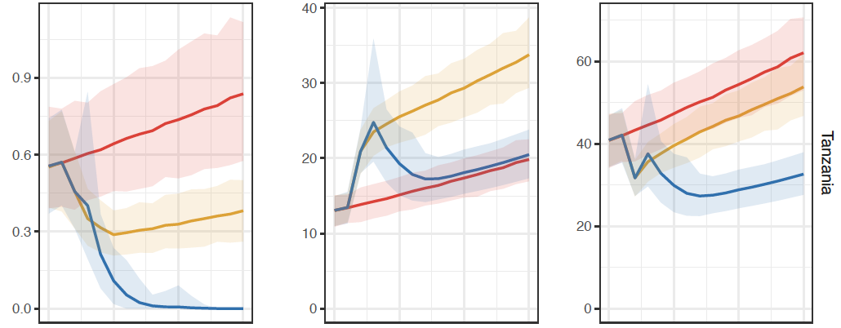
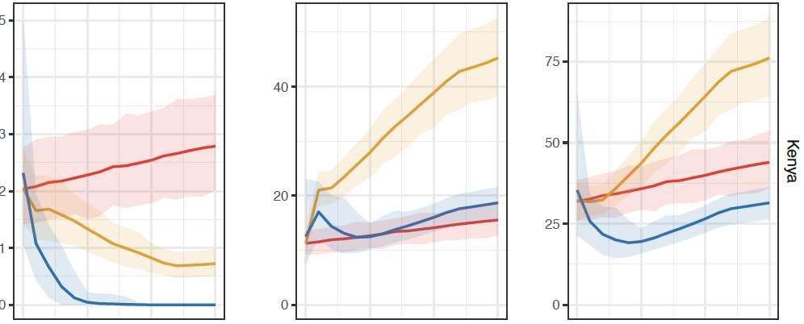
Examples of country-specific model projections (VIS)
Human rabies deaths Persons vaccinated Vaccine vials
1000s
Uncertainties with introduction of sensitization from Gavi-rollout & MDV
Uncertainties PEP provisioning from devolution, private providers, required health system strengthening
WHO rabies modeling consortium. Lancet Infectious Diseases (2019)

Slide 24
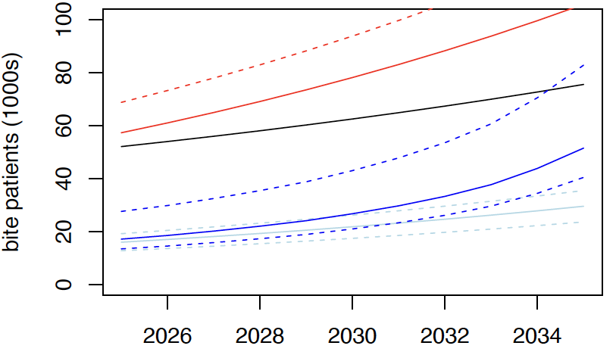
Tanzania – projected bite patients
Revisiting: how many doses will be needed?
UNCERTAINTIES
Data:
Total bites (IDSR) ~20-80% higher than calibrated IBCM records.
Includes facilities without PEP
Double counts patients at local clinics (no PEP) that travel to hospitals (for PEP)
Yearly total bite variation +/- 20%
IBCM variation greater
Model:
Uncertain how PEP seeking & compliance will change with free in-stock PEP
Population growth expected
Reduce time horizon for better accuracy
Projected bites under Gavi support
Status Quo
Projected bites calibrated by IBCM under Gavi support
Notes:
Example of Tanzania
Bites increase as population grows
Using only total bite data we extrapolate a high number of vials, probably unrealistic bc reflects patients attending facilities without PEP, reduced by ~20-50% when calibrated from IBCM
Yearly variation is quite dramatic!
We made several assumptions about changes in PEP seeking & compliance!

Slide 25
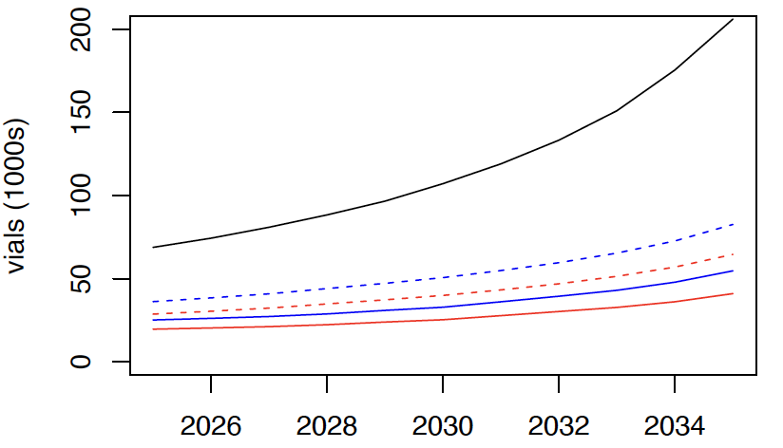
Tanzania – projected vaccine vials
Scenarios
IM regimen (updated Essen 4 visits)
ID updated TRC (4 visits), 1 mL vials
ID IPC (3 visits), 1 mL vials
Centralized to district hospitals
Decentralized at 4 facilities/ district
- Greater number but qualitatively similar pattern for 0.5 ml vials
- partial compliance uses ~25% less vials
- projections calibrated from IBCM
Dashed - decentralized
Solid - centralized
IM delivery
ID updated TRC
ID 1-week IPC
Notes:
When translating bite patients to PEP – ID wins out, and not so much variation in vials under ID use, 1ml vials generally more effective (fewer vials per population) but depends on vial price

Slide 26
Zambia – projected bite patients
UNCERTAINTIES
Data:
Investigate how DHIS2 bites relate to patients that obtain PEP
Model:
Unclear how PEP seeking & compliance will change with free and in-stock PEP
Gavi-upper projection
SQ projected bites
Gavi-lower projection
Notes:
Unable to make such detailed predictions from Zambia, but based on CDC provided numbers able to project numbers of bite patients

Slide 27
Zambia – projected vaccine vials
Scenarios
IM regimen (updated Essen 4 visits)
ID updated TRC (4 visits), 1 mL vials
ID IPC (3 visits), 1 mL vials
Assume PEP remains centralized (changes expected if most PEP currently from private providers)
Assume full PEP compliance
Requires calibration (with IBCM if possible)
IM delivery
ID updated TRC range
ID 1-week IPC range
Notes:
And vials! But uncertainty relates largely to current provisioning & requires calibration

Slide 28
Key Questions
What PEP regimen should be used?
How should PEP be supplied?
How many doses will be needed?
- ID always the better choice – treats more patients, fewer vials & visits, more resilient against stockouts/ surges
- Gavi investment will: mitigate payment challenges of vial sharing; support health worker training & insulin needles
- Gavi should request producers to label vials for ID use
- Gavi should support access in main hospitals serving >200k, decentralizing below is country prerogative
- decentralizing increases vial use/ patient, but still cost saving, increases compliance & feasible with EPI system
- Awareness/ sensitization should be supported by IBCM practitioner training
Projections broadly predictable:
- Expect increased demand with free PEP & improved access (predictions harder in more middle-income i.e. non-eligible countries)
- Uncertainty in vial estimates much lower than uncertainty & annual variability in demand (patients)
But, country-specific estimates likely to differ mostly due to:
- Uncertainty in dog population estimates
- Different health policies, specifically access (decentralization), cost (free/charged), & sensitization
- Response to Gavi intervention
Notes:
Key Qs

