Slide 1

Internship at UFRGS
Chirp Detection 14/08/2014

Slide 2


Principle
Acoustic beacon
Robot
Auto-calibration
Auto-calibration
send chirp
receive chirp
send chirp
receive chirp
Measuring time of flight

Slide 3

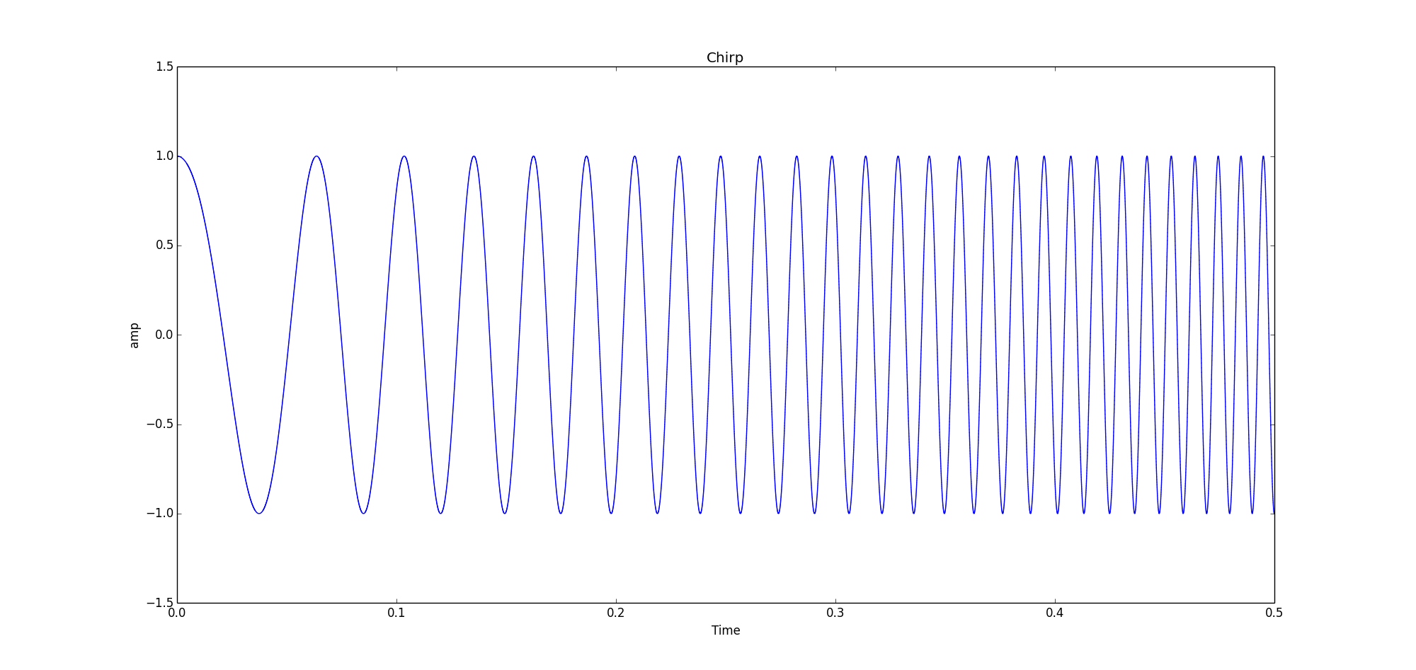
What is a chirp ?
A signal in which the frequency increase or decrease with time.

Slide 4
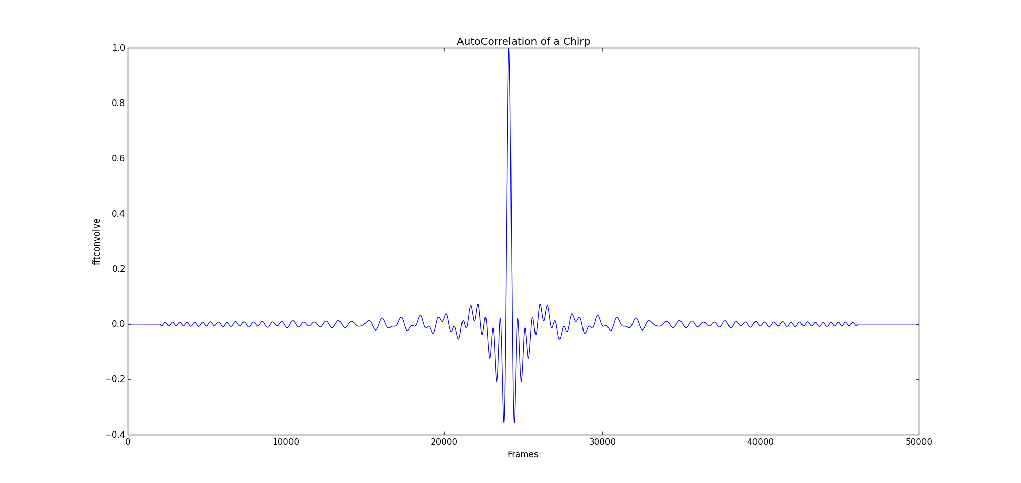
Why is chirp used ?
Compared to mono-frequency impulsion :
Increasing the length of impulsion decrease the precision of detection

Slide 5
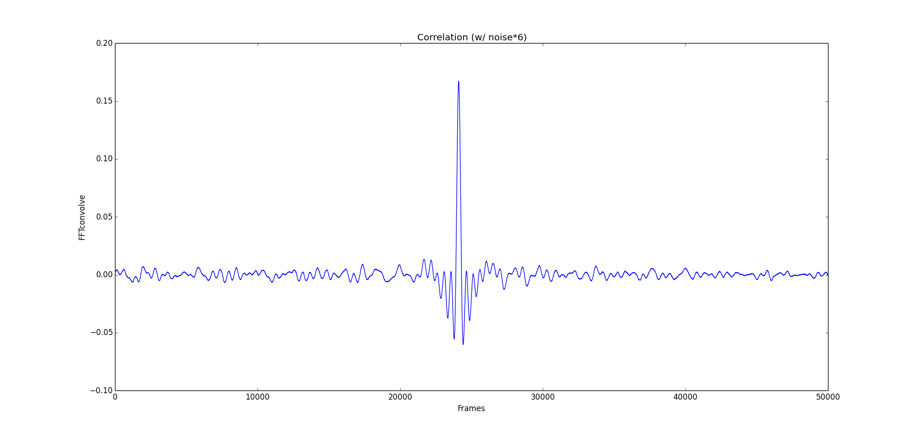
Why is chirp used ?
Compared to mono-frequency impulsion :
Chirp has a better noise-resistance

Slide 6
Operation
On the robot side :
Start Recording ambient sound
Send Chirp
Hear its own chirp
Hear the beacon chirp
Calculate the time between the two chirp
On the beacon side :
Start Recording ambient sound
Hear the robot chirp
Send chirp 1 second later (exactely)

Slide 7
Challenge with time-measuring
Speed of sound :
330 m/s in the air ( 33 cm for 1 ms)
1500 m/s in water (1.5 m for 1 ms)
Source of imprecision :
Latency in sound card
The intern clock cannot be trusted
Using fonction such as time.time() is impossible

Slide 8
A solution: using the number of frames
Sound card is set on non-blocking mode :
Creates a new thread to control the sound card
Always recording
The rate is known and precise
This solution solves the problem of latency (for the robot)
Total Latency
Output Latency
Input Latency
Delay to measure
Number of frames
Peak on speaker
Time of detection

Slide 9
Source of vagueness
Autocalibration is needed for the beacon
Must send back chirp 1 sec later
1 second less total latency
Input Latency
Output Latency
Number of frames
Peak on speaker
Time of detection
Must be 1 sec

Slide 10
Operating principle
4 object:
Callback fonction : record the sound
FIFO : store the data
Chirp detection: detect the chirp
Semaphore : which regulate the use of the FIFO

Slide 11



Operating principle
Callback
FIFO
Chirp detection
Semaphore
Detection
Size of a chirp

Slide 12
Nowadays
Using pyAudio to access the sound card
Software works great on Windows
Accurate to 40 centimeter
Does not work on raspberrypi or Linux
Configuration of the sound card is very difficult
Latency varies with time
Not stable (stop working after multiple test)

