Slide 1

Internship at UFRGS
Chirp Detection 24/07/2014

Slide 2

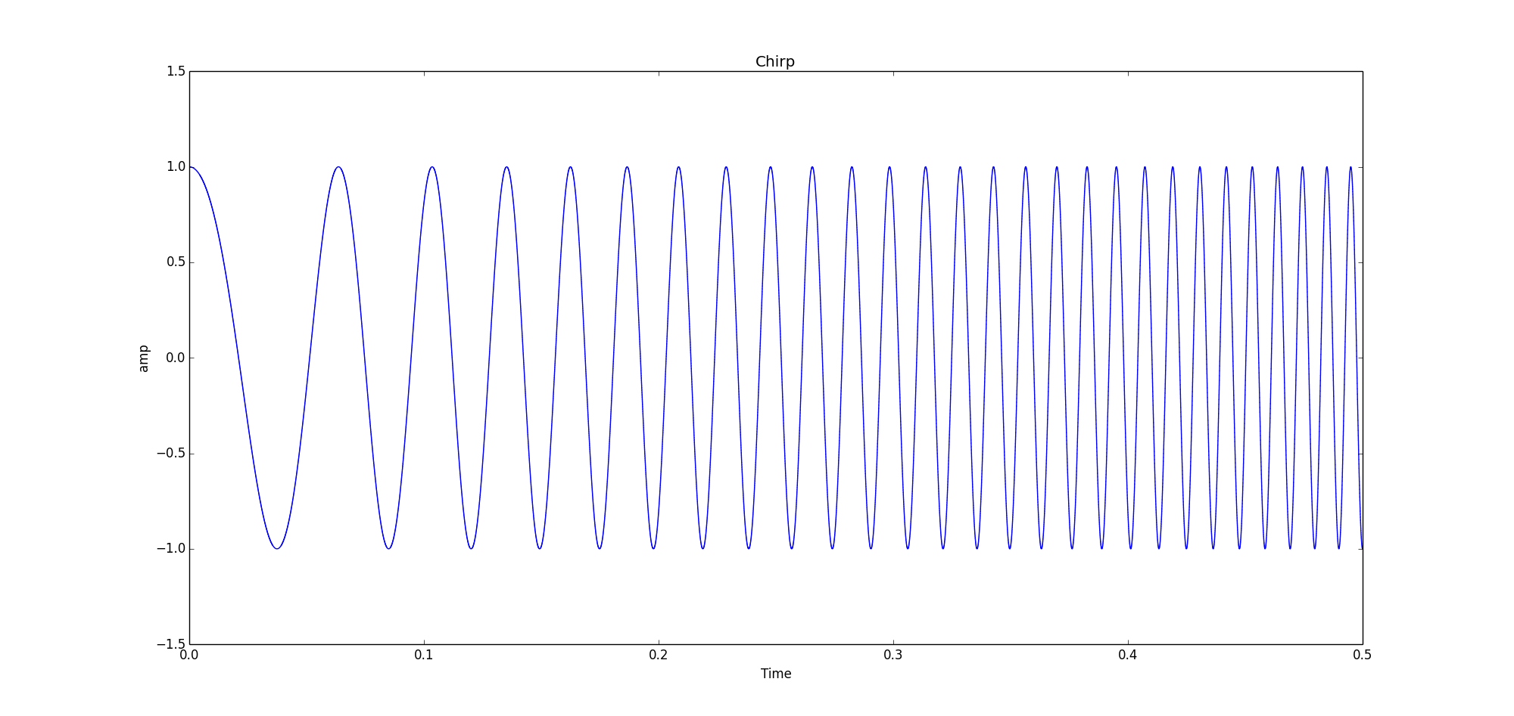
What is a chirp ?
A signal in which the frequency increase or decrease with time.

Slide 3
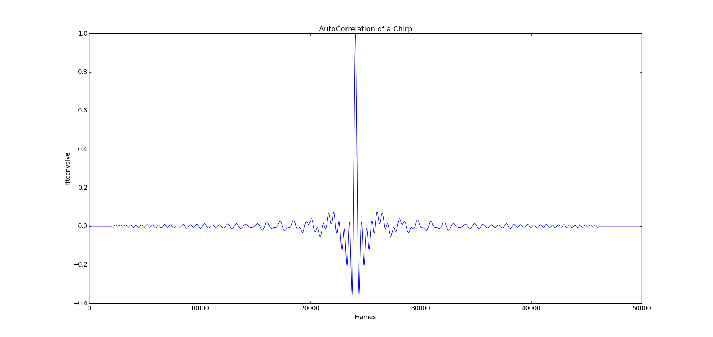
Why is chirp used ?
Compared to mono-frequency impulsion :
Increasing the length of impulsion decrease the precision of detection

Slide 4
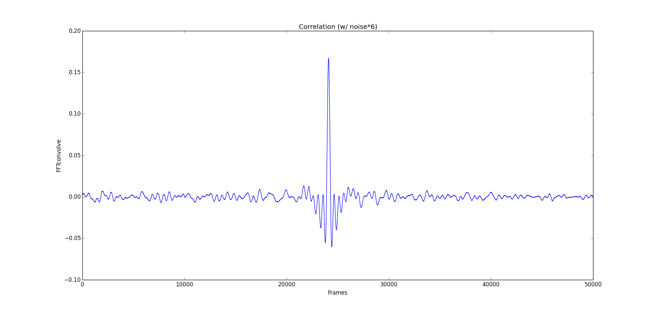
Why is chirp used ?
Compared to mono-frequency impulsion :
Chirp has a better noise-resistance

Slide 5
Operating principle
4 object:
Callback fonction : record the sound
FIFO : store the data
Chirp detection: detect the chirp
Semaphore : which regulate the use of the FIFO

Slide 6



Operating principle
Callback
FIFO
Chirp detection
Semaphore
Detection
Size of a chirp

Slide 7
Nowadays
Using pyAudio to access the sound card
Software works great on Windows
Accurate to 20 centimeter
Does not work on raspberrypi or Linux
Configuration of the sound card is very difficult
Latency varies with time

