Slide 1
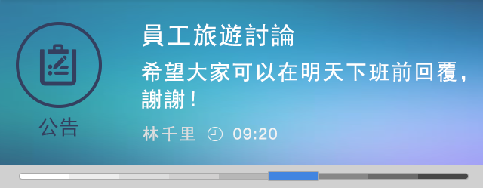

uiSpec-common /icon
timeline
uiSpec-common /icon/icon_time_lightwhite
uiSpec-common /icon/icon_time_gray

Slide 2
uiSpec-common /personal photo

