Slide 1
Semantic Web for Social & Economic Development?
Stéphane Boyera
CEO
stephane@sbc4d.com
SBC4D – http://www.sbc4d.com
19 September 2013
http://demo.sbc4d.com/public/2013/09/sb_downscale13.pptx

Slide 2
Overview
Introduction
Web for Developing countries & underprivileged populations?
New ways of accessing the Web
Importance of Open Linked Data
Challenges & Requirements of Open Linked Data
Conclusion & References

Slide 3
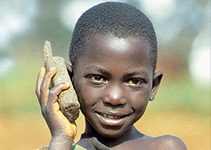
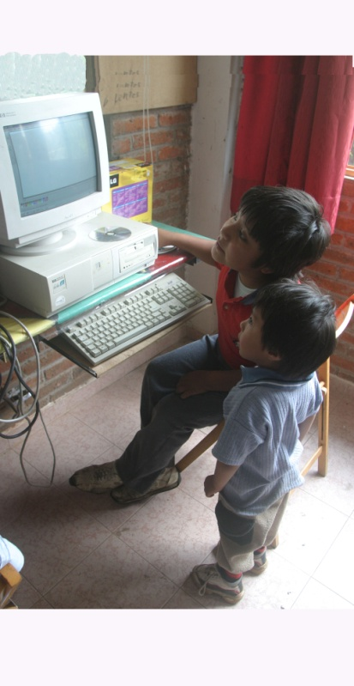
The promises of ICTD
WSIS 2003/2005: Technology is a development tool:
  Overcoming infrastructure challenges
    Education
    Healthcare
    Livelihood
    etc.
  Leveraging communication independently of physical/geographical barriers
  Improving transparency, accountability, efficiency of governments

Slide 4
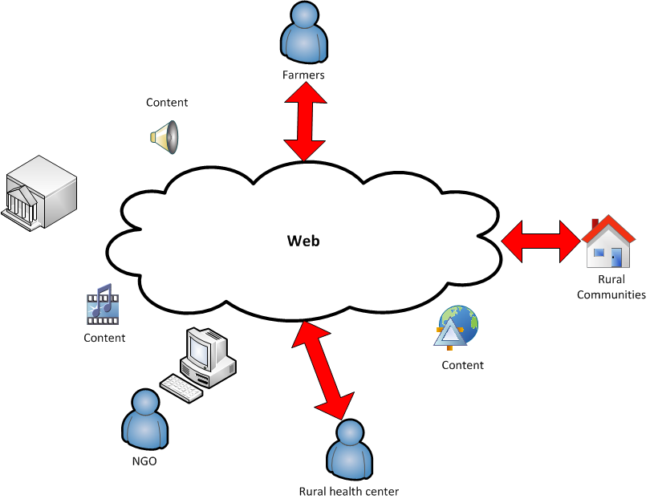
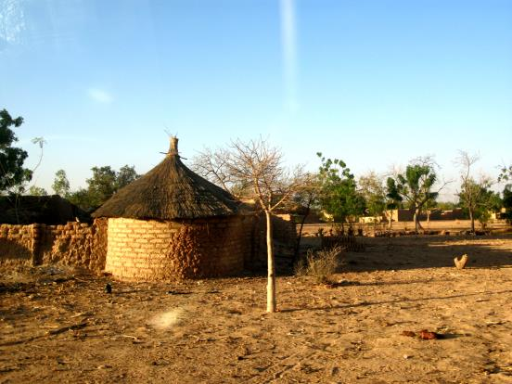
Challenges of Web access
Lack of Infrastructure & devices
High Level of Illiteracy
Lack of ICT-Skills and exposure to technology
Low disposable income

Slide 5
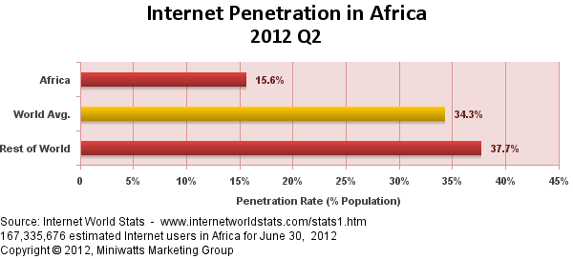
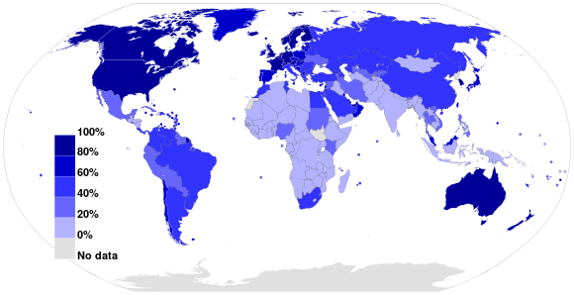
Web Access: Current State

Slide 6
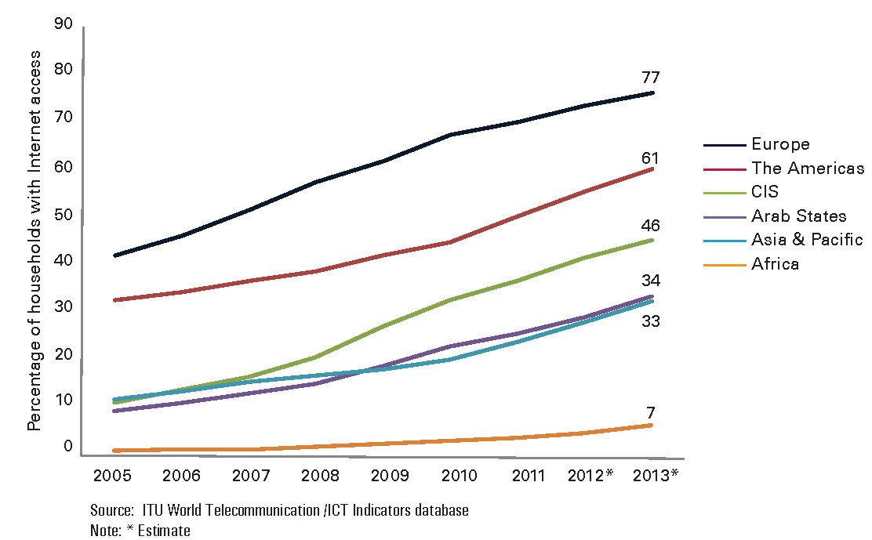
Web Access: Current State

Slide 7
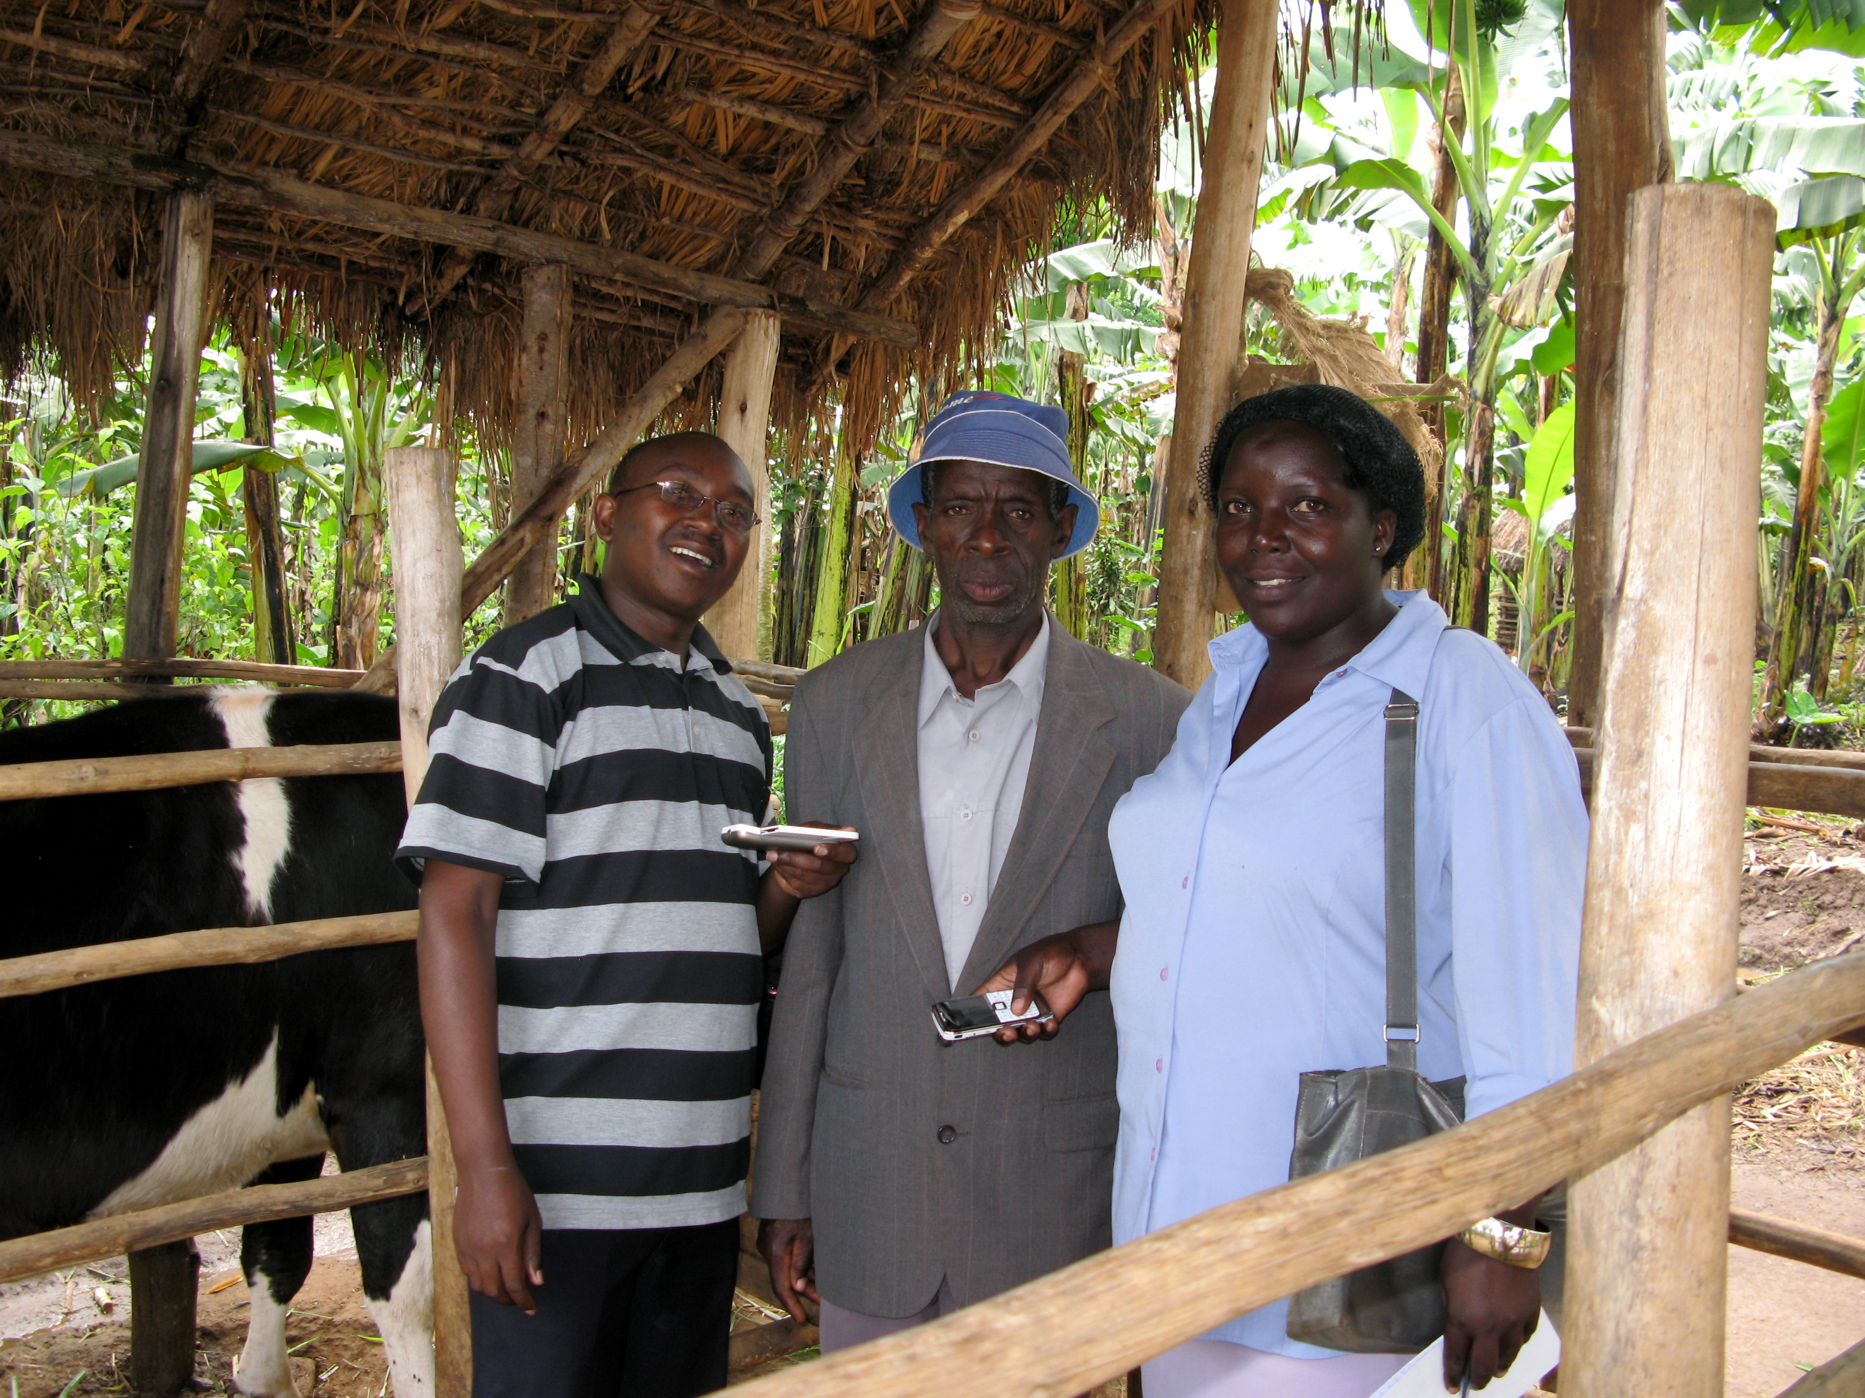
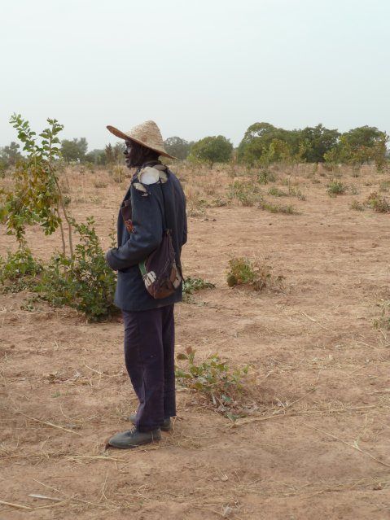
Huge Information needs
  Agriculture
    Market Prices
    Business opportunities
    Support
    Etc.
  Health
    Prevention
    Access to healthcare
    Detection of disease outbreak
    etc.
  Education
  Etc.

Slide 8
New ways of accessing the Web

Slide 9
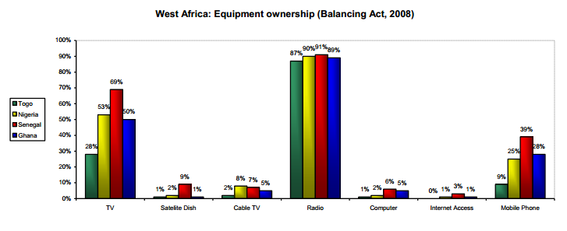
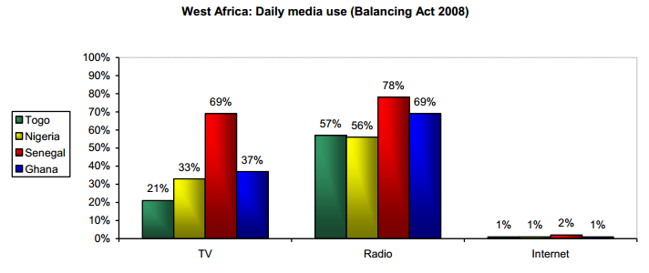
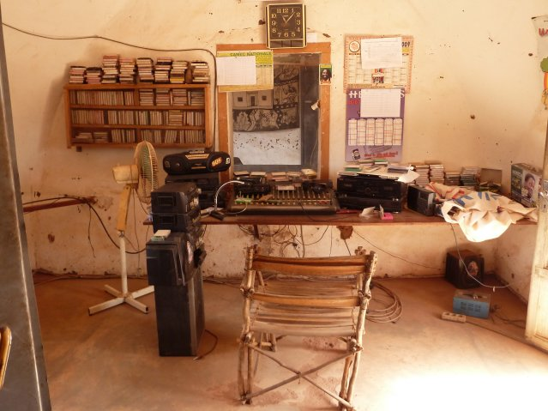
Information Appliances: Radio

Slide 10
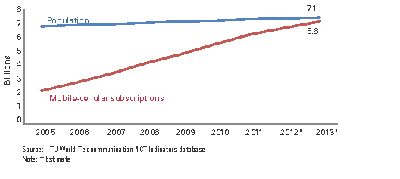
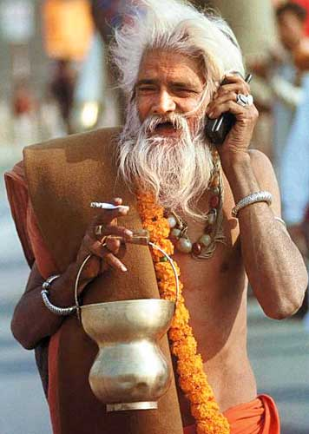
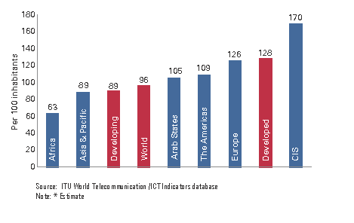
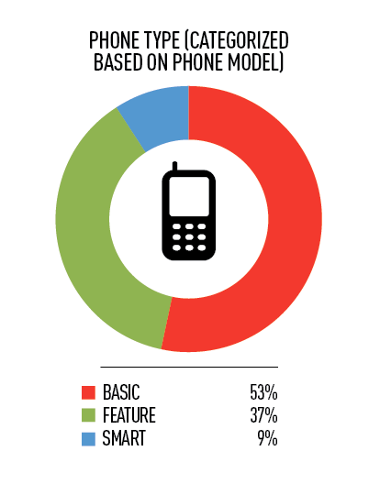
Information Appliances: Mobile phones

Slide 11
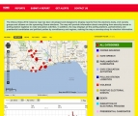
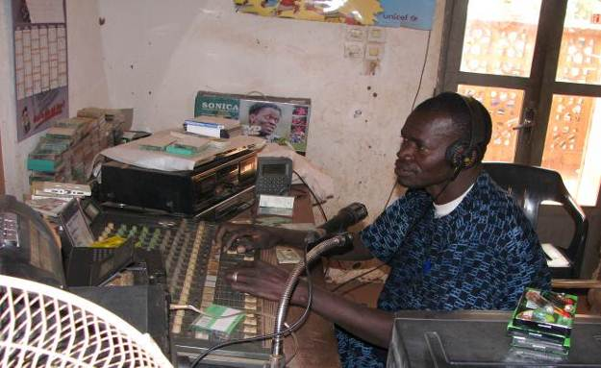
Web of Mobile, voice & radio
  Lots of SMS+Web applications
  Web Alliance for Regreening in Africa (W4RA)
    Tools for small-holder farmers
    Tools for community radio stations
  VOICES
    EU-Funded research project
    Voice technology toolbox

Slide 12
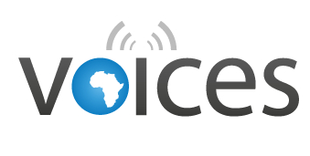





VOIce-based Community-cEntric mobile Services for social development
  EU-Funded research project
  Focused on voice & radio services
  Themes
    Agriculture in Mali
    Health in Senegal
  Result:
    A voice toolbox
    A portfolio of business models

Slide 13
Open Linked Data

Slide 14

Why Open Linked Data?
  Lots of small NGOs working in silos
    On specific products
    With specific communities
  Lots of knowledge is lost
    due to lack of publication
  Lots of phenomena are global
    Food security
    Climate Change
    etc.
  => Knowledge & data sharing is essential

Slide 15
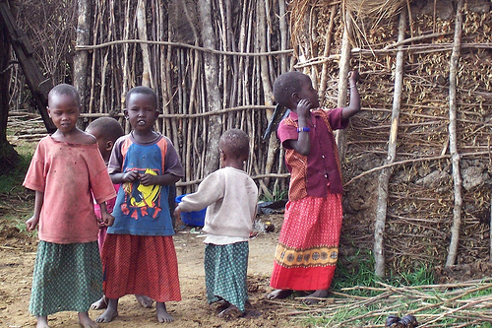
Generating new knowledge
Knowledge Sharing
Mash-up of datasets from different sources
  Linking NGOs’ data and Gov. Data
  Evaluating impacts of events on global trends (e.g. impact of war on food security and prices)
  Detecting new trends (e.g. disease outbreak)

Slide 16
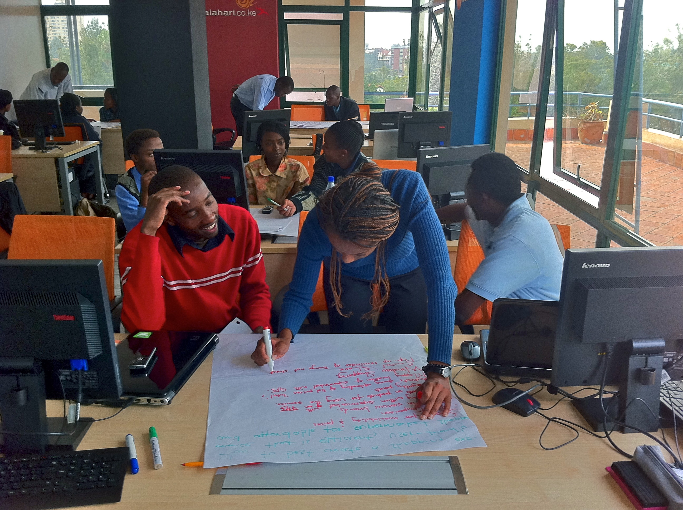
Challenges of Linked Open Data
  Lack of efficient infrastructure for sharing datasets
  Lack of LOD concept in popular tools
  Lack of data reuse, mash-up, etc.
  Training & capacity building at developer level

Slide 17
Conclusion

Slide 18
Conclusion
The Web has a huge potential in Social & Economic Development
Traditional Web access is very limited for people living at the base of the pyramid
New opportunities for providing the benefit of the Web are now arising, based on Mobile, Voice or Radio
There is a growing number of services
Data and knowledge sharing is critical to measure global phenomena and generate new knowledge. open linked data is the model to go
More work is needed to built open linked data paradigm in ongoing initiatives

Slide 19
References
http://www.sbc4d.com
http://www.mvoices.eu
http://www.w4ra.org/
http://www.w3.org/TR/2009/NOTE-mw4d-roadmap-20091208/
http://www.stephb.org

