Slide 1
Business matching service for small-holder illiterate farmers
Stéphane Boyera
CEO
stephane@sbc4d.com
SBC4D – http://www.sbc4d.com
4 November 2013
http://demo.sbc4d.com/public/2013/10/sb_ict4ag.pptx

Slide 2
Overview
Introduction
Context
Objectives
Platform Design
Demonstration
Business Model
Deployment
Conclusion
References

Slide 3


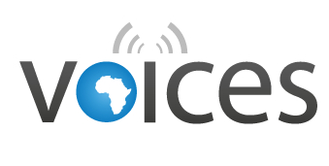


Introduction
SBC4D an IT company specialized in mobile & web services for Social & economic development
  Expertise: Agriculture, Education, Governance, Media, Health
Work & platform built on top of
  Web Alliance for Regreening in Africa (W4RA )
    VU University (NL), Sahel Eco (Mali)
  VOICES: EU-Funded FP7 project in Mali & Senegal
    12 partners EU+Africa:
      Orange, Portugal Telecom
      VU, TNO, CRS4, CSIR, NWU, ESMT
      Web Foundation, W3C, Sahel Eco, Fondation Mérieux

Slide 4
Context

Slide 5
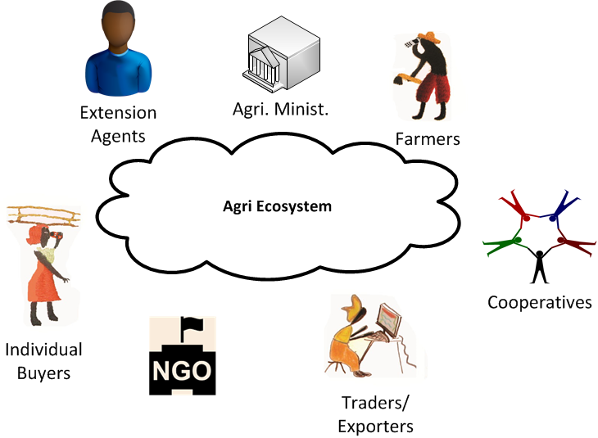
Agri Stakeholders: Actors
Public actors (Ministry, etc.)
Farmers
Buyers
Traders/Exporters
NGOs
Cooperatives
Extension agents

Slide 6
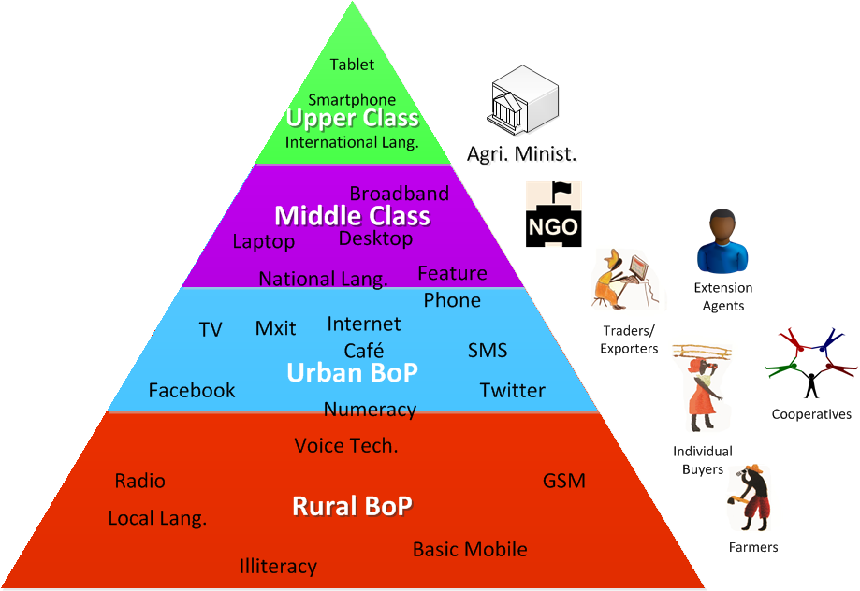
Agri Stakeholders: Profiles
Needs for Information exchanges are high
ICT has a huge role to play
Very different profiles
  Language & literacy
  Access to ICT equipment
  Exposure to technology
  Disposable income

Slide 7
Platform Design

Slide 8
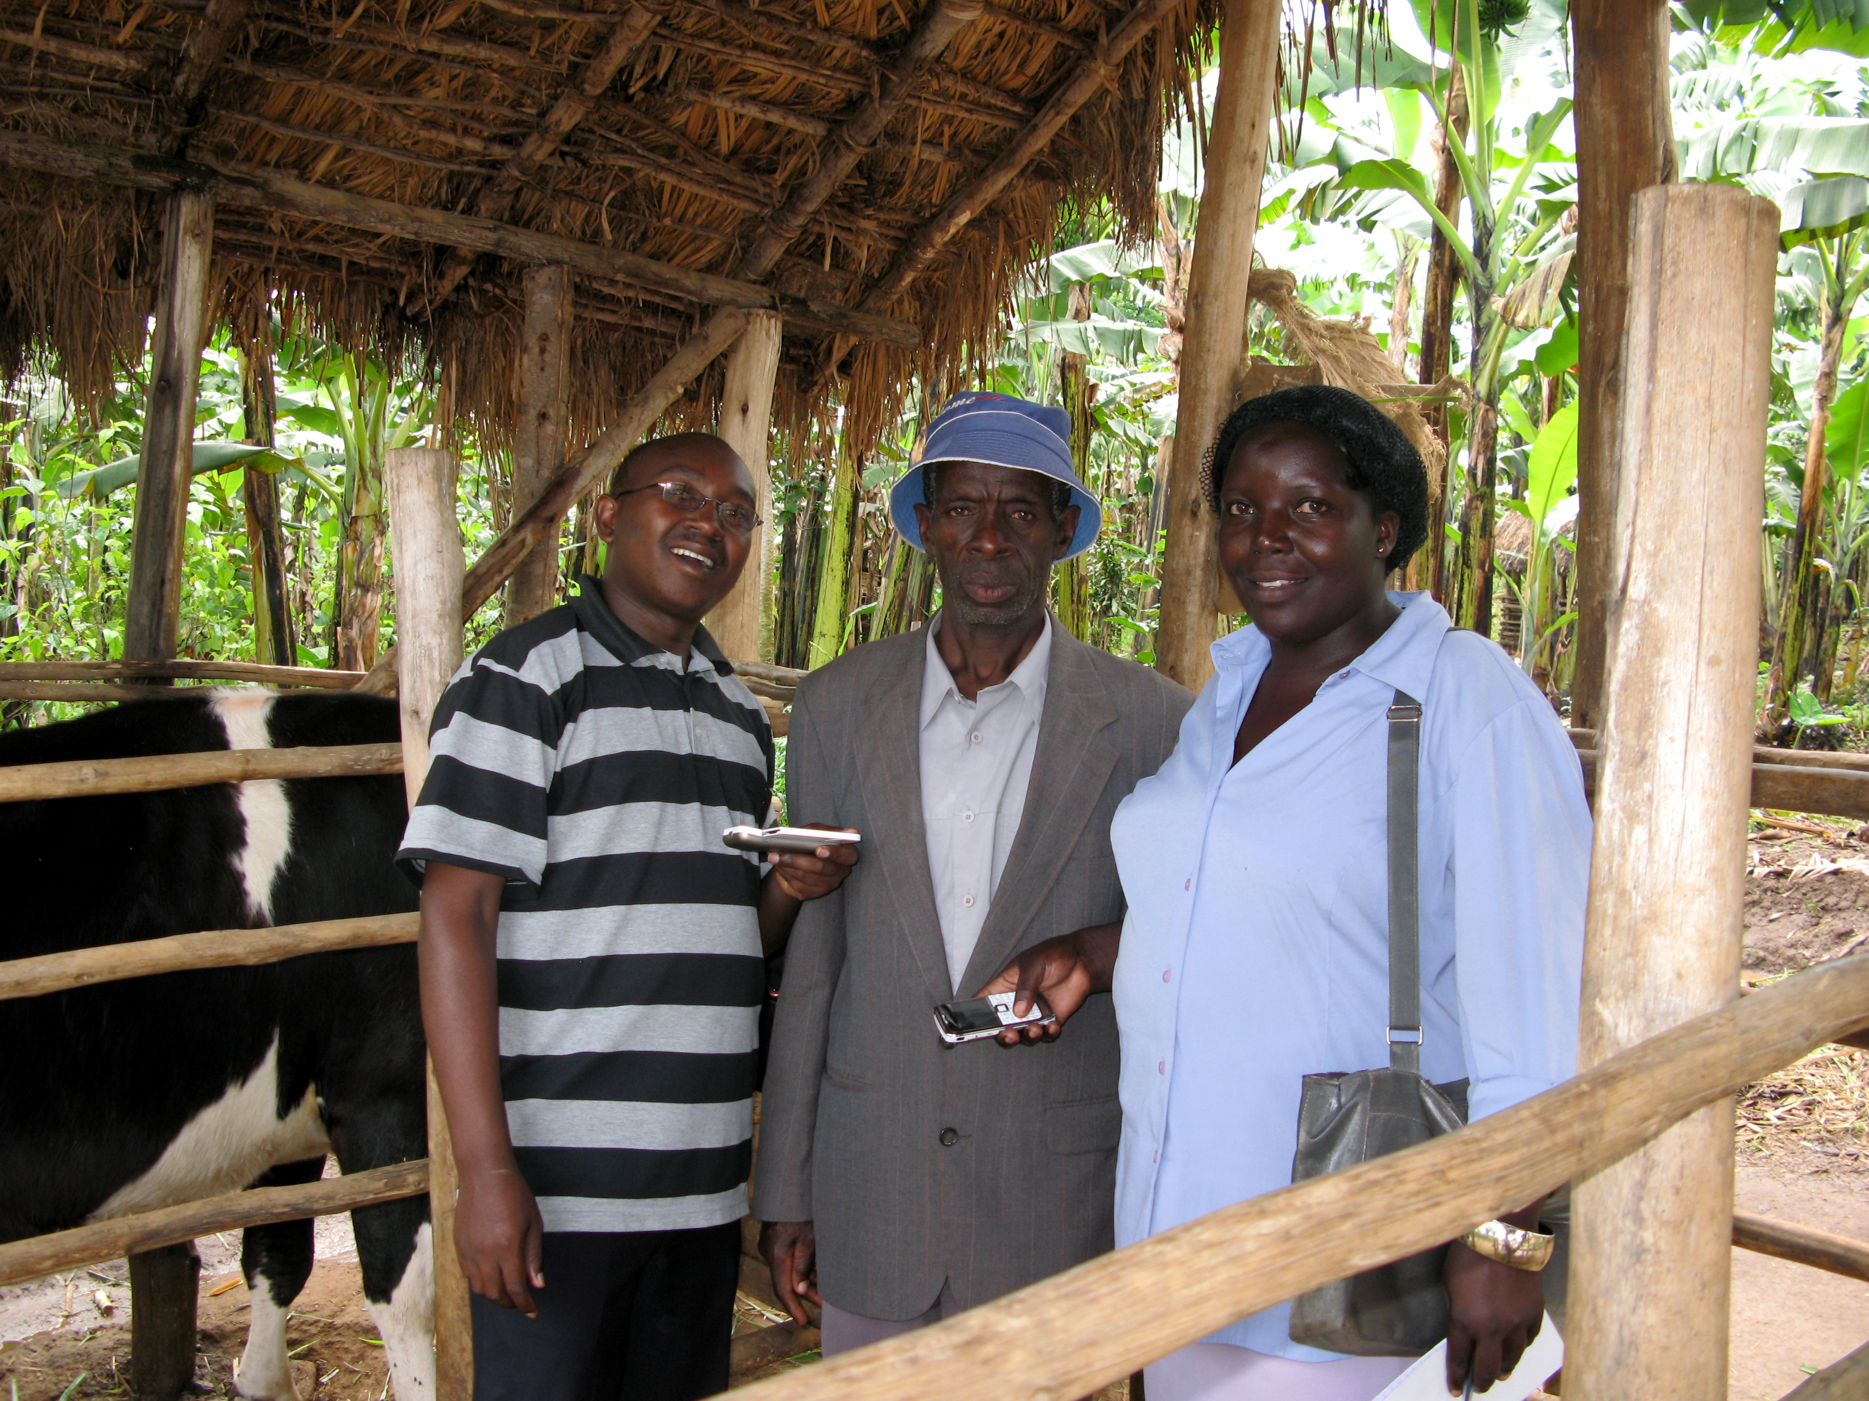
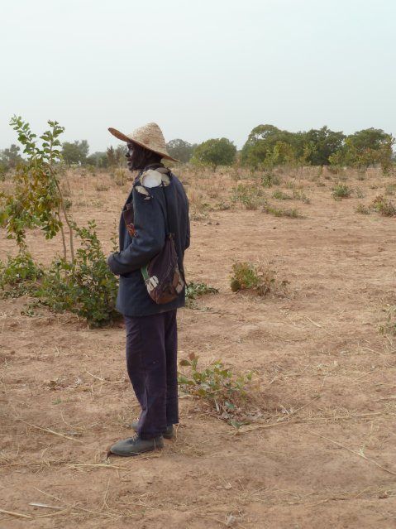
Objectives
Provide the best accessible interface
  To each group individually
    not the lowest common denominator
  Without intermediaries due to:
    Costs challenge
    Motivation challenge
Rely on what is existing in the field already
    For sustainability
    For scalability

Slide 9
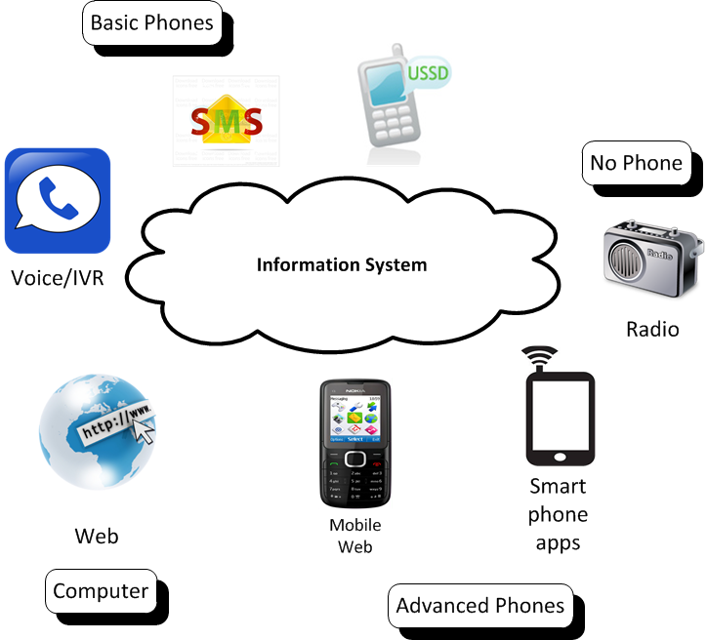
Platform Design
A multi-channel approach to fit
  Multiple contexts
  Varieties of actors

Slide 10
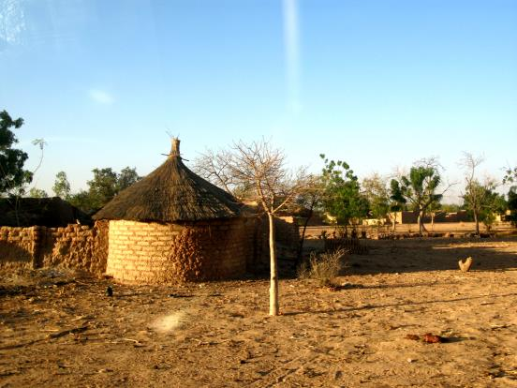
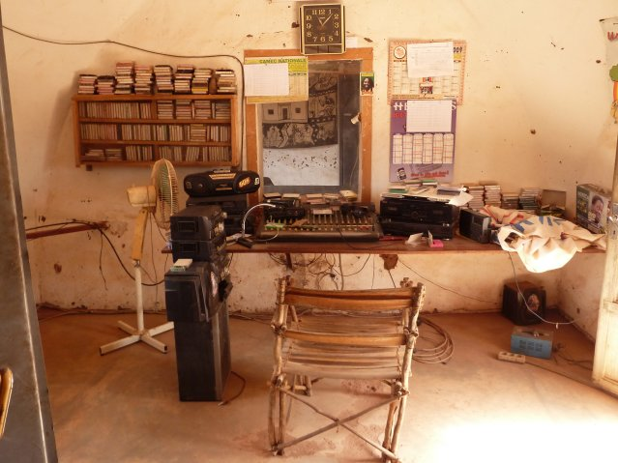
Core Challenges & Innovation
Illiteracy
  Technology Solution: IVR
  Audio Interface Design
    Make the simplest possible interface
    Enrich interactions with metadata
Community Radio
  Generation of broadcast
  Transfer of broadcasts to radio
    Web
    IVR

Slide 11
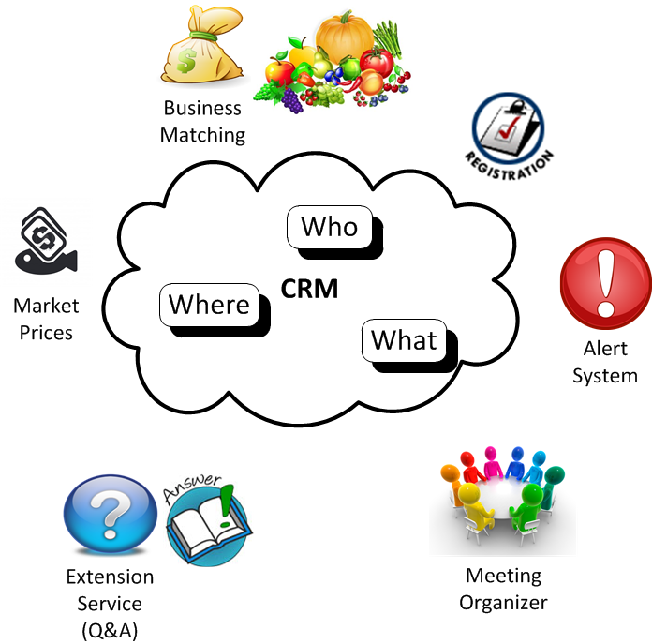
A Modular Approach

Slide 12
DEMO

Slide 13



Demonstration
  Soko Hewani in Kenya
    Business Matching service
    IVR + Web
    Mobile Money
    Etc.
  Radio Marché in Mali

Slide 14
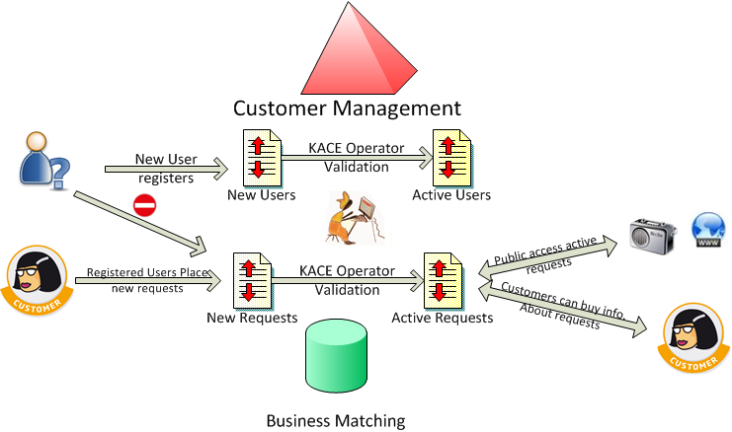
Demonstration: Soko Hewani

Slide 15
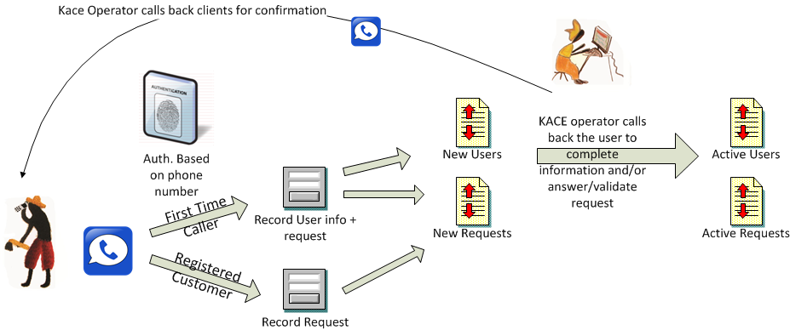
Demonstration: Soko Hewani

Slide 16
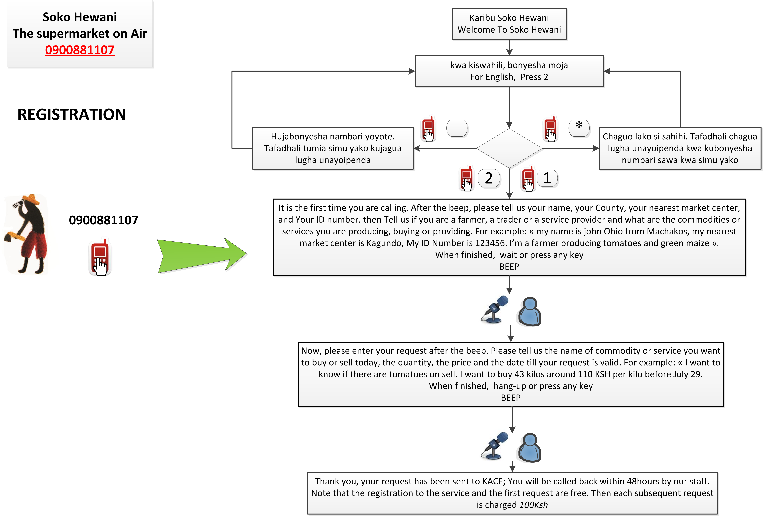
Demonstration: Soko Hewani

Slide 17
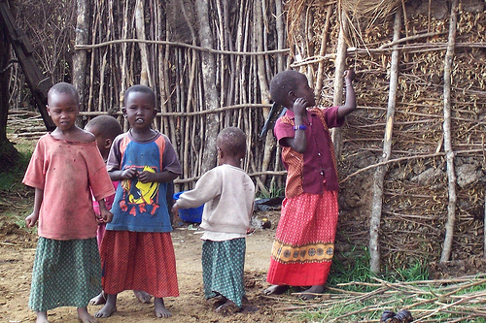
Business Models
  Challenge: Collection money/payments
  Solutions
    Premium rate numbers: not working
      Hard to discuss and setup with operators
      Expensive for users
      Low revenue for service providers
    Subscription Model: more sustainable
      Cash
      Mobile Money

Slide 18

Deployments
  Objective:
    Scalability
    Separating application development from hosting/deployment
  Challenge: local IVR solution
  Solutions
    Development using standards (VoiceXML)
    Basic: <50-100 users: cheap simbank
    Medium: <5000-10000 users: Private hosting with E1 line
    Professional grade: Operator hosted
  Web Alliance for Regreening in Africa (W4RA)
    Tools for small-holder farmers
    Tools for community radio stations
  VOICES
    EU-Funded research project
    Voice technology toolbox

Slide 19




Current deployments
  Kenya: Kenya Agricultural Commodities Exchange supported by ITC
    Soko Hewani: IVR+Web business matching tool
  Fiji: Fiji Crop & Livestock Council supported by ITC
    Agritips: USSD+SMS+Web extension service
  Mali: Sahel Eco supported by W4RA
    Radio Marché: IVR+Radio Business matching tool
    Tabale: IVR Meeting Organizer & alert system

Slide 20
Conclusion

Slide 21
Conclusion
Our platform is not a product but a toolbox
  Needs deep local context analysis
  Selection of services & channels
  Customization
  Training
It can fit with a lot of contexts
Still recent, just out of the research phase, needs validation (sustainability)
Word of cautious: ICT is a just a tool not a solution
  Specific products & value chains in specific geographies have specific challenges
  Agriculture & farmers knowledge are essential, not techies
  Local IT capacities are critical

Slide 22
References
http://www.sbc4d.com
  http://www.sbc4d.com/product-services/demo/
http://www.mvoices.eu
http://www.w4ra.org/
My blog: http://www.stephb.org
  http://stephb.org/2012/12/mobile-ict-small-scale-farmers/
  http://stephb.org/2013/03/demystifying-voice-technologies-for-development/
http://www.w3.org/TR/2009/NOTE-mw4d-roadmap-20091208/
Contact:
  Stephane Boyera
  stephane@sbc4d.com
  @stephb4d

