Slide 1


Web of Voices
14:45-16:15
Lab 5 – ICT for Social & Economic Development

Slide 2

ICT & Social & Economic Development ?
Stéphane Boyera
CEO
stephane@sbc4d.com
SBC4D – http://www.sbc4d.com
26 November 2013
http://demo.sbc4d.com/public/2013/10/sb_edd.pptx

Slide 3
Overview
ICT for Development History
Mobile revolution & Mobile Hype
ICTD Challenges
VOICES a successful approach
Conclusion

Slide 4
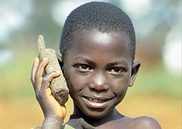
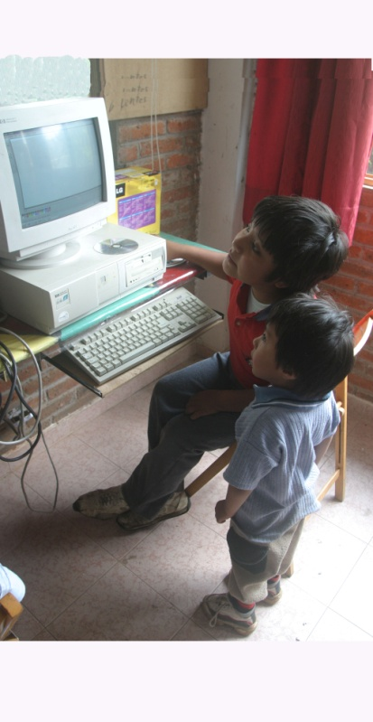
Why Technology or the Promises of ICTD
WSIS 2003/2005: Technology is a development tool:
  Overcoming infrastructure challenges
    Education
    Healthcare
    Livelihood
    etc
  Leveraging communication independently of physical/geographical barriers
  Improving transparency, accountability, efficiency of governments

Slide 5
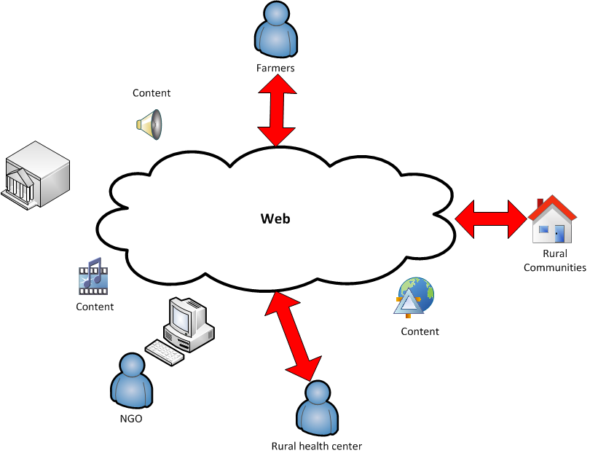
Challenges: Infrastructure & Devices

Slide 6
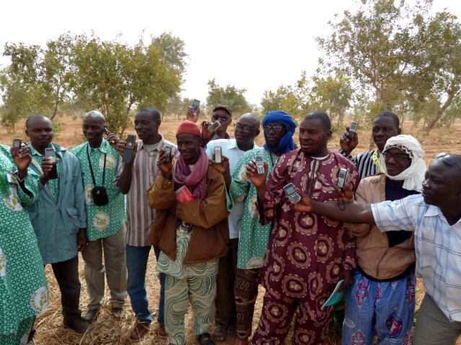
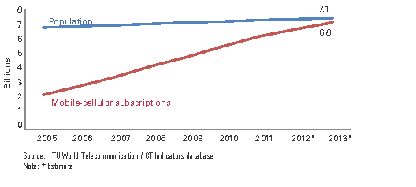
Mobile Revolution
90% of the World population covered, 6 Billions subscribers
First time in history that a minimal ICT appliance is available at that scale
First time that a bi-directional interactive communication device is available in the hands of the poorest
Infrastructure gap is (almost) bridged

Slide 7
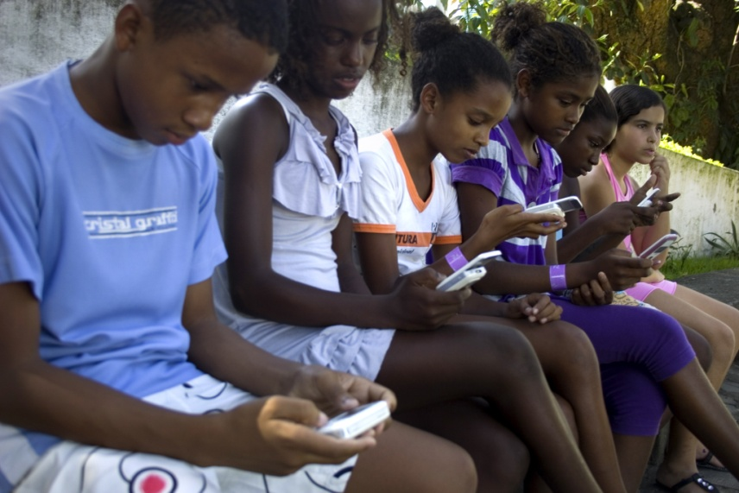
Mobile Hype
Thousands of Initiatives
  Health
  Education
  Agriculture
  Financial services
  Etc.
ICT & mobile are the new magic wand for development
Usage & Impact are unclear
Development Outcomes are low

Slide 8
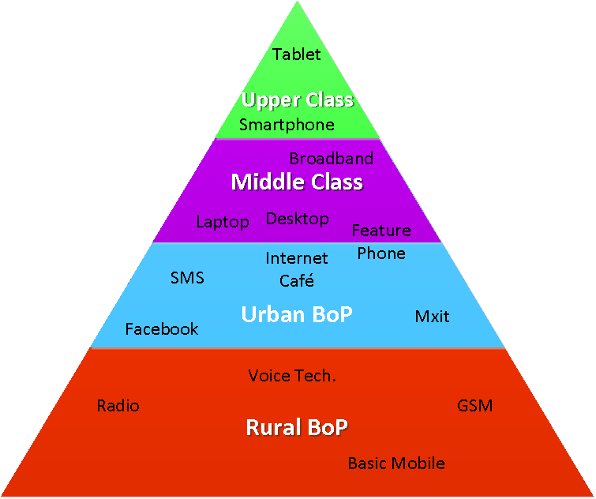
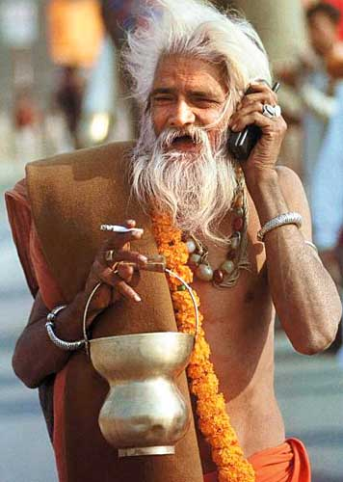
Barriers & Challenges
High Level of Illiteracy
Lack of ICT-Skills and exposure to technology
Lots of dialects
Most phones are basic phones
Low disposable income

Slide 9


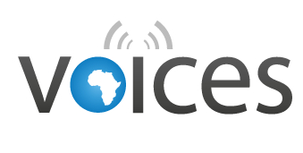
Strategy: Advancing EU research & partnership in ICTD
Developing new approaches to ICTD Challenges
Building multi-stakeholders partnership
  Research team in EU and Africa
  Development Organizations
  Local & International NGOs
  Industrial partners
Building multi-expertise approach
  ICT expertise
  Field expertise
  Financial expertise
Validating in the field

Slide 10




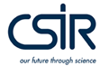


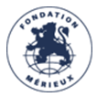

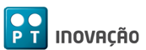
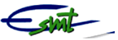
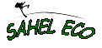
VOICES Fact Sheet
Project Name: VOIce-based Community-cEntric mobile Services for social development (VOICES)
January 2011 – June 2013
30 Months
12 Partners from France, Switzerland, Italy, Netherland, Senegal, Mali, South Africa, Portugal
Budget: ~3M Eur project (~2M EC contribution)
Geographical Area: Senegal and Mali
Domain: ICTD – Health/Agriculture/Entrepreneurship
10

Slide 11
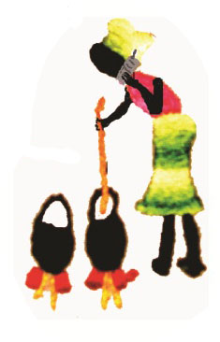

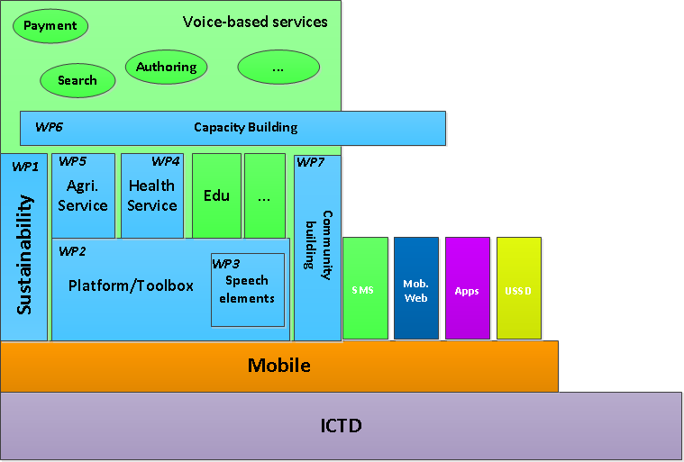


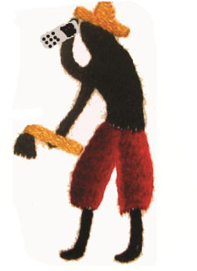
VOICES Structure & Organization

Slide 12
Video

Slide 13
Conclusion
ICTD & Mobiles are not a Magic Wand but just a tool to solve some specific challenges
An holistic approach is essential
A Multi-stakeholder approach is required
Local capacity building is also critical
  In ICT
  In research capacities

Slide 14
References
http://www.sbc4d.com
  http://www.sbc4d.com/product-services/demo/
http://www.mvoices.eu
http://www.w4ra.org/
Contact:
  Stephane Boyera
  stephane@sbc4d.com
  @stephb4d

