Slide 1
Mobile and Voice Technologies for Social & Economic Development
Stéphane Boyera
CEO
stephane@sbc4d.com
SBC4D – http://www.sbc4d.com
Perspectives on ICT4D – Vu University, Amsterdam - 16 May 2014
http://demo.sbc4d.com/public/2014/05/sb_vu.pptx

Slide 2
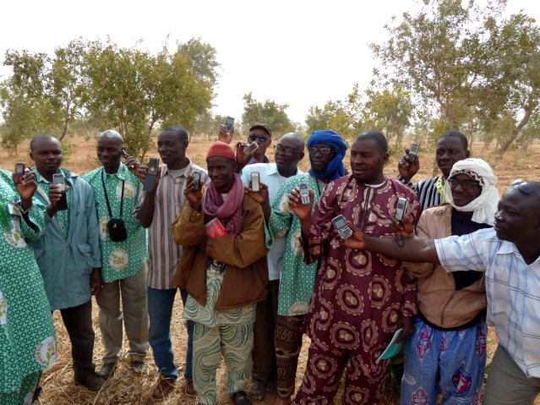
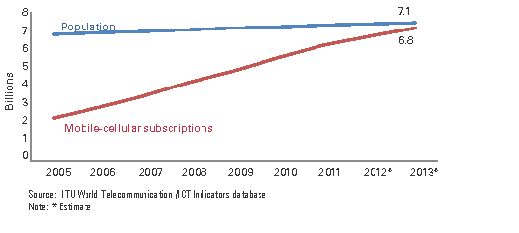
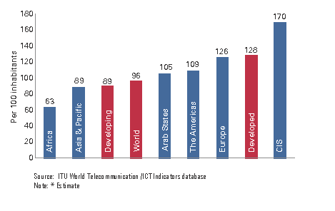
Mobile Revolution
90% of the World population covered, 6 Billions subscribers
First time in history that a minimal ICT appliance is available at that scale
First time that a bi-directional interactive communication device is available in the hands of the poorest

Slide 3
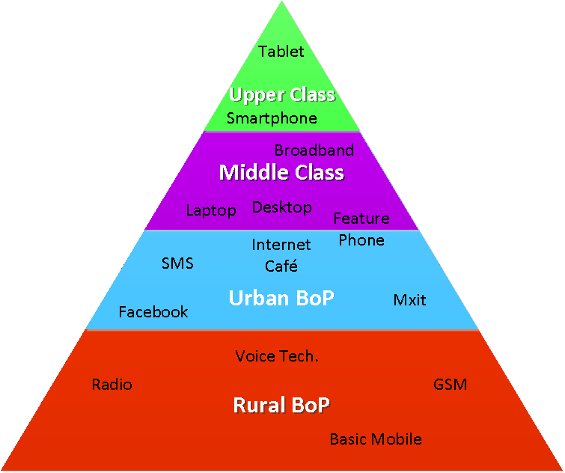
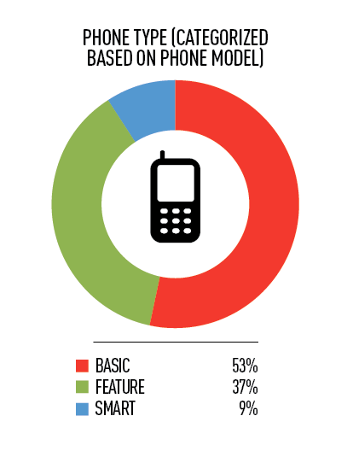
Barriers & Challenges
High Level of Illiteracy
Lack of ICT-Skills and exposure to technology
Low disposable income
Lots of dialects
Most phones are basic phones

Slide 4

Voice technologies
Bridge (most of) the hardware gap
  works on all phones – open ICT to 6B of people
Bridge the Internet Connectivity gap
  works on all phone networks – open ICT to 90% of the World Pop.
Bridge the language gap
  Works in all languages (7000+ ) of the World (recorded audio)
Bridge the literacy gap
  Does not require textual literacy (1+B illiterate adults)
Bridge the ICT-skill gap
  Use an obvious function of the phone

Slide 5
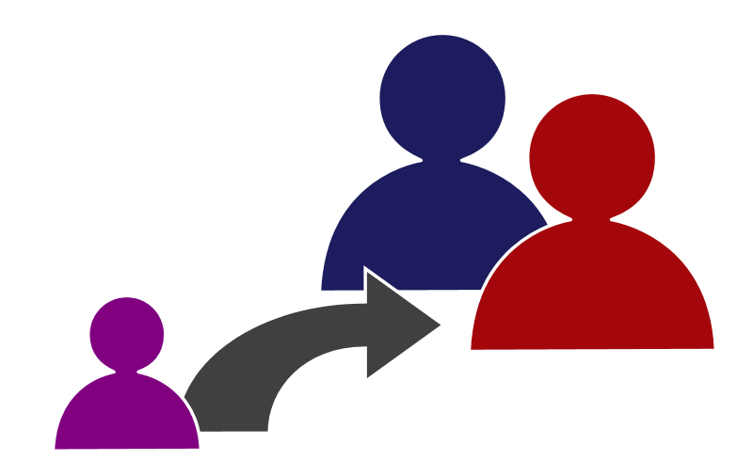
Adoption challenges
Relevance, accessibility, usability, trust
Affordability & Sustainability
Scalability

Slide 6
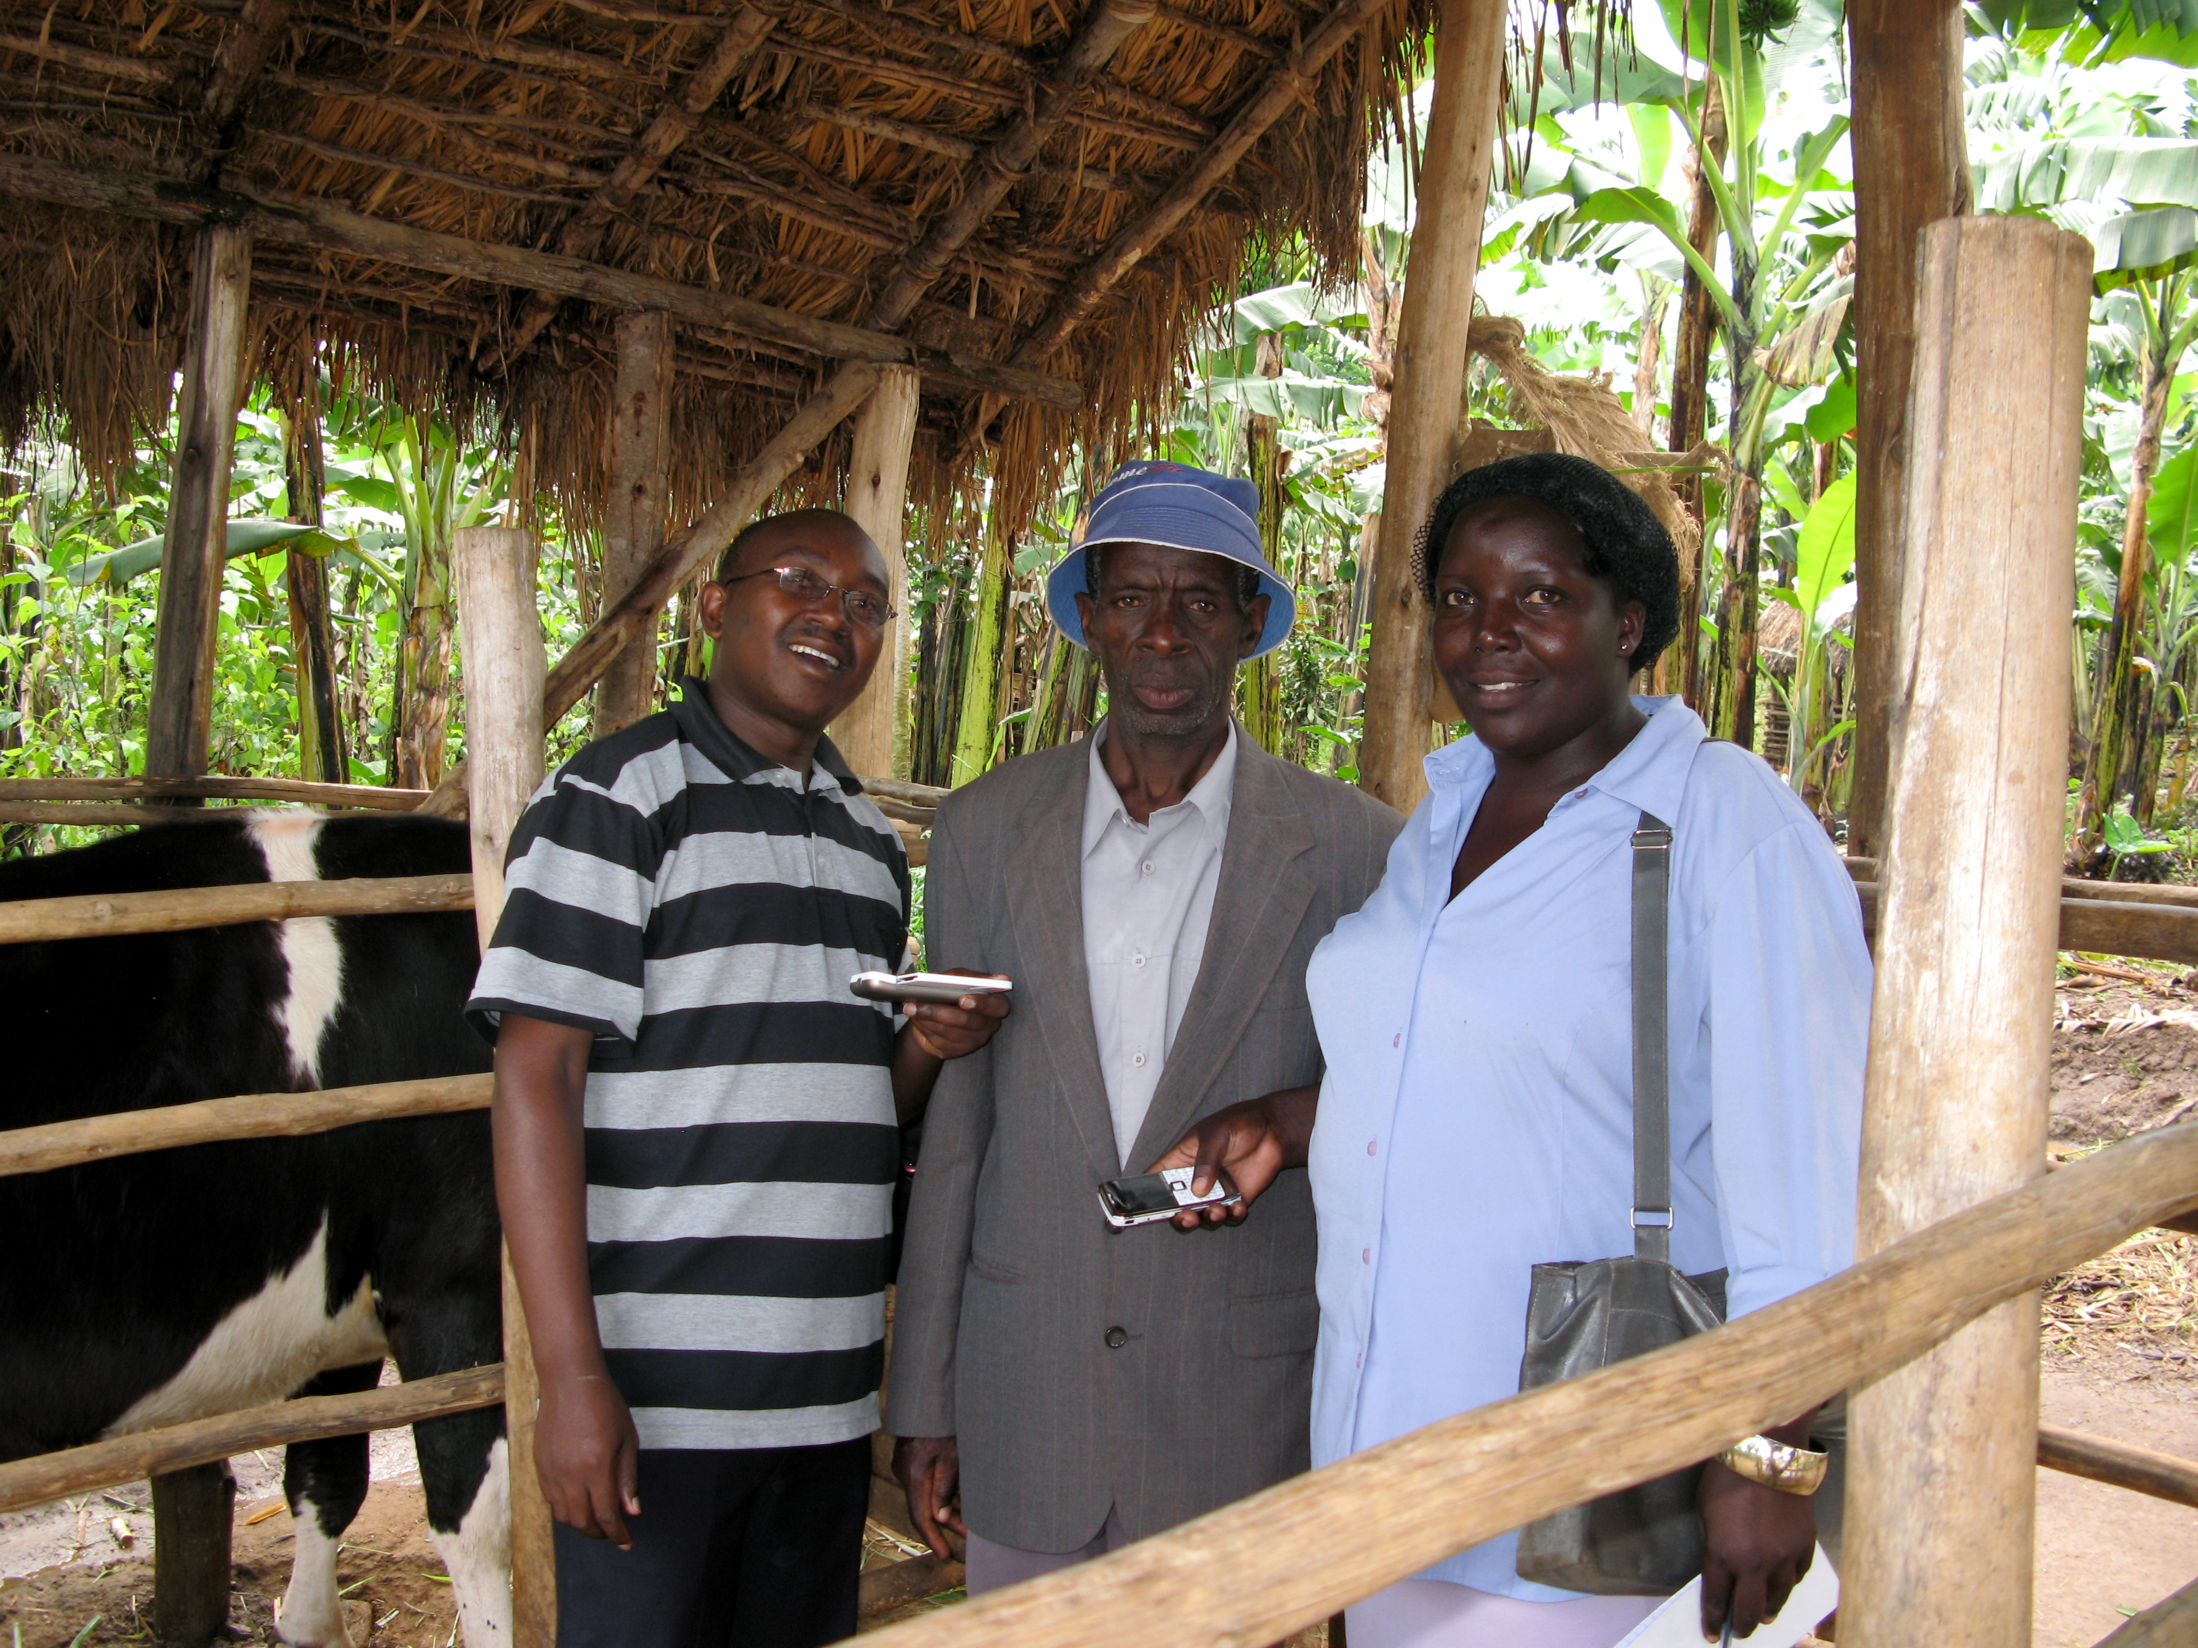
Human Factors & UI
Audio interface design is a challenge:
  computer and technologies are not a natural concept
  Mental models are different and impact the task
    complexity and depth of menus
  Type of illiteracy has a huge impact on design: e.g. DTMF navigation, Data input
  Trust building is critical
    Type of voice has impact (gender, known voices, etc)

Slide 7
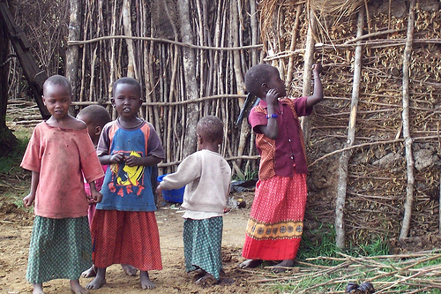
Business Model
Who pays and who benefits?
What is the Return on Investment?
What are incentives to dedicate time & Money and bridge knowledge gaps?
  Social
  Economic
How to implement the business model?

Slide 8
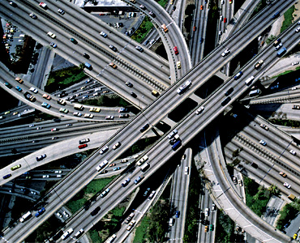
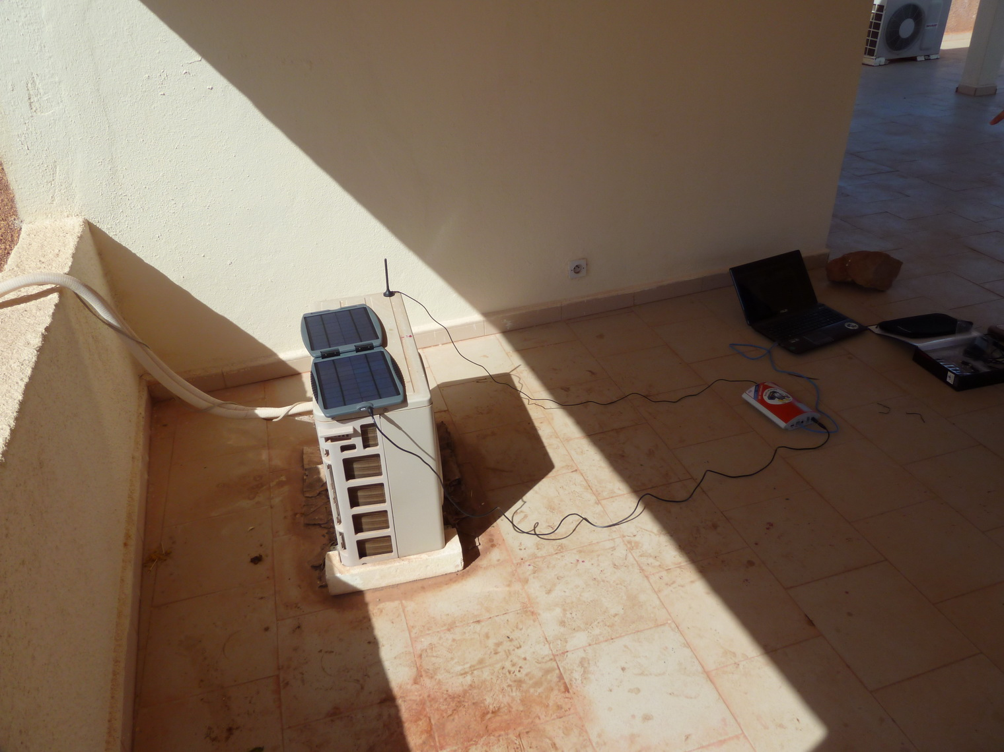
Deployment Challenges
Local phone numbers
Capacities (e.g. Concurrent calls)
Data Center: backup, energy, etc.
Sustainability & Update
Local Competencies
Negotiation with mobile operators

Slide 9
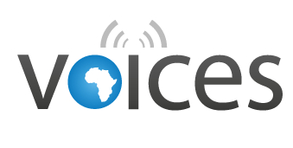





VOIce-based Community-cEntric mobile Services for social development
  EU-Funded research project
  Focused on voice & radio services
  Themes
    Agriculture in Mali
    Health in Senegal
  Result:
    A voice toolbox
    A portfolio of business models

Slide 10





Other Applications
  Election Monitoring by in Ghana (2012) and Kenya (2103) with Al Jazeera
  Business Matching services for Farmers in Kenya, Fiji with International Trade Center
  MTV Shuga Drama
  Helpline for public Health (HIV/Aids) information with MTV and M. of Health in Nigeria

Slide 11
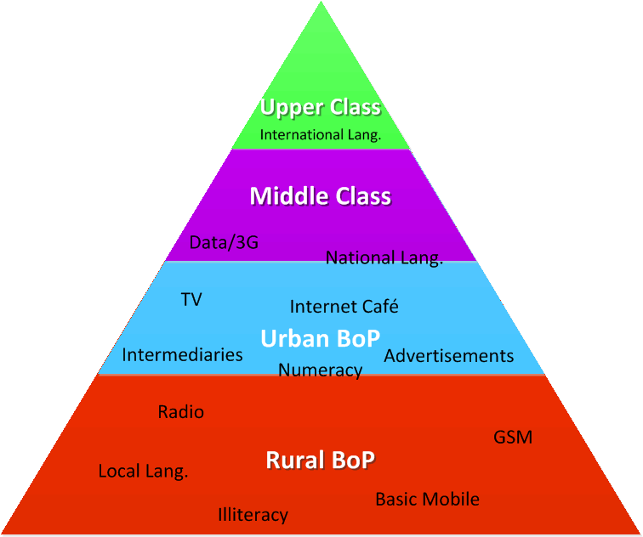

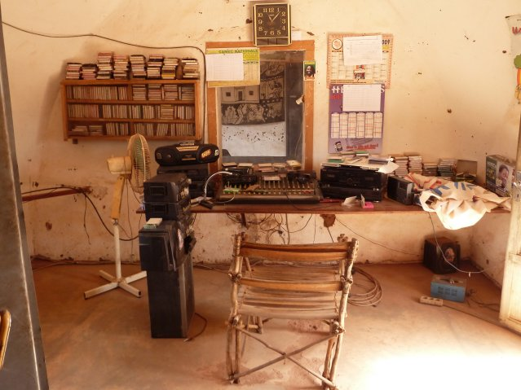

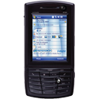
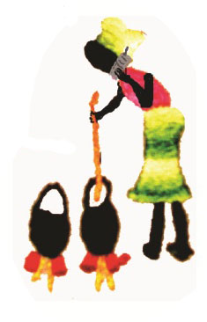

Multi-stakeholders: Multi-Channel
Organization level
Field agent level/Intermediaries
Citizen Level

Slide 12
Next Wave?

Slide 13


Open Data
  Lots of Countries are opening their Data all over the world
    see OGP commitments
  Big focus on developing countries
    Partnership on Open Data
  Huge opportunity to develop more services: Data==fuel for ICT services

Slide 14
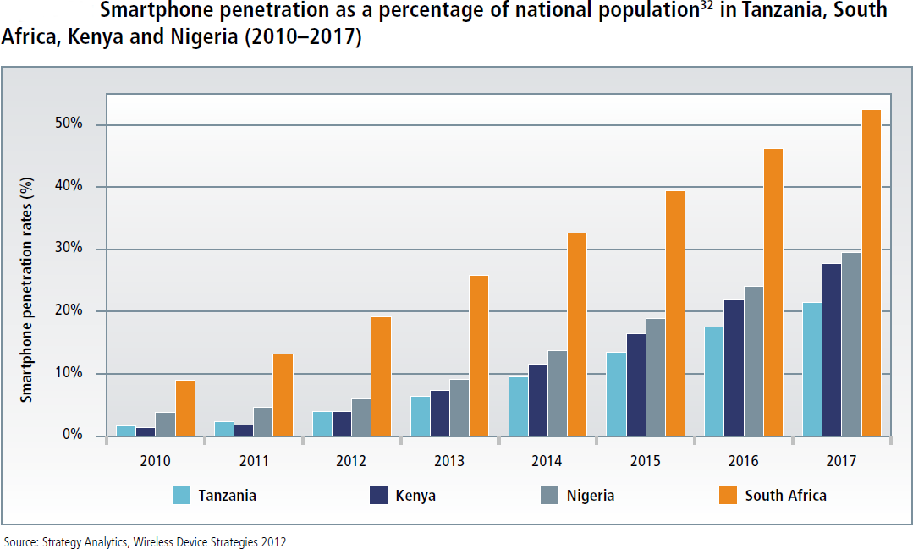
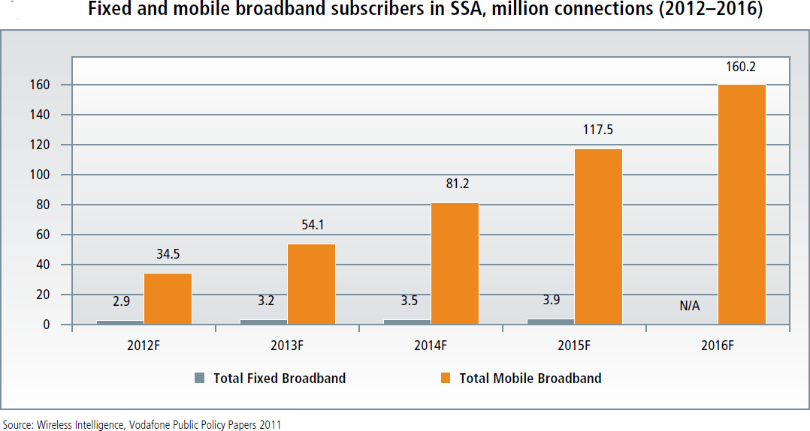
Data, Smartphones & New Interfaces

Slide 15
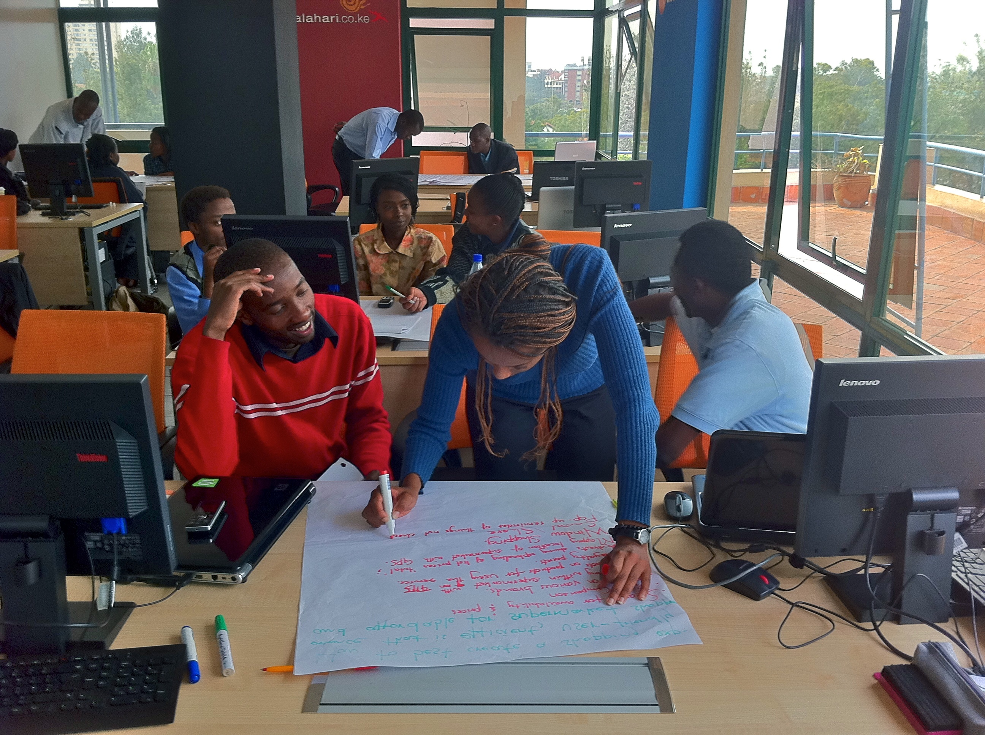
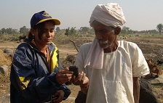
Data, Smartphones & New Interfaces
  New UI for illiterate people
    Icon-based interfaces
    Multi-modal interfaces
  New intuitive interfaces for newcomers
  Adapted smartphones:
    Prices
    Energy
    etc.

Slide 16
Conclusion

Slide 17
Conclusion
The Web has a huge potential in Social & Economic Development
Traditional Web access is very limited for people living at the base of the pyramid
New opportunities for providing the benefit of the Web are now arising, based on Mobile, Voice or Radio
There is a growing number of services
Open Data and new graphical interfaces are the next frontiers

Slide 18
References
http://www.sbc4d.com
http://www.mvoices.eu
http://www.w4ra.org/
http://www.w3.org/TR/2009/NOTE-mw4d-roadmap-20091208/
http://www.stephb.org

