Slide 1
Open Data in Developing Countries: State of the Art & input for GODAN
Stéphane Boyera
CEO
stephane@sbc4d.com
SBC4D – http://www.sbc4d.com
GODAN Meeting, The Hague, Netherland - 10 July 2014
http://demo.sbc4d.com/public/2014/07/sb_godan.pptx

Slide 2
Introduction

Slide 3

Open Data in Developing Countries: State of the Art
A study of the Partnership for Open Data
Period: March-June 2014
Public almost final draft: http://bit.ly/1uJk9ZI
Objectives:
  Identify key actors & activities
  Identify trends & patterns
  Identify promising geographical areas/countries

Slide 4
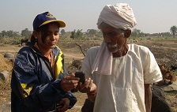
Open Data & Agriculture
Almost no work identified in the sector:
  W4RA led by VU University – Sahel Region
  ILDA in Latin America
  Some national initiatives have some datasets
    Usually Ministries of agriculture are less tech-savy than other with some exceptions
    Related agencies: weather, map, etc.
Some related work
  Open Climate

Slide 5
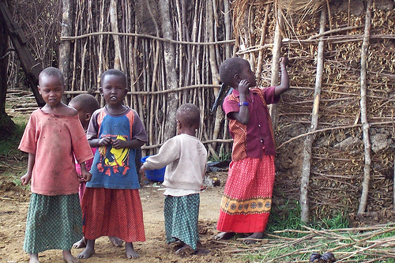
What can we learn from other domains?
What are the key ingredients of an initiative?
What are the possible position and role of a coordinating body like GODAN?
Who are the key partners?
What are possible approaches?

Slide 6
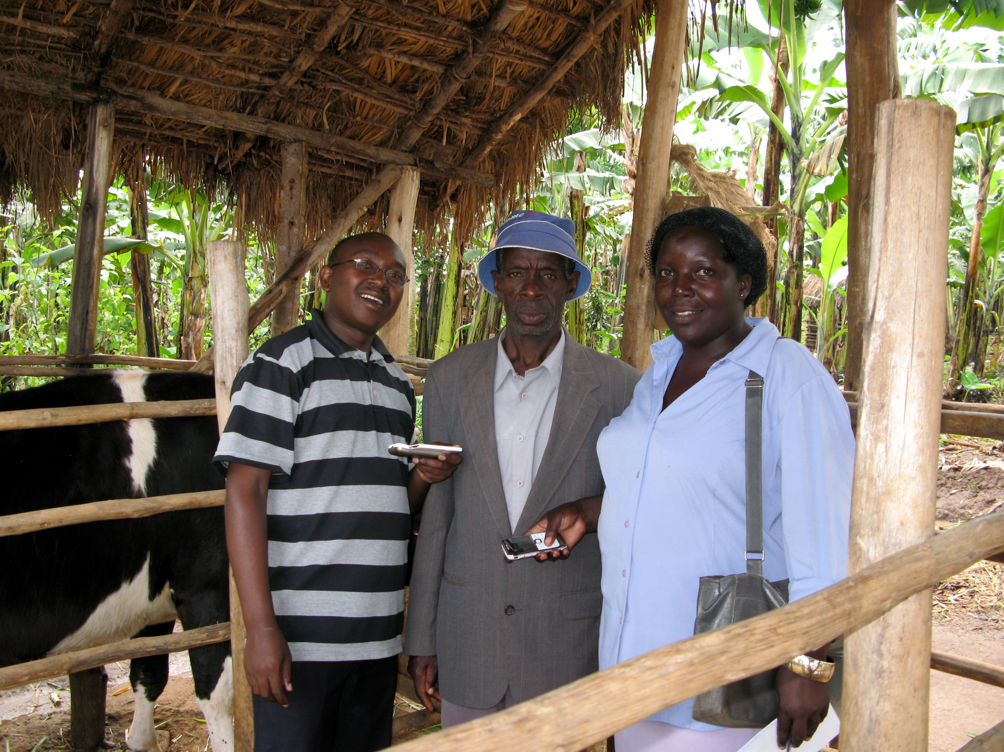
Key Ingredients of an OD-related initiative
Splitting the domain in specific elements: targeted impacts
Providing Data format
Providing Tools
Providing registry(ies)
Providing shining examples
Leveraging Innovation
Mixing global & local approaches

Slide 7

Possible Role for a coordinating body
Coordination of activities & assistance
  e.g. POD
Coordination of funders
  e.g. TAI, Public Health Research Data Forum
Funding Body: E.g. MAVC
Implementation
  e.g. Landportal, open climate portal
Resources development: tools, training, use-cases, etc.
  e.g. OKF

Slide 8
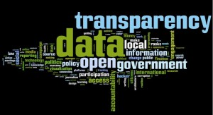
Potential Key Partners
Partnership for Open Data
  Implementation, Assistance
Governments implementing OD
  OGP
    ODWG:
      Sector agnostic
    A dedicated WG?
  World Bank
    Potential Amplifier
Open Climate initiative
  Elements of the strategy?

Slide 9
Potential Approaches
Tools Vs Solution or Objective Vs Mean
Defining objectives in terms of OD
  measure of datasets etc.
  define mission as part of OD org.
  E.g. OD country approaches, IATI
Defining objectives in terms of Agri
  Measure of GDP, production, poverty reduction, exports, etc.
  Define mission within the Agri sector
  E.g.: Open Climate, EITI, COSTS
  Harder (wider expertise required), more measurable impact, likely more interest

Slide 10
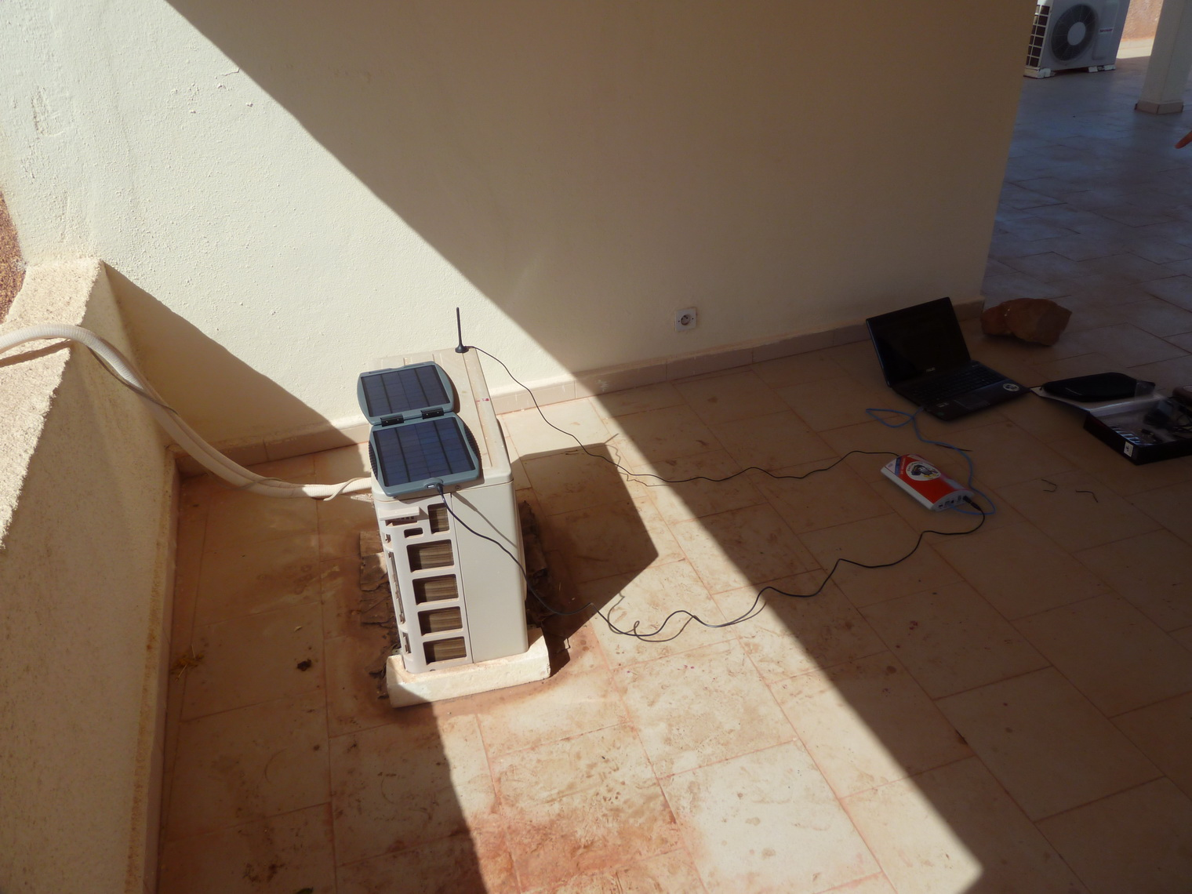
Other related work to leverage
ICT for Agriculture initiatives
  Different topics:
    Trade
    MIS
    Extension Services
    Weather forecast
    etc.
  Different technologies
    Mobile (SMS/IVR)
    Radio/TV/Video
    etc.

Slide 11
Conclusion

Slide 12
Conclusion
Godan is feeling a gap and has lots of potential
  Need to define the core mission:
    What are the objectives?
      T&A?
      Social & Economic Development?
    Who are the targets?
    What are the expected benefits?
There are lots of existing initiatives to leverage
Lots of potential synergies with some other partners
Lot of experience to learn from other domains

Slide 13
References
Open Data in Developing Countries: State of the Art: http://bit.ly/1uJk9ZI
SBC4D: http://www.sbc4d.com
  http://www.sbc4d.com/publications-resources/
W4RA: http://www.w4ra.org/
Personal Blog (on professional matters) http://www.stephb.org

