Slide 1
Opening Government Data to support Agriculture
Stéphane Boyera
CEO
stephane@sbc4d.com
SBC4D – http://www.sbc4d.com
18 February 2015
https://public.sbc4d.com/2015/02/sb_cta_bru.pptx

Slide 2

SBC4D: Where ICT meets Social & Economic Development
Consulting Company specialized in ICTD
  Open Data & Open Linked Data: Strategy & Implementation
    Supporting Governments in ACP Countries in their Open Data Initiative
    Supporting International Organizations
  Mobile & Web services: Strategy, design, deployment. Specific expertise on multi-channel applications, and ICT for illiterate underprivileged communities
Sector Expertise: Agriculture, Governance, Media, Health
Geography:
  70% of activities in Sub-Saharan Africa
  Operation in South Asia (India, Indonesia), Pacific Islands (Fiji), Latin America (Chile, Colombia)

Slide 3

Open Government Data?
A new approach started in 2009 in UK & US, now with more than 60 countries (OGP) over the world
Leveraging access and reuse of public data
  Releasing public data in a machine readable format
  Releasing data with an open licenses
Rationale
  Lots of Datasets available at country level
  Increase value of public Data for all actors
    Private sector & Businesses
    Civil Society organizations & NGOs
    Academics
  Improve transparency & accountability
  Improve public service delivery
  Leads to social and economic development
  Develop the ICT sector

Slide 4
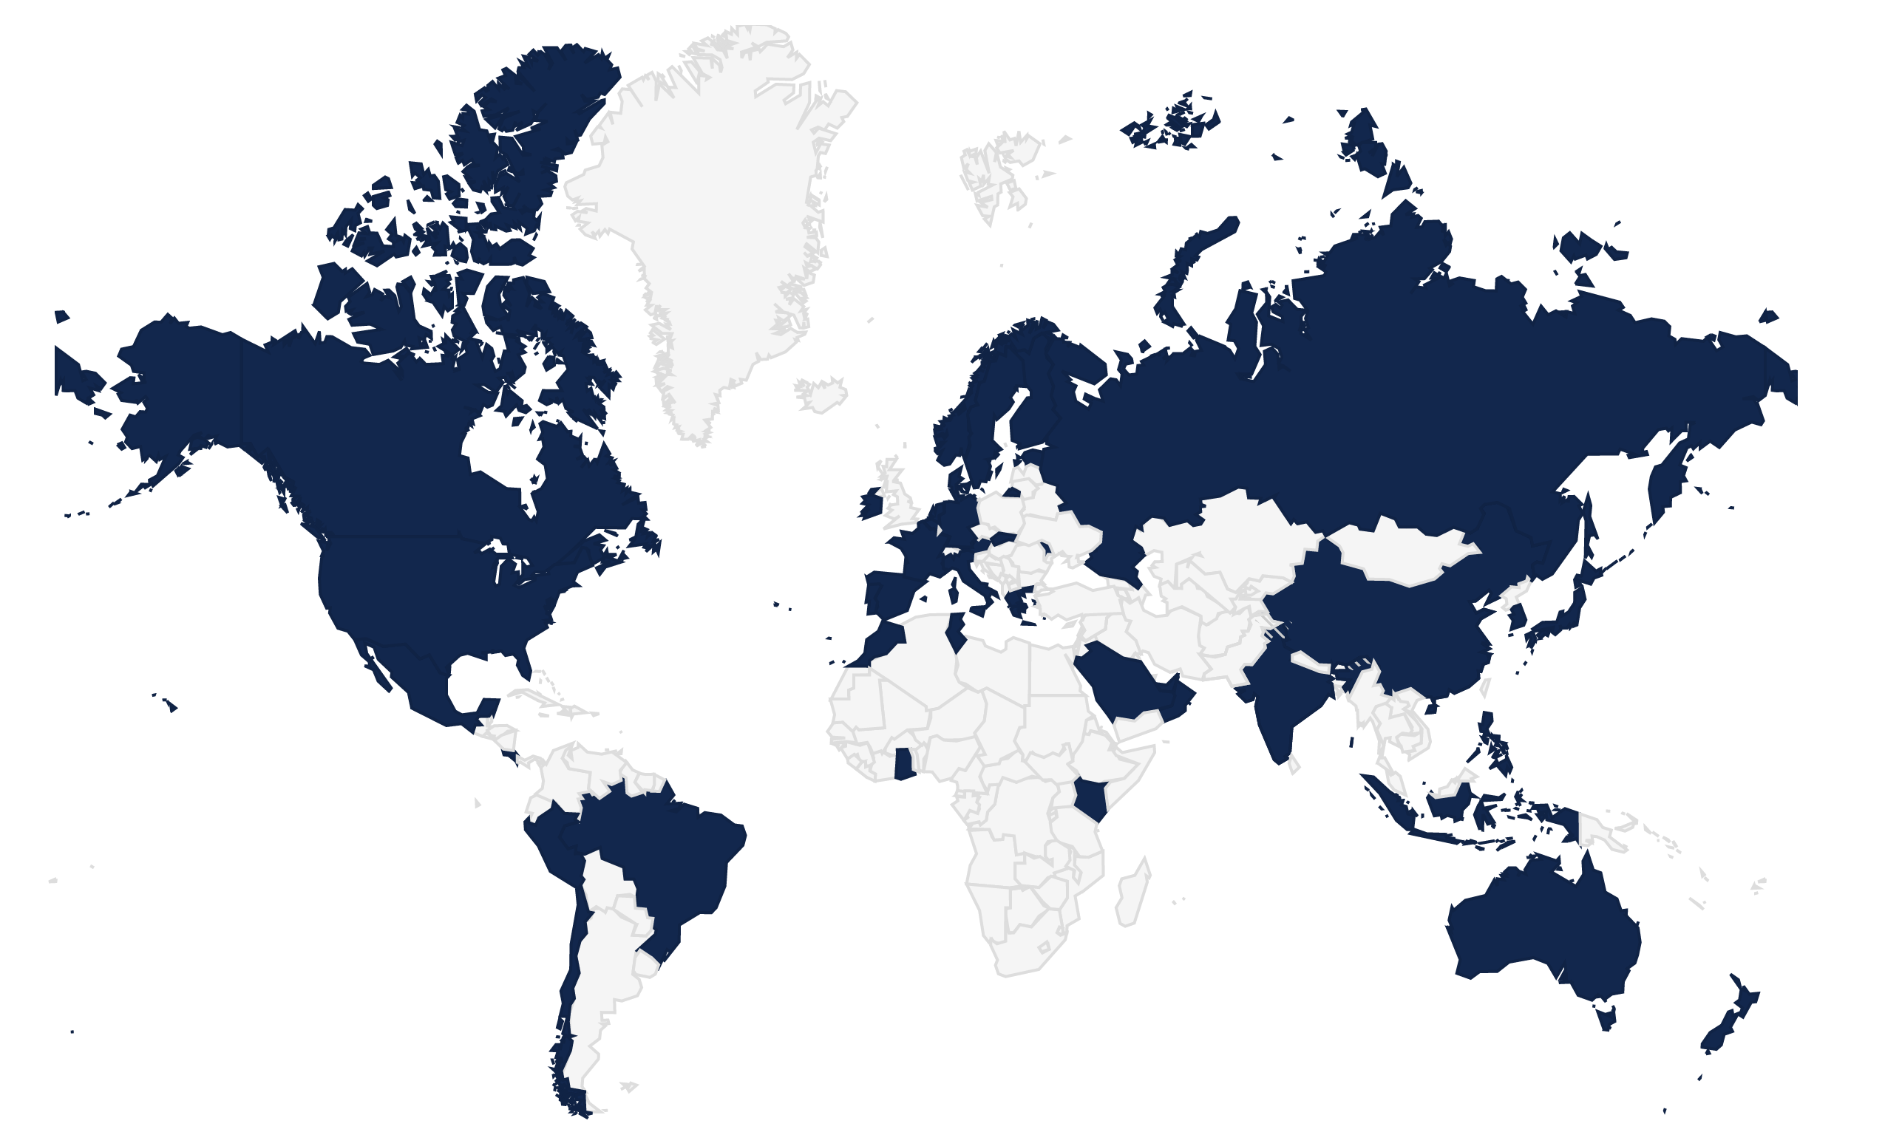
Open Government Data: A global movement?

Slide 5
OGD Approach & Challenges
Political
Social
Legal
Open Govt/ Data
Organizational
Economic
Technical
Specific LMIC Challenges
  Legal Framework: Lack of FoI/RTI
  Data Collection & electronic Storage
  Web/ICT Access

Slide 6

Technical Level Challenges
Growing importance of ICT and ICT tools within LMIC governments
Not all platform are OD ready
Align your ICT strategy with OD requirements
Be Ready at the technical level
  at the country level
  at the international organization level
    Adapt technical assistance
Example: Market Information System in Fiji

Slide 7
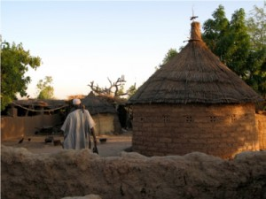
ICT for Agriculture & Open Data
ICT and mobile are a great opportunities to develop agriculture
More data available to the public more innovation
  Entrepreneurs
  Agri Private Sector
The most important piece of information is still farmer mapping
  To know who is where doing what
  To provide appropriate information to the right people
  To prevent data overload
Using existing organizational structure instead of replacing it (ICT as a tool vs a solution)
  Extension agent network
  Cooperatives
  …

Slide 8
Conclusion
The biggest source of Data that are relevant to people is at the country level
They are few challenges to solve to launch a national open data initiative
It is possible to prepare today the future and support the political agenda
  Integrate OD principles in ICT tools
  Align ICT strategies with OD

Slide 9
References
http://www.sbc4d.com
  http://www.sbc4d.com/product-services/demo/
  http://www.sbc4d.com/publications-resources/
    Open Data Readiness Assessments
    Open Data in developing countries State of the art
http://www.mvoices.eu
http://www.w4ra.org/
Some relevant blog posts:
  http://stephb.org/2012/12/mobile-ict-small-scale-farmers/
  http://stephb.org/2013/03/demystifying-voice-technologies-for-development/
http://www.w3.org/TR/2009/NOTE-mw4d-roadmap-20091208/
Contact: Stephane Boyera - stephane@sbc4d.com

