Slide 1
Agri-tourism in South Pacific Islands
Stéphane Boyera
CEO
stephane@sbc4d.com
SBC4D – http://www.sbc4d.com
9 June 2015
https://public.sbc4d.com/2015/06/sb_cta_wa.pptx

Slide 2

SBC4D: Where ICT meets Social & Economic Development
Consulting Company specialized in ICTD
  Open Data & Open Linked Data: Strategy & Implementation
    Supporting Governments in ACP Countries in their Open Data Initiative
    Supporting International Organizations (e.g. WB, ODI, OKF, Web Foundation, IFAD,…) in research capacity buildig & implementation
  Mobile & Web services: Strategy, design, deployment. Specific expertise on multi-channel applications, and ICT for illiterate underprivileged communities
Sector Expertise: primarily Agriculture, but also Governance, Media, Health
Geography:
  70% of activities in Sub-Saharan Africa
  Operation in South Asia (India, Indonesia), Pacific Islands (Fiji), Latin America (Chile, Colombia)

Slide 3
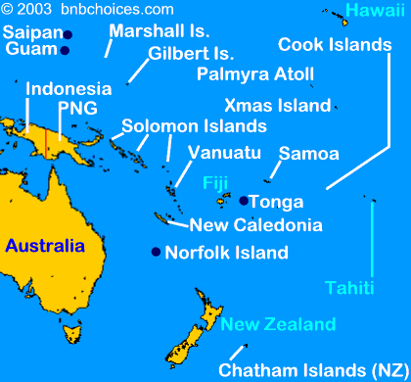
South Pacific Experience
Working in Fiji since 2013 on ICT4ag solutions
  MIS for the Ministry of Agriculture
  A portfolio of web & SMS services for FCLC to reach farmers
  A portfolio of mapping applications
    mapping farmers and clusters
    mapping individual fields and production info
  EU-Funded projects IKSL/IKSA
  Working for ITC
Consultant for CTA (April 2015) for
  Capturing opportunities and challenges for a sustainable ICT platform for Agri-tourism development
  Defining requirements, functionalities, and action plan
  Covering South-Pacific and Caribbean region

Slide 4

Agri-Tourism Concept & Rationale
AKA: Farm-to-fork, farm-to-table or farm-to-restaurant concept
Concept: Leverage use and consumption of locally produced commodities by hotels and restaurants
Rationale
  Expand the benefit of tourism to a greater part of the population in places where tourism is well developed
  Increase tourist expenditure on farm/food activities
  Decrease country import bill of commodities
Old idea, not much impact yet
Common to various regions of the world in particular South Pacific Islands or Caribbean Islands

Slide 5
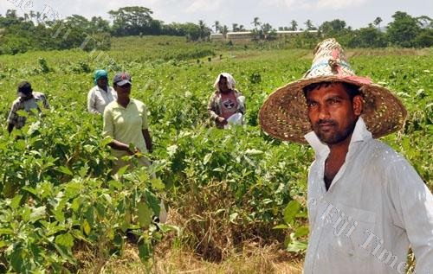
Challenges
Supply side
  Quantity and predictable Quality
  Risks and burden of managing lots of small producers or multiple providers focusing on a limited number of commodities
  Inadequacy between commodities requested and commodities grown
  Purchase requirements: credit, packaging, etc.
Demand Side
  Using local commodities instead of western products and still fit western palate
  Using food as a marketing element
  Understanding the extended benefits on side activities (cooking classes, farm visits, etc. )
  Growing tourist demand for e.g. locally produced food, organic foods, local dishes but tourism sector not really inline/focused on this trend

Slide 6
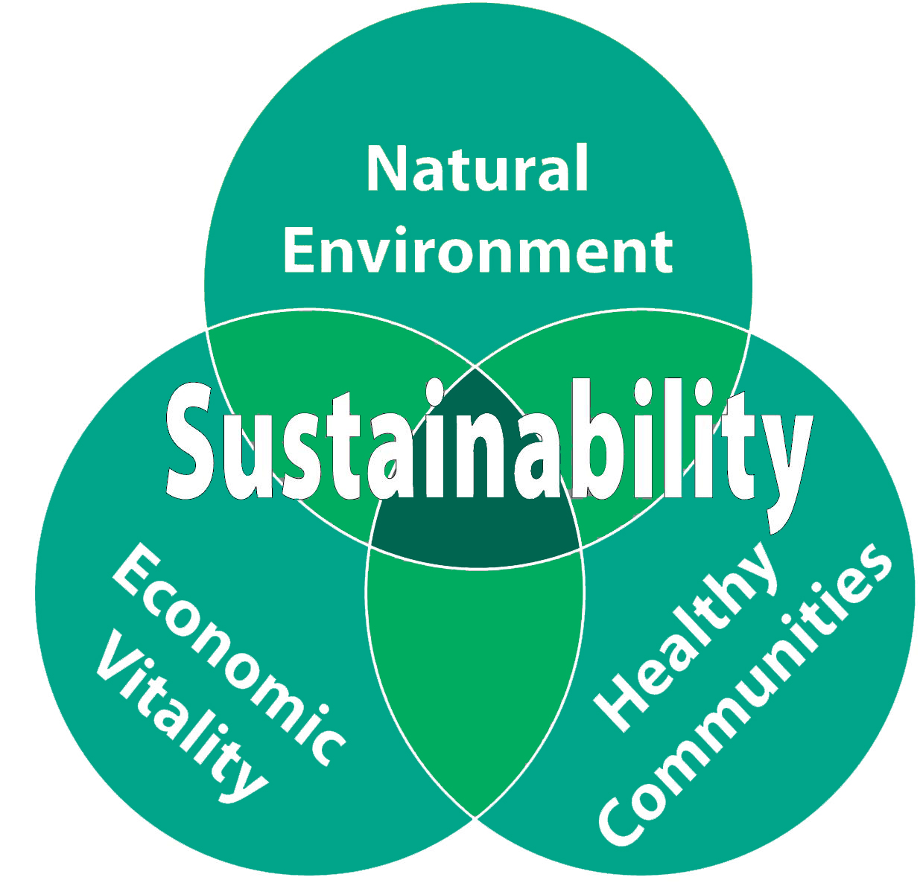
A Possible sustainable approach
Demand has to be nurtured
  Chefs need training on use of local products, innovation with local commodities, and local traditional dishes
  Hotels & restaurants needs awareness raising on the business opportunities, and demand from tourists
Supply has to be structured and clustered with intermediaries (organizations, agri-business, ngos etc.) to reduce risks and offer multiple products
Policy has to be adapted to support the transformation
Connection, information sharing, and understanding between actors has to be developed
  Purchase requirements
  Product demands
  Quantity/quality
  …
Notes:
The environment needs to be developed, not the direct connection.

Slide 7
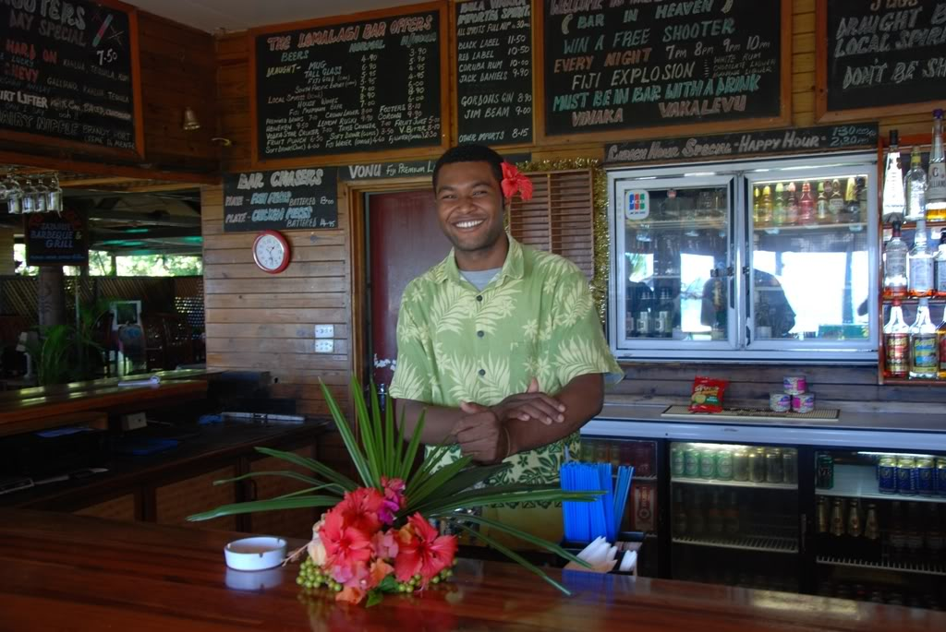
Status in South Pacific Islands
Lots of activities but siloed activities done separately and not coordinated
Many organizations (local, regional, international) are working on coordinating farmers and farmers organizations
  SPC, PIFON, ITC
  FCLC (Fiji), Wibdi (Samoa)
Active private sector organizations: PIPSO & their NPSO
Lots of activities with chefs
  Organizations: SPTO, CTA
  Highly Visible ambassadors: Robert Oliver, Lance Seeto
Existing networks: Pafpnet
Annual Agribusiness week: CTA, SPC
Notes:
The environment needs to be developed, not the direct connection.

Slide 8

ICT in South Pacific Islands
various actors different world:
  email/web for accommodation, organizations,
  FB/twitter for chefs, not much for other. Even if social media is mentioned by all interviewees, this is not really used in a professional context to conduct business or run discussions
Completely different world for farmers: basic phones but SMS aware, no internet connectivity/usage.
Fiji a little bit more developed than other islands on that regards, but still almost inexistent at the farmer level
Successful examples of dedicated platforms to support a sector (makeitfiji), as well as failure examples (true pacific)
Examples of active networks: Pacific Agricultural & Forestry Policy Network (PAFPNET)
Notes:
The environment needs to be developed, not the direct connection.

Slide 9

Knowledge Platform possible approach
Provide to a wide range of information for all stakeholders
  Resources for chefs
  Policy resources: studies, etc.
Directories of actors for operational exchange
  Demand side: Purchasing requirements; Commodities, volume and quality
  Supply side
    Actors in contact with farmers and clusters & services offered: e.g. MIS, mapping tools etc/
    Agri-businesses
    Commodities
Discussions
  leverage cross-sector discussions
News & Events
Inquiries
For each module, a multi-dimensional approach: geographic/topic/stakeholders
Notes:
The environment needs to be developed, not the direct connection.

Slide 10
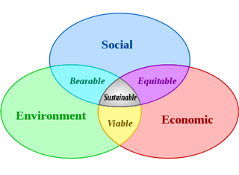
Knowledge Platform Sustainability Model
A business-focused professional platform
  Potential for a marketing platform later
  In the future, include a tourist/public entry point
A multi-stakeholder platform
  An overall leader PIPSO
  Stakeholder leaders:
    SPTO for Chefs & hotels
      Need involvement/agreement of ambassadors
    PIFON/SPC for farmers
    PIPSO and NPSO for agri-business
  Country-level leaders:
    NPSO
A Federated platform linking existing elements
A Multi-channel discussion platforms
  Email, FB, Web
Notes:
The environment needs to be developed, not the direct connection.

Slide 11
Directory Sustainability Model
Focus: Business-focused organizations not individual members
Implementation Option 1: linking existing elements from various actors sites
  Pro: quick & cheap
  Cons: not homogeneous access ; no easy export and exploitation
Implementation Option 2:
  One directory,
  Multiple contributors
  Multiple access from each organization site
  User standardized format (agro-profiles)
  Can be exported as open data
  In the future can be connected to an OD
Notes:
The environment needs to be developed, not the direct connection.

Slide 12

Data Needs
Commodities information (production zone etc.) and cycles
Prices information
  Might be available as OD from MoA for Fiji
  Might be available from other islands
Actors profiles
Policy studies (sector potentials, new activities) on both sectors
Provision of all data (directories, resources, …) as open data for easy integration in other platforms or innovation
Notes:
The environment needs to be developed, not the direct connection.

Slide 13
Conclusion
Agri-tourism is a hot topic in the south pacific islands
There are lots of activities done separately
Can all these actors cooperate and create an ecosystem to boost agri-tourism?
  All conditions are present but still to become a reality
  A twofold strategy based on an annual face-to-face event and online platform seems the most promising approach
  Key requirements for a knowledge platforms identified
Next steps:
  Validation and implementation
  Investigation of commonalities and differences with other ACP regions and Caribbean islands in particular

