Slide 1


Workshop Focus & Objectives
Stéphane Boyera
CEO
stephane@sbc4d.com
SBC4D – http://www.sbc4d.com

Slide 2

Overview
Principles of farmer profiling
Farmers profiling & Access to Finance
Key hypotheses
Workshop objectives
Workshop agenda

Slide 3
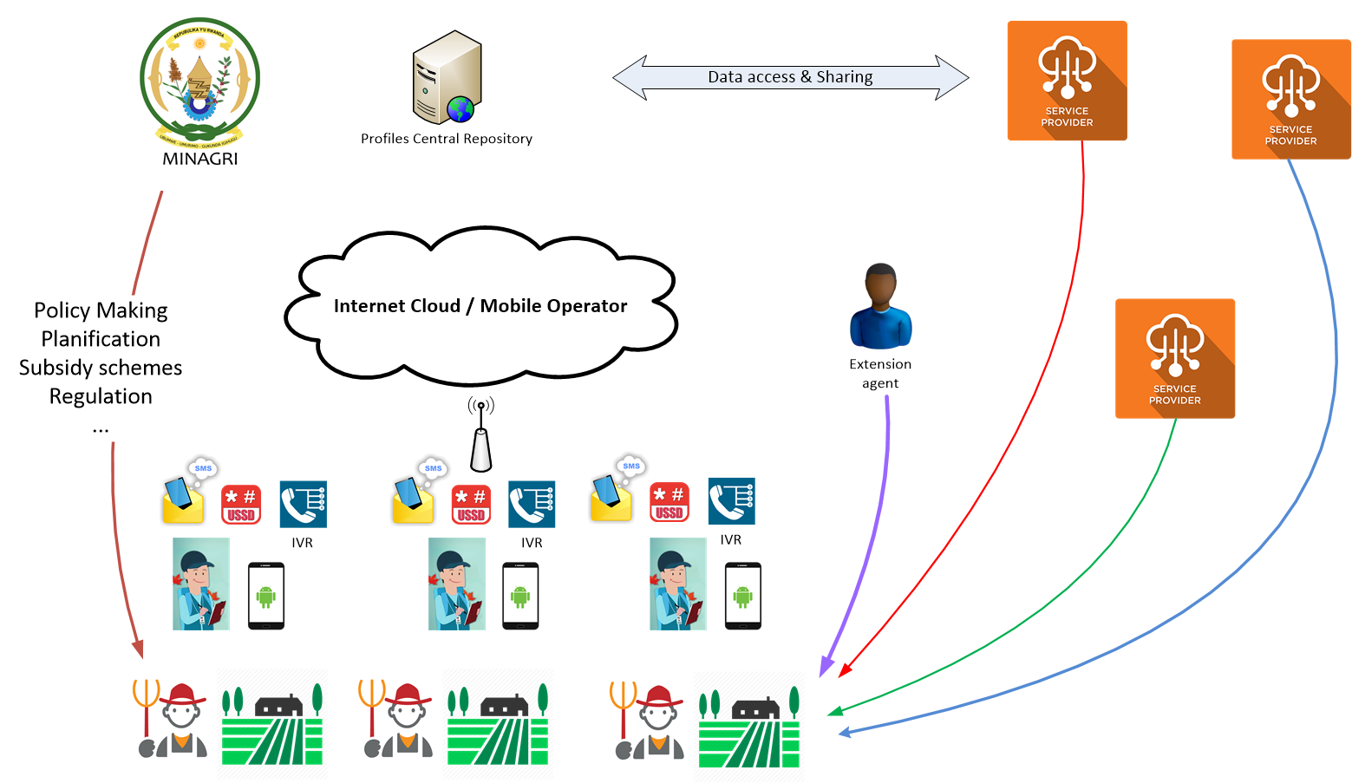
Principles of Farmer Profiling

Slide 4
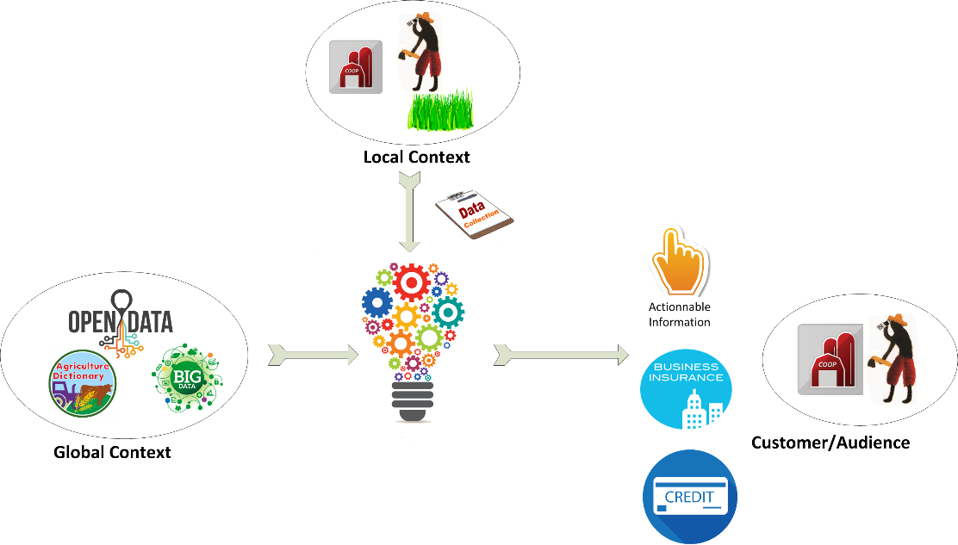
Principles of Farmer Profiling (2)

Slide 5
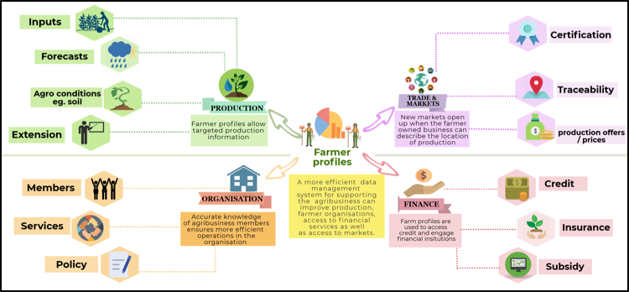
Services leveraging farmer profiles

Slide 6

Farmer profiling expected impact
Better policy based on real data
Greater access to financial services by smallholder farmers
Easier access to extension and trade services
Greater yields
Greater income

Slide 7

Building blocks
Profile content
  Which information needed for which service(s)?
Data collection and update model
Technical platform
Business model

Slide 8

Challenges of access to finance in agriculture
Financial institutions have tough time evaluating risks associated with agricultural activities
Financial institutions have tough time delivering credit services in rural areas
Farmers don’t necessarily have the capacity to answer Financial institutions requests
Farmers find it difficult to fill in the credit dossier

Slide 9

Hypotheses
Data about farmers and their activities (farmer profile) and the design of specific products (cash flow model, business plan, …) can help solve the issue of eligibility & credit scoring
ICT and mobile phones can be a channel to connect financial institutions and farmers

Slide 10

Objectives of the workshop
What information would help financial institutions in evaluating risks and leveraging credits in agriculture?
Can we design a common credit scoring module that will be able to use farm-level raw data and generate usable information for Financial Institutions to take decisions?
What information is required for filling a credit dossier?
Are there financial institutions and other actors interested in piloting this approach?

Slide 11

Workshop Agenda
Presentations to get into more details on challenges of access to finance in agriculture
  From the perspective of farmers
  From the perspective of financial institutions
Group work:
  Information needs linked to farmers for
  Where is the required information
  How to collect it?
  What would be a trust model?
  Common credit scoring module?

Slide 12
Workshop Agenda
09:50 - 10:10 - Challenges for access to credit in agriculture
10:10 - 10:20 - Challenges to finance agriculture activities
10:20 - 10:30 – Q&A
10:30 - 10:50 - Break
10:50 - 12:15 - Breakout session
12:15 - 13:15 - Debriefing
13:15 - 14:15 - Lunch
14:15 – 15:00 - Workshop output and next steps
15:00 – Wrap up and close

Slide 13
Breakout Session topics
What is the process of defining credit eligibility for a given farmers, and what are information that are needed for that process?
Where the required information is available?
How can it be verified?
How often it has to be updated
How FIs would trust the provided information?
How to design a common credit scoring module that would transform farm-level data and global data into usable information by FIs
After the decision on lending is positive, how to organize the credit dossier and deliver credit to farmers

Slide 14
Categories of information to consider
Farmer information: Personal details, household size,…
Financial information: bank account, ongoing credits, credit history, income(s),…
Legal information: Land title,…
Farms activities: Workforce & equipment, livestock, Fields location, Farm area under cultivation and crops variety, Production (history, forecast), Certification & farmer capacities,…
Access to service: Subsidies, Insurance, Extension service, …
Farm/crop business plan (financial needs across a production cycle)
Crop information: production, risks, market information,…
Method of sales: raw product vs transformation, customers (cooperatives, direct, etc.) …
Cooperative membership
Risks: Weather, Pest & disease
Other

Slide 15


