Slide 1
Data for Small-holder farmers
Stéphane Boyera
CEO
stephane@sbc4d.com
SBC4D – http://www.sbc4d.com
12 January 2017

Slide 2

SBC4D: Where ICT meets Social & Economic Development
Consulting Company specialized in ICTD
  Open Data & Open Linked Data: Strategy & Implementation
    Supporting Governments in ACP Countries in their Open Data Initiative
    Supporting International Organizations (e.g. WB, ODI, OKF, Web Foundation, IFAD, MCC…) in research capacity buildig & implementation
  Mobile & Web services: Strategy, design, deployment. Specific expertise on multi-channel applications, and ICT for illiterate underprivileged communities
Sector Expertise: primarily Agriculture, but also Governance, Media, Health
Geography:
  70% of activities in Sub-Saharan Africa
  Operation in South Asia (India, Indonesia), Pacific Islands (Fiji), Latin America (Chile, Colombia)

Slide 3
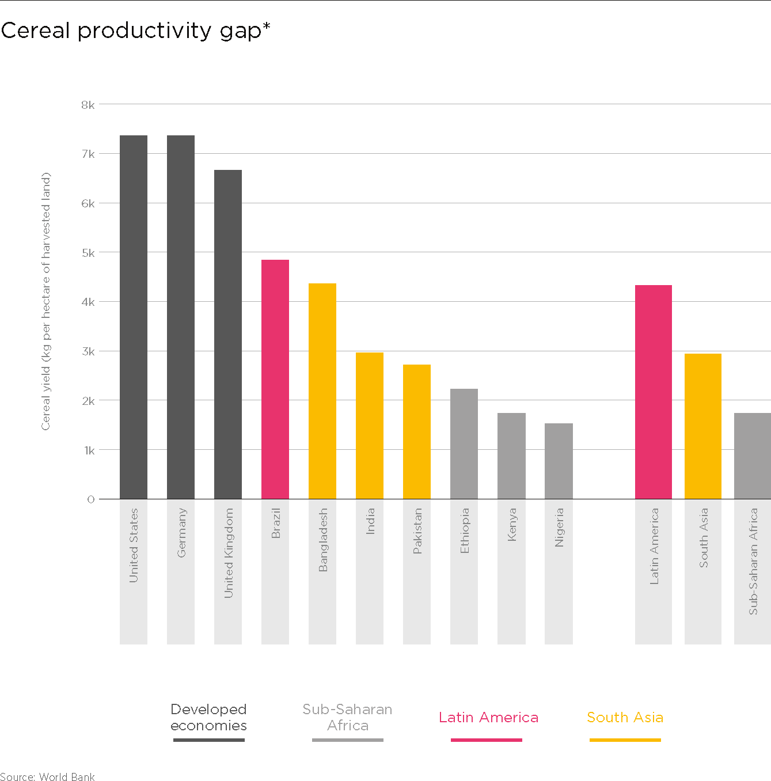
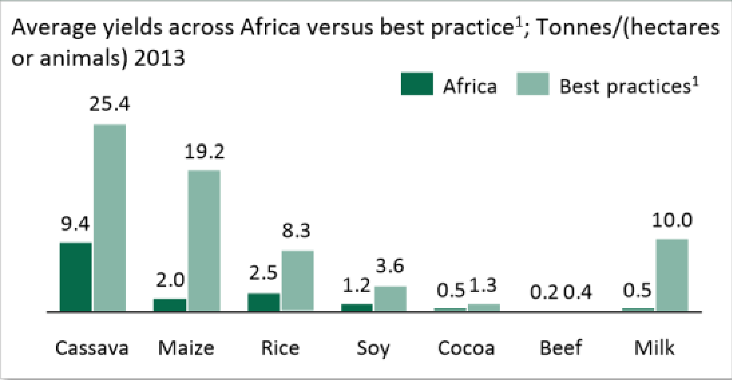
The Problem & The Opportunity

Slide 4

The hypothesis
Provision of timely actionable information to small-holder farmers at each stage of the crop cycle can help bridging the productivity gap, make farmers more resilient to climate change and other potential disasters, and prevent food security issues

Slide 5
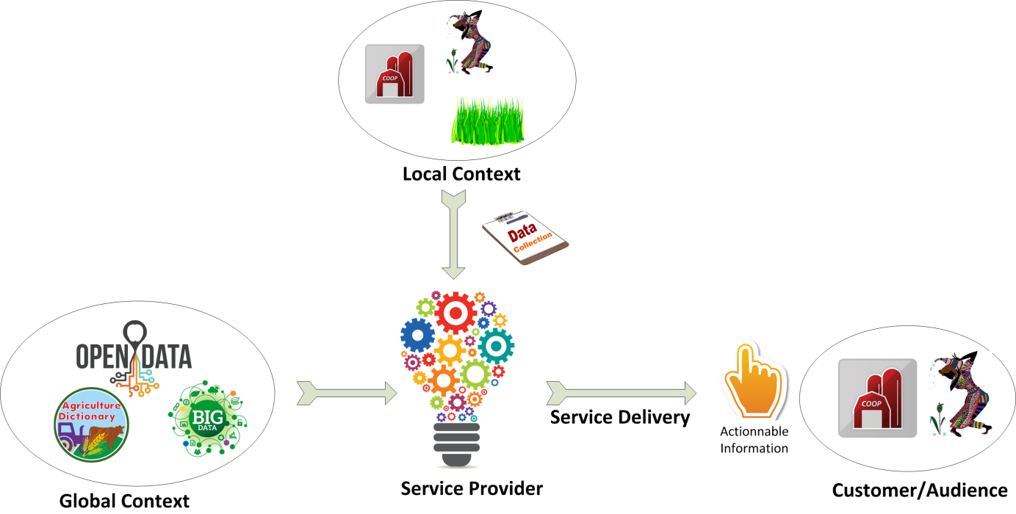
Actionnable information & Data needs

Slide 6

Key Questions
Which information to collect at the famer level? (aka farmer profile) ?
Which datasets are useful?
Which technologies to collect data?
Which technologies to deliver services
What are challenges?
Is there any other elements to take into account (aka other enablers)?

Slide 7

Approach
  Look at each phase of the crop cycle
  Identify farmer pain points and existing services to support the cycle
  Identify the stakeholders involved in the cycle
  Identify stakeholder data need and the way they access/acquire it
    includes technology
  Identify service delivery processes
    includes technology
  Explore challenges

Slide 8



Methodology
  Desk Research
  Interviews & Discussion
  Compilation
Notes:
The environment needs to be developed, not the direct connection.

Slide 9

Scope
  Study focuses on Crop
  Other products such as livestock or Aquaculture not covered even if there are interesting development
    FiTI
    Lots of highly visible use-cases on fisheries and livestock (e.g. mFisheries, iCow)
  Traceability covered only from the certification perspective
Notes:
The environment needs to be developed, not the direct connection.

Slide 10
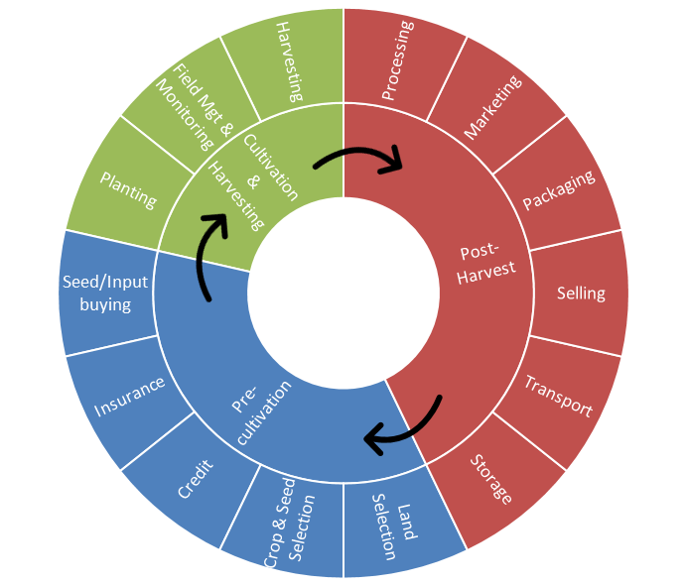
Crop Cycle
Notes:
The environment needs to be developed, not the direct connection.

Slide 11

Expected Output
  A view on data needs at different stages of the crop cycle
  A view on technology relevance for data collection at different stages of the crop cycle and associated challenges
  A view on technology relevance for service delivery at Farmer level and associated challenges
  Identification of the various data elements of a “farmer profile” and associated challenges
  An overview of other key enablers

Slide 12
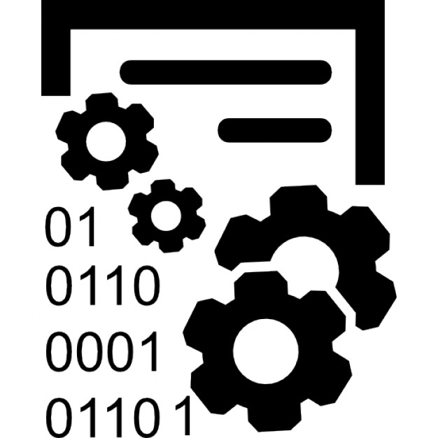
Overview of Data needs (WiP)
Notes:
The environment needs to be developed, not the direct connection.

Slide 13

Overview of technology relevance for data collection (WiP)
Notes:
The environment needs to be developed, not the direct connection.

Slide 14

Overview of technology relevance for service delivery (WiP)
Notes:
The environment needs to be developed, not the direct connection.

Slide 15

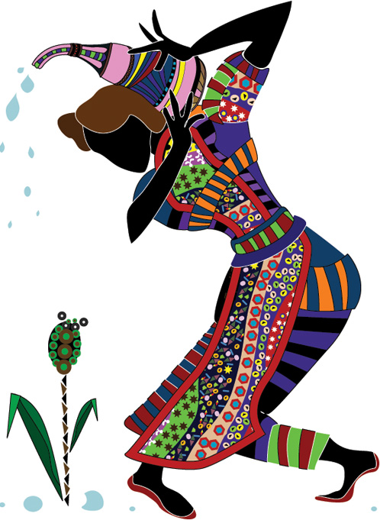
Farmer Profile (WiP)
Farmer basic data
  phone number(s)
Field data: size/map, elevation, type, soil, land tenure, crop history
Crop data: seed varieties,etc.
Qualification & certification data
Production data: yield, planting info (time, space, etc.), inputs data (fertilizer, treatments etc.), activity info (weeding, pruning, etc)
Business data: cooperative, cluster, market the farmers have access to/use, agribusiness linkage
Credit data: credit records
Notes:
The environment needs to be developed, not the direct connection.

Slide 16
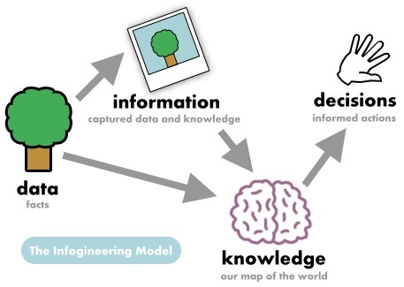
Other Enablers
Trust
Farmer Data Policy
Emerging Opportunities
  ID4D
Notes:
The environment needs to be developed, not the direct connection.

Slide 17
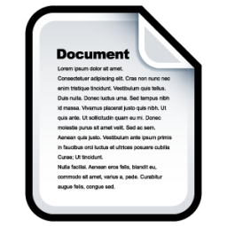
Document Structure
Introduction
Methodology
Approach
Scope of the study
Data needs analysis across the Crop lifecycle
  Pre-cultivation
  Crop-cultivation & Harvesting
  Post-Harvest
Synthesis
  Datasets relevance per crop cycle
  Data capture technologies relevance & challenges per crop cycle
  Data delivery technologies relevance & challenges per crop cycle
  Farmer Profile & challenges
  Other enablers
Conclusion

Slide 18
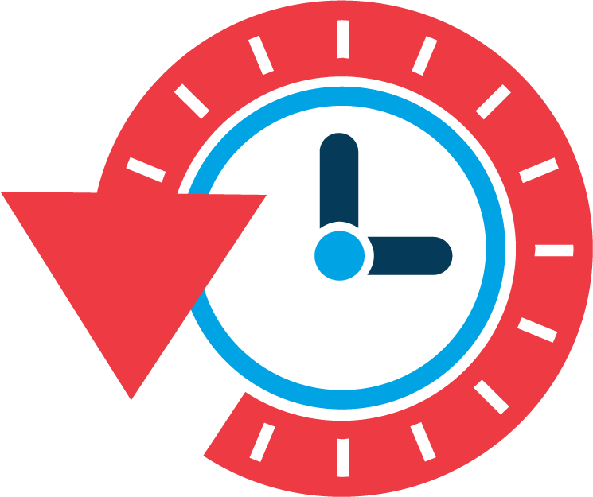
Timeline
Today:
  Discussion on the approach
  Capture of information/discussion/interviews with CTA experts on specific elements:
    Services
    Technologies: Drones, IoT, etc.
Godan Meeting (13-15 February)
  First output
End of February: first integrated draft report
End of march: final report

