Slide 1


Farmer profiling : lessons from 7 initiatives
Stéphane Boyera
CEO
stephane@sbc4d.com
SBC4D – http://www.sbc4d.com

Slide 2

Overview
SBC4D experience in Farmer profiling
Introduction to Farmer profiling
CTA Data4Ag experience
Main lessons & Best practices

Slide 3

SBC4D: Where ICT meets Social & Economic Development
Consulting Company specialized in ICTD since 2009
  Mobile & Web services: Strategy, design, implementation, deployment. Specific expertise on multi-channel applications, and ICT for illiterate underprivileged communities
  Open Data & Open Linked Data: Strategy & Implementation
  Sector Expertise: primarily Agriculture, but also Governance, Media, Health
    ICT4Ag: farmer profiling, AMIS, business matching, insurance, communication (IVR, CC, etc.)
Major clients: Governments, Development agencies (USAID, MCC,…), UN (ITC, UNDP, FAO, IFAD, etc.), WB, EU (CTA,…) private foundations & NGO (Care, BMGF, …), private sector (Orange, MTV, Al Jazeera, …)
Geography: 70% of activities in Sub-Saharan Africa, Operation in South Asia (India, Vietnam, Bhutan, Indonesia), Pacific Islands (Fiji), Latin America (Chile, Colombia)
Notes:
First profiling experience in 2010
About a dozen design/implementation/deployments
Senegal (FO - 80k profiles)
The Gambia (NGO/FO - 6k profiles)
Fiji (Government - 35k profiles)
Comoros (Government/Coop. – 2k profiles)
Mali (NGO - 12k profiles)
Kenya (NGO)
Liberia (NGO)
India (NGO)
Advisor on a few projects
National Farmer Digital Profiling (MoA - Rwanda)
FEPAB (CTA/Afdi – Burkina Faso)
A few publications on the topic (CTA working paper)

Slide 4
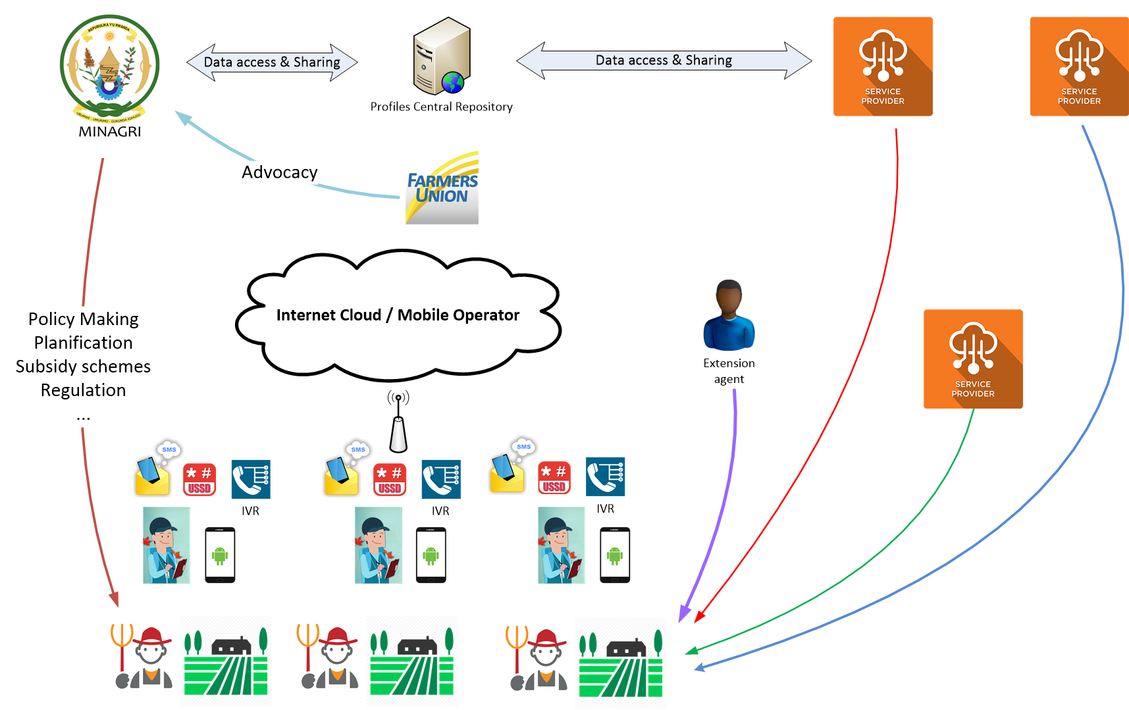
Principles of Farmer Profiling

Slide 5
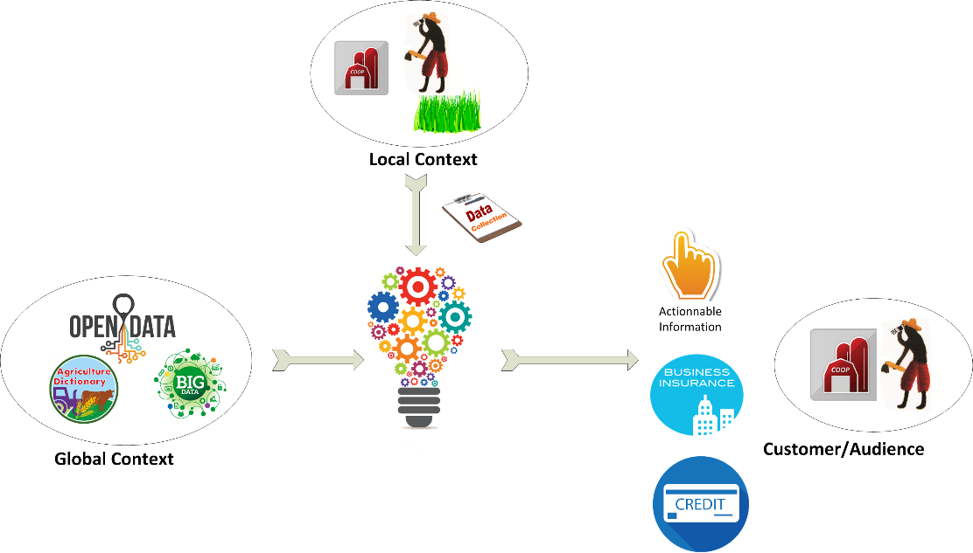
Principles of Farmer Profiling (2)

Slide 6
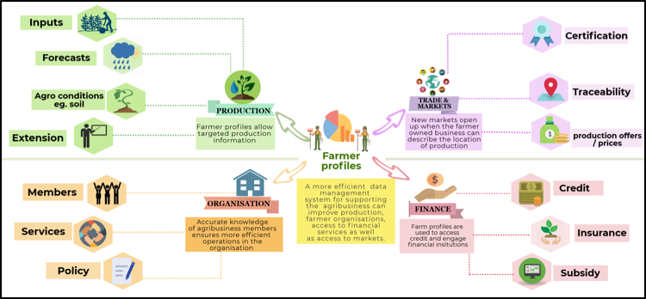
Services leveraging farmer profiles

Slide 7
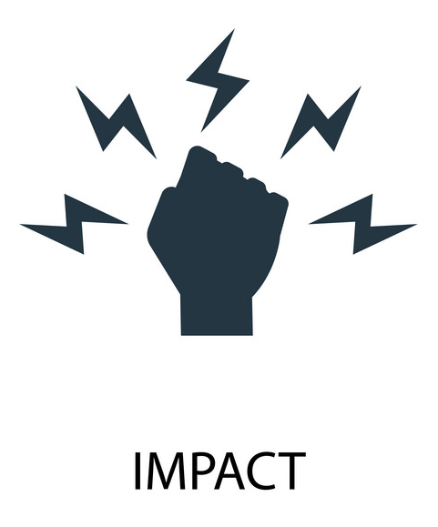
Farmer profiling expected impact
Better policy based on real data
More advocacy power for Farmer Organizations
Greater access to financial services by smallholder farmers
Easier access to extension and trade services
Greater yields
Greater income

Slide 8

Building blocks
Profile content
  Which information needed for which services?
Data collection and update model
Technical platform
Business model

Slide 9



CTA Data4Ag initiative
A joint initiative with PAFO and Agricord since 2016
Objective: Support FOs to take advantage of new data-driven services
Implementation: funding of a series of FOs across Africa to test various technologies
This study: Review the farmer profiling component of 7 projects

Slide 10


National Union of Coffee Agribusiness and Farm Enterprises (NUCAFE)
Almost 19.000 farmers
Main objective:
  digitization of membership
  New services: Value chain support and access to credit
Profile use:
  Work at individual farmer level (training needs…)
  Geographical Indication & Certification (fair trade, organic)
  Traceability
  Advocacy and global impact measurement
Main output
  Increased farmer production
  Increased coffee revenue for farmers (GI, Traceability)
  Better position of collection points

Slide 11

Igara Growers Tea Factory (IGTF)
Almost 20k farmers and more than 22k gardens profiled
Profile use:
  Input calculation
  Access to credit
Main success
  Saving for IGTF on inputs
  More farmers delivering to IGTF
  Better position of delivery points
  Easier access to credit for farmers
  Greater trust from farmers

Slide 12

FÉDÉRATION DES PROFESSIONNELS AGRICOLES DU BURKINA (FEPA/B)
2053 farmers profiled
Main focus: FEPA/B advocacy
Main output: Data collection capacities within FEPA/B
Future use
  Access to cheaper inputs
  Market Linkages
Challenges:
  Business model
  Benefit/cost ratio
  Scale-up

Slide 13

Confédération des Associations des Producteurs Agricoles pour le Développement (CAPAD)
Joint initiative with Collectif Stratégie Alimentaire
14153 farmers from 39 cooperatives profiled
Main objective: support smallholder farmers in production and selling of agriculture products
Profile use: help CAPAD provide better on-time services (input provision, credit) to their members
Main output:
  More cooperatives are able to sell product to WFP schools cafeteria program
  Cooperatives have data to support dispute resolution with the Tax authority
  More advocacy power for CAPAD
Main challenges: Technical platform (offline capabilities)

Slide 14

Eastern Africa Farmers’ Federation (EAFF)
Approx. 190.000 farmers in Kenya and 14.000 in Uganda profiles
Profile use:
  Access to credit
  Access to cheaper input (group buying)
  Market linkages (group selling)
  E-extension
Output
  Greater revenue for farmers
  Access to larger credit for farmers
  Greater advocacy power for EAFF
  Design of a future business intelligence service for EAFF
Challenge: credit interest rates

Slide 15

Swaziland National Agriculture Union (SNAU)
Joint initiative with SACAU
Approximately 23.000 farmers profiled
Main objective: digitalize farmer union membership management
Main output:
  Better understanding of membership
  Partnership with MoA to implement the national subsidy scheme for Maize via e-voucher system
Profile use:
  Direct communication
  Policy studies
  Advocacy
Challenges:
  Business model
  Technical platform

Slide 16

Lesotho National Farmers Union (LENAFU)
Joint initiative with SACAU
52000 farmer profiled
Main objective: digitized LENAFU farmer registry
Main output:
  Data collection capacities
  Access to new opportunities thanks to data & capacities: Partnership with WFP and with MoA & FAO
Profile use:
  Communication with members
  Design new services for members
  Business intelligence service
Challenges
  Business model
  Technical platform

Slide 17

Lesson 1: Profiling is beneficial to all FOs
FOs acquired ICT and data collection skills that are valuable in the country and open doors for new opportunities
Profile repository contains useful data that can be used for other purposes than the one primary objective

Slide 18
Lesson 2: Sustainability comes from financial impact of profiling task
3 over 7 projects did not continue the process after project funding due to cost/benefit ratio
Successful projects make farmers proactive in provision of profile information
  Require a critical mass of profiled farmers
  Require the delivery of financially impactful services to farmers
Reinforcing FO advocacy power is not a strong-enough incentive
  Growing fatigue among farmer and resistance to numerous data collection that does not provide any output to them
Sustainability also relies on low operational costs
  Almost all SaaS model have been dropped after the end of the project

Slide 19
Lesson 3: Personal Data Protection legislations have a major impact on profiling
Only few FOs are aware of the need to comply to PDP regulations
  Some are infringing laws on data hosting, declaration, capture of consent,…
PDP best practices are useful to
  Leverage trust among farmers
  Prepare FOs for change in legislation
PDP impacts many components
  Software and hosting
  Training of enumerator
  Data collection setup
  Profile data use
PDP best practices have to be considered at the earliest possible stage of such projects

Slide 20
Lesson 4: no free and open-source reference technical platform for farmer profiling
Almost all projects were facing challenges with the technical platform
  Financial
  Technical
  Legal
Profile information is useful for other services (credit, value chain development, etc.) with their own platform. Profile information should be a pluggable module
There isn’t any free and open source package with all functionalities
  Some reference module (e.g. ODK)
  Some fully-integrated solutions (e.g. blue number)
A promising initiative from CSA/CAPAD project: PUMA2 published on Framagit
  Need further investment and the development of a community

Slide 21
Lesson 5: Profile content should be designed through a multi-stakeholder process
Different stakeholders and different services require different types of data point
The sustainability of a profiling platform depends on the number of users of profile information
Some services/stakeholders require specific data collection and verification process that needs to be included in the data collection and update model

Slide 22
Lesson 6: Profile data update is problematic
Organization of a census-type activity is costly but relatively easy
Such approach does not fit with quarterly or even annually update
Options
  Self-update process through mobile
    How to validate?
  Use existing structure and network to update and validate information:
    Collection points
    Extension agents
    …

Slide 23
Lesson 7: Potential of business intelligence services on top of profile data?
Almost all projects foresee potential revenue linked to BI service on top of profile data
None have successfully demonstrated the viability of this hypothesis
  Require a detailed market analysis to identify products and customers
  Require data analytics/data science expertise
This area needs further investigations

Slide 24

Conclusion
The output of the 7 projects are quite homogeneous in terms of challenges and in terms of opportunities
All FOs involved had a direct outcome (e.g. securing new projects) from the profiling activity
The sustainability of such approaches is hard to achieve and rely on the farmers active contribution in the process. Such contribution occurs when there is a clear direct benefit for them
Profiling is a tool to implement services for farmers and is not a goal.
The domain requires further investigation and development:
  An open source package for the technical platform
  Exploration and validation of BI service on top of profile data

Slide 25

Références
CTA Working Paper “Farmer profiling: Making data work for smallholder farmers”: https://www.cta.int/en/digitalisation/article/farmer-profiling-making-data-work-for-smallholder-farmers-sid08ef124c5-a521-4128-b7dd-db108d223250
DIGITAL FARMER PROFILES: Reimagining Smallholder Agriculture. Landscaping Study, USAID, Grameen Foundation: https://www.usaid.gov/digitalag/documents/data-driven-agriculture
CTA Experiences : https://www.cta.int/en/digitalisation/all/article/agricultural-data-systems-to-transform-smallholder-farming-sid0ec4b7362-20bc-476f-b0ad-3fe3d5a4aa24

Slide 26


