Slide 1
A Generic template for Farmer profiling
Stéphane Boyera
CEO
stephane@sbc4d.com
SBC4D – http://www.sbc4d.com

Slide 2

Overview
Introduction to Farmer profiling
Standardizing a farmer profile template
Discussion

Slide 3

SBC4D: Where ICT meets Social & Economic Development
Consulting Company specialized in ICTD since 2009
  Mobile & Web services: Strategy, design, implementation, deployment. Specific expertise on multi-channel applications, and ICT for illiterate underprivileged communities
  Open Data & Open Linked Data: Strategy & Implementation
  Sector Expertise: primarily Agriculture, but also Governance, Media, Health
    ICT4Ag: farmer profiling, AMIS, business matching, insurance, communication (IVR, CC, etc.)
Major clients: Governments, Development agencies (USAID, MCC,…), UN (ITC, UNDP, FAO, IFAD, etc.), WB, EU (CTA,…) private foundations & NGO (Care, BMGF, …), private sector (Orange, MTV, Al Jazeera, …)
Geography: 70% of activities in Sub-Saharan Africa, Operation in South Asia (India, Vietnam, Bhutan, Indonesia), Pacific Islands (Fiji), Latin America (Chile, Colombia)
Notes:
First profiling experience in 2010
About a dozen design/implementation/deployments
Senegal (FO - 80k profiles)
The Gambia (NGO/FO - 6k profiles)
Fiji (Government - 35k profiles)
Comoros (Government/Coop. – 2k profiles)
Mali (NGO - 12k profiles)
Kenya (NGO)
Liberia (NGO)
India (NGO)
Advisor on a few projects
National Farmer Digital Profiling (MoA - Rwanda)
FEPAB (CTA/Afdi – Burkina Faso)
A few publications on the topic (CTA working paper)

Slide 4
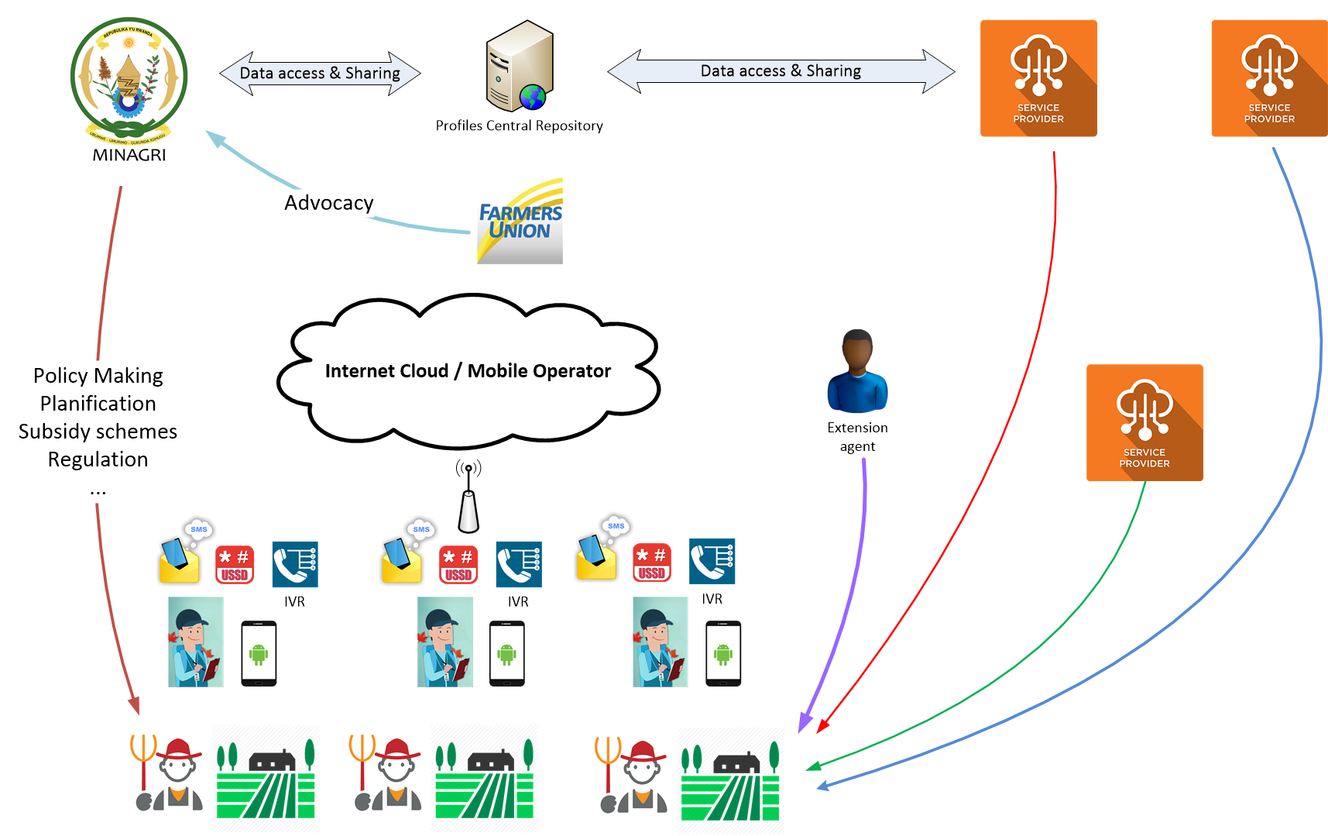
Principles of Farmer Profiling

Slide 5
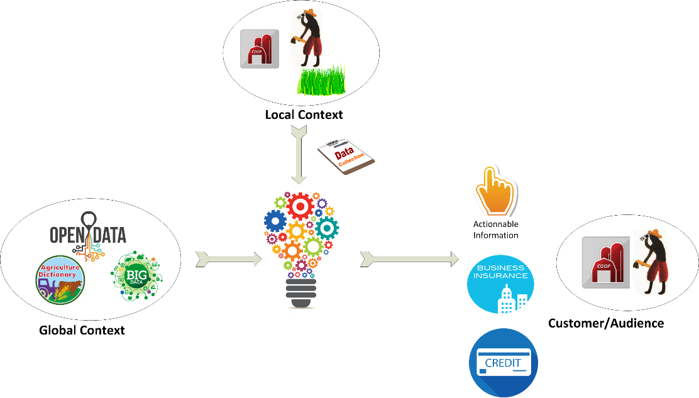
Principles of Farmer Profiling (2)

Slide 6
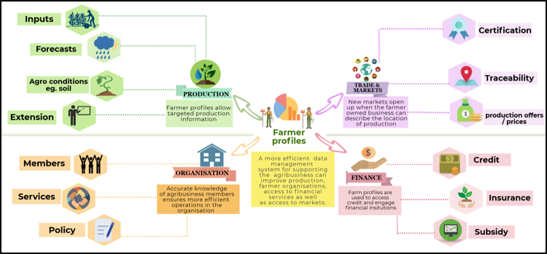
Services leveraging farmer profiles

Slide 7

Farmer profiling expected impact
Better policy based on real data
More advocacy power for Farmer Organizations
Greater access to financial services by smallholder farmers
Easier access to extension and trade services
Greater yields
Greater income

Slide 8

Building blocks
Profile content
Data collection and update model
Technical platform
Business model

Slide 9

Standardizing profile content ?
Data aggregation is difficult
  Numerous initiatives taking place at local (cooperatives, FOs,…),subnational, national and regional level
  Lots of platforms and profiles but difficulties for aggregation
    Different fields that prevent data aggregation and mash-up
Starting from scratch is difficult
  Hard to design a profile from scratch
  Very different information depending on services and value chain
A set of common information from identity, to farm description…
Can we collectively agree on a standard for common fields?

Slide 10

Discussion
Is the adoption of a generic template for profiles an appropriate approach compared to other elements (software platform, data collection, business model...)?
At which level should the standardization happen? Should that be replaced/completed by value-chain specific standardized template?
What should be the level of interoperability? Data level? Platform/SI level?

Slide 11

Characteristics of a generic template
Requirements: useful for services, can be captured, common across all countries, crops, agriculture activities and value chains
Modular: Not all initiatives/services need all information
Standardization of Data Attributes
  Collection method
  Validation process
  Dynamic/Static
  Date of update
  History
  Sensitiveness
  Personal data
  Legal risk
Source: field initiatives & research studies

Slide 12
Key Fields and metadata
  Information that allows a classification of farmers
  Information that support analytics and data use
  Information that support services provision
  Information that increase confidence in the profile data
  Information that enable quality check

Slide 13
Profile Categories
Category | Content
Personal Information | Identity information including education level, income group,…
Communication Information | Information about how to communicate with the person (technologies, device, language…)
Location | Location of the person (address official, local, GPS)
Financial instruments | Financial instruments used by the person
Credit information | credits
Insurance information | insurance
Farm details | Farm information: tools, manpower, registration
Qualification and certification data | Information about qualification and certification (organic, export, etc.)
Field information | Information about field (size, position, crop…)
Production information | Yields, planting information,…
Business information | Market linkages, trade agreements…
Legal information | Mandatory information imposed by Personal data protection legislation

Slide 14
Categories & Services
Category | Type of services exploiting the information
Personal Information | All – Personal information appears in all profiling platform
Communication Information | All types of services that require direct interaction with the producer
Location | All – Location information appears in all profiling platform
Financial instruments | Services that involves financial transactions: subsidy, trade, access to credit…
Credit information | Access to credit, subsidy scheme
Insurance information | Access to credit
Farm details | Production services
Qualification and certification data | Production services, trade services, access to credit, subsidy scheme
Field information | Production services, financial services
Production information | Trade services, financial services
Business information | Trade services, financial services
Legal information | Mandatory in countries where a personal data protection legislation exists

Slide 15
Discussion
Is proposed template with both data and data attributes the right level ?
Comments on the proposed modular approach and the list of categories ?

Slide 16
Profile Information
Category | Fields
Personal Information | Name, first name, ID, gender, birthdate, marital status, income, education, household size, main income source, other income sources, activity start date, disabilities, health info., health insurance
Communication Information | Phone, phone type, email, social network, data plan, languages, pref. comm. channel, pref. Radio/TV & watching time, phone literacy
Location | Country, Administrative address, village, local address, GPS coord.
Financial instr. | Bank accounts
Credit information | Credit records, credit events, farm business plan, SACCOS/ROSCAs membership
Insurance info. | Insurance
Farm details | ID, Manpower, tools, warehouse, storage, livestock
Qualif. & certif. data | certifications
Field information | Location, size, map, soil, own. & title, areas under cultivation, irrigation
Production information | Planting information, production activities, harvest & post-harvest information, weather, yields,
Business information | Coop., agribusiness linkages, markets, processors, transport
Legal information | Explicit agreement, data sharing agreements

Slide 17
Personal Information
Field | Dynamic/ Static | Validation | History | Sensitivity/ Personal info.
Name | Static | 0 | 0 | 0/1
First name | Static | 0 | 0 | 0/1
Marital status | Static | 0 | 0 | 0/0
ID Number | Static | 0 | 0 | 0/1
Gender | Static | 0 | 0 | 0/0
Date of birth | Static | 0 | 0 | 0/0
Income Group | Static | 0 | 0 | 1/0
Main income source | Static | 0 | 0 | 0/0
Other income sources | Static | 0 | 0 | 0/0
Education Level | Static | 0 | 0 | 1/0
Household size | Static | 0 | 0 | 0/0
Agriculture activity start year | Static | 0 | 0 | 0/0
Disabilities | Static | 0 | 0 | 1/0
Health information | Static | 0 | 0 | 1/1
Health insurance | Static | 0 | 0 | 1/0

Slide 18
Communication Information
Field | Dynamic/ Static | Need for validation | History | Sensitivity/ Personal information
Phone | Dynamic | 0 | 0 | 0/1
Phone type | Static | 0 | 0 | 0/0
Email | Static | 0 | 0 | 0/1
Social Network | Static | 0 | 0 | 0/1
Data plan | Static | 0 | 0 | 0/0
Languages | Static | 0 | 0 | 0/0
Preferred communication channel | Static | 0 | 0 | 0/0
Preferred Radio/TV Channel | Static | 0 | 0 | 0/0
Listening/Watching time | Static | 0 | 0 | 0/0
Mobile Phone Literacy | Static | 0 | 0 | 0/0

Slide 19
Location
Field | Dynamic/ Static | Need for validation | History | Sensitivity/ Personal information
Country | Static | 0 | 0 | 0/0
Administrative location | Static | 0/1 | 0 | 0/0
Village | Static | 0 | 0 | 0/0
Neighborhood location | Static | 0/1 | 0 | 0/0
GPS coordinates of the farm | static | 0/1 | 0 | 0/1

Slide 20
Financial Instrument
Field | Dynamic/ Static | Need for validation | History | Sensitivity/ Personal information
Bank Accounts | Static | 0 | 0 | 0/0

Slide 21
Credit Information
Field | Dynamic/ Static | Need for validation | History | Sensitivity/ Personal information
Credit Records | Dynamic | 0 | 0 | 1/1
Credit Events | Static | 1 | 0 | 1/1
Farm Business plan | Static | 0 | 0 | 0/0
SACCOs/ROSCAs membership | Static | 0 | 0 | 0/0

Slide 22
Insurance Information
Field | Dynamic/ Static | Need for validation | History | Sensitivity/ Personal information
Insurance | Dynamic | 1 | 0 | 1/0

Slide 23
Farm Details
Field | Dynamic/ Static | Need for validation | History | Sensitivity/ Personal information
Farm Registration Number | Static | 0 | 0 | 0/0
Manpower on farm | Static | 0 | 0 | 0/0
Warehouse Information | Static | 0 | 0 | 0/0
Equipment | Static | 0 | 0 | 0/0
Storage | Static | 0 | 0 | 0/0
Livestock | Dynamic | 1 | 1 | 0/0

Slide 24
Qualification & Certification
Field | Dynamic/ Static | Need for validation | History | Sensitivity/ Personal information
Certifications | Static | 0 | 1 | 0/0

Slide 25
Field Information
Field | Dynamic/ Static | Need for validation | History | Sensitivity/ Personal information
Field Location | Static | 1 | 0 | 0/0
Field size | Static | 1 | 0 | 0/0
Field geo-fencing | Static | 0 | 0 | 0/0
Soil | Static | 0 | 1 | 0/0
Field Ownership | static | 0 | 0 | 0/0
Land title | Static | 0 | 0 | 0/0
Areas under cultivation | Dynamic/static | 1 | 1 | 0/0
Type of watering/ irrigation sources | Static | 0 | 0 | 0/0

Slide 26
Production Information
Field | Dynamic/ Static | Need for validation | History | Sensitivity/ Personal information
Planting information | Dynamic | 0/1 | 1 | 0/0
Production activities | Dynamic | 0/1 | 1 | 0/0
Harvest and Post-harvest activities | Dynamic | 0/1 | 1 | 0/0
Weather information | Dynamic | 0/1 | 1 | 0/0
Yields | Dynamic | 0/1 | 1 | 0/0

Slide 27
Business Information
Field | Dynamic/ Static | Need for validation | History | Sensitivity/ Personal information
Cooperatives/ production cluster/ Innovation Platform (IP) membership | Static | 0 | 0 | 0/0
Markets | Static | 0 | 0 | 0/0
Agribusinesses Linkages | Static | 0 | 0 | 1/0
Processor linkages | Static | 0 | 0 | 1/0
Transport Linkages | Static | 0 | 0 | 1/0

Slide 28
Legal Information
Field | Dynamic/Static | Need for validation | History | Sensitivity/ Personal information
Explicit agreement for personal data capture | NA | 0 | 0 | 0/0
Authorized sharing agreement | NA¹¹ | 0 | 0 | 0/0

Slide 29
Discussion
Comments on the proposed fields ? Does it support all value-chain actors needs?
The template capture farmer information, should we extend the profile to also characterize other actors such as agribusinesses, processors, etc.?
Is the proposed template support appropriately gender-disaggregated statistics and policies?

Slide 30
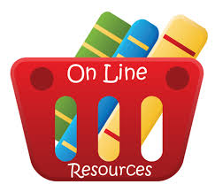
Références
CTA Working Paper “Farmer profiling: Making data work for smallholder farmers”: https://www.cta.int/en/digitalisation/article/farmer-profiling-making-data-work-for-smallholder-farmers-sid08ef124c5-a521-4128-b7dd-db108d223250
DIGITAL FARMER PROFILES: Reimagining Smallholder Agriculture. Landscaping Study, USAID, Grameen Foundation: https://www.usaid.gov/digitalag/documents/data-driven-agriculture
CTA Experiences : https://www.cta.int/en/digitalisation/all/article/agricultural-data-systems-to-transform-smallholder-farming-sid0ec4b7362-20bc-476f-b0ad-3fe3d5a4aa24

Slide 31


