Slide 1
Investigation overview
Research Questions:
RQ1: Have SERC services had a demonstrable impact on maternal/neonatal outcomes in the intervention areas?
Measurable Outcomes:
Maternal Deaths – as recorded by DHIMS.
RQ2: Have SERC services had a demonstrable impact on maternal/neonatal outputs in the intervention areas?
Measurable Outputs:
Facility-based deliveries – as recorded by DHIMS.
C-sections – as recorded by DHIMS.

Slide 2
Step 1: Construct Time series

Slide 3
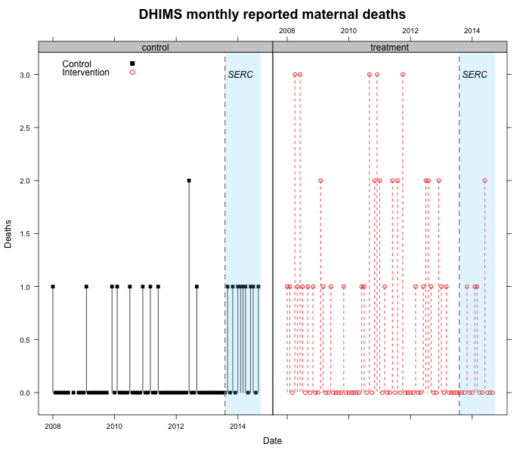
Step 1: Deaths- Intervention

Slide 4
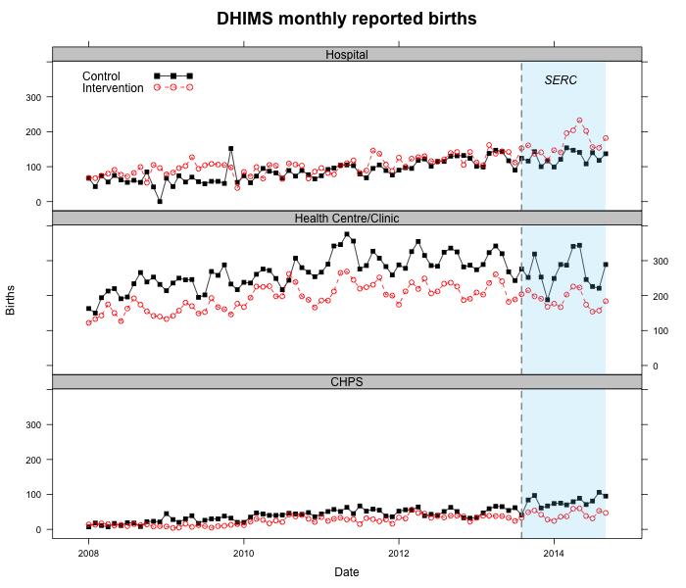

Slide 5
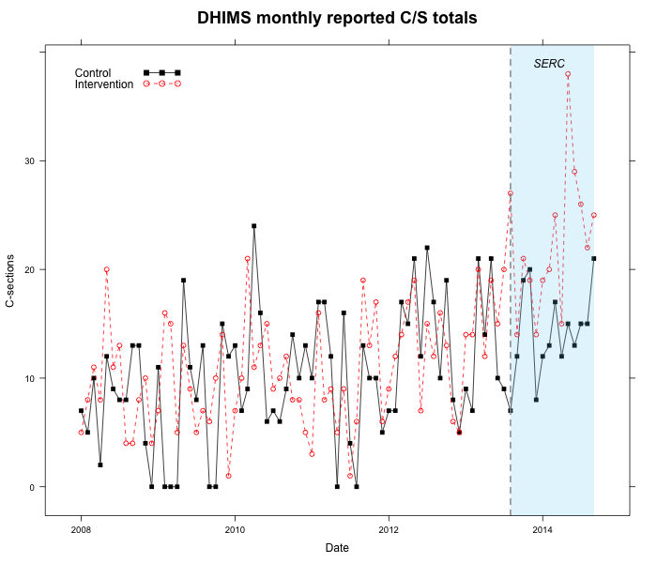

Slide 6
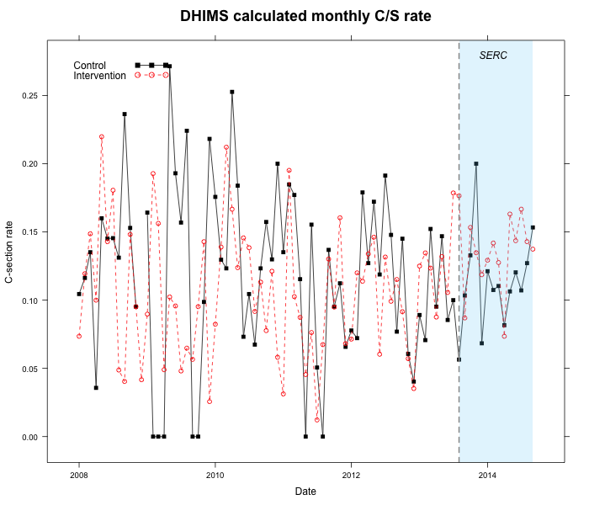

Slide 7
Step 2: pre/post intervention comparisons

Slide 8
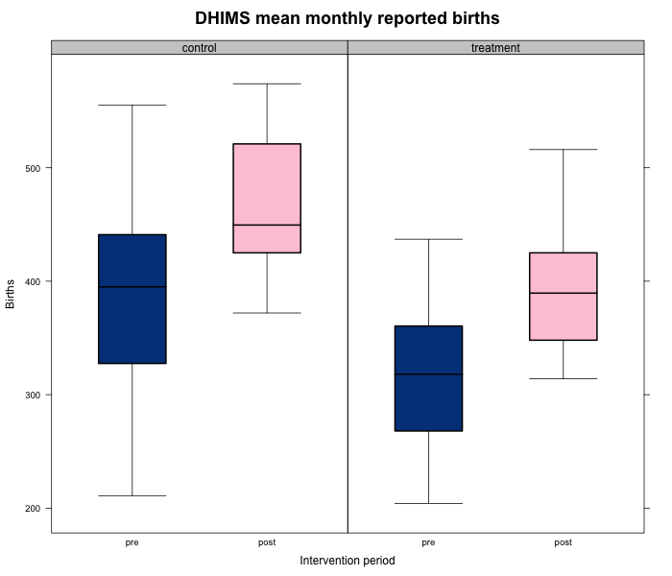

Slide 9
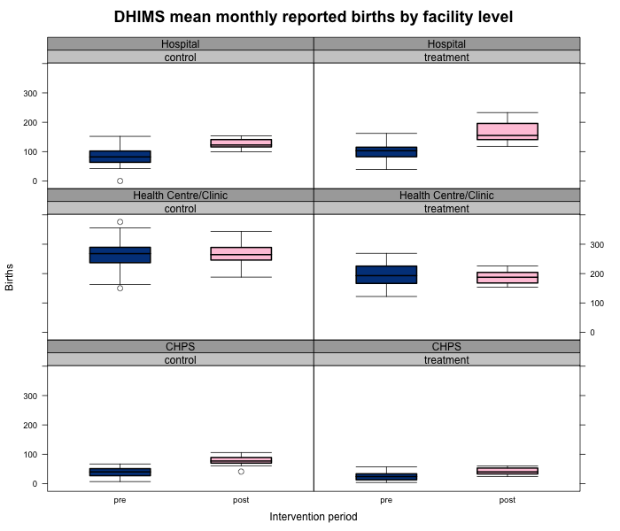

Slide 10
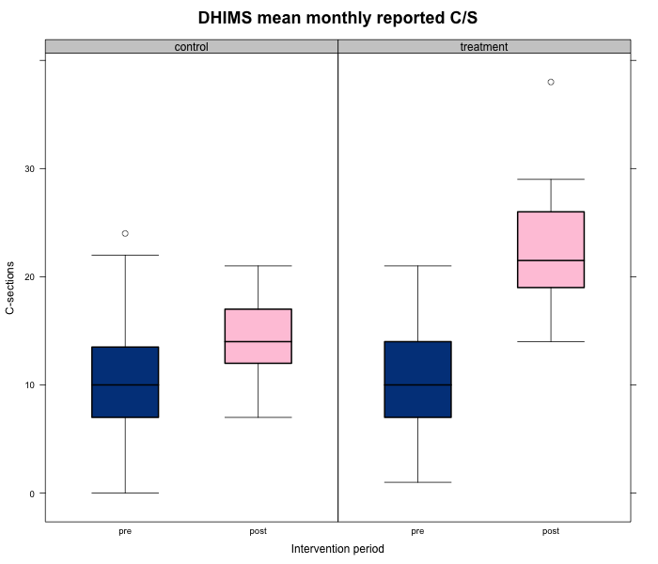

Slide 11
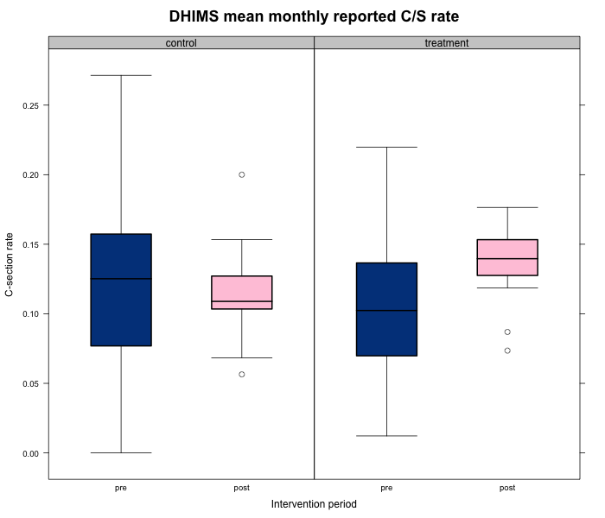

Slide 12
Step 3: Model Construction

Slide 13
Model Construction 1
Model 1:
Y_{j}(t) Expected number of births at facility j
Y_{j}(t-1) Expected number of births at facility j at time t – 1
t Time recorded in months
s_{j}(t) Time-varying covariate representing exposure to SERC
lj Facility level (Hospital, Health Centre, CHPS)
u₀ , u₁ , … Random effects by facility
β₀ , β₁ , … Fixed effects

Slide 14
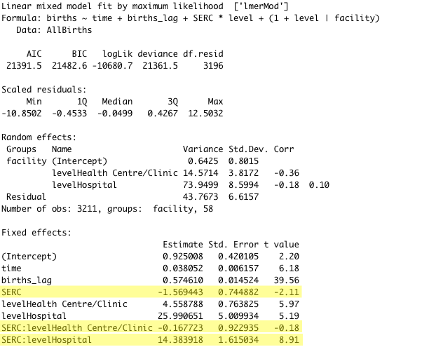
*
***
***
*
***
***
***

Slide 15
Model Construction 2
Model 2:
Y_{j}(t) Expected number of c/s at facility j
Y_{j}(t-1) Expected number of c/s at facility j at time t – 1
t Time recorded in months
s_{j}(t) Time-varying covariate representing exposure to SERC
u₀ , u₁ , … Random effects by facility
β₀ , β₁ , … Fixed effects

Slide 16
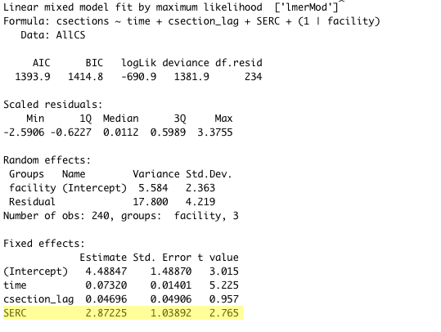
**
***
**

Slide 17
Model Construction 3
Model 3:
Y_{j}(t) Expected death count at facility j
Y_{j}(t-1) Expected death count at facility j at time t – 1
t Time recorded in months
s_{j}(t) Time-varying covariate representing exposure to SERC
u₀ , u₁ , … Random effects by facility
β₀ , β₁ , … Fixed effects

Slide 18
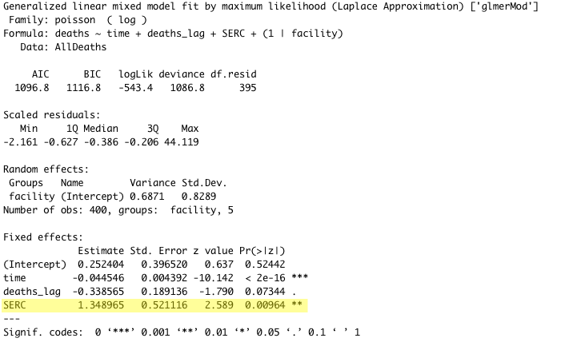

Slide 19
Limitations (for discussion)
Autocorrelation of time series values
Data quality – I removed two data point from the Bawku maternal death time series because they did not make sense
Have not tested model assumptions (working on this)

Slide 20
Summary
SERC exposure is associated with modest decline in mortality (if these data are to be trusted)
SERC exposure is also associated with an increase in deliveries and c/sections at the hospital level.

